Slide 1

Introduction to Data Analysis with R
Zaw Myo Tun
10-14 April 2023

Slide 2
Statistical analysis

Slide 3

Statistical analysis
Interactive exploratory analysis
Creating publication-ready tables
Output tables
Descriptive analysis
Univariable and multivariable analysis

Slide 4
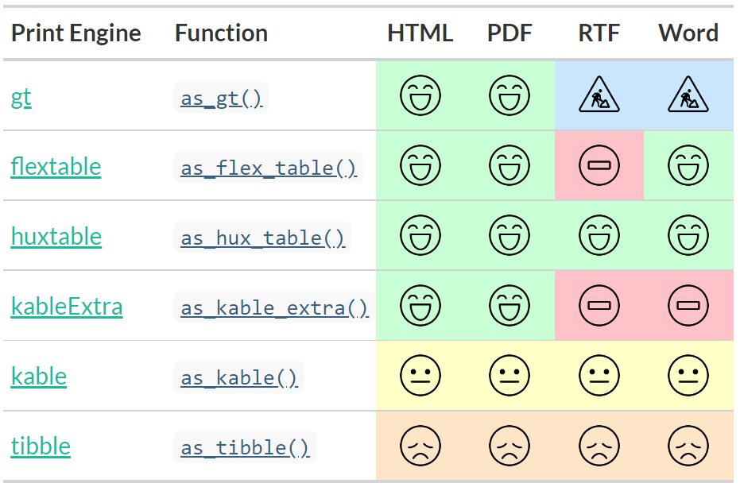
Formats supported by R packages for tables

