Slide 1
Query Processing
Query Processing encompasses all the activities involved in retrieving data from the database.
Aims of QP:
  Transform query written in high-level language (e.g. SQL), into a correct and efficient execution strategy expressed in low-level language (implementing RA);
  Execute the strategy to retrieve the required data.

Slide 2
Phases of Query Processing
QP has four main phases:
  decomposition (consisting of parsing and validation) and finally transforming the query into a RA tree;
  optimization;
  code generation;
  execution.

Slide 3
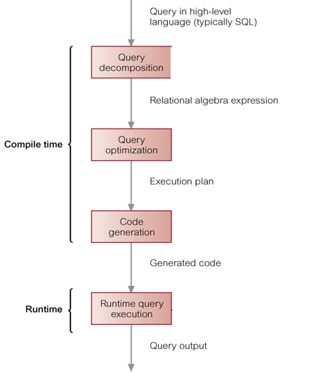
Phases of Query Processing

Slide 4
Query Optimization
With declarative languages such as SQL, the user specifies what data is required
  E.g. SELECT name FROM Sailor WHERE rating =7;
rather than how it is to be retrieved.
  E.g. RA select
  RA project
  Π_{name}(σ _{rating = 7} (Sailor) )
This relieves user of knowing what constitutes good execution strategy.
It also gives DBMS more control over system performance.

Slide 5
Query Optimization
Query Optimization is the activity of choosing an efficient execution strategy for processing query.
There will be many equivalent transformations of the same high-level query. The aim of QO is to choose one that minimizes resource usage.
  Generally, reduce total execution time of query.
  May also reduce response time of query.
The problem of finding a near optimum solution is computationally difficult with a large number of relations.

Slide 6
Heuristic Optimization
  Heuristic Optimization order operations in a query;
  Comparing different strategies based on relative costs, and selecting one that minimizes resource usage.
Disk access tends to be the dominant cost in query processing in a DBMS.

Slide 7
Transforming the query into a query tree
Transform the query into a query tree
  Leaf node created for each base relation.
  Non-leaf node created for each intermediate relation produced by RA operation.
  Root of tree represents query result.
  Sequence is directed from leaves to root

Slide 8
Relational algebra tree
SELECT * FROM Staff s, Branch b
WHERE s.branchNo = b.branchNo
AND s.position = ‘Manager’ AND b.city=‘London’ ;
σ b.city=‘London’
σ s.position = ‘Manager’
σ s.branchNo = b.branchNo
X
Staff
Branch

Slide 9
Transformation Rules for RA Operations
The query tree can be transformed to become more efficient, following a set of transformation rules.
Here are 2 examples
σ_{lName='Beech'}(Π_{fName,lName} (Staff)) =
Π_{fName,lName} (σ_{lName='Beech'} (Staff))
  Staff |X| staff.branchNo=branch.branchNo Branch =
  Branch |X| staff.branchNo=branch.branchNo Staff
Applying the rules gives us a more efficient tree

Slide 10
Heuristical Processing Strategies
Perform Selection operations as early as possible.
Combine Cartesian product with the appropriate Selection to form a Natural Join operation.
Rearrange leaf nodes so leaf nodes with the most restrictive Selection operations are executed first
  Cut down the number of rows involved.

Slide 11
Heuristical Processing Strategies
Perform Projection as early as possible.
  Cut down the number of columns involved
Compute common expressions once.
  If common expression appears more than once, and result not too large, store result and reuse it when required.

Slide 12
Relational algebra tree - improved
The selections have been done first to reduce the number of rows involved in the join.
The join and related WHERE condition have been recognised as a natural join
|X| s.branchNo = b.branchNo
σ s.position = ‘Manager’
σ b.city=‘London’
Staff
Branch

Slide 13
COST ESTIMATION for RA Operations
There are many different ways of implementing RA operations.
The aim of QO is to choose the most efficient one.
  Use formulae that estimate costs for a number of options, and select one with lowest cost.
  Consider cost of disk access, which is usually dominant cost in QP.
  Many estimates are based on cardinality of the relation (i.e. how many), so need to be able to estimate this.

Slide 14
Database Statistics
Success of estimation depends on amount of statistical information DBMS holds.
Keeping statistics current can be problematic.
  If statistics updated every time a tuple is changed, this would impact on performance.
DBMS could update statistics on a periodic basis, for example nightly, or whenever the system is idle.

Slide 15
Updating Statistics
Here are typical statistics kept
  For a relation
    Number of tuples, number of tuples per block, number of blocks
  For an index
    Number of levels, number of leaf blocks

Slide 16
Selection Operation Implementation
E.g σ _{s.position = ‘Manager’}
May be simple or composite.
If there is no index on the attribute(s), the whole table must be scanned
If there is an index which matches the attribute(s), use it to retrieve the matching tuples
If the records are stored in attribute order, access will be far more efficient.

Slide 17
Join Operation Implementation
SELECT * FROM Reservations R, Sailors S
where R.sid = S.id
The main strategies for implementing the join are:
  Block Nested Loop Join.
  Indexed Simple Loop Join.
  Sort-Merge Join.
  Hash-join

Slide 18
Simple Nested Loop Join
The simplest join algorithm is nested loop that joins two relations together a tuple at a time.
  For each tuple in the outer relation R
    Scan the entire inner relation S
    if match found, add to result
As the basic unit of reading/writing is a disk block, a better approach would be
  For each block of R
    For each block of S
    Check each row of R with each row of S as above

Slide 19
Indexed Simple Loop Join
If there is an index (or hash function) on the join attributes of the inner relation, we can use index lookup.
  For each tuple in R
    Scan index for matching tuples of S
    Use index to access the tuple in S

Slide 20
Sort-Merge Join
The most efficient join is when both relations are sorted on the join attributes, then ‘merge’ by scanning through both looking for matching values
  Sort R on join attribute i
  Sort S on join attribute j
  Scan files concurrently, matching records with same join attribute

Slide 21
Hash-join
The records of files R and S are both hashed to the same hash file using the same hashing function on the join attributes A of R and B of S as hash keys.
Partitioning Phase
  First, a single pass through the file with fewer records (say, R) hashes its records to the hash file buckets.
  Assumption: The smaller file fits entirely into memory buckets after the first phase.
Probing Phase
  A single pass through the other file (S) then hashes each of its records to probe appropriate bucket, and that record is combined with all matching records from R in that bucket.

Slide 22
Projection Operation Implementation
E.g. SELECT sid, bid FROM Reservations
To implement projection need to:
(1) Remove attributes that are not required
  This is straightforward

Slide 23
Pipelining
Materialization
  The output of one operation is stored in a temporary relation for processing by next.
Pipelining or on-the-fly processing
  Pipeline results of one operation to another without creating temporary relation.
  Saves on cost of creating temporary relations and reading results back in again.
  Generally, a pipeline is implemented as separate process or thread.

Slide 24
Physical Operators & Strategies
Physical operator
  refers to specific algorithm that implements a logical operation, such as selection or join.
For example, can use sort-merge join to implement the join operation.
Annotating a query tree with physical operators produces an execution strategy (or query evaluation plan or access plan).

Slide 25
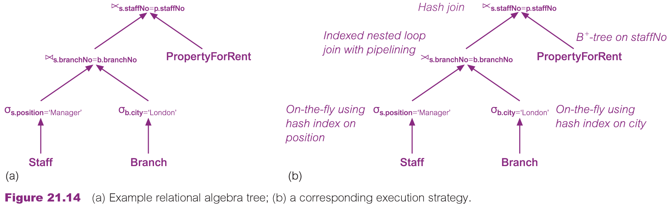
Physical Operators & Strategies

Slide 26
Physical Operators & Strategies

