Slide 1
Transaction Processing

Slide 2
Introduction to Transaction Processing
Single-User System: At most one user at a time can use the system.
Multiuser System: Many users can access the system concurrently.
Concurrency
Interleaved processing: concurrent execution of processes is interleaved in a single CPU
Parallel processing: processes are concurrently executed in multiple CPUs.

Slide 3
Introduction to Transaction Processing
A Transaction: logical unit of database processing that includes one or more access operations (read -retrieval, write - insert or update, delete).
A transaction (set of operations)
Transaction boundaries: Begin and End transaction.
An application program may contain several transactions separated by the Begin and End transaction boundaries.

Slide 4
SIMPLE MODEL OF A DATABASE
A database - collection of named data items
Basic operations are read and write
read_item(X): Reads a database item named X into a program variable. To simplify our notation, we assume that the program variable is also named X.
write_item(X): Writes the value of program variable X into the database item named X.

Slide 5
READ AND WRITE OPERATION
Basic unit of data transfer from the disk to the computer main memory is one block. In general, a data item (what is read or written) will be the field of some record in the database, although it may be a larger unit such as a record or even a whole block.
read_item(X) command includes the following steps:
Find the address of the disk block that contains item X.
Copy that disk block into a buffer in main memory (if that disk block is not already in some main memory buffer).
Copy item X from the buffer to the program variable named X.

Slide 6
READ AND WRITE OPERATION
write_item(X) command includes the following steps:
Find the address of the disk block that contains item X.
Copy that disk block into a buffer in main memory (if that disk block is not already in some main memory buffer).
Copy item X from the program variable named X into its correct location in the buffer.
Store the updated block from the buffer back to disk (either immediately or at some later point in time).

Slide 7
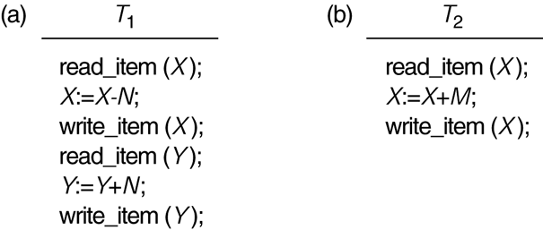
Two sample transactions. (a) Transaction T₁. (b) Transaction T₂.

Slide 8
Why Concurrency Control is needed?
The Lost Update Problem.
This occurs when two transactions that access the same database items have their operations interleaved in a way that makes the value of some database item incorrect.
The Temporary Update (or Dirty Read) Problem.
This occurs when one transaction updates a database item and then the transaction fails for some reason. The updated item is accessed by another transaction before it is changed back to its original value.

Slide 9
Why Concurrency Control is needed?
The Incorrect Summary Problem .
If one transaction is calculating an aggregate summary function on a number of records while other transactions are updating some of these records, the aggregate function may calculate some values before they are updated and others after they are updated.

Slide 10
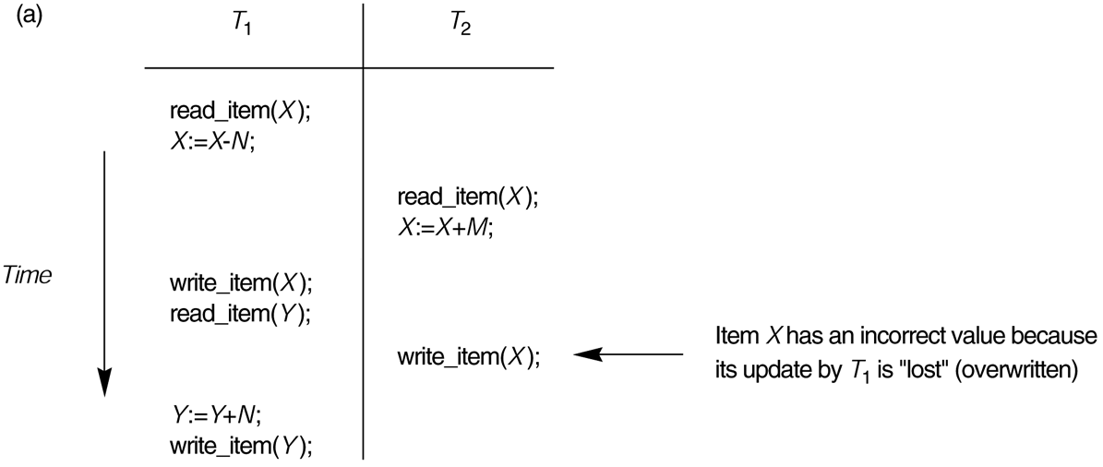
Some problems that occur when concurrent execution is uncontrolled. (a) The lost update problem.

Slide 11
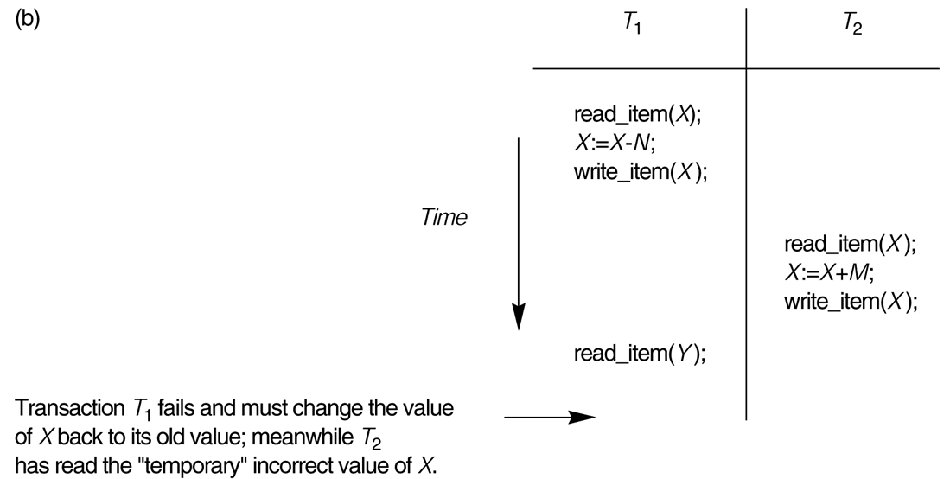
Some problems that occur when concurrent execution is uncontrolled. (b) The temporary update problem.

Slide 12
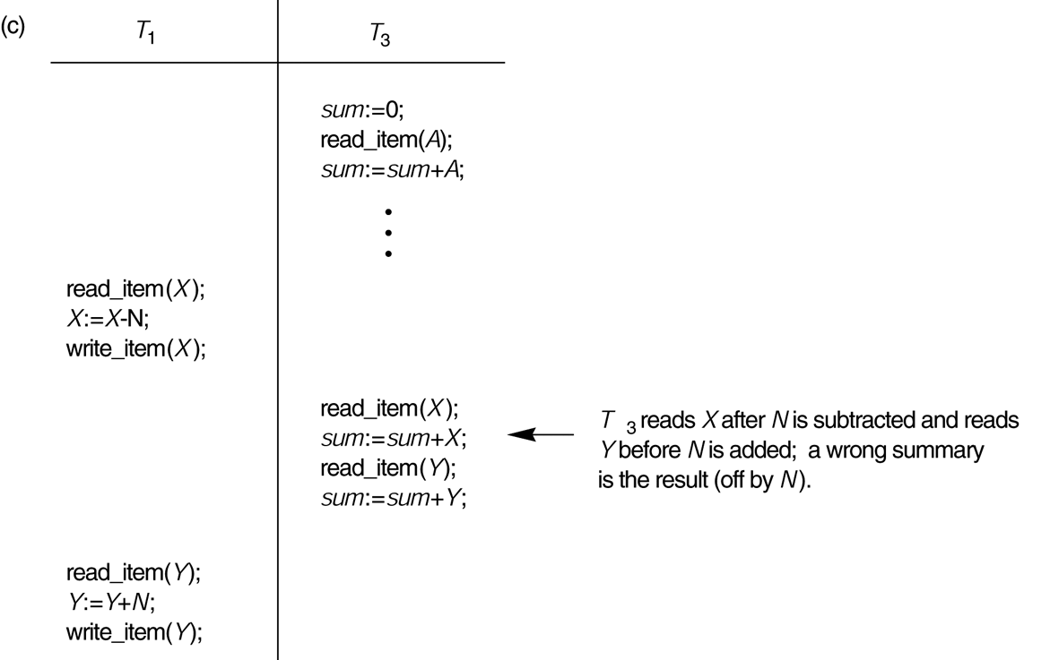
Some problems that occur when concurrent execution is uncontrolled. (c) The incorrect summary problem.

