Slide 1

Entrepreneurship
Productive, Unproductive And Destructive Vol 96, No 5, 1990
Seminal article BY: WILLIAM J. BAUMOL

Slide 2

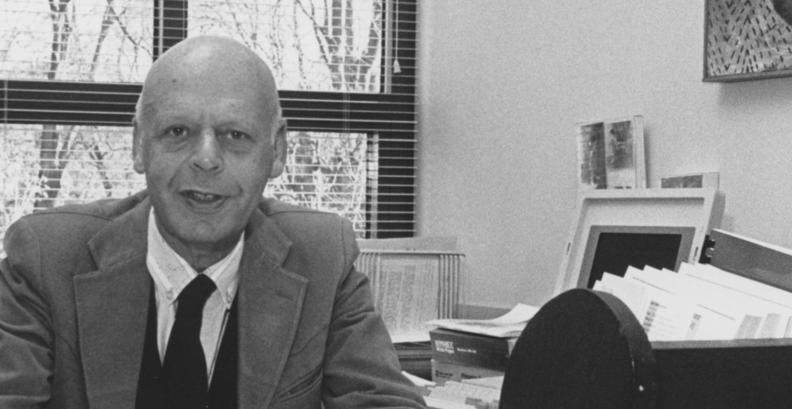
A brief Introduction of Author
William J. Baumol is an American economist. He is a professor of economics at New York University. Academic Director of the Berkley Centre for Entrepreneurship and innovation, and Professor Emeritus at Princeton University
Born February 26, 1922 (age 97 years)

Slide 3
Outline of Paper
Overview.
Entrepreneurs productive, unproductive the rules do change.
On the Historical Character of the Evidence.
The Schumpeterian Model Extended: Allocation of Entrepreneurship.
The five elements of Schumpeterian Model.
Historical Evidence:
1.Ancient Rome
2.Era of commerce and industry
3.14th Century
4.Medieval China
5.Early Middle Ages
6.Later Middle Ages
On Unproductive avenues for today’s Entrepreneur : A Delicate Balance.
Propositions.
Conclusion.

Slide 4
Overview
The basic hypothesis is that the total supply of entrepreneurs varies among societies.
The contribution of the society's entrepreneurial activities varies much more because of their allocation between productive activities and unproductive activities.
This allocation is heavily influenced by the relative payoffs society offers to such activities. This implies that policy can influence the allocation of entrepreneurship more effectively than it can influence its supply.

Slide 5
Overview
The basic proposition, if sustained by the evidence, has an important implication for growth policy.
The notion that our productivity problems reside in "the spirit of entrepreneurship" that waxes and wanes for unexplained reasons is a counsel of despair, for it gives no guidance on how to reawaken that spirit once it has lagged.
If that is the task assigned to policymakers, they are destitute: they have no means of knowing how to carry it out.

Slide 6
ENTREPRENEURS PRODUCTIVE, UNPRODUCTIVE THE RULES DO CHANGE
The central hypothesis of this paper:
Entrepreneurship can sometimes be unproductive or even destructive, and that whether it takes one of these directions or one more that depends heavily on
The rules of the game
The reward structure in the economy
Thus the central hypothesis here is that it is the set of rules and not the supply of entrepreneurs that determine the entrepreneurial behavior
Entrepreneurs who specialize in violence are inventive. In Colombia and Nigeria, for instance, employees in the oil industry are regularly kidnapped by violent entrepreneurs and released for a ransom. Rebels also extort the oil companies by threatening to blow up their pipelines.”

Slide 7
The Schumpeterian Model Extended: Allocation of Entrepreneurship.
According to Schumpeter “the function of entrepreneur is to reform and revolutionize the pattern of production by developing an innovation”.
He called innovation as the combination of new things
This concept covers the following five cases
The introduction of a new good-that is one with which consumers are not yet familiar-or of a new quality of a good.
The introduction of a new method of production
The opening of a new market, that is a market into which the particular branch of manufacture of the country in question has not previously entered
The conquest of a new source of supply of raw materials
The carrying out of the new organization of any industry, like the creation of a monopoly position or the breaking up of a monopoly position

Slide 8

The five element that translate the domain of activates of an entrepreneur

Slide 9
Shortcoming's of Schumpeter analysis
Schumpeterian analysis, whose main shortcoming, for our purposes, is the paucity of insights on policy that emerge from it.
According to W. J Baumol, Schumpeter highlight only the positive aspects of entrepreneurial activities but innovation can also takes place in unproductive activities too
In simple Schumpeterian idea does not go far enough to account for TOT to take advantage in some other area with modifications.
It may also be expanded to include discovery of previously unused legal gambit that is effective in diverting rents to those who are first in exploiting it.

Slide 10






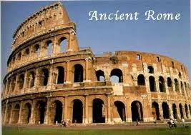
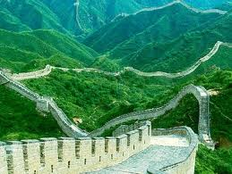

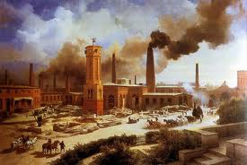
On the Historical Character of the Evidence
The rules of the game usually change very slowly, a case study approach to investigation of my hypotheses drives me unavoidably to examples spanning considerable periods of history and encompassing widely different cultures and geographic locations and based on historical illustrations encompassing all the main economic periods and places.
On the Historical Character of the Evidence

Slide 11
Historical evidence Ancient Rome
They had no reservation about the desirability of wealth. All avenues were open to Romans as long a they did not involve participation in Commerce/ industry.
Persons of honorable status had three primary and acceptable sources of income:
Land holding
Usury
Political payment
The whole society was involved in corruption and malpractices.
They poured money from general public in form of booty
Indemnity, taxes and overcharging fees.
It lead to unproductive entrepreneurial activity.
SO WHEN THEN OPERATED COMMERCE & INDUSTRY

Slide 12
Era of commerce and industry
According to Veyne (1961), it was an occupation heavily undertaken by freedmen (former slaves) who, incidentally, bore a social stigma for life.
A clever (and handsome) member of the lower orders might deliberately arrange to be sold into slavery to a wealthy and powerful master.
Then, with luck, skill, and drive, he would grow close to his owner, perhaps managing his financial affairs
The master then gained cachet, by granting freedom to the slave, setting him up with a fortune of his own.
Regarding the Romans' attitude to the promotion of technology and productivity, they provide high reward to those who come with an invention and productivity.

Slide 13
14th Century
The era of military activities notably the 100 year war between France and England .
Payoff inclined to favor more inventions for military purposes.
Canons appeared as siege and amore were more heavier.
More imaginative war devices were proposed such as stirrup.
Conclusion the activities went towards the destructive side

Slide 14
Medieval China
In China when monarch were in dire financial straits they generally took over possession of the property of wealthy subjects.
That was a big hurdle in the expansion in the economy because people did not want to invest in such a society.
Imperial examinations were taken by the Chinese state to select the best administrative officials for the state of bureaucracy.
Main contents of exams were Confucian Philosophy and Calligraphy.
During Sung Dynasty the imperial examination were held every 3 years. The scholar families made a lot of effort and investments to prepare their children through years of laborious study for imperial examination.

Slide 15
Medieval China
The successful candidates took a good position in the state bureaucracy and extracted both the principal and Interest.
This rule was completely biased and was totally against the acquisition of wealth and position through Schumpeterian behavior.
Chinese officials were very unfriendly to the innovations and they take over all the enterprises made by the people.
The three main inventions at that time were:
1). Paper 2). Printing 3). Bill of Exchange.
Paper invented by eunuch. BOE used as expedient of private business and printing used by Buddhist for religious propaganda

Slide 16
The Earlier Middle Ages
Wealth and power were pursued through military activities due to which many of the innovations of that time belongs to military.
The other reason for the military prominence in this era can be attributed to primogeniture which compelled the younger sons to take part in military activities.
Primogeniture refers to exclusive right of eldest son to inherit his father’s estate.
The innovations in those days were purely military based that includes the stirrup that helps the cavalries in the battlefield, castles were build of stones instead of woods and the towers were changed to round from rectangular.
Other innovations includes crossbow, the longbow, and ultimately artillery based on gun powder.
So to speak entrepreneurship practices of conquering new countries were largely destructive. On one hand it helped the economy grow but it also caused the destruction of other countries and societies.

Slide 17
On Unproductive Avenues for today’s
Entrepreneur : A Delicate Balance
The prime threat to productive entrepreneurship now a days are tax evasion, rent-seeking.
To become rich in a high tax based society you have to adopt unproductive ways of entrepreneurship.
The main reason of quoting these activities was to help policy designers to seek where rent-seeking activities are found and to divert their entrepreneurial talent into productive channel.
Rent seeking is the use of resources to obtain economic gain from others without reciprocating any benefit to society i.e lobbying.

Slide 18
PROPOSITIONS
PROPOSITION 1. The rules of the game that determine the relative payoffs to different entrepreneurial activities do change dramatically from one time and place to another .
PROPOSITION 2. Entrepreneurial behavior changes direction from one economy to another in a manner that corresponds to the variations in the rules of the game.
PROPOSITION 3. The allocation of entrepreneurship between productive and unproductive activities, though by no means the only pertinent influence, can have a profound effect on the innovativeness of the economy and the degree of dissemination of its technological discoveries.
THE END QUESTIONS PLEASE

Slide 19


