Slide 1
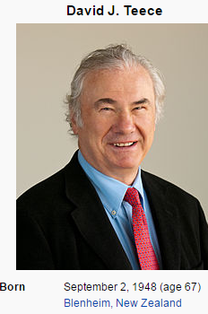
Entrepreneurship
Profiting from technological Innovation: Implications for integration, collaboration, licensing and Public Policy
David J. Teece University of California Berkely

Slide 2
Time for New Technologies to Penetrate 25 % of US Population
Electricity household (1873) | 46 years
Telephone (1875) | 35 years
Automobile (1885) | 55 years
Airplane travel (1903) | 54 years
Radio (1906) | 22 years
Television (1925) | 26 years
VCR (1952) | 34 years
PC (1975) | 15 years
Mobile Phone (1983) | 13 years
World Wide Web (1992) | 5 years

Slide 3
Abstract
This paper attempts to explain why innovating firms often fail to obtain significant benefits from an innovation while customers, imitators and other industry participants benefit.
It demonstrates when imitation is easy markets don’t work well, and the profits from innovation may accrue to the owners of certain complementary assets, rather than to developer to intellectual property
Innovators with new products and processes which provide value to consumers may sometimes be so ill positioned in the market that they necessarily will fail.
The paper proposes that manufacturing often matters particularly to innovating nations.
Innovating firms without the requisite manufacturing and related capabilities may die, even though they are the best at innovation.

Slide 4
Introduction
It is quite common for innovators to lament the fact that competitors/imitators have profited more from the innovation than the first firm to commercialize it.
The aim of this paper is to explain why a fast second or even a slow third might out perform the innovator.
Science & Engineering driven companies harbor the mistaken illusion that developing new products which meet customer needs will ensure fabulous success. It may possibly do so for the product, but not for the innovator.

Slide 5
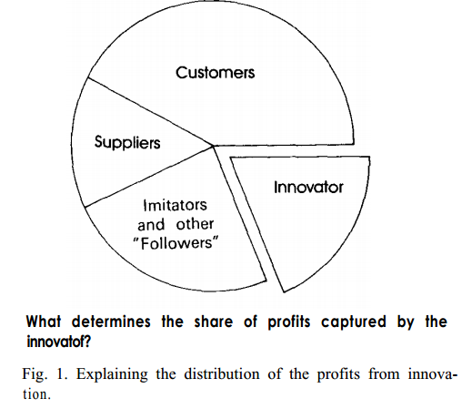
.
.

Slide 6
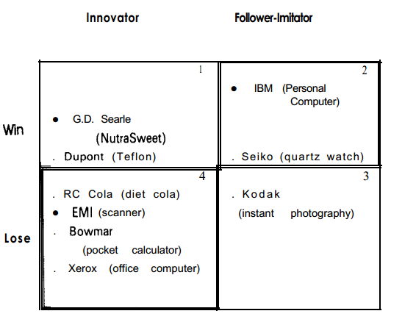
Taxonomy of outcomes from the innovation process

Slide 7
The phenomena
Quadrant 1 represents positive outcomes for the innovator. A first-to-market advantage is translated into a sustained competitive advantage which either creates a new earnings stream or enhances an existing one.
Quadrant 4 and its result quadrant 2 are the ones which are the focus of this paper.

Slide 8
The phenomena
The EM1 CAT scanner is a classic case of the phenomenon to be investigated. By the early the UK firm Electrical Musical Industries Ltd. was in a variety of product lines including, movies, and advanced electronics. EM1 had developed high resolution TVs in the pioneered airborne radar during World War II.
In the late 1960s Godfrey Houndsfield, an EMI senior research engineer engaged in pattern recognition research which resulted in his displaying a scan of a pig’s brain.
Subsequent clinical work established that Computerized Axial Tomography (CAT) was viable for generating cross-sectional “views” of the human body, the greatest advance in radiology since the discovery of X rays in 1895
While it was initially successful with its CAT scanner, within 6 years of its introduction into the US in 1973 the company had lost market leadership, and by the eighth year had dropped out of the CT scanner business, Other companies successfully dominated the market, though they were late entrants, and are still profiting in the business today.

Slide 9
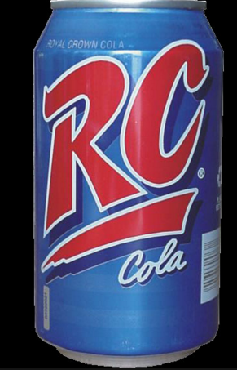
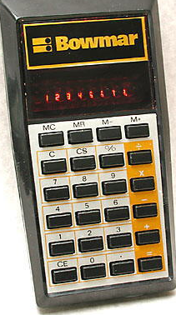
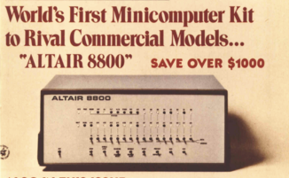
The phenomena
Other examples include RC Cola, a small beverage company that was the first to introduce cola in a can, and the first to introduce diet cola. Both Coca Cola and Pepsi followed almost immediately and deprived RC of any significant advantage from its innovation.
Bowmar which introduced the pocket calculator, was not able to withstand competition from Texas Instruments, Hewlett Packard and others, and went out of business.
Xerox failed to succeed with its entry into the office computer business, even though Apple succeeded with the which contained many of Xerox’s key product ideas, such as the mouse and icons.
MITS introduced the first personal computer, the Altair, experienced a burst of sales, then slid quietly into oblivion.

Slide 10
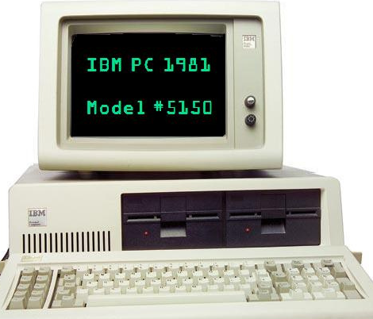
The phenomena
If there are innovators who lose there must be followers/imitators who win.
A classic example is IBM with its PC, a great success since the time it was introduced in 1981. Neither the architecture nor components embedded in the IBM PC were considered advanced when introduced; nor was the way the technology was packaged a significant departure from then current practice.
Yet the IBM PC was fabulously successful and established DOS as the leading operating system for 16-bit PCs. By the end of 1984, IBM has shipped over 500,000 PCs, and many considered that it had irreversibly eclipsed Apple in the PC industry.

Slide 11
3.1 Profiting from innovation: Basic building blocks
Three fundamental building blocks must first be put in place: the Appropriability regime, Complementary Assets, and the Dominant design paradigm.
3.1 Regimes of appropriability
A regime of appropriability refers to the environmental factors, excluding firm and market structure, that govern an innovator’s ability to capture the profits generated by an innovation.
The most important dimensions of such a regime are the nature of the technology, and the efficacy of legal mechanisms of protection
LEGAL INSTRUMENTS | NATURE OF TECHNOLOGY
PATENTS | PRODUCT
COPYRIGHTS | PROCESS
TRADE SECRETS | TACIT OR CODIFIED
Figure 3. Appropriability regime Key Dimensions

Slide 12
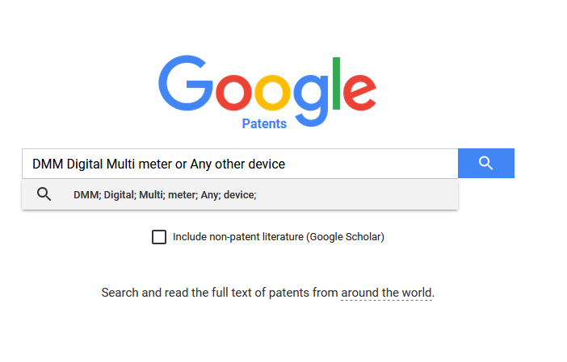
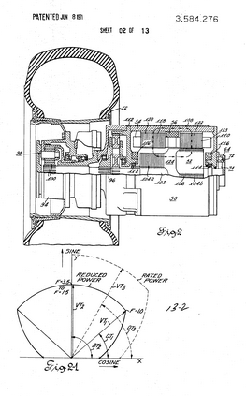
Some additional concepts

Slide 13
Some additional discussion in IP (property)
Most entrepreneurs will not be inventors
They are however, concerned with protecting their idea.
Understanding patent law becomes paramount
When entrepreneurs protect unusual brand names of establish ownership of IP, then understanding of copyrights and trademarks is vital.
Although the filing laws are simple the procedures can be complex i.e. seek help of legal eagles.

Slide 14
What is a Patent?
A right to exclude others from: making, using, offering for sale, selling or importing the patented invention
Not a right to use the invention
Quid Pro Quo: sufficient disclosure
For 20 years from date of filing
A Common Misperception... Patents inhibit free exchange of information.
TO THE CONTRARY…
The patent laws require DISCLOSURE of the structure of the invention, how to make and use it and the best mode of the invention.
Patent applications are typically PUBLISHED 18 months after filing and in any event upon issue.

Slide 15
Requirements for Patentability
USEFUL
NOVEL
NON-OBVIOUSNESS
Must have some utility; achieve some objective; not against public policy
Must be new, i.e., different from prior art
Subject matter as a whole would not have been obvious at the time to person of ordinary skill in the art

Slide 16

Trademarks

Slide 17

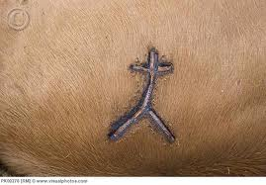
What is a Trademark?
“A sign capable of distinguishing the goods or services produced or provided by one enterprise from those of other enterprises”

Slide 18

What is Copyright?
“The exclusive right given by law for a certain term of years to an author, composer etc. (or his assignee) to print, publish and sell copies of his original work”
(Oxford English Dictionary)
A copyright is distinct from patents and trademarks in the that IP is protected for the life of the originator plus 50 years. Anything that lacks creative authorship cannot be copyrighted

Slide 19
Trade Secret
Business information that is the subject of reasonable efforts to preserve confidentiality and have value because it is not generally known in the trade
Examples: formulae, devices, manufacturing processes, customer lists & preferences
Uses: good alternative to a patent if invention cannot be reverse-engineered [i.e. recipe & formulation of Coca-Cola]

Slide 20
Regimes of appropriability
It has long been known that patents do not work in practice as they do in theory. Rarely, if ever, do patents confer perfect appropriability, although they do afford considerable protection on new chemical products and rather simple mechanical inventions.
Many patents can be “in-vented around” at modest costs. They are especially ineffective at protecting process innovations.
Often patents provide little protection because the legal requirements for upholding their validity or for proving their infringement are high.
In some industries, particularly where the innovation is embedded in processes, trade secrets are a viable alternative to patents.
Trade secret protection is possible, however, only if a firm can put its product before the public and still keep the underlying technology secret.
Usually only chemical formulas and industrial-commercial processes (e.g., cosmetics and recipes) can be protected as trade secrets after they’re “out”

Slide 22
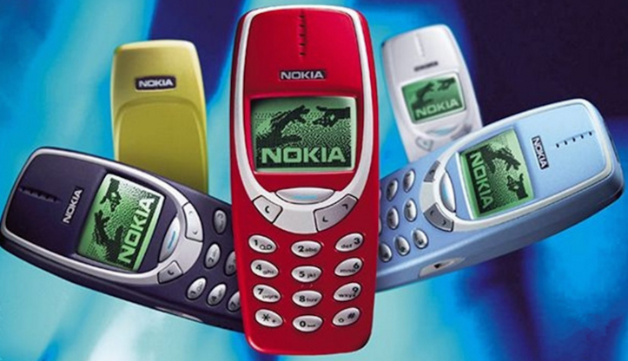
3.2. The dominant design paradigm
There are two stages in the evolutionary development of a given branch of a science:
The Preparadigmatic Stage- when there is no single generally accepted conceptual treatment of the phenomenon in a field of study.
The Paradigmatic stage which begins when a body of theory appears to have passed scientific acceptability.
The emergence of a dominant paradigm signals scientific maturity and the acceptance of agreed upon “standards” by which what has been referred to as “normal” scientific research can proceed.
These “standards” remain in force unless or until the paradigm is overturned.

Slide 23
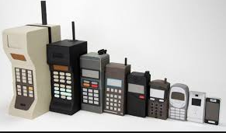
The dominant design paradigm
In the early stages of industry development, product designs are fluid, manufacturing processes are loosely and adaptively organized, and generalized capital is used in production.
Competition amongst firms manifests itself in competition amongst designs, which are markedly different from each other.
This might be called the pre-paradigmatic stage of an industry

Slide 24
The dominant design paradigm
After considerable trial and error in marketplace, one design or a narrow class of designs begins to emerge as more promising. Such a design must be able to meet a whole set of user needs in a relatively complete fashion.
Model T Ford; IBM 360, are examples of dominant designs.
Once a dominant design emerges, competition shifts to price and away from design.
Scale and learning become much more important, and specialized capital gets deployed as firms seek to lower unit costs through exploiting economies of scale and learning. Reduced uncertainty over product design provides an opportunity to amortize specialized long-lived investments.
When the game of musical chairs stops, and a dominant design emerges, the innovator might well end up positioned disadvantageously relative to a follower.

Slide 26
3.3. Complementary Assets
In almost all cases, the successful commercialization of an innovation requires technical know-how in question be utilized in conjunction with other capabilities or assets.
Services such as marketing, competitive manufacturing, and after-sales support are almost always needed. These services are often obtained from complementary assets which are specialized.
For example, the commercialization of a new drug is likely to require the dissemination of information over a specialized information channel.

Slide 27
Complementary Assets
In some cases, as when the innovation is systemic, the complementary assets may be other parts of a system.
For instance;
Computer hardware typically requires specialized software, both for the operating system, as well as for applications.
Even when an innovation is autonomous Just as with plug compatible components, certain complementary capabilities or assets will be needed for successful commercialization.
Figure 5 summarizes this schematically.
Figure 6 differentiates between complementary assets which are generic, specialized, and co-specialized

Slide 28
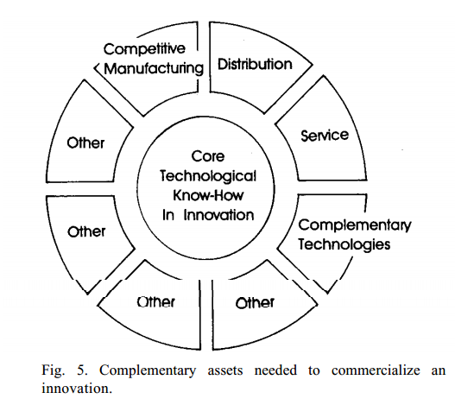
.

Slide 29
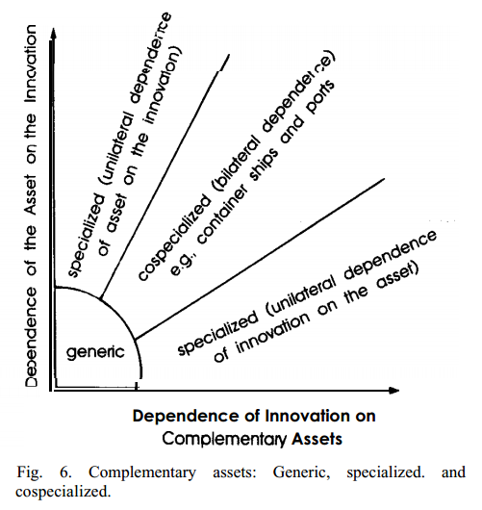
Generic assets are general purpose assets which do not need to be tailored to the innovation in question.
Specialized assets are those where there is unilateral dependence between the innovation and the complementary asset.
Co specialized assets are those for which there is a bilateral dependence.
For instance, specialized repair facilities were needed to support the introduction of the rotary engine by Mazda.

Slide 30
Complementary Assets….
These assets are co-specialized because of the mutual dependence of the innovation on the repair facility.
Containerization similarly required the deployment of some co-specialized assets in ocean shipping and terminals.
An example of a generic asset would be the manufacturing facilities needed to make running shoes. Generalized equipment can be employed in the main, exceptions being the molds for the soles

Slide 31
4. Implications for profitability
These three concepts can now be related in a way which will shed light on the imitation process, and the distribution of profits between innovator and follower.
We begin by examining tight appropriability regimes.
4.1. TIGHT APPROPRIABILITY REGIMES
In those few instances where the innovator has an iron clad patent or copyright protection, the innovator is almost assured of translating its innovation into market value for some period of time.
Even if the innovator does not possess the desirable complementary costs, iron clad protection of intellectual property will afford the innovator the time to access these assets.

Slide 32
4.1. TIGHT APPROPRIABILITY REGIMES..
If these assets are generic, contractual relation may well suffice, and the innovator may simply license its technology.
Similarly, if the innovator comes to market in the pre-paradigmatic phase with a sound product concept but the wrong design, a tight appropriability regime will afford the innovator the time needed to perform the trials needed to get the design right.
The best initial design concepts often turn out to be hopelessly wrong, but if the innovator possesses an impenetrable patent, or has technology which is simply difficult to copy, then the market may well afford the innovator the necessary time to ascertain the right design before being eclipsed by imitators.

Slide 33
4.2. Weak appropriability
Tight appropriability is the exception rather than the rule. Accordingly, innovators must turn to business strategy if they are to keep imitators/followers at bay. The nature of the competitive process will vary according to whether the industry is in the paradigmatic or preparadigmatic phase.
PRE-PARADIGMATIC STAGE:
In the pre-paradigmatic phase, the innovator must be careful to let the basic design “float” until sufficient evidence has accumulated that a design has been delivered which is likely to become the industry standard.
In some industries there may be little opportunity for product modification. In microelectronics, for example, designs become locked in when the circuitry is chosen.
Product modification is limited to “debugging” and software modification.

Slide 34
Preparadigmatic stage:
The early history of the automobile industry exemplifies exceedingly well the importance for subsequent success of selecting the right design in the preparadigmatic stages. None of the early producers of steam cars survived the early shakeout when the closed body internal combustion engine automobile emerged as the dominant design. The steam car, nevertheless, had numerous early virtues, such as reliability, which the internal combustion engine autos could not deliver.
Paradigmatic stage:
Rivalry is focused on trying to identify the design which will be dominant. Production volumes are low, and there is little to be gained in deploying specialized assets, as scale economies are unavailable, and price is not a principal competitive factor. However, as the leading design or designs begin to be revealed by the market, volumes increase and opportunities for economies of scale will induce firms to begin gearing up for mass production by acquiring specialized tooling and equipment, and possibly specialized distribution as well.

Slide 35
5. Channel strategy issues
The access to complementary assets, such as manufacturing and on competitive terms is critical if the innovator is to avoid handling over the lion’s share of the profits to imitators, and/or to the owners of the complementary assets.
It is well to recognize that the variety of assets and competencies which need to be accessed is likely to be quite large, even for only modestly complex technologies.
To produce a personal computer, for instance, a company needs access to expertise in semiconductor technology, display technology, disk drive technology, net-working technology, keyboard technology, and several others. No company can keep pace in all of these areas by itself
The answer lies in contractual relationships for their securing

Slide 36
5.1. Contractual modes
The innovator will not have to make the capital expenditures needed to build or buy the assets in question. This reduces risks as well as cash requirements.
Contracting rather than integrating is likely to be the optimal strategy when the innovators appropriability regime is tight and the complementary assets are available in competitive supply (i.e. there is adequate capacity and a choice of sources).
IBM’s arrangement with Microsoft to use the latter’s MS-DOS operating system software on the IBM PC facilitated the timely introduction of IBM’s personal computer into the market.
However, The situation is one open to opportunistic abuses on both sides. The innovator has incentives to overstate the value of the innovation, while the supplier has incentives to “run with the technology” should the innovation be a success.

Slide 37
START HERE
YES
NO
1. Innovation Requires
Access to Complementary Assets for commercialization
2.Specialized assets
Contract for Access
YES
3. APPR Regime Weak
NO
Contract for Access
NO
YES
Commercialize
Directly
4.Specialized assets critical
NO
Contract for Access
YES
5. Cash Position OK
NO
Contract for Access
Integrate
YES
NO
6. Imitators & Competitors better positioned
YES
Contract for Access
FLOW CHART OF INTEGRATION VS CONTRACT DECISIONS FIG 10

Slide 38
Concluding the paper
Teece’s 1986 paper “Profiting from Technological Innovation” was selected by the editors as one of the best papers published in Research Policy from 1971 to 1991 and is the most cited paper ever published in the publication. In this paper, Teece explained why innovative firms often fail to capture economic returns from their invention.
He described how it is sometimes more important for a business to be able to win at marketing, distribution, manufacturing, and other areas than to come up with a big idea in the first place
He identified the factors which determine whether the firm that wins from innovation is the firm that is first to market, a follower firm, or a firm that has related capabilities that the innovation requires to provide value to a customer.
The factors include the imitability of the innovation (how easily competitors can copy it) and the ownership of complementary assets.

Slide 39
THE END
Thank you for your attentive listening and participation!

