Slide 1
Business Plans COMPLETE SLIDES
Presented By
Dr. M. Tariq Yousafzai

Slide 2










Business Model Canvas - Template – Assignment No 2 (related to your business Plan
Key Partners | Key Activities | Value Propositions |  | Customer Relationships | Customer Segments
 | Key Resources |  |  | Channels
Cost Structure |  |  | Revenue Streams
Social & Environmental Cost |  |  | Social & Environmental Benefit
http://www.businessmodelgeneration.com

Slide 3
I. THE EXECUTIVE SUMMARY
The summary is usually short and concise (1/2 pages)
The summary articulates what the opportunity conditions are and why they exist
Who will execute the opportunity and why the are capable of doing so
How the firm will gain entry and market penetration and so on
The summary is usually prepared after other sections of the business plan are completed
Unless the summary is appealing and compelling, it may be the only section read, and you may never get the chance to make a presentation or discuss your business in person

Slide 4
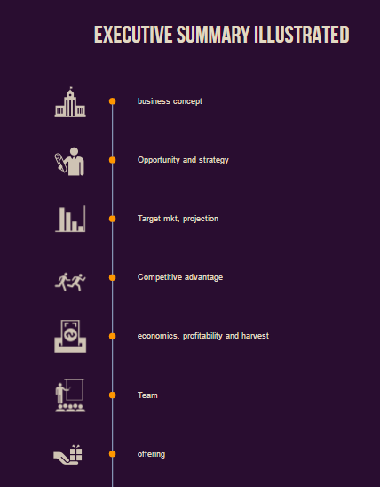

Slide 5
I. THE EXECUTIVE SUMMARY
A. Description of the business concept and the business
Describe the business concept for the business you are or will be in.
Be sure the description of your concept includes explains how your product or service will fundamentally change the way customers currently do things.
Safe Home Project and Jewellers

Slide 6
I. THE EXECUTIVE SUMMARY
B. The Opportunity and Strategy
Summarize what the opportunity is, why it is compelling, and the entry strategy planned to exploit it.
This information may be stated as an outline of the key facts, conditions, competitor vulnerabilities (sleepiness, sluggishness, or poor service, etc)

Slide 7
I. THE EXECUTIVE SUMMARY
C. The target market and projections.
Identify and briefly explain the industry and market, who the primary customer groups are, how the product or service will be positioned, and how you plan to reach and service these groups.
Include information about the structure of the market, the size and growth rate for the market segments or niches you are seeking

Slide 8
I. THE EXECUTIVE SUMMARY
D. The competitive advantages
Indicate the significant competitive edges you enjoy or can create as a result your innovative product, service, and strategy:
Advantages in lead time; competitors’ weaknesses and vulnerabilities; and other industry conditions.

Slide 9
I. THE EXECUTIVE SUMMARY
E. The economics, profitability and harvest potential.
Describe the relevant time frames to attain break-even and positive cash flow, key financial projections;
the expected return on investment; and so on. Be sure to include your contribution analysis and the underlying operating and cash conversion cycle.
Use key numbers whenever possible.

Slide 10
I. THE EXECUTIVE SUMMARY
F. The team
Summarize the relevant knowledge, experience, know how, and skills of lead entrepreneur and any team members, noting previous accomplishments, especially those involving profit and loss responsibility as well as general management and people management experience

Slide 11
I. THE EXECUTIVE SUMMARY
G. The offering
Briefly indicate the amount of equity and/or debt financing needed.
How much of the company you are prepared to offer for that financing,
what principal use will be made of the capital,
and how the targeted investor, lender or strategic partner will achieve its desired returns.

Slide 12
II. THE INDUSTRY AND THE COMPANY AND ITS PRODUCT(S) OR SERVICE(S)
A major area of consideration is the company, its concept for product(s) and service(s), and its interface with the industry in which it will be competing.
This is the context into which the marketing information, for example, fits in.
Information needs to include a description of the industry, a description of the concept, a description of the company and a description of the product(s) or service(s) you will offer, the proprietary position of these products(s) or service(s), their potential advantages, and entry growth strategy for the product(s) or service(s).

Slide 13
II. THE INDUSTRY AND THE COMPANY AND ITS PRODUCT(S) OR SERVICE(S) Continued…
The industry:
Present the current status and prospects for the industry in which the proposed business will operate.
Discuss briefly Market size, Growth Trends, and competitors
Discuss any new products or developments, new products and customers, new requirements, new entrants and exits, and any other national or economic trends and factors that could affect the venture’s business positively or negatively.

Slide 14
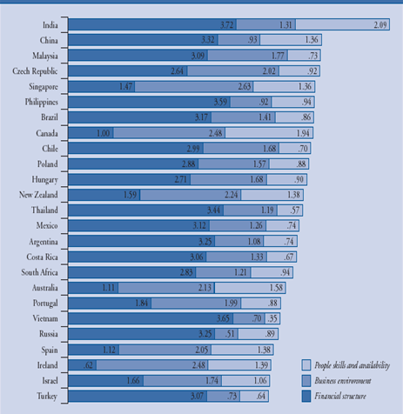
Offshore location attractiveness index

Slide 15
II. THE INDUSTRY AND THE COMPANY AND ITS PRODUCT(S) OR SERVICE(S)
B. The Company and the concept
Describe what business your company is in or intends to enter, what products/service will it offer, and who will be its principal customers.
If your company has been in business for several years and is seeking expansion financing, review its history and cite its prior sales and profit performance, and if your company had setbacks or losses in prior years, discuss these and emphasize current and future efforts to prevent a recurrence of these difficulties and to improve your company’s performance.

Slide 16
II. THE INDUSTRY AND THE COMPANY AND ITS PRODUCT(S) OR SERVICE(S)
C. The Product(s) or service(s)
Describe in some detail each product or service to be sold
Discuss the application of product or service and describe the primary end use as well as any significant secondary applications (Haier)
Describe your USP; also describe what is currently on the market and what will you offer that will account for your market penetration
Include a description of any possible drawbacks (including problems with obsolescence) of product or service

Slide 17
II. THE INDUSTRY AND THE COMPANY AND ITS PRODUCT(S) OR SERVICE(S) cont’d
D. Entry and growth strategy:
Indicate key success variable in your marketing plan (e.g., an innovative product, timing advantage, or marketing approach) and your pricing, distribution, advertising and promotional plans.
Summarize how fast you intend to grow and to what size during the first five years and your plans for growth beyond your initial product or service
AVOID THE SHINY OBJECT SYNDROME

Slide 18
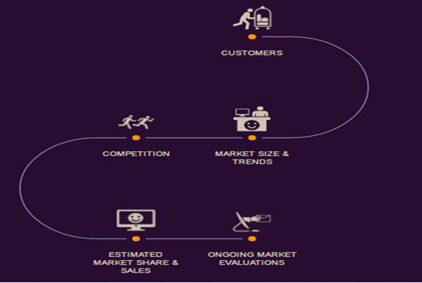
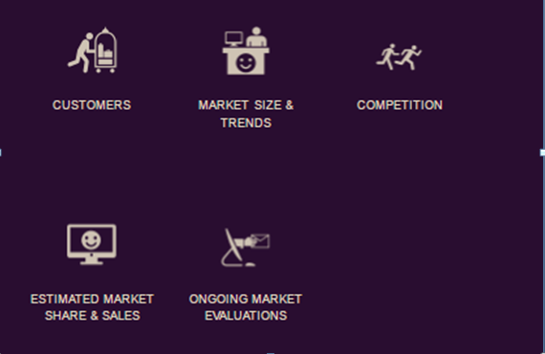
III. Market Research and Analysis

Slide 20

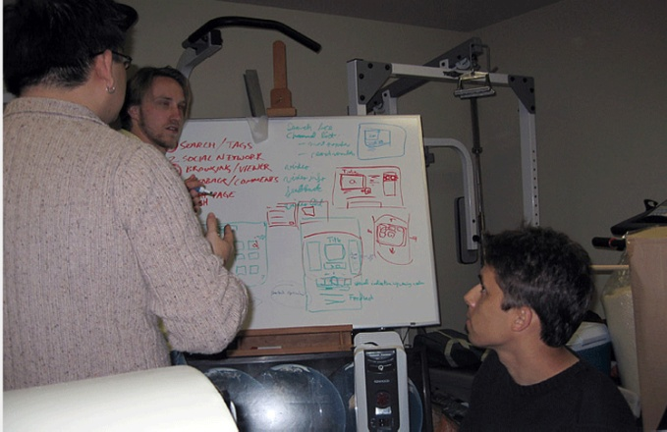

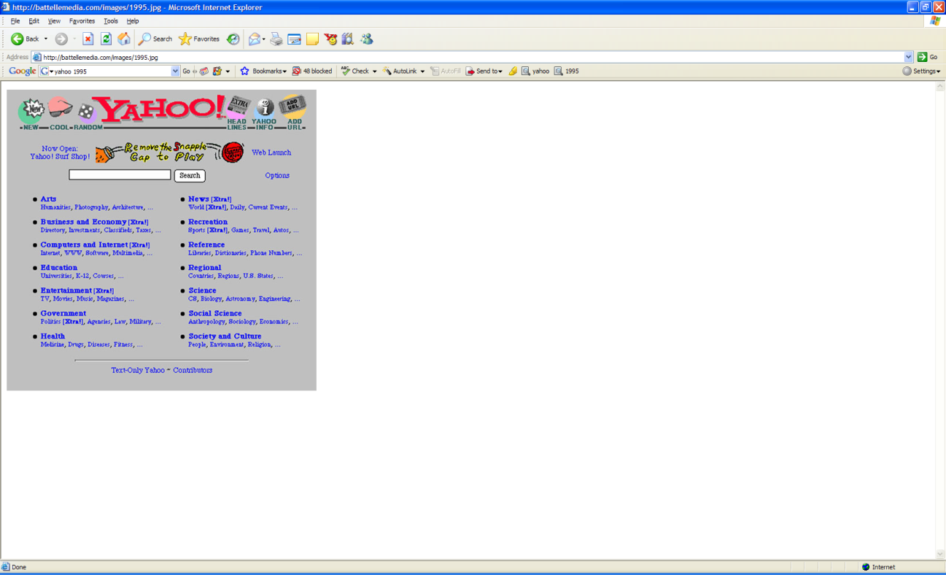
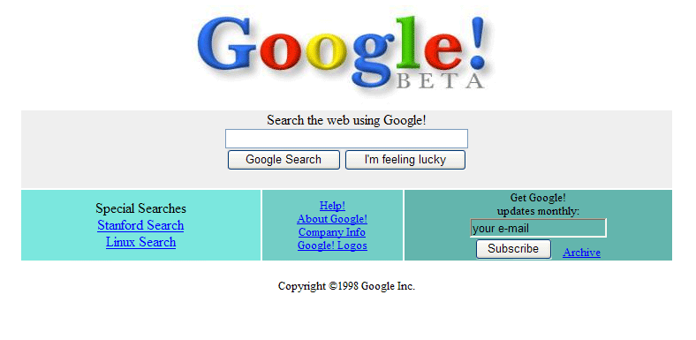
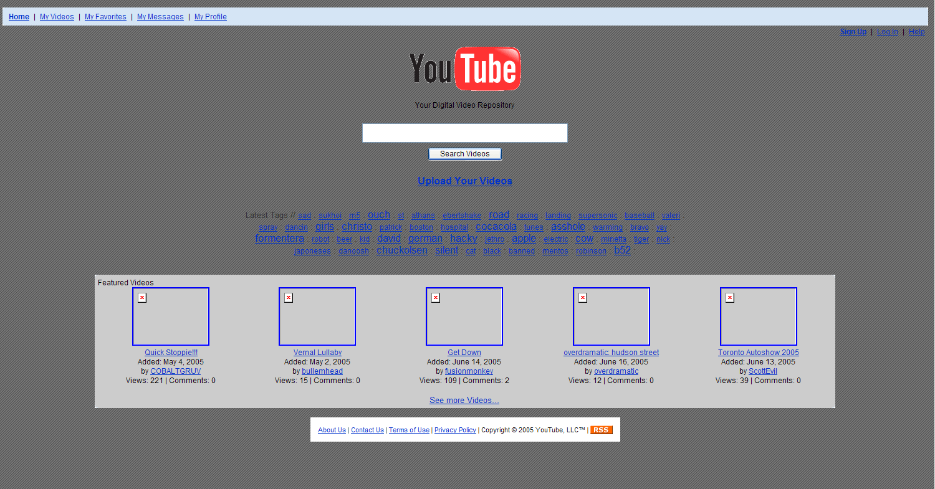
HUMBLE BEGINNINGS
Steve Chad Jawed
Jerry & David
Larry & Sergey
Notes:
Jerry Yand and David Filo

Slide 21
III. MARKET RESEARCH AND ANALYSIS
Due to critical dependence of other parts of the plan on this section, you are advised to prepare this section before any other.
Check the market (Present or future)
Check alternative sources of market data and take time on this part (Prefeasibility studies available at SMEDA website)
Important because predicted sales levels directly influence such factors as the size of manufacturing operation, the marketing plan and the amount of debt and equity capital you will require

Slide 22
III. MARKET RESEARCH AND ANALYSIS
Customers
Discuss who the customers for the product(s) or service(s) are or will be.
Note that potential customers need to be classified by relatively homogenous groups having common, identifiable characteristics (e.g., by market characteristics)
For example, automotive part might be sold to manufacturers and to parts distributors supplying the replacement market, so the discussion needs to reflect two market segments.
If you have existing business, list your principal current customers and discuss the trends in your sales to them.

Slide 23
Segmentation Bases
By Behavior | By Demography | By Geography | By Psychographics
-Benefit sought from the product -How often the product is used (usage rate) -Usage situation (daily or holiday use) -Buyers status and loyalty to the product (non-user, first time user, regular) | -Age/ Generation -Income -Gender -Family lifecycle -Family size -Occupation -Nationality | -Region (Region Continent, Country, State) -Size of city or town Population density Climate | Activities Interests Opinions

Slide 24
IMPORTANT BEFORE YOU PROCEED ANY FURTHER Entrepreneurial plans
ORDINARY PLAN
Is for existing organisation
Proposes incremental changes
Projections based on past achievements
ENTREPRENEURIAL PLAN
Is for new organisation
Proposes a radical change (an innovation)
No historic basis for projections

Slide 25
III. MARKET RESEARCH AND ANALYSIS
B. Market Size and Trends
Show for five years the size of total current market and the share you will have, by segment and/or by region and/or country, for product or service you will offer, in units, dollars and potential profitability.

Slide 26
III. MARKET RESEARCH AND ANALYSIS
C. Competition and competitive advantage
Make a realistic assessment of the strengths and weaknesses of competitors.
Assess the substitutes and/or alternative products and services and list the companies that supply them, both domestic and foreign, as appropriate.
Compare competing and substitute products or services on the basis of market share, quality, price, performance, delivery, timing, service, warranties, and other pertinent features.

Slide 27
III. MARKET RESEARCH AND ANALYSIS
C. Competition and Competitive Edges
Make a realistic assessment of competitors strengths and weaknesses
Compare competing and substitute products or services (local & Foreign)
Draw a perceptual map to determine the relative competitive position of competitors
Discuss the advantages gained through patents if any?

Slide 28

III. MARKET RESEARCH AND ANALYSIS
D. Ongoing market evaluation:
Explain how you will continue to evaluate your target markets so as to assess customer needs and service to guide product improvements, new product programs, plans for expansion of your production facility, and guide product or service pricing
Recursive process

Slide 29
IV. Marketing Plan
The marketing plan describes how sales projections will be achieved. Includes a discussion of your sales and service policies; pricing, distribution, promotion and advertising strategies; and sales projections.
The marketing plan needs to describe what is to be done, how it will be done, when it be done, and who will do it.

Slide 30
IV. Marketing Plan
Overall marketing strategy
Indicate whether the product(s) or service(s) will initially be introduced internationally, nationally or regionally; explain why; and if appropriate.
indicate any plans for extending sales at a later date.
Discuss any seasonal trends that underlie the cash conversion cycle in the industry and what can be done to promote sales out of season.
Describe any plans to obtain government contracts as a means of supporting product development costs and overhead

Slide 31
IV. Marketing Plan
B . Pricing
First compare your pricing policy with your major competitors
Discuss the gross profit margins between manufacturing and ultimate sales costs.
Indicate whether this margin is large enough to allow for warranties, training, service, price competition, and so forth- still allow a profit

Slide 32
IV. Marketing Plan
B . Pricing
Explain how the price you set will enable you
To get the product or service accepted
To maintain and increase market share in the face of competition
To produce profits
If your product is to be priced lower than competitors, explain how you will do this and maintain profitability e.g.
(through greater value added via effectiveness in manufacturing and distribution, lower labor costs, lower material costs, lower overhead or other component of the cost).
Describe any discount allowance for prompt payment or volume purchases.

Slide 33
IV. Marketing Plan
C. Sales tactics
Describe the methods e.g.., your own s/force, sales representatives, direct mail or distributors
Include initial plans and longer range plans for a sales force. Include a discussion of any special requirement (e.g.,) refrigeration
Describe how distributors or sales representatives, if they are used will be selected, when they will start to represent you, the areas they will cover and head count of representatives and expected sales to be made each month.

Slide 34
IV. Marketing Plan
Service and Warranty Policy
If your company will offer a product that will require service, warranties, or training, indicate the importance of these to the customers’ purchasing decision and discuss your method of handling service problems.
Indicate who will handle the after sales services and show whether service calls will be a profitable or breakeven operation.

Slide 35
IV. Marketing Plan
E. Advertising and promotion
Describe the approaches the company will use to bring its product or service to the attention of prospective purchasers.
For manufacturers of industrial products, indicate the plans for trade show participation, trade magazine advertisements, direct mailings, the preparation of product sheets and promotional literature, and the use of advertising agencies.
For consumer products indicate what kind of advertising campaign is contemplated to introduce the product and what kind of sales aids will be provided to dealers, what trade shows and so forth are required

Slide 36
IV. Marketing Plan
F. Distribution
Describe the methods and channels of distribution you will emplo
Indicate how sensitive shipping cost is as a percent of the selling price
If international sales are involved, note how these sales will be handled, including distribution, shipping, insurance, credit and collections

Slide 37
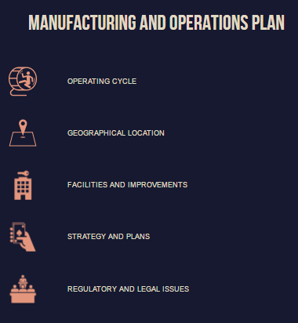

Slide 38
V. Manufacturing and Operations Plans
Needs to include such factors as plant location, space requirements, capital equipment requirements, and labor for (full and part- time) requirements.
For a manufacturing firm it needs to include policies on inventory control, make or buy decisions.
A service firm may require special attention to location (proximity to customers is generally a must) minimizing overhead, and obtaining competitive productivity from a labor force.

Slide 39
V. Manufacturing and Operations Plans
Operating cycle:
Describe the lead/lag times that characterize the fundamental operating cycle in your business (ceramics, Pottery, Bricks, Bakery etc)
Explain how seasonal production loads will be handled without severe dislocation (e.g., by building inventory or using part time help in peak periods)
B. Geographical location
Include location analysis if possible
Discuss pros and cons of site location in terms of such factors such as labor (availability, unionized or not and wage rates) closeness to customers or suppliers

Slide 40
SCOR - 5 distinct Management Processes
Plan
Deliver
Source
Make
Deliver
Source
Make
Deliver
Source
Make
Deliver
Source
Return
Return
Return
Return
Return
Return
Return
Return
Suppliers’ Supplier
Supplier
Your Company
Customer
Customer’s Customer
Internal or External
Internal or External
SCOR Model
Processes
Metrics
Best Practices

Slide 41
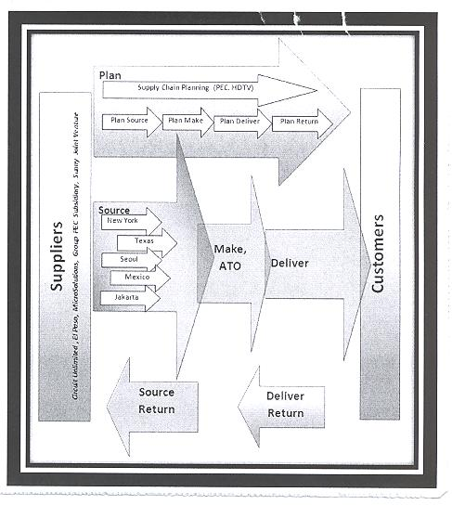

Slide 42
V. Manufacturing and Operations Plans
C. Regulatory and Legal Issues
Discuss any relevant state, federal or foreign regulatory requirements unique to your product, process or service such as laws or other regulatory compliance such as health permits, environmental approvals etc
Note any pending regulatory changes that can affect the nature of your opportunity and its timings.

Slide 43
V. Manufacturing and Operations Plans
D. Strategy and plans
Describe the manufacturing processes involved in production of your products and any decisions with respect to subcontracting of component parts, rather than complete in-house manufacture.
Describe your approach to quality control, production control, inventory control, and explain what quality control and inspection procedures the company will use to minimize service problems and associated customer dissatisfaction

Slide 44
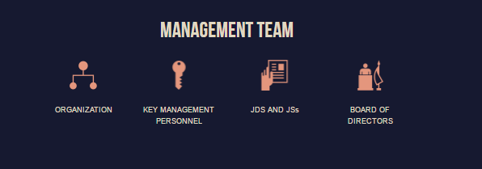

Slide 45
VI Management Team
This section includes a description of the functions need to be filled, a description of key management personnel and their primary duties as well as an organogram
You need to present indications of commitment such as the willingness of team members to initially accept modest salaries and of the existence of the proper balance of technical, managerial, business skills and experience in doing what is proposed

Slide 46
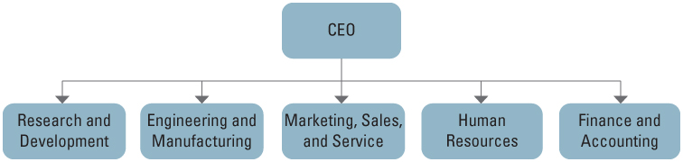
Typical Functional Structure
.

Slide 47
A description of Board of directors BoDs
Describe the company’s philosophy about the size and composition of board
Identify any board members and include a one or two sentence statements of the member’s background that shows what he or she can bring to the company

Slide 48
Job Description & Specification JDs & JSs
A job description is a written statement of what the job holder does, under what conditions, and why
Job descriptions list:
job title
job identification
job duties/essential functions in order of importance

Slide 49
Job Description & Specification JDs & JSs
Job specification states the minimum acceptable qualifications that the incumbent must possess to perform the job successfully such as
Specific skills
Education/experience
Certification
Physical abilities/Work environment

Slide 50
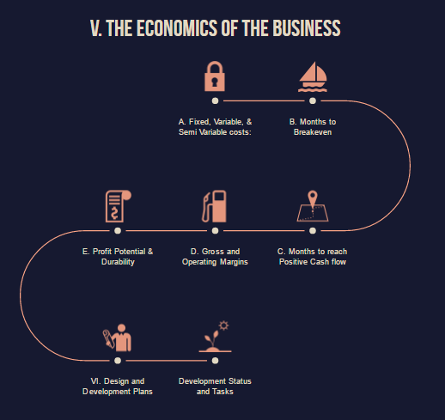

Slide 51
VII. The Economics of the Business
The foundation on which economic view of value hinges is the assumption of “homo oeconomicus” meaning that humans are sternly rational with regards to utility maximization in a rather opportunistic and calculated ways.
Describe the market structure such as Monopoly (Oil & Power), Duopoly, Oligopoly (Mobilink, Ufone, Telenor), Monophony (Defense)
“Pak ext debt 98 Bill $, Exports 26 Bill $, Ali baba one day sales 30 Bill $
Fixed, Variable, and Semi Variable costs:
Provide a detailed summary of above cost in rupees and as percent of total costs as appropriate.
Show relevant industry benchmarks

Slide 52
VII. The Economics of the Business
C. Months to reach positive cash flow
Show when the venture will attain positive cash flow
Show if and when you will run out of cash
Note any significant stepwise changes in cash flow that will occur as you grow and add capacity

Slide 53
VII. The Economics of the Business
D. Gross and Operating Margins
Describe the magnitude of gross margins i.e.,
Gross margin is also called gross profit margin, represents the %age of total revenue a firm is left above costs directly related to production and distribution
Describe operating margins for each of the product(s) and/or service(s) you are selling in the market niche(s) you plan to attack. Also called EBIT- Subtracts all overheads such as insurance, repair, fees, bills, advertising etc

Slide 54
VII. The Economics of the Business
E. Profit potential and durability:
Describe the magnitude and expected durability of the profit stream the business will generate- Before and After taxes and with reference appropriate industry benchmarks, other competitive intelligence, or your own relevant experience.
Address the issue of how perishable or durable the profit stream appear to be.
Provide reasons why your profit stream is perishable or durable such as barriers to entry you can create, your technological and market lead time, and so on.

Slide 55
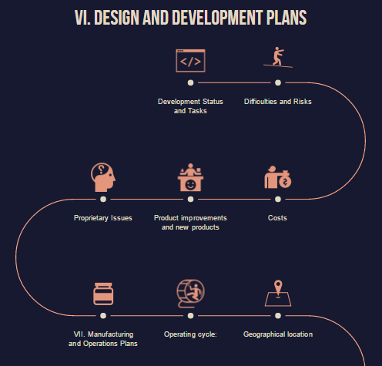

Slide 56
VIII. Design and Development Plans
The nature, time and money required for development before the product is made marketable must be considered. (often they are underestimated)
It may include the engineering work necessary to convert a laboratory prototype into finished product; the design of special tooling; identification and organization of employees, equipment, new computer software etc

Slide 57
VIII. Design and Development Plans
Development Status and Tasks
Describe the current status of each product or service and explain what remains to be done to make it marketable.
Describe briefly the competence or expertise that your company has or will require to complete this development (Citizen journalism & Live Streaming)
List any customers or end users who are participating in the development, design, and or testing or service.
Indicate results to date or when results are expected

Slide 58
VIII. Design and Development Plans
B. Difficulties and Risks
Identify any major anticipated design and development problems and approaches to their solution.
Discuss the possible effect on the cost of design and development, on the time to market introduction, and so forth, of such problems
Costs Present and discuss the design and development budget, including costs of labor, materials, consulting fees and so on so forth
Discuss the impact on cash flow projections of underestimating this budget, including the impact of a 15-30 percent contingency
DFM & DFA with overall goal to reduce component parts which reduces raw material and labor costs as well as saves time

Slide 59
VIII. Design and Development Plans
C. Product improvements and new products
In addition to existing products development, include some discussion on any ongoing design and development work that is planned to stay competitive
Discuss the customers who have participated in these efforts and their reactions, and include any evidence that you may have

Slide 60
VIII. Design and Development Plans
E. Proprietary Issues
Describe any patent, trademark, copyright, trade secret or any other intellectual property rights you own or are seeking
Describe any contractual rights or agreements that give you exclusivity or proprietary rights
Discuss the impact of any unresolved issues or existing or possible actions pending, such as disputed rights of ownership (kodak vs polariod instant photography)

Slide 61
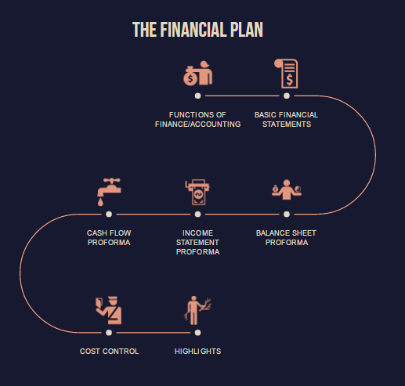

Slide 62
IX.Financial Plan.
In times of inflation people save more yet people save less
When there is a high level financial sophistication people may choose to borrow rather than save because the ultimate interest rate may be negative.
You already know something about financial literacy and know the difference between asset and liabilities.
How rich pay taxes in the last while poor pay taxes at first.
“In accounting,” rich dad would say, "it's not the numbers, but what the numbers are telling you. It's just like words. It's not the words, but the story the words are telling you

Slide 63
IX Financial Plan.
For instance, this is the cash flow pattern of a poor person, or a young person still at home: Job (provides income)-> Expenses(Taxes Food Rent Clothes Fun Transportation) Asset (none) Liability (none)
This is the cash flow pattern of a person in the middle class: Job (provides income)-> Expenses(Taxes Food Mortgage Clothes Fun Transportation) Asset (none) Liability (Mortgage Consumer loans Credit Cards)
This is the cash flow pattern of a wealthy person: Assets(stocks bonds notes real estate intellectual property)->income (dividends interest rental income royalties) Liabilities (none

Slide 64
IX.Financial Plan.
1. Tax advantages: A corporation can do so many things that an individual cannot. Like pay for expenses before it pays taxes. That is a whole area of expertise that is so exciting, but not necessary to get into unless you have sizable assets or a business. Employees earn and get taxed and they try to live on what is left.
A corporation earns, spends everything it can, and is taxed
on anything that is left. It's one of the biggest legal tax loopholes that the rich use. They're easy to set up and are not expensive if you own investments that are producing good cash flow.
For example; by owning your own corporation - vacations are board meetings in Hawaii. Car payments, insurance, repairs are company expenses. Health club membership is a company expense. Most restaurant meals are partial expenses. And on and on - but do it legally with pretax dollars.

Slide 65
IX. Financial Plan
The functions of finance/accounting comprise three decisions:
Investment Decisions := Capital (larger in nature) Budgeting (Investment appraisal). Only those projects should be undertaken which yield most returns
2. Financing Decisions := Capital Structure (How the firm finances its overall operations and growth by using various sources of funds) Debt vs equity ratio
3. Dividend Decisions := Retained & Paid
Dividend equalization fund in some companies

Slide 66
IX. The Financial Plan
Actual Business Statements and Balance Sheets
For an existing business, prepare income statements and balance sheets for the current year and for the prior two years.
B. Proforma income statements
Proforma are basically projections
Using sales forecasts and the accompanying production or operations costs, prepare proforma income statements for at least the first three years.
Fully discuss assumptions such as amount allocated to bad debts and discounts, or 20 % reduction in sales due to adverse impact or climbing a production learning curve to reach full productivity over time

Slide 67
Income Statement (Earning statement) (Revenues-Expenses= Net income/Net Loss)
NET SALES | 1, 000, 000 PKR (1 million)
REVENUE FROM RENTS | 525,000 PKR (525 thousand)
TOTAL REVENUE | 1,525,000 PKR (15 lack 25 thousand)
COSTS OF GOODS SOLD | 725,000 PKR (725 thousands)
SELLING EXPENDITURES | 115,000 PKR (115 thousands)
ADMINISTRATIVE EXPENTURES | 45,000 PKR (45 thousands)
INCOME STATEMENT EXPENSE | 35,000 PKR (35 thousands)
TOTAL EXPENSE | 920,000 PKR
NET INCOME (1,525,000 - 920,000) | 605,000 PKR
NOEW LETS ASSUME 1,000,000 SHARES ARE OUTSTANDING THEN EARNINNG PER SHARE WOULD BE 0.605 i.e. (605,000/1000000)

Slide 68
Balance Sheet Equation
A balance sheet or statement of financial position is a summary of the financial balances of an individual or organization, whether it be a sole proprietorship, a business partnership, a corporation, private limited company or other organization such as Government or not-for-profit entity.
Assets=Liabilities + Owners Equity
You can do the transformation easily

Slide 69

Cash Flow Statement
A cash flow statement is a financial statement that provides aggregate data regarding all cash inflows a company receives as well as all cash outflows that is paid for business activities during a given period

Slide 70
Direct method - Example
Cash receipts from customers | 30,150
Cash paid to suppliers and employees | (27,600)
Cash generated from main operations | 2,550
Income taxes paid | (1170)
Net cash flow from operating activities | 1,380

Slide 71
IX.The Financial Plan
C. Proforma Balance sheets
Prepare proforma balance sheets semiannually in the first year and at the end of each of the first three years of operation.
D. Breakeven Chart
Calculate BE and prepare a chart that shows when BE will be reached and any stepwise changes in BE which may occur.
Show whether it will be easy or difficult to attain BE including a discussion on size of BE sales

Slide 72
X.Overall Schedule
The underlying cash conversion and operating cycle of the business will provide key inputs for the schedule.
Show deadlines critical to the venture’s success, a well presented schedule can be extremely valuable in convincing potential investors that the management team is able to plan for venture growth in a way that recognizes obstacles and minimizes investor risk.

Slide 73
X.Overall Schedule
Show on the schedule the deadlines or milestones critical to venture success such as:
Incorporation of the venture
Completion of design and development
Completion of prototypes
Obtaining of sales representatives
Obtaining product displays at trade shows
Signing up of distributors or dealers
Ordering of material in production quantities
Starting production or operations
Delivery on first sale
Receiving the first payment on accounts receivables

Slide 74
XI.Critical Risks, Problems, and Assumptions
If the venture has anything that could be considered a fatal flaw, discuss why it is not. Do not omit this section or the reader will make one of following conclusions
You think he or she is incredibly naive or stupid or both
You hope to pull the wool over his/her eyes
You do not have enough objectivity to recognize and deal with assumptions and problems.

Slide 75
XI.Critical Risks, Problems, and Assumptions
Discuss assumptions and risks in your plan
Identify major problems and risks such as running out of cash before orders are received
Potential price cutting by competitors
Any potentially unfavorable industry wide trends
Design or manufacturing costs in excess of estimates
Sales projections not achieved
Any unmet product development schedule
Difficulties or long lead times in procurement of parts or raw materials
Difficulties in obtaining needed bank credit
Larger than expected innovation and expected costs
Running out of cash after orders pour in

Slide 76
THE END
Thank you for your patience and participation throughout the lectures!

