Slide 1
Lecture 1
Introduction
National University of
Computer & Emerging Sciences

Slide 2
About me
Office: Opposite to kitchen
Extension: 105
Office hours – to be decided

Slide 3
Some Rules
  Raise your hand before asking any question and then WAIT for the permission
  Never ever miss a class
  Never ever “sleep” in the class
  Never use mobile phones in the class
  Above all, whatever you do, please do not disturb others

Slide 4
Dishonesty, Plagiarism
All parties involved in any kind of cheating in any exam (Quizzes, Assignments & Projects) will get minus (-) 50% in that exam

Slide 5
Dishonesty, Plagiarism
You can fool some of the people all of the time,
and all of the people some of the time,
but you can not fool all of the people all of the time.
Abraham Lincoln,
16th president of US (1809 - 1865)

Slide 6
Pre-Requisites
Must have passed Data Structures
Familiar with programming C/C++

Slide 7
Tentative Evaluation Breakdown
Assignments | 5
Quizzes | 5
Projects | 15
Sessional I | 15
Sessional II | 15
Final | 45
Total | 100
Note: The evaluation Breakdown plus course outline for all sections will be same
Grading will be combined so don’t rely on your class position look for the batch position

Slide 8
Course outline
Introduction
Processes, inter-process communication, threads
Synchronization, Semaphores, Deadlocks
CPU Scheduling
Memory and File-system management
…

Slide 9
Books
Text Book:
  Operating System Concepts, 9th Editon, Silberschatz Galvin Gagne
Reference Books:
  Modern Operating Systems, 2nd Edition, Andrew S. Tanenbaum
  Operating Systems, 4th Edition, William Stallings

Slide 10
What is an Operating System?
It is a program!
Top-down view
  Provides an extended or virtual machine abstraction to user programs
    Easier to program than the underlying hardware.
    All services are invoked and accomplished through system calls.
Bottom-up view
  Acts as a resource manager of a complex system
  Resources consist of processors, memories, timers, disks, keyboard, network interfaces, printers etc.
  OS manages allocation of these resources to user programs in an orderly and controlled manner

Slide 11
What is an Operating System?
OS do nothing by themselves.
Similar to subroutine libraries, do nothing unless they are invoked by programs
Act as an intermediary between users and the hardware

Slide 12
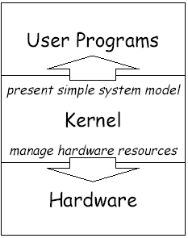
Two Goals of Operating Systems
Manage hardware resources
  System operates smoothly: efficiently, reliably, securely
Present abstract system model to programmer
  Simple and convenient access to and control of resources

Slide 13
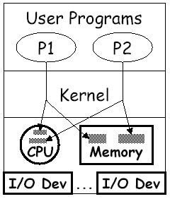
Manager/Coordinator of Resources
Coordinates who gets what
  “who”: running programs
  “what”: resources
  “when”: scheduling time
  “where”: organizing space
  “whether”: limits, rights
Goal: smooth system operation
  efficiency,reliability,security

Slide 14
Resource multiplexing
OS multiplexes resources in two ways:
In time
  Time multiplexing involves different programs taking turns in using the resource.
    Example: CPU scheduling
    printer sharing.
In space
  Space multiplexing involves different program getting part of the resource possibly at the same time.
    Example: memory is divided into several running programs.

Slide 15
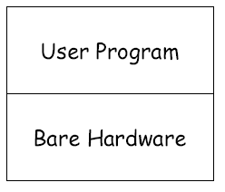
What If No Operating System?
All we have is bare hardware
You want to run a program
  How do you load it?
  How do you run it?
  What happens when it completes?
Need at least some minimal OS to do these functions

Slide 16
…Lets go back to the “stone age” of computing…

Slide 17
Early Systems
No Operating systems,
your Data and your Programs
  X = X + 1;
As
  Load Register1, x
  Load Direct Register2, 1
  Add Register3, Register2, Register1
  Store Register3, x
Time slots allocated to scientists
Enter programs using binary switches

Slide 18
Early Systems
Problem:
  computer idles while programmer sets things up.
  Poor utilization of huge investment.
Solution:
  Hire a specialized person to do setup.
Problem:
  Faster than programmer, but still a lot slower than the machine.
Solution:
  Build a batch monitor.

Slide 19

The Monitor
Early batch system
  bring cards to 1401
  read cards to tape
  put tape on 7094 which does computing
  put tape on 1401 which prints output

Slide 20
Simple Batch System
The user submits a job (written on a card or tape) to a computer operator.
The computer operator place a batch of several jobs on a input device
A special program, the monitor, manages the execution of each program in the batch
Resident monitor is in the main memory and available for execution

Slide 21
The Monitor
Monitor reads job one at a time from the input device
Monitor places a job in the user program area
A monitor instruction branches to the start of the user program
Execution of the user program continues until:
  End of program occurs
  Error occurs

Slide 22
Why study operating systems?
Point of describing change isn’t “Look how stupid batch processing is” – it was right for tradeoffs of the time, but not anymore
Point is: have to change with changing technology
Situation today is much like it was in the late 60’s OS’s today are enormous, complex things
  100k's of lines (or >1M lines)
  Windows NT is 20M lines
  Windows2000 and Windows XP are about 40M lines.
Key aspect of this course, understand OS’s so we can simplify them!

Slide 23
Beyond batch processing systems
The Era of Timesharing and Multiprogramming
Multiprogramming - Execute multiple jobs simultaneously
Timesharing - Processor’s time is shared among multiple users

Slide 24
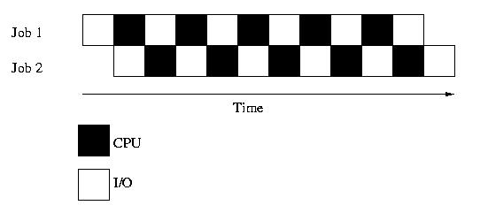
Multiprogramming
Execute multiple jobs simultaneously
But a CPU can execute a single instruction at a time???
One job can use the CPU while the other is waiting for I/O
Small jobs not delayed by large jobs
Context switching

Slide 25
Requirements for Multiprogramming
Hardware support:
  I/O interrupts and (possibly) DMA
    OS requests I/O, goes back to computing, gets interrupt when I/O device finishes
  Memory management
    several ready-to-run jobs must be kept in memory
    Memory protection (data and programs)
Software support from the OS:
  Job Scheduling
    which ready jobs should be brought to memory
  CPU Scheduling
    which program is to be run next
  To manage resource contention

Slide 26
Multiprogramming
What is the Performance criteria?
Turn-Around Time
  the length of time between the start of the job and when the output was done.

Slide 27
Time Sharing System (TSS)
Processor’s time is shared among multiple users
Use cheap terminals to let multiple users interact with the system at the same time.
OS does timesharing to give illusion of each user has own computer

Slide 28
Time Sharing System (TSS)
Time sharing was achieved by resource sharing
Eg, the CPU among the jobs
Performance measured in terms of Response Time
  the length of time between the start of a job and the first output.
Utilization is still a problem. Why?
CPU time sacrificed to get better response time for users
CPU still has to wait, while a slower user is entering data on key board.
Other jobs must run during this time.

Slide 29
Personal Computing
Computers are cheap, so give everyone a computer.
Initially, OS became a subroutine library again (MSDos)
Since then, adding back in memory protection, multiprogramming, etc.
Because when humans are expensive, don’t waste their time by letting programs crash each other

Slide 30
Distributed Computing
Computers so cheap – give people a bunch of them
  I have a 2 PCs at home, 1 in my office, 3 smart phones and share some machines in a lab how do I coordinate a bunch of machines?
Networks fast – allow machines to share resources and data easily
Networks cheap – allow geographically distributed machines to interact

