Slide 1
Lecture 2
OS Overview
National University of
Computer & Emerging Sciences

Slide 2
The Operating System controls the machine
gcc
gdb
User
OS Kernel
grep
diff
Application
Hard
ware
vi
date
Operating System
xterm
emacs
Hardware
netscape

Slide 3
A better picture
Many
applications
Application
One Operating
System
System
calls
Operating
System
One Hardware
Machine
instructions
Privileged
instructions
Hardware

Slide 4
Operating System in Action
OS is a program, just like any other program
When you turn power on, bootstrap program is loaded from ROM
Boot program
  Examine/check machine configuration
    # CPUs
    How much memory
    # and type of HW devices
  Build configuration structure describing the HW
  Locates and Loads the OS
  The control transfers to the OS

Slide 5
Operating System in Action
Operating System:
Initialize kernel data structures
Initialize state of HW devices
Creates a number of processes to start operation

Slide 6
Process
A computer program in execution on a machine is a process
More formally:
“A Sequential stream of Execution in its own address space”
Two parts to a process
1) Sequential Execution:
  no concurrency inside a process
  everything happens sequentially

Slide 7
Process Address Space
A list of memory locations from some min (usually 0) to some max that a process can read and write.
Contains
  the executable program
  program’s data
  Stack
  Associated with a process is a set of registers e.g. PC and other information to run the program.

Slide 8
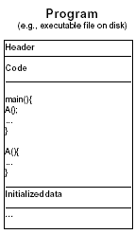
Process =? Program
Program: series of commands (e.g. C statements, assembly commands, shell commands)

Slide 9
Process =? Program
Anatomy of a process
1) More to a process than just a program
  program is part of process state
  I run dir, you run dir – same program, different processes
2) Less to a process than a program
  A program can invoke more than one process to get the job done

Slide 10
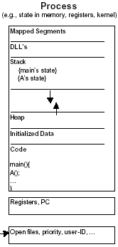
Process =? Program

Slide 11
Components of an OS

Slide 12
Common System Components
Process Management
Main Memory Management
File Management
I/O System Management
Secondary Management
Networking
Protection System
Command-Interpreter System

Slide 13
Process Management
Creation/deletion of a process
Create and make available, an execution environment
Suspension/resumption and CPU scheduling in a fair manner
Mechanisms for synchronization
Mechanisms for inter-process communication
Deadlock handling

Slide 14
Operating System Services

Slide 15

A View of Operating System Services

Slide 16
Operating System Services
Program execution – system capability to load a program into memory and to run it
I/O operations – since user programs cannot execute I/O operations directly, the operating system must provide some means to perform I/O
File-system manipulation – program capability to read, write, create, and delete files
Communications – exchange of information between processes executing either on the same computer or on different systems tied together by a network. Implemented via shared memory or message passing
Error detection – ensure correct computing by detecting errors in the CPU and memory hardware, in I/O devices, or in user programs

Slide 17
A View of Operating System Services

Slide 18
System Calls
Programming interface to the services provided by the OS
Typically written in a high-level language (C or C++)
Mostly accessed by programs via a high-level Application Program Interface (API) rather than direct system call use
Three most common APIs are Win32 API for Windows, POSIX API for POSIX-based systems (including virtually all versions of UNIX, Linux, and Mac OS X), and Java API for the Java virtual machine (JVM)

Slide 19

Example of System Calls
System call sequence to copy the contents of one file to another file

Slide 20

API – System Call – OS Relationship

Slide 21

Standard C Library Example
C program invoking printf() library call, which calls write() system call

Slide 22
System Call Parameter Passing
methods used to pass parameters to the OS
  Simplest: pass the parameters in registers
    In some cases, may be more parameters than registers
  Parameters stored in a block, or table, in memory, and address of block passed as a parameter in a register
    This approach taken by Linux and Solaris
  Parameters placed, or pushed, onto the stack by the program and popped off the stack by the operating system
  Block and stack methods do not limit the number or length of parameters being passed

Slide 23
Types of System Calls
Process control
File management
Device management
Information maintenance
Communications
Protection

Slide 24

Examples of Windows and Unix System Calls

Slide 25
Operating System Design and Implementation

Slide 26
Simple Structure
MS-DOS – written to provide the most functionality in the least space
  Not divided into modules
  Although MS-DOS has some structure, its interfaces and levels of functionality are not well separated

Slide 27

MS-DOS Layer Structure

Slide 28

Layered Operating System

Slide 29
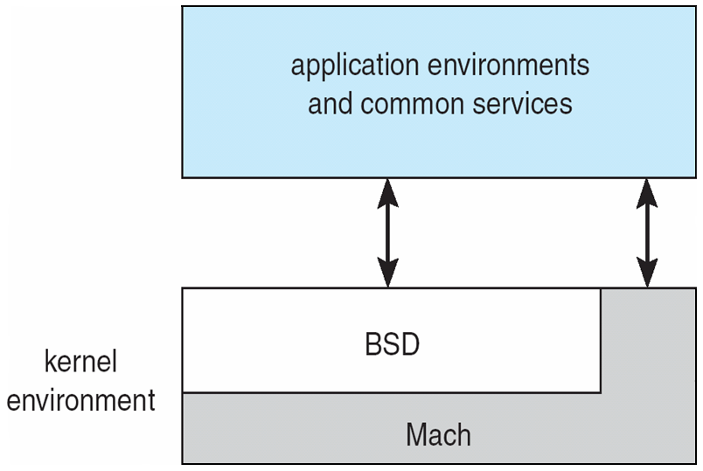
Mac OS X Structure

Slide 30

Solaris Modular Approach

Slide 31
Virtual Machines

Slide 32
Virtual Machines
A virtual machine takes the layered approach to its logical conclusion. It treats hardware and the operating system kernel as though they were all hardware
A virtual machine provides an interface identical to the underlying bare hardware
The operating system creates the illusion of multiple processes, each executing on its own processor with its own (virtual) memory

Slide 33
Virtual Machines (Cont.)
The resources of the physical computer are shared to create the virtual machines
  CPU scheduling can create the appearance that users have their own processor
  A normal user time-sharing terminal serves as the virtual machine operator’s console

Slide 34

Virtual Machines (Cont)
(a) Nonvirtual machine (b) virtual machine
Non-virtual Machine
Virtual Machine

Slide 35
Java Virtual Machine
Compiled Java programs are platform-neutral byte-codes executed by a Java Virtual Machine (JVM)
JVM consists of
  Class loader
  Class verifier
  Runtime interpreter
Just-In-Time (JIT) compilers increase performance

Slide 36
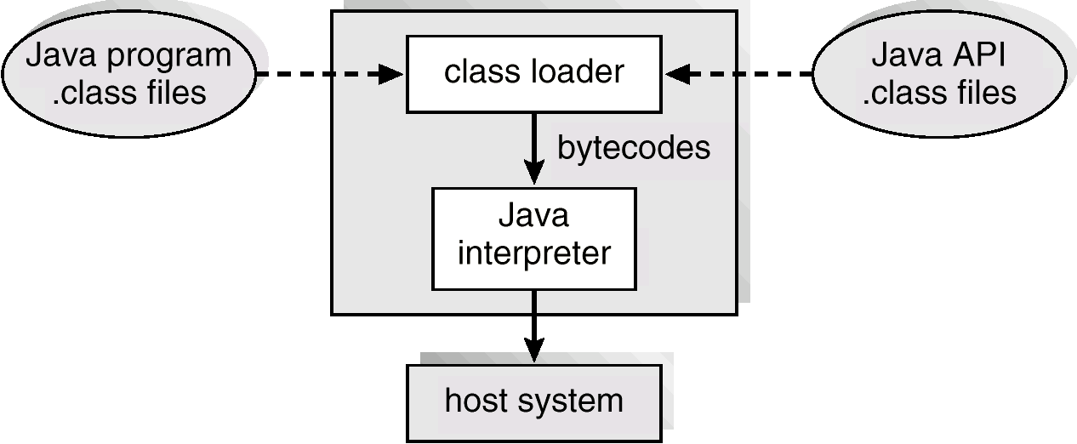
The Java Virtual Machine

Slide 37
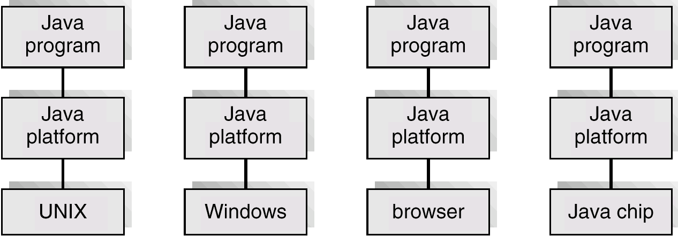
The Java Platform

Slide 38
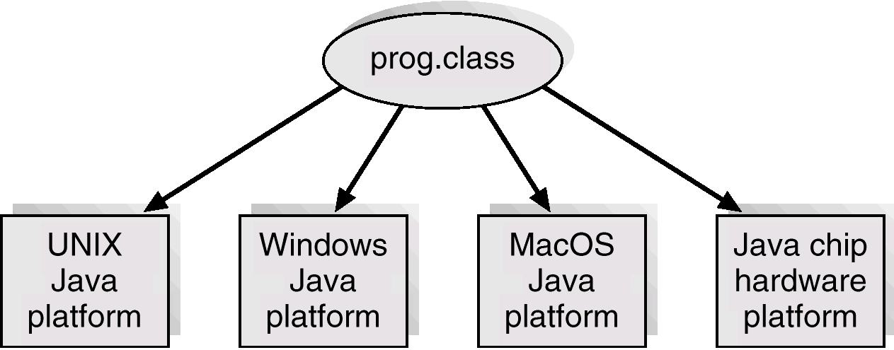
Java .class File on Cross Platforms

Slide 39
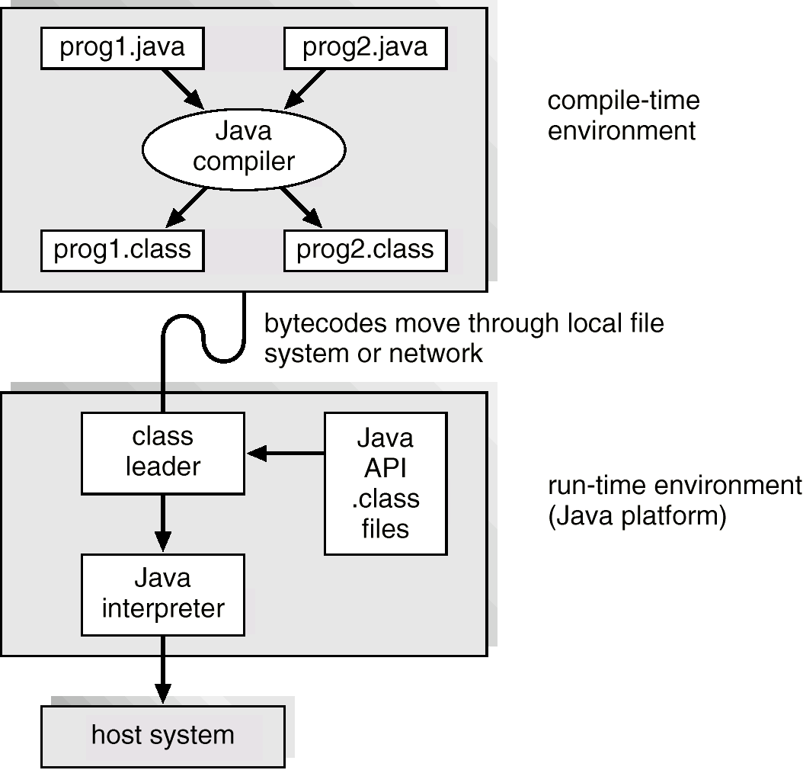
Java Development Environment

