Slide 1
Lecture 3
OS Services and Design
National University of
Computer & Emerging Sciences

Slide 2

A View of Operating System Services

Slide 3
Operating System Services
Program execution – system capability to load a program into memory and to run it
I/O operations – since user programs cannot execute I/O operations directly, the operating system must provide some means to perform I/O
File-system manipulation – program capability to read, write, create, and delete files
Communications – exchange of information between processes executing either on the same computer or on different systems tied together by a network. Implemented via shared memory or message passing
Error detection – ensure correct computing by detecting errors in the CPU and memory hardware, in I/O devices, or in user programs

Slide 4
A View of Operating System Services

Slide 5
System Calls
Programming interface to the services provided by the OS
Typically written in a high-level language (C or C++)
Mostly accessed by programs via a high-level Application Program Interface (API) rather than direct system call use
Three most common APIs are Win32 API for Windows, POSIX API for POSIX-based systems (including virtually all versions of UNIX, Linux, and Mac OS X), and Java API for the Java virtual machine (JVM)

Slide 6

Example of System Calls
System call sequence to copy the contents of one file to another file

Slide 7

API – System Call – OS Relationship

Slide 8
Dual-mode operation
Dual-mode operation allows OS to protect itself and other system components
  User mode and kernel mode
  Mode bit provided by hardware
    Provides ability to distinguish when system is running user code or kernel code
    Some instructions designated as privileged, only executable in kernel mode
    System call changes mode to kernel, return from call resets it to user

Slide 9

Transition from User to Kernel Mode

Slide 10
System Call Parameter Passing
methods used to pass parameters to the OS
  Simplest: pass the parameters in registers
    In some cases, may be more parameters than registers
  Parameters stored in a block, or table, in memory, and address of block passed as a parameter in a register
    This approach taken by Linux and Solaris
  Parameters placed, or pushed, onto the stack by the program and popped off the stack by the operating system
  Block and stack methods do not limit the number or length of parameters being passed

Slide 11
Types of System Calls
Process control
File management
Device management
Information maintenance
Communications
Protection

Slide 12

Examples of Windows and Unix System Calls

Slide 13
Operating System Design and Implementation

Slide 14
Simple Structure
MS-DOS – written to provide the most functionality in the least space
  Not divided into modules
  Although MS-DOS has some structure, its interfaces and levels of functionality are not well separated

Slide 15

MS-DOS Layer Structure

Slide 16

Layered Operating System

Slide 17
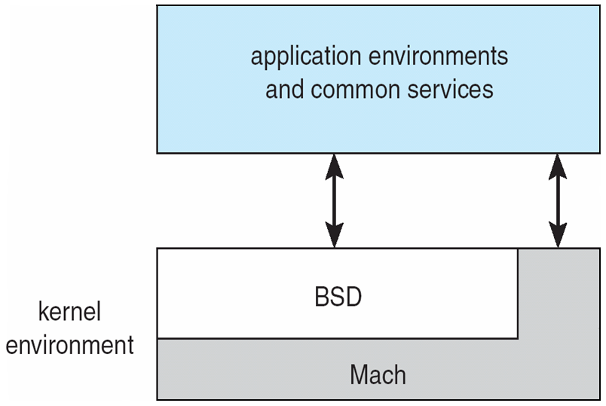
Mac OS X Structure

Slide 18

Solaris Modular Approach

Slide 19
Virtual Machines

Slide 20
Question
Can a “small” operating system simulate the hardware of some machine so that
  Another operating system can run in that simulated hardware?
  More than one instance of that operating system run on the same hardware at the same time?
  More than one different operating system can share the same hardware at the same time?
Answer: Yes

Slide 21
Solution – Virtual Machine
A virtual machine provides interface identical to underlying bare hardware
  I.e., all devices, interrupts, memory, page tables, etc.
Virtual Machine Operating System creates illusion of multiple processors
  Each capable of executing independently
  No sharing, except via network protocols

Slide 22

Virtual Machines (Cont)
(a) Nonvirtual machine (b) virtual machine
Non-virtual Machine
Virtual Machine

Slide 23
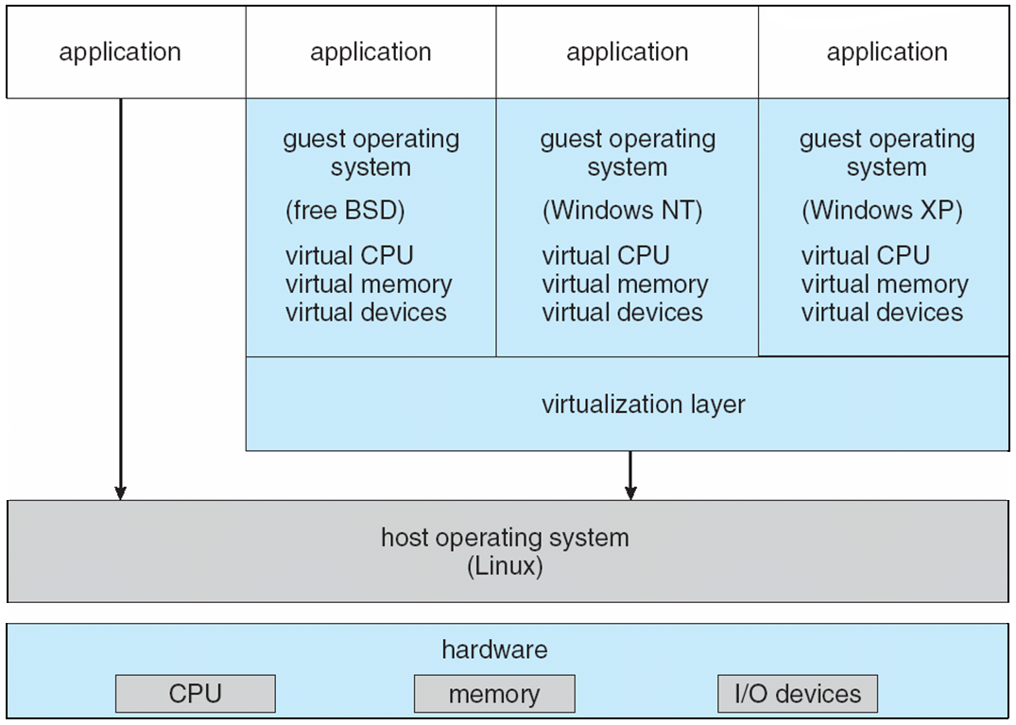
VMware Architecture

Slide 24
Java Virtual Machine
Compiled Java programs are platform-neutral byte-codes executed by a Java Virtual Machine (JVM)
JVM consists of
  Class loader
  Class verifier
  Runtime interpreter
Just-In-Time (JIT) compilers increase performance

Slide 25
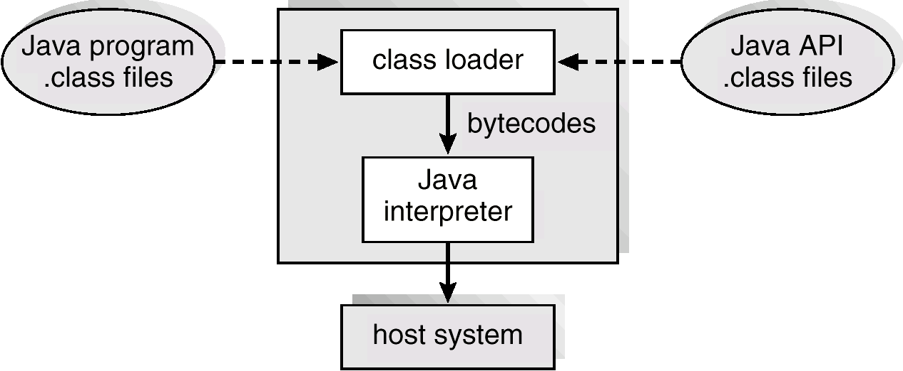
The Java Virtual Machine

Slide 26
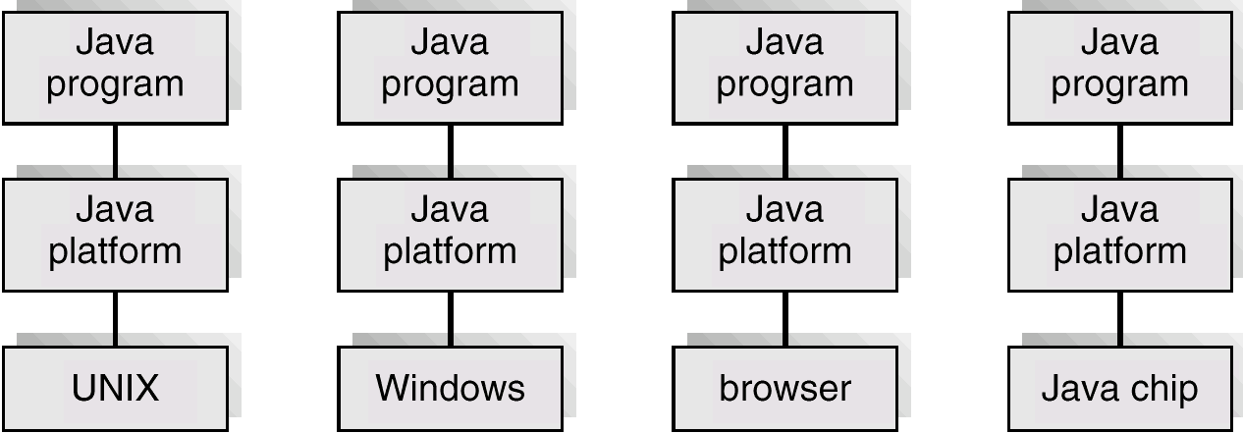
The Java Platform

Slide 27
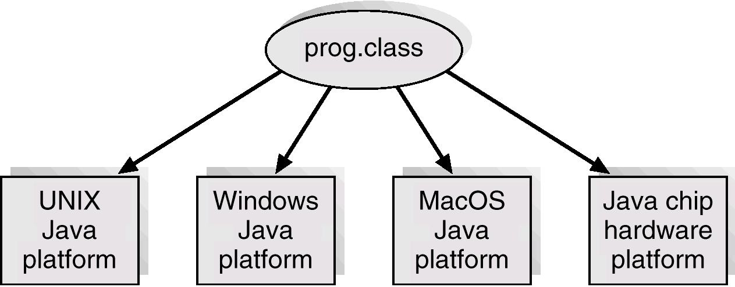
Java .class File on Cross Platforms

Slide 28
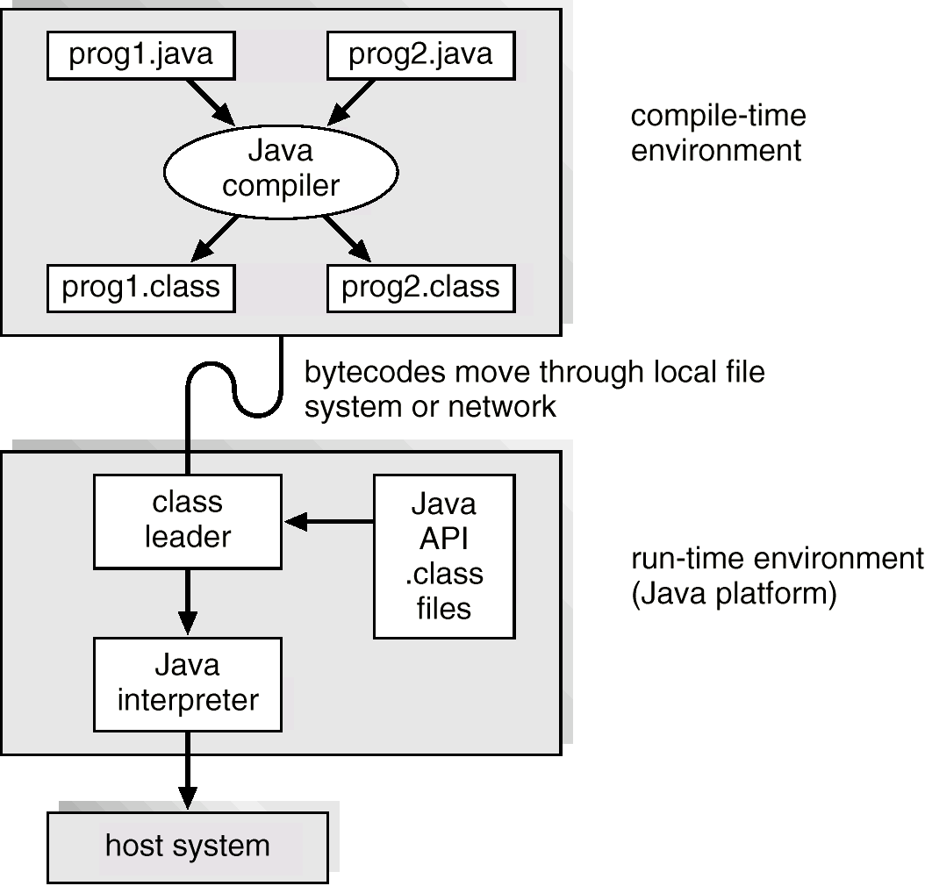
Java Development Environment

Slide 29
