Slide 1

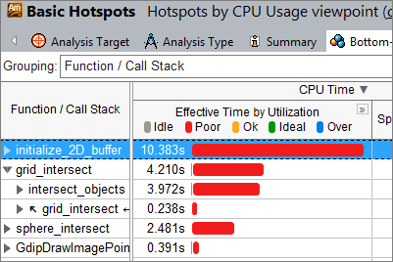


UVA campus network
CS servers
(labsrv06, granger1…)
portal.cs.virginia.edu
SSH
SSH
Your local machine
~/.ssh/ (Linux or WSL) or C:\Users\%USERNAME%\.ssh\ (Windows)
id_rsa.pub
# pubkey of your local machine. can share with others (e.g. the server)
id_rsa
# private key (the secret) of your local machine. do not share with others
config
# configuration. contains the shortcuts for known hosts, etc.
ssh-copy-id
~/.ssh/ (permission: 700)
authorized_keys (permission:600)
# a list of pubkeys the portal accepts
id_rsa.pub
# pubkey of your account on portal. can differ from your local machine’s id_rsa.pub
id_rsa (permission:600)
# private key. the secret of your account on portal. can differ from your local machine’s id_rsa
config
~/.ssh/
authorized_keys (permission: 600)
# a list of pubkeys the server accepts
A pair from “ssh-keygen”
ssh-copy-id
A pair from “ssh-keygen”

Slide 2
SSH
SSH
portal.cs.virginia.edu
Your local machine
CS servers
(labsrv06, granger1…)
UVA campus network

Slide 3
SSH
SSH
portal.cs.virginia.edu
Your local machine
CS servers
(labsrv06, granger1…)
UVA campus network

