Slide 1




Zhang, Aiyin, Robert Gilmore Pontius Jr, Thomas Mumuni Bilintoh, Florencia Sangermano, and John Rogan. 2025. “DynamicPATCH: Method and Software for Spatially Explicit Dynamic Patch Transition Characterization.” Landscape Ecology 40 (7): 132. https://doi.org/10.1007/s10980-025-02120-1.
DynamicPATCH: Method and Software for
Spatially Explicit Dynamic Patch Transition Characterization
Aiyin Zhang
AiZhang@clarku.edu
Authors: Aiyin Zhang, Robert Gilmore Pontius Jr, Thomas Bilintoh, Florencia Sangermano, John Rogan

Slide 2
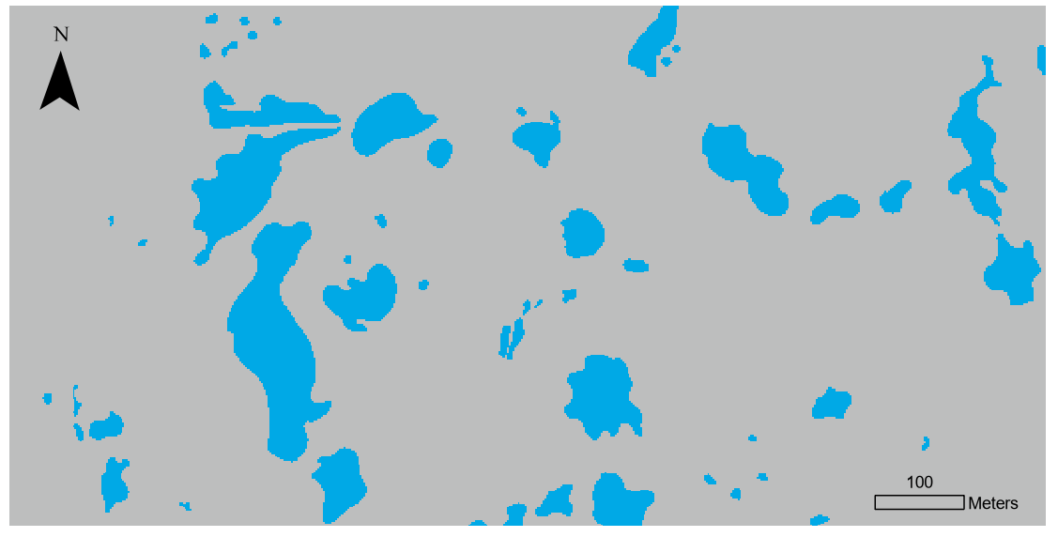
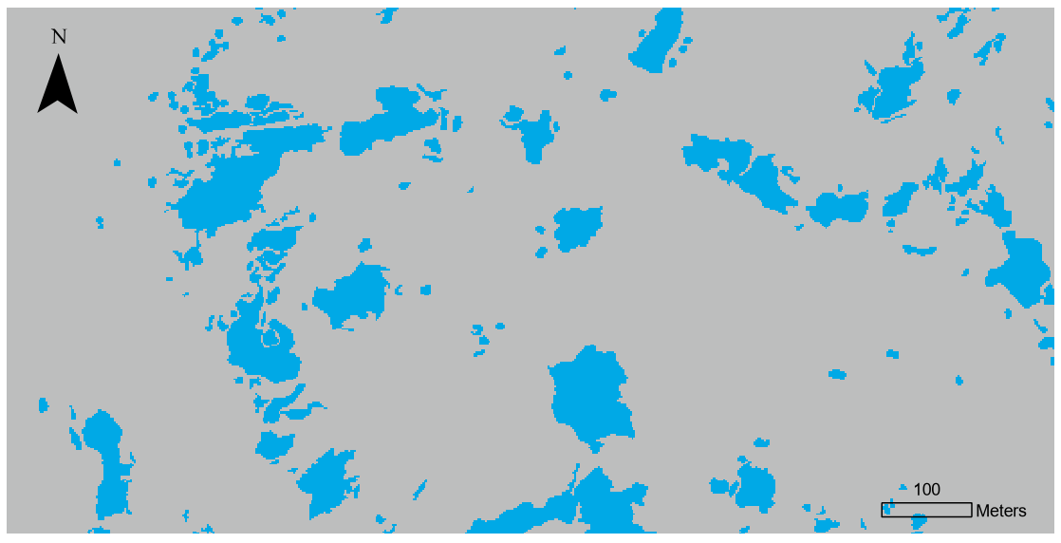
Introduction
Data source: https://portal.edirepository.org/nis/mapbrowse?packageid=knb-lter-gce.657.6
Study area: Long Term Ecological Research Network’s Plum Island Ecosystems (PIE-LTER)
1971
2013
Pond

Slide 3
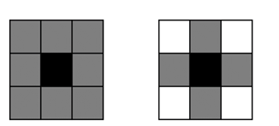
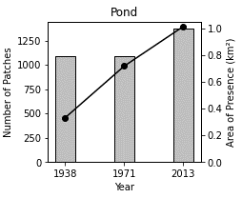
Introduction
How would you analyze the change patterns of ponds in the maps below?
Pixel-based approach: analyze land change on a per-pixel level
Patch-based approach: analyze land change on a patch level
1971
8-connectivity
4-connectivity
Two ways to define ‘connected’
2013
Pond

Slide 4
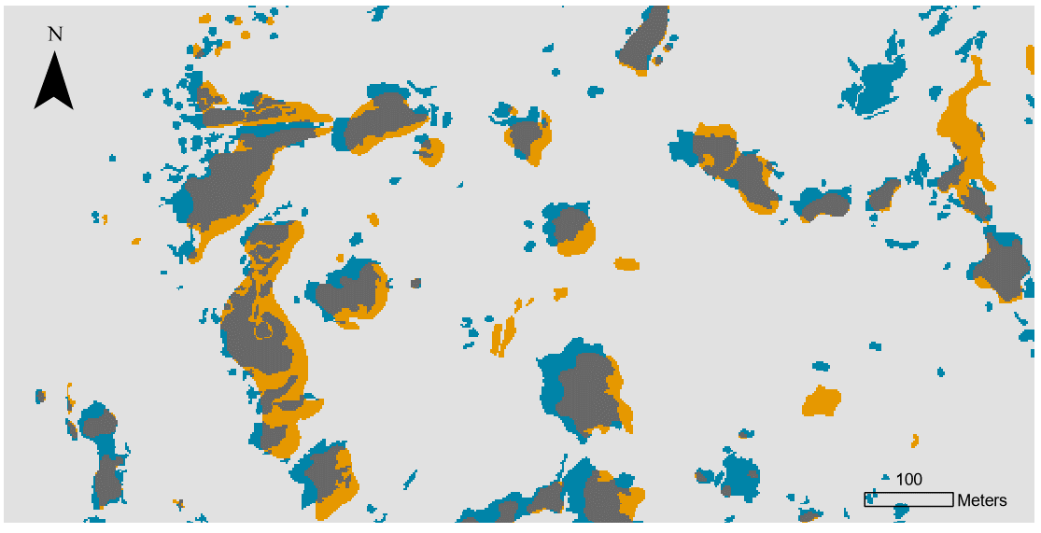
Introduction
How would you analyze the change patterns of ponds in the maps below?
1971
GIS map overlays provide a spatially explicit characterization of landscape change
2013
Gain
Stable Absence
Stable Presence
Loss
How do we explicitly characterize the dynamic transition patterns of a target land cover (e.g., ponds)?
Pond

Slide 5
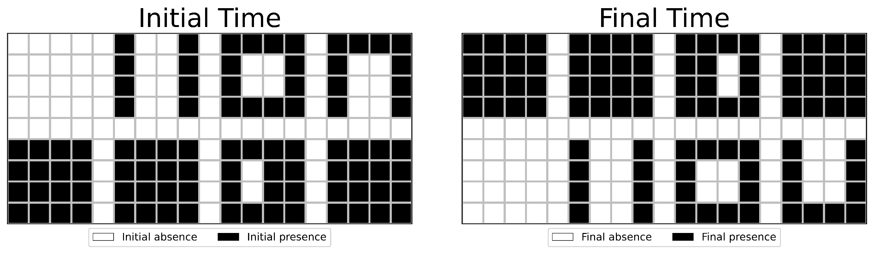
Introduction
  What’s the size of presence (in # of pixels) at the Initial Time and the Final Time?
  Size of presence: 92 pixels
  Size of presence: 92 pixels

Slide 6
Introduction
  How many presence patches at the initial time and the final time?
  How many absence patches at the initial time and final time?
  Number of presence patches: 8
  Number of presence patches: 8

Slide 7
Introduction
What is the change in number of patches and size of presence during the time interval of Initial Time – Final Time?
  Number of presence patches: 8
  Size of presence: 92 pixels
  Number of presence patches: 8
  Size of presence: 92 pixels
  Net change in number of patches: 0
  Net change in size of presence: 0

Slide 8
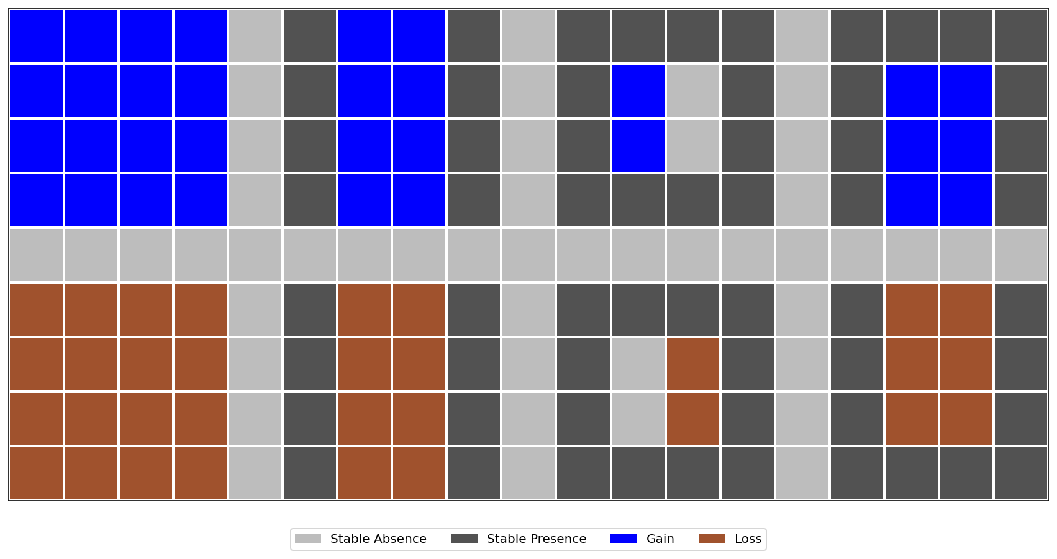
Introduction
In the example map below, each change patch has a unique transition pattern
  Overlay
  Change pixels: 64
  Change patches: 8
Change patch: a patch of gain or a patch of loss during a time interval

Slide 9
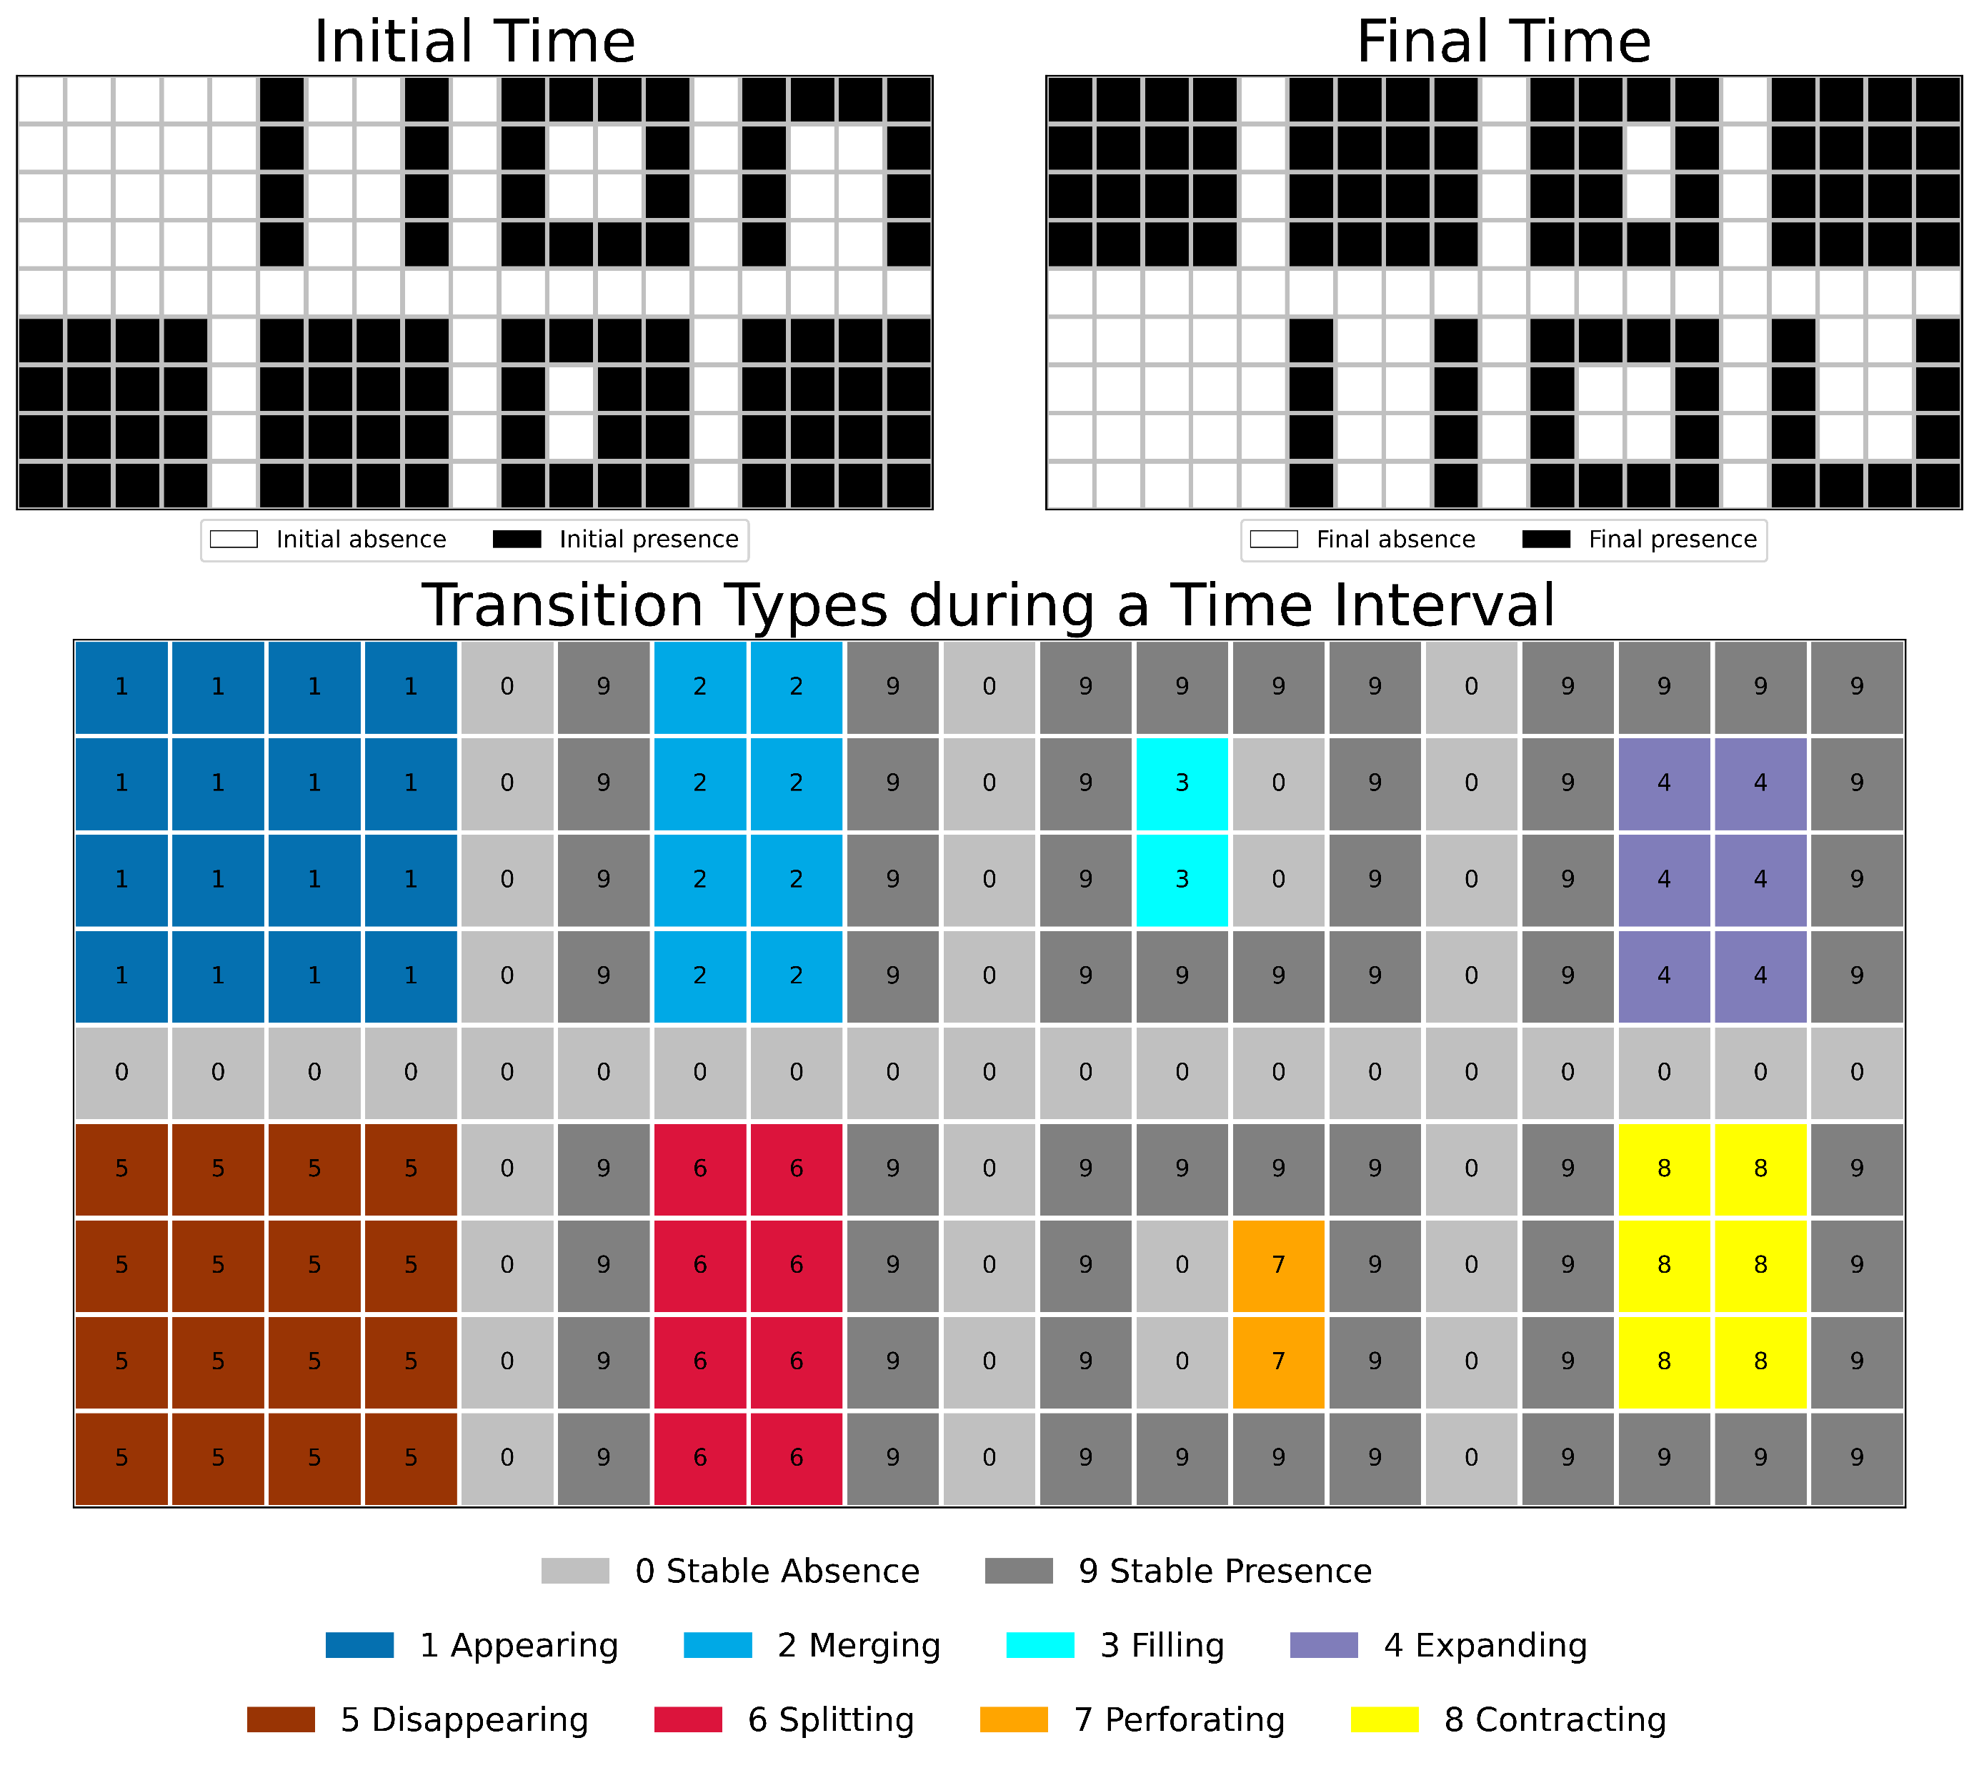
DynamicPATCH:
Spatially Explicit Dynamic PAtch Transition CHaracterization
Identification of transition types
Transition Type | Change type | Number of connected patch(es)* |  |  |  | Gross change in the number of patches
 |  | Initial Presence | Final Presence | Initial Exterior Absence | Final Exterior Absence
Appearing | Gain |  | 0 |  |  | Increase
Merging | Gain | >1 |  |  |  | Decrease
Filling | Gain | 1 |  |  | 0 | No gross change
Expanding | Gain | 1 |  |  | >0 | No gross change
Disappearing | Loss | 0 |  |  |  | Decrease
Splitting | Loss |  | >1 |  |  | Increase
Perforating | Loss |  | 1 | 0 |  | No gross change
Contracting | Loss |  | 1 | >0 |  | No gross change
DynamicPATCH identifies eight patch-based transition types that are mutually exclusive and collectively exhaustive
Characterizing patch-transition types: a designed example

Slide 10
DynamicPATCH
How does DynamicPATCH quantify gross changes?
Gross Gain in size:
Appearing: 16 Merging: 8
Filling: 2
Expanding: 6
Total: 32
Gross Loss in size:
Disappearing: 16
Splitting: 8
Perforating: 2
Contracting: 6
Total: 32
Notes:
How does dynamicpatch differ from traditional GIS overlay

Slide 11
DynamicPATCH
How does DynamicPATCH quantify gross changes?
Union patch: the union of Initial Presence and Final Presence
Change in number of patch in each union patch
= Number of Final Presence patches – Number of Initial Presence patches
+1
-1
0
0
Gross increase: +2
Gross decrease: -2
-1
+1
0
0

Slide 12
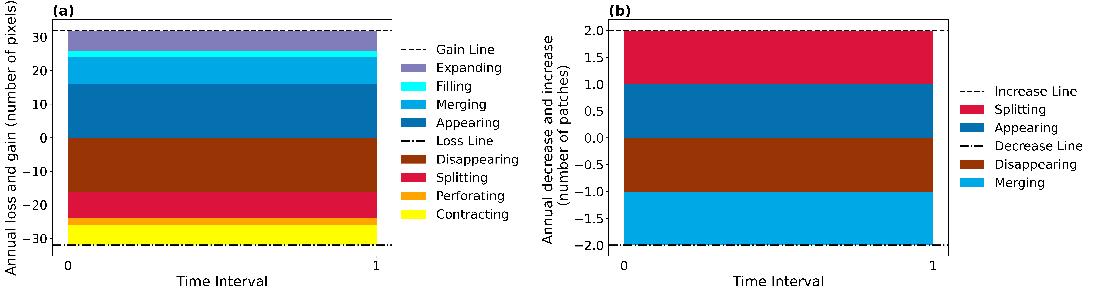
DynamicPATCH
How does DynamicPATCH quantify gross changes?

Slide 13
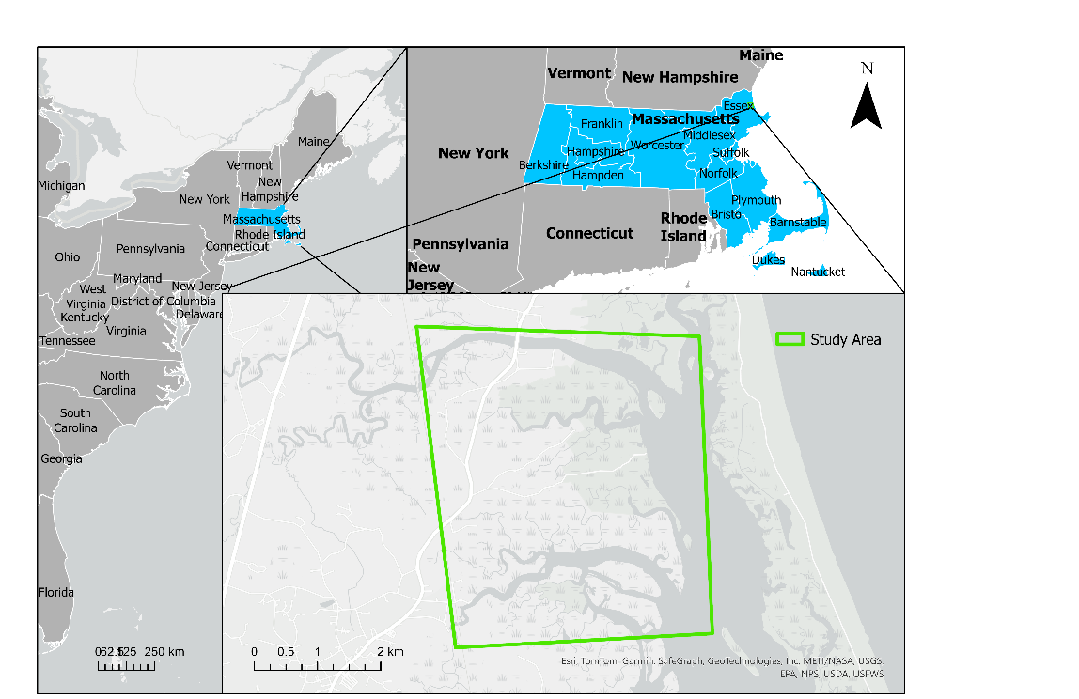
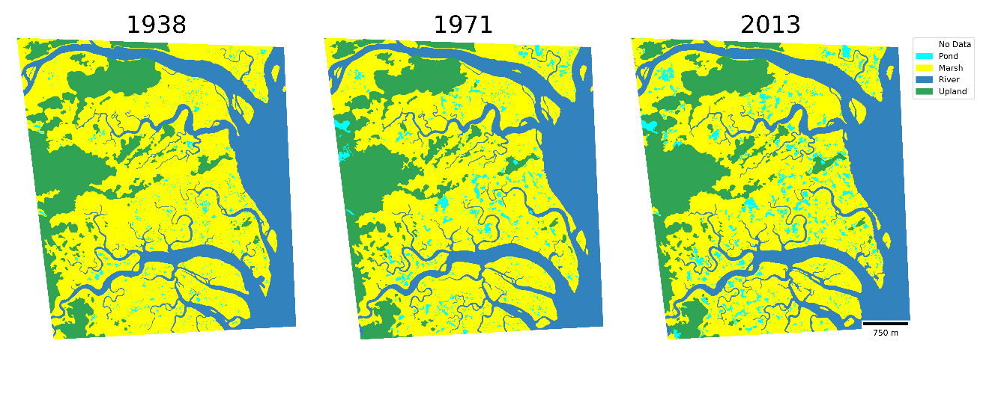
Case study at PIE-LTER
Study Area
Study area: Long Term Ecological Research Network’s Plum Island Ecosystems (PIE-LTER)

Slide 14
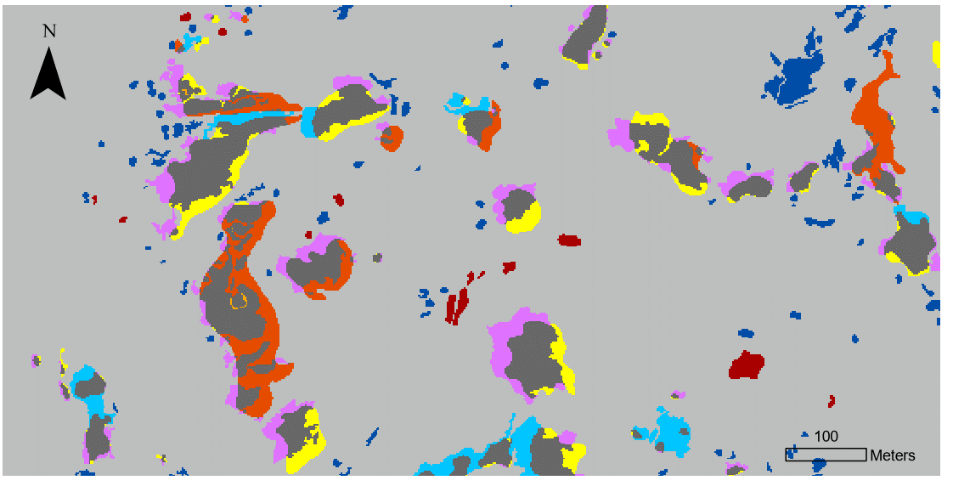
Case study at PIE-LTER
Results
1971
1971
2013
2013
Pond
Pond

Slide 15
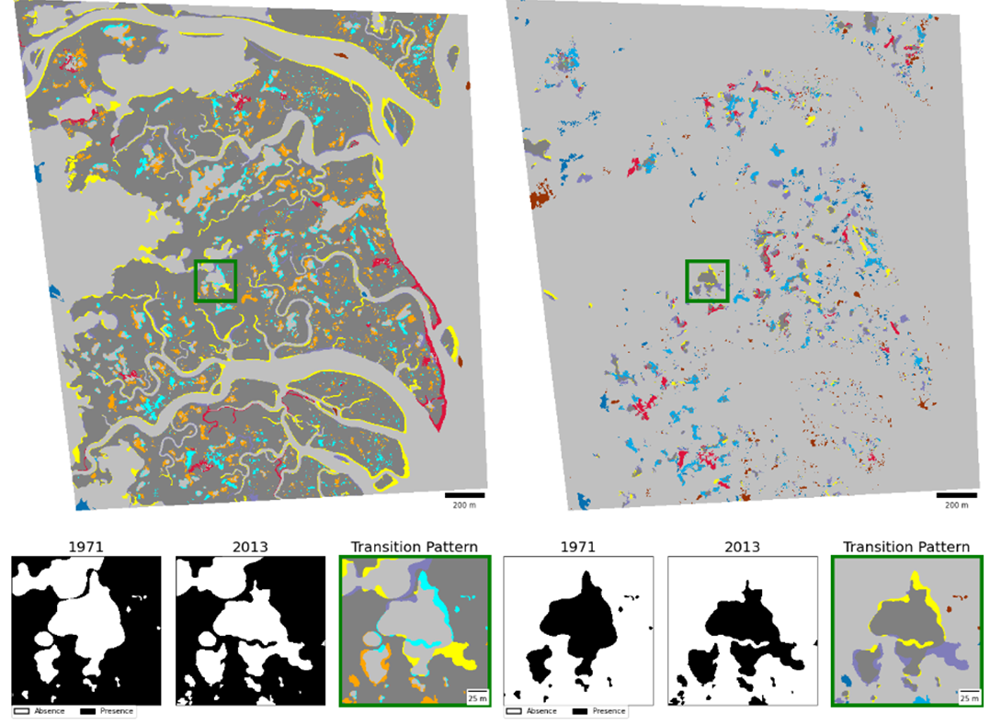

Case study at PIE-LTER
Results
Marsh
Pond
Marsh
Pond
1938 - 1971
1971 - 2013
DynamicPATCH creates maps of transition patterns in Marsh and Pond at PIE. Where each map shows two types of stable and eight types of transitions.

Slide 16
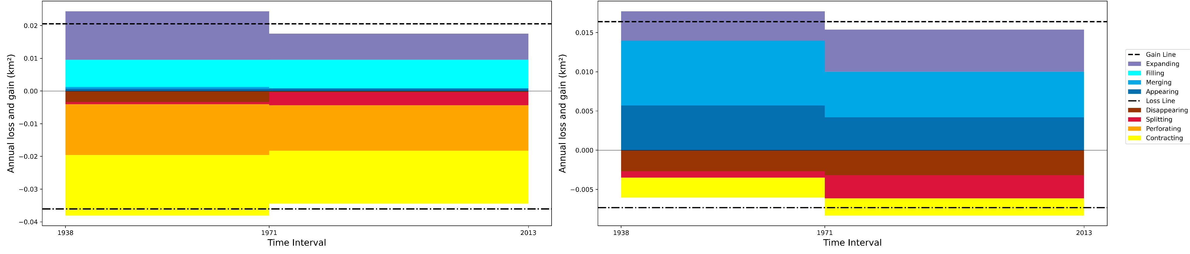
Case study at PIE-LTER
Results
DynamicPATCH quantifies annual gross change in both the area and number of patches, revealing gross changes that are much larger than net changes
Marsh
Pond
Perforating and Contracting account for most gross loss in Marsh area (89%); Expanding and Filling account for most gross gain in Marsh area (94%).
Gross gains of pond area are more than twice the size of gross losses of pond area.

Slide 17
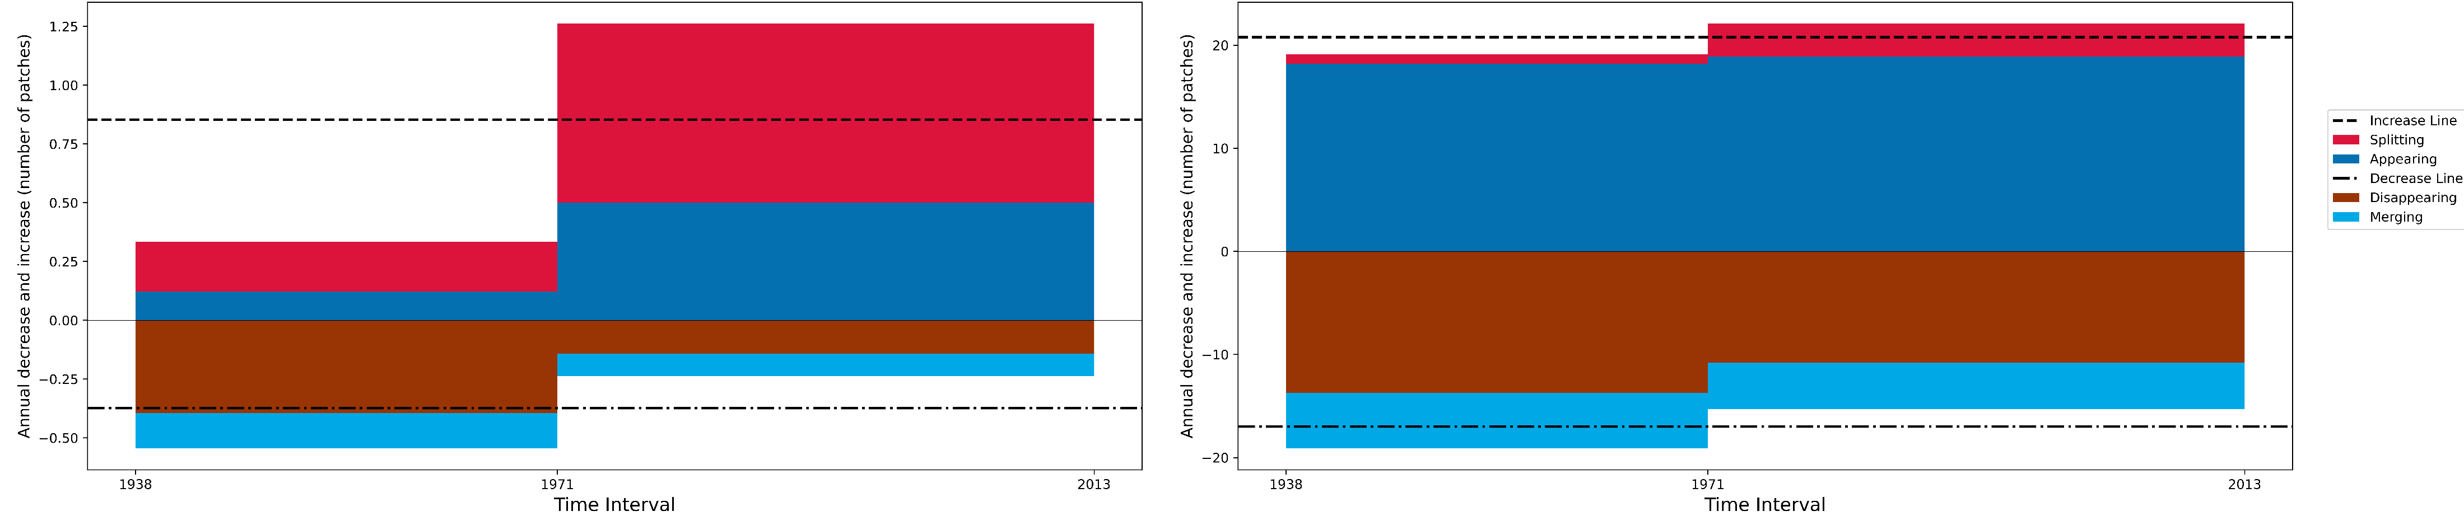
Case study at PIE-LTER
Results
DynamicPATCH quantifies annual gross change in both the area and number of patches, revealing gross changes that are much larger than net changes
Marsh
Pond
Annual gross increase in the number of Marsh patches during the second time interval is 3.8 times greater than during the first time interval
Appearing and Disappearing account for most gross change in number of Ponds, which is ten times greater than the net change in number of Ponds.

Slide 18
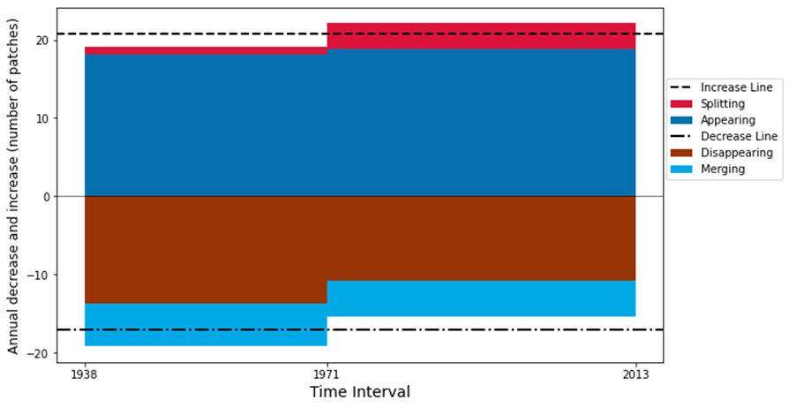
Discussions
DynamicPATCH captures gross changes that traditional methods miss by measuring only net change
Traditional methods shows Pond experienced 0 net change during 1938 – 1971.
DynamicPATCH shows Pond experienced dramatic changes in number of patches. Where gross increase equals gross decrease during 1938 - 1971, resulting in a net change of zero patches
Time Interval | Gross Increase | Gross Decrease | The sum of Gross Increase and Decrease | Net change in the number of patches
1938 - 1971 | 631 | 631 | 1262 | 0
1971 - 2013 | 928 | 643 | 1571 | 285
Sum | 1559 | 1274 | 2833 | 285
Number of patches and area of Pond at PIE at three years, which show net change but not gross changes

Slide 19
Discussions
Potential applications of DynamicPATCH
New approach in dynamic pattern analysis: Urban expansion pattern, disturbance pattern, forest fragmentation, etc.
New approach in connecting pattern and processes: drivers and impacts of disturbance patterns, change in species richness & movement patterns, etc.
Habitat fragmentation analysis and connectivity research
Map comparison
Land change modelling
You can use DynamicPATCH with any categorical maps with more than one time point.

Slide 20
Discussions
Challenges
Border effect: patches along the border of the spatial extent can be miss-characterized
Sensitivity to connectivity: using the 8-connectivity case or the 4-connectivity case will have different results
Impact of noise: Isolated pixels can impact results
Computationally expensive

Slide 21
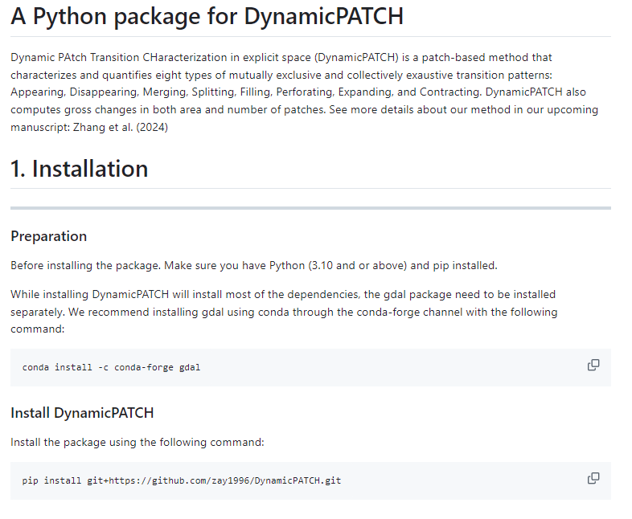
Where & how to use DynamicPATCH
DynamicPATCH can be applied using our open-source Python package available at https://github.com/zay1996/DynamicPATCH.git
Zhang, Aiyin, Robert Gilmore Pontius Jr, Thomas Mumuni Bilintoh, Florencia Sangermano, and John Rogan. 2025. “DynamicPATCH: Method and Software for Spatially Explicit Dynamic Patch Transition Characterization.” Landscape Ecology 40 (7): 132. https://doi.org/10.1007/s10980-025-02120-1.

Slide 22
Where & how to use DynamicPATCH
Step by step guide on preparing Python environment for installing DynamicPATCH:
Install Anaconda or Miniconda
  Which one should I choose?
Install Git (or run this line in your conda prompt terminal: conda install -c anaconda git)
Open Anaconda Prompt or terminal
Create a virtual environment using the following command
Activate the virtual environment
5. Install DynamicPATCH
conda create --name myenv python=3.10 # replace myenv with an environment name you want, specify Python version as 3.10, another version may lead to installation failure.
conda activate myenv # windows
source activate myenv # macOS
pip install git+https://github.com/zay1996/DynamicPATCH.git # public version
pip install git+https://github.com/zay1996/DynamicPATCH.git@developer-branch # developer’s version (recommend)
Zhang, Aiyin, Robert Gilmore Pontius Jr, Thomas Mumuni Bilintoh, Florencia Sangermano, and John Rogan. 2025. “DynamicPATCH: Method and Software for Spatially Explicit Dynamic Patch Transition Characterization.” Landscape Ecology 40 (7): 132. https://doi.org/10.1007/s10980-025-02120-1.
Notes:
+ git installation step

Slide 23


Where & how to use DynamicPATCH
You should use a Python IDE to run DynamicPATCH unless you want to do everything in a terminal.
I recommend using either of these two: JupyterLab or VS Code
Installing JupyterLab: In your Anaconda Prompt terminal, run conda install jupyterlab under your environment, then run jupyter lab after installation
Installing VS Code: https://code.visualstudio.com/download
Zhang, Aiyin, Robert Gilmore Pontius Jr, Thomas Mumuni Bilintoh, Florencia Sangermano, and John Rogan. 2025. “DynamicPATCH: Method and Software for Spatially Explicit Dynamic Patch Transition Characterization.” Landscape Ecology 40 (7): 132. https://doi.org/10.1007/s10980-025-02120-1.

Slide 24
Where & how to use DynamicPATCH
Running DynamicPATCH using command line:
import os
import dynamicpatch
from dynamicpatch import main
package_dir = os.path.dirname(os.path.abspath(dynamicpatch.__file__)) # find directory of the package
## specify the parameters
main.run_dynamicpatch(
workpath = package_dir + '/static/example.xlsx',
year = [0,
1
],
in_nodata = -1, # optional, default = 0
connectivity = 8, # optional, default = 8
targ_pre = 1, # optional, default = 1
study_area = None, # optional, default = None
map_show = True, # optional, default = True
chart_show = True, # optional, default = True
unit = None, # let program decide automatically
log_scale = True, # optional
export_map = False, # optional, default = True
width = 0.35 # optional, default = 0.35
)
Zhang, Aiyin, Robert Gilmore Pontius Jr, Thomas Mumuni Bilintoh, Florencia Sangermano, and John Rogan. 2025. “DynamicPATCH: Method and Software for Spatially Explicit Dynamic Patch Transition Characterization.” Landscape Ecology 40 (7): 132. https://doi.org/10.1007/s10980-025-02120-1.

