Slide 1

Project PORTFOLIO

Slide 2
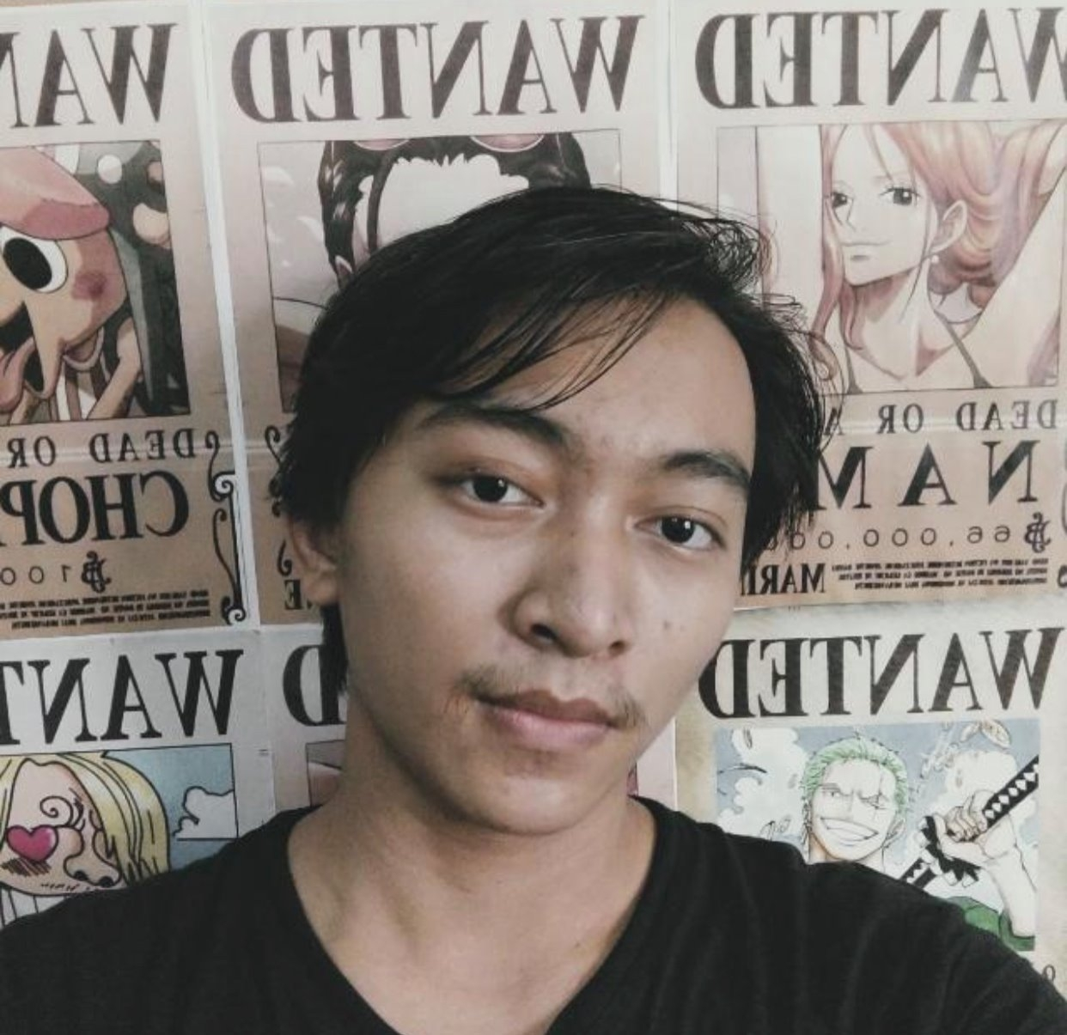
ABOUT Me
My Name Is ZayarMoeKaung,
Studies Software Engineering Diploma in University of Yangon. Been working on freelance web projects ever since I graduated. Currently as a Full Stack Web Developer in Noshikumi - Chums Solutions Myanmar.
Developed awesome web applications using latest frameworks and technologies.

Slide 3
Skill set
Front End
Development
Back End
Development
DevOp
Develop frontend UIs using HTML, CSS , SASS , Bootstrap and JS as well as JS frameworks like vue, react.
Develop Back End Server / APIs using Languages and frameworks like PHP, Laravel, Flask , Ruby on Rails and DBMS like MySQL , MongoDB , Dynamo DB
Create , Configure and maintain web servers on AWS.
Take part in making CI/CD pipelines and deployment.

Slide 4

projects
I will show case the recent projects in which I'm responsible for entirely
Or Highly contributed

Slide 5

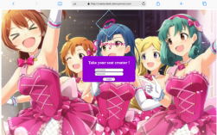
Three picture collage
Otamm
http://www.otamyanmar.com
Status – developing , not published
Type - freelance project
My Contribution - Full Stack / DevOp
A fan website which will upload manga/comic/web novel reviews and articles. Developing using Laravel as backend and simple HTML , CSS, JS frontend UI for lighter and faster performance.

Slide 6
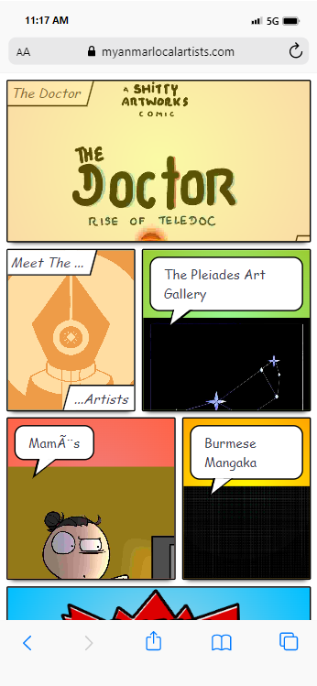
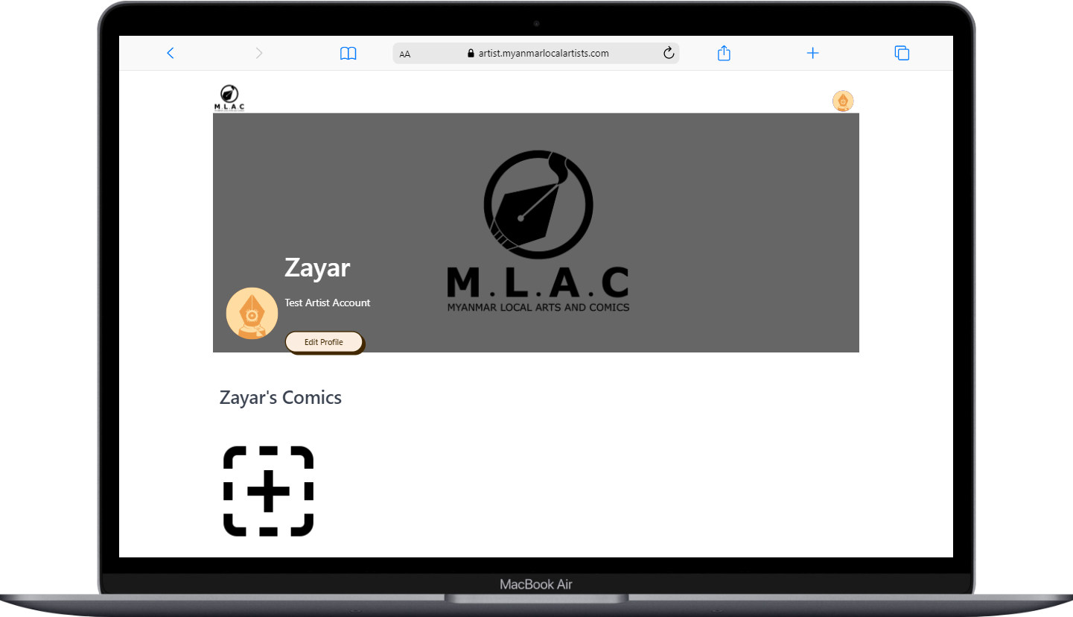
MLAC
www.myanmarlocalartists.com
artist.myanmarlocalartists.com
Status – published, soft lunched
Type - freelance project
My Contribution - Full Stack / DevOp
Comic website developed for an artist group in Myanmar (MLAC). An aesthetic comic book UI for client side comic reader and artist website where artists can create accounts and upload their works.
Developed Using Laravel backend and HTML, CSS , JS UI.

Slide 7
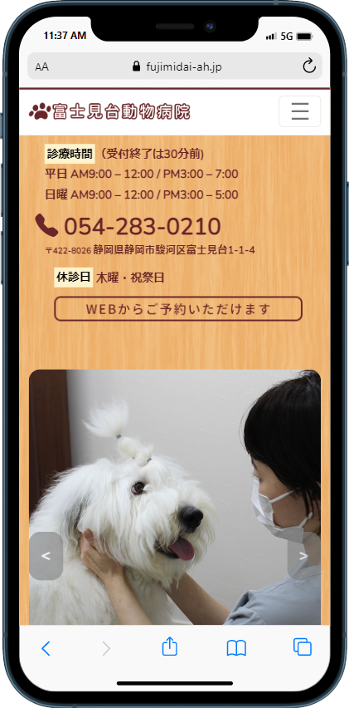
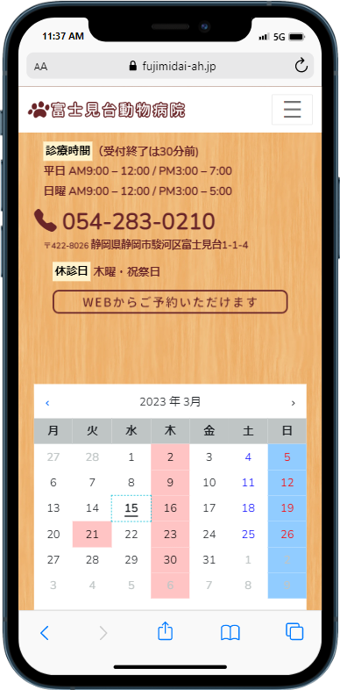
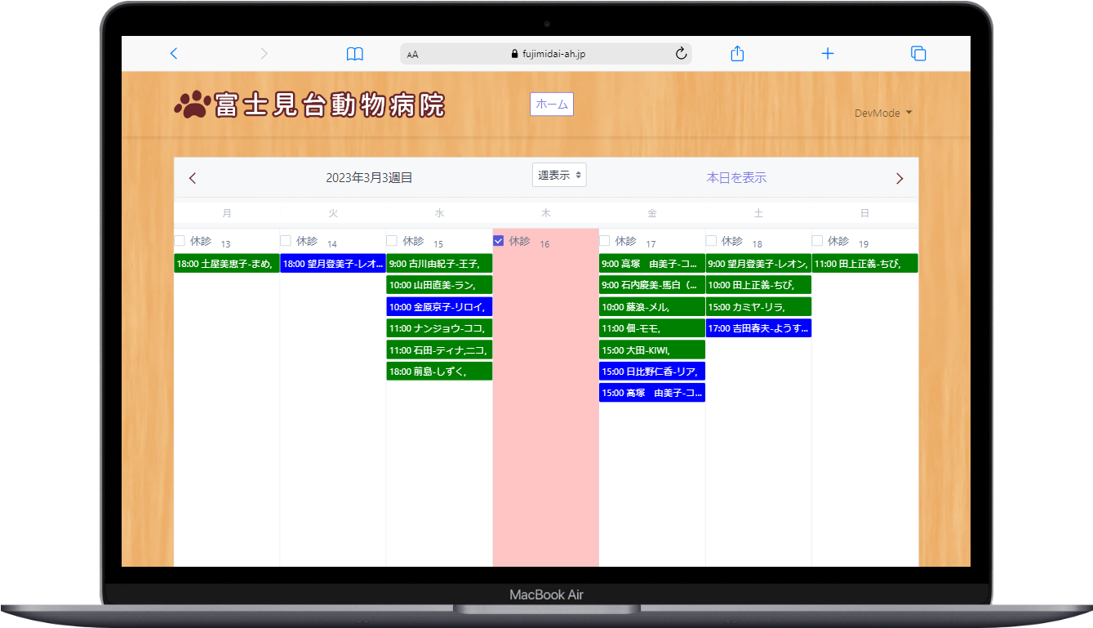
Fujimaidai
https://fujimidai-ah.jp
Status – published
Type - Project of Noshikumi – Chums Solutions
My Contribution - UI for Home page ,
Booking System (client side + admin dashboard)
Website for Fujimaidai Animal Hospital in Japan. I've developed UI for WordPress home page and booking appointment system with client side web app and admin dashboard using PHP/Laravel as backend , HTML , CSS, JS and Bootstrap for UI.

Slide 8
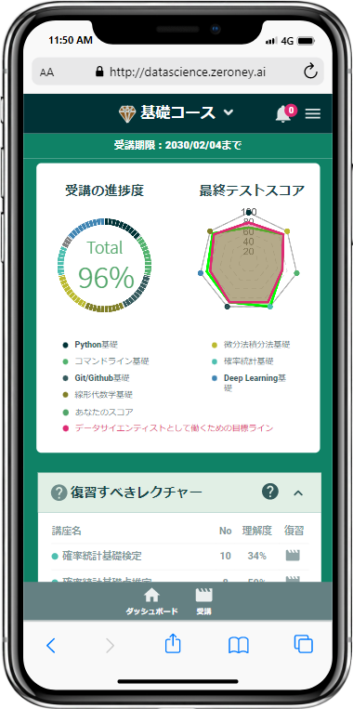
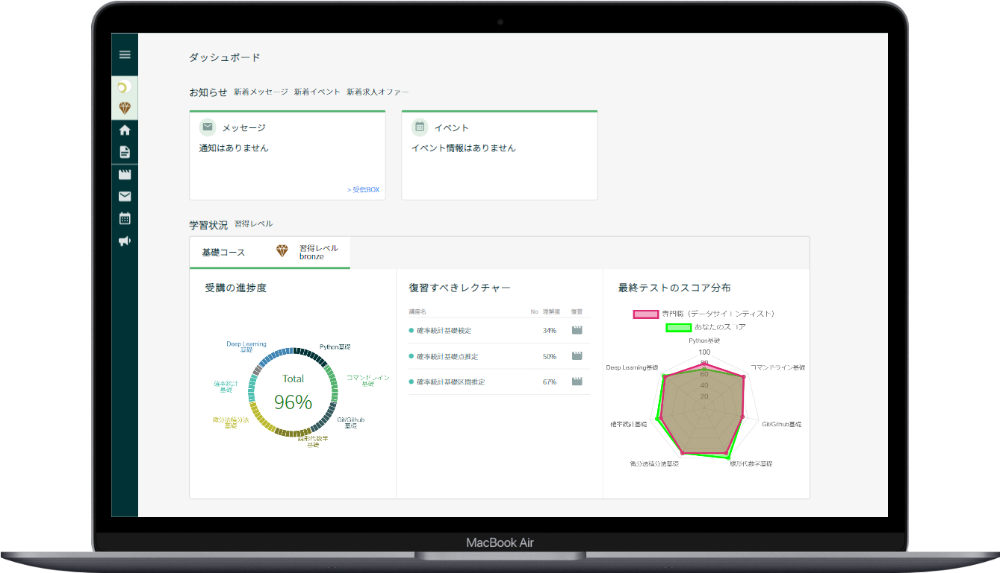
Zeroney
http://datascience.zeroney.ai/
Status – published
Type - Legacy Project of Noshikumi – Chums Solutions
My Contribution - Mobile UI
A LMS website for a Zeroney. I've developed entire mobile UI for the website as well as modify the backend methods a bit to work well with mobile UI. Develop using Ruby on Rails as backend and HTML, SCSS , JS and some JS libraries.

Slide 9
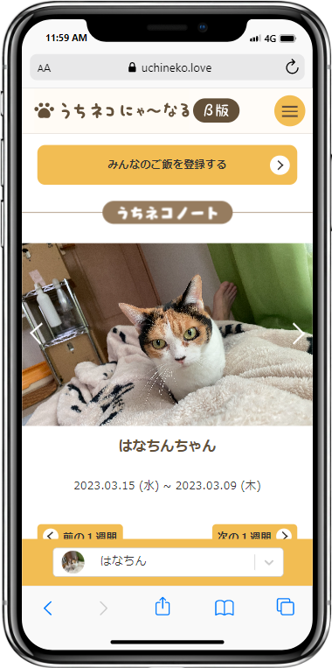
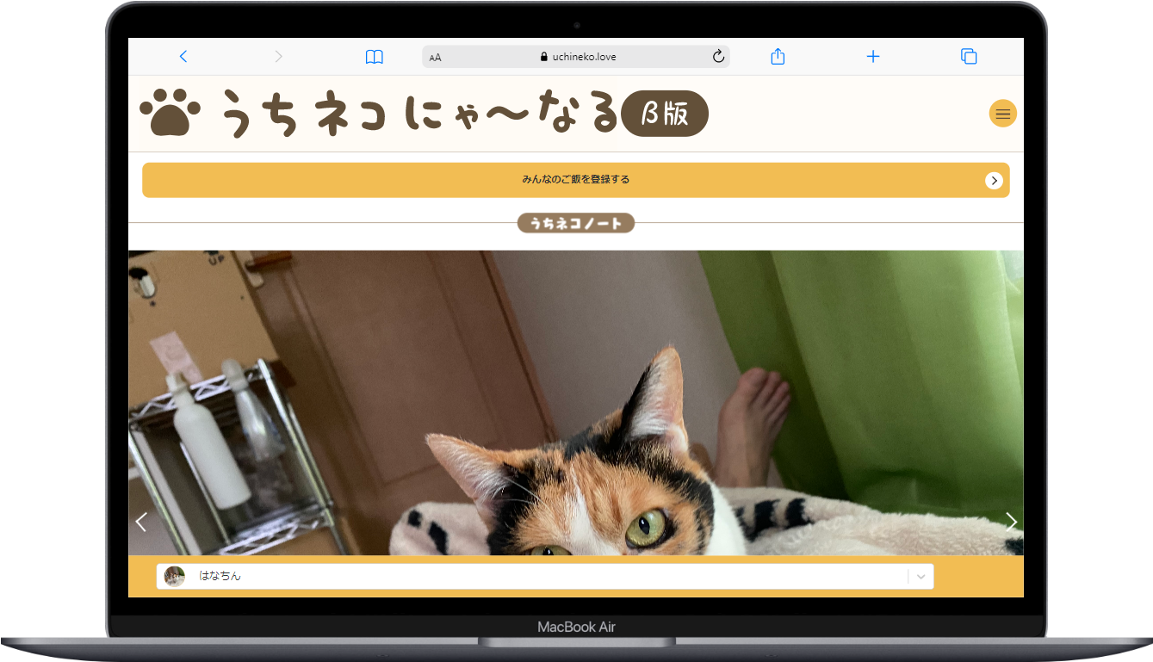
Uchineko
https://uchineko.love/
Status – Developing , not published
Type - Legacy Project of Noshikumi – Chums Solutions
My Contribution - Refactoring , Implementing New Features
Japanese website for monitoring and recording pet's activities. I'm responsible for refactoring the codes to get better and faster performance also design and implement new features .
Develop using Python Flask as backend and react.js as frontend UI.

Slide 10
THANK YOU
zayarmoekaung0@gmail.com
+95 997 542 7773

