Slide 1

SRM INSTITUTE OF SCIENCE AND TECHNOLOGY
HOME WIRELESS NETWORK
SUBMITTED BY:
RA2011003011177 SIDDHARTH PATEL
RA2011003011175 AYUSH DOGRA
RA2011003011176 YASH VEER SINGH
RA2011003011178 ZAYD HASSAN
RA2011003011150 SM FAHAD JAAN

Slide 2
CONTENT
Introduction
History
Need
Wifi
Advantages
Future
Network Topology Diagram
Ping command Screenshot

Slide 3
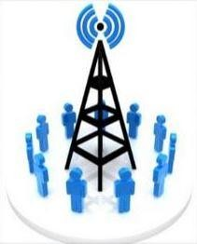
INTRODUCTION TO WIRELESS NETWORK COMMUNICATION
One of the medium of communication
Transfer without conductor
of information any electrical
Used for both long & short distances
Radio frequency, Infrared light, Laser light etc. is used.

Slide 4
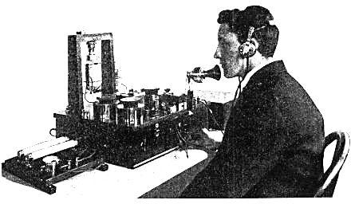
HISTORY OF WIRELESS COMMUNICATION
Wireless telephone conversation occurred in 1880 using ‘photo phone’.

Slide 5

NEED OF WIRELESS COMMUNICATION
Communicating with each other and sharing information
For a business deals
Remote medical
access to records by a
a
paramedic may save life
At the time of disaster

Slide 6
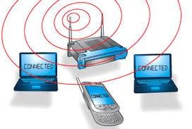
WIRELESS NETWORK WI-FI
Popular over the past few years
A wireless local area network
Portable computing devices to connect easily to the internet

Slide 7
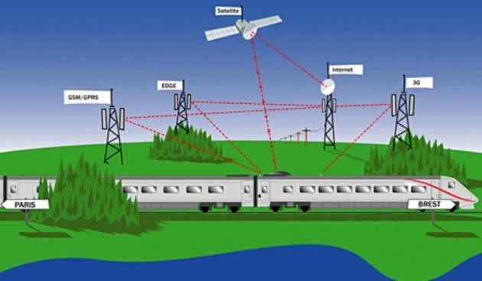
ADVANTAGES OF WIRELESS NETWORK
Used for both short & long distances
Can be used in any condition like disasters
Easy mobility of the devices
Low maintenance and no additional cost of rewiring

Slide 8
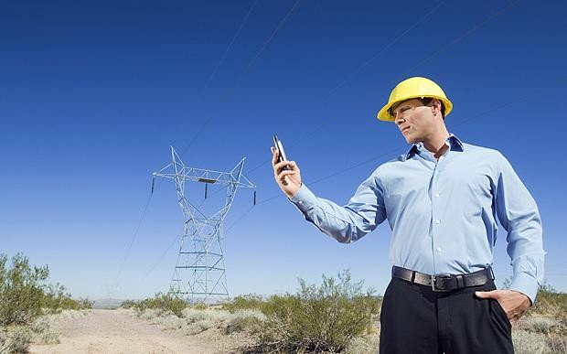
FUTURE OF WIRELESS NETWORK
Some improvement to be done:-
Has to be made more secured
Eco friendly and non-risky ways to be find out
Speed to be increased

Slide 9
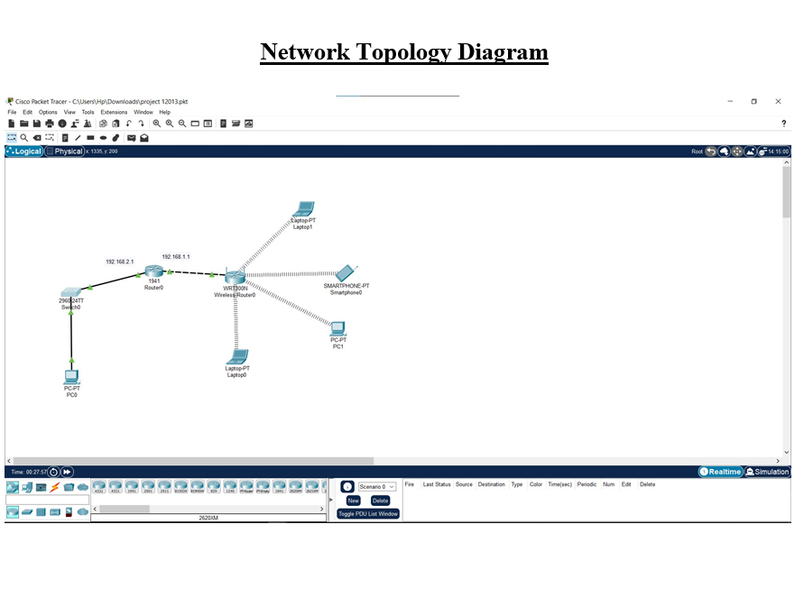
Output Screenshot

Slide 10
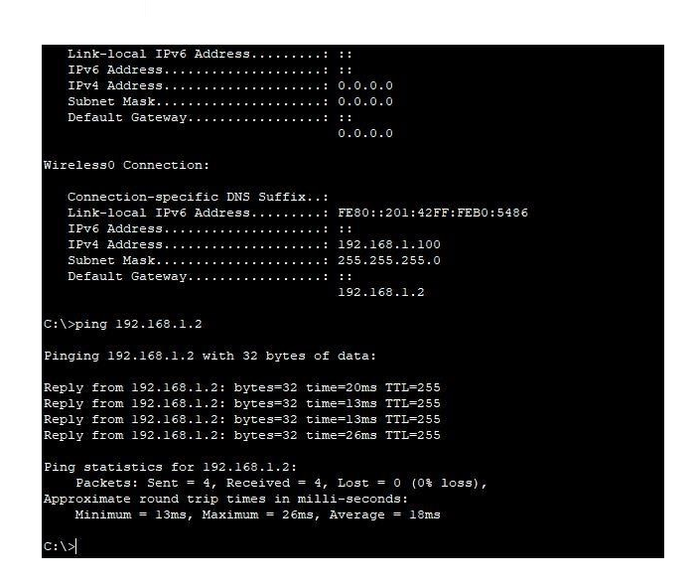
Ping Command Screenshot

