Slide 1
Customer Shopping
Behavior Analysis
From raw customer records to actionable business insights
PYTHON
MYSQL
POWER BI
PROJECT WALKTHROUGH • DATA → ANALYSIS → DASHBOARD

Slide 2
01 / OVERVIEW
Project at a glance
What can shopping data tell us about customer behavior?
3,900
18
This project explores spending patterns, product preferences,
review ratings, discount usage and subscription behavior using a
workflow across Python, MySQL and Power BI.
records in dataset
source columns
37
3 tools
missing review ratings
end-to-end workflow
PROJECT OBJECTIVES
Compare customer segments
Gender, age group, subscription and shipping type.
Support decisions with evidence
Dataset: customer_shopping_behavior.csv
Records are described as dataset rows; transaction-level interpretation
should be validated.
Use SQL results and a dashboard to communicate patterns.
02

Slide 3
02 / METHOD
A repeatable analytics workflow
01
02
03
04
PREPARE
→
STORE
→
ANALYZE
→
COMMUNICATE
Python + Pandas
MySQL
MySQL Workbench
Power BI
Inspect structure, review nulls and
duplicates, create analytical
features.
Load the cleaned DataFrame into
customer_behavior for SQL
analysis.
Answer 10 business questions with
aggregates, CASE, CTEs and
window functions.
Build KPI cards, category and
age-group charts, plus interactive
slicers.
Outcome: one connected workflow from data preparation to interactive reporting.
03

Slide 4
03 / DATA PREPARATION
Preparing the data for analysis
37
Missing review ratings
null Review Rating values
Filled with the median Review Rating within each product category.
Age group feature
0
Created age_group using quartiles of the age distribution; groups are dataset-relative.
duplicates reported
Purchase-frequency feature
Mapped labels to approximate day intervals (e.g., Weekly = 7, Bi-Weekly = 14, Monthly = 30).
2
Column decision
engineered columns
Removed promo_code_used from the working DataFrame; this can limit promotion-specific analysis because it may differ
from discount_applied.
04

Slide 5
04 / SQL ANALYSIS
SQL turned questions into evidence
AGGREGATIONS
SUBQUERIES
CASE WHEN
CTEs
WINDOW FUNCTIONS
01
Revenue by gender
02
Discounted purchases ≥ average
03
Top 5 products by rating
04
Standard vs Express spend
05
Subscribers vs non-subscribers
06
Products with highest discount rate
07
New / Returning / Loyal segments
08
Top 3 products in each category
09
Repeat buyers and subscription
10
Revenue by age group
Queries were written and executed in MySQL Workbench against customer_shopping_behavior.
05

Slide 6
05 / FINDINGS
What the results show
233K
$59.76
3.75
27%
total purchase amount shown
average purchase amount shown
average review rating
subscription = Yes (shown)
PURCHASE AMOUNT BY CATEGORY (APPROX.)
SUBSCRIPTION COMPARISON
Clothing
104K
$59.49 vs $59.87
Accessories
74K
Average spend is slightly lower for subscribers than
non-subscribers in the query results.
Footwear
36K
Outerwear
19K
Association ≠ causation
06

Slide 7
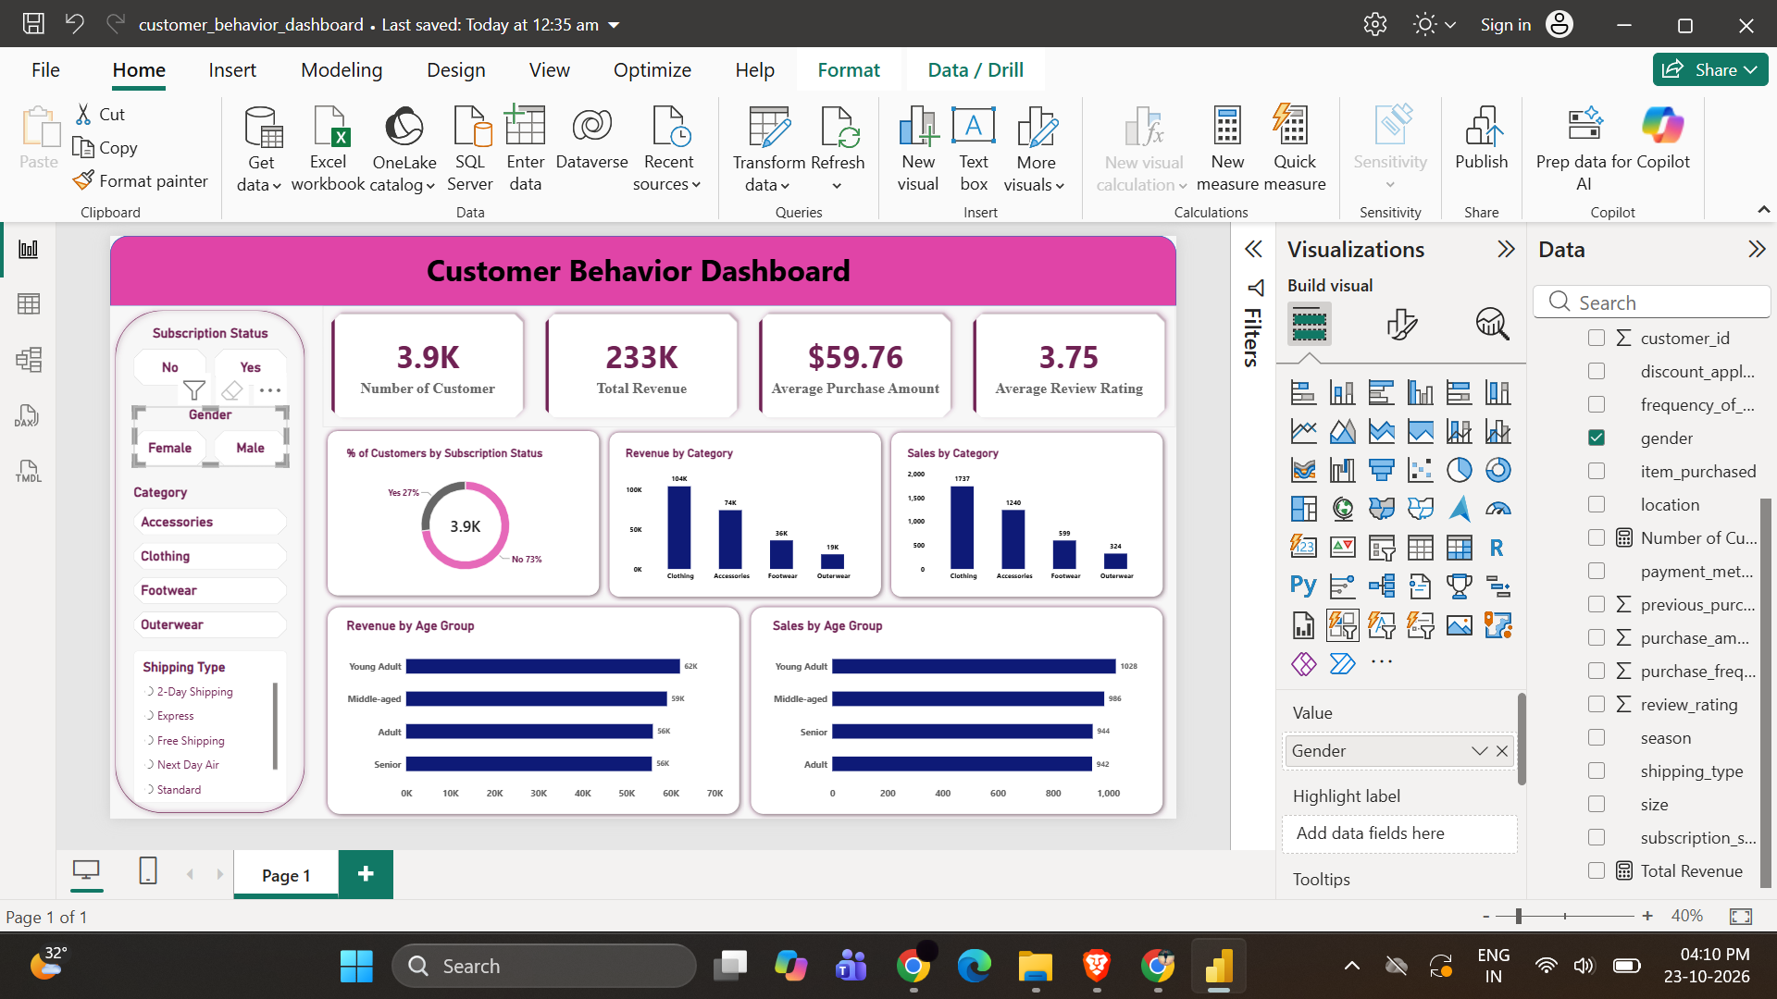
06 / THE DASHBOARD
One view. Multiple ways to explore.
KPIs, category comparisons, age groups and interactive slicers

Slide 8
07 / RECOMMENDATIONS
From analysis to action
Explore subscription growth
Build customer loyalty
01
02
Test subscriber benefits and measure conversion; current data does not
prove subscription causes higher spend.
Use purchase-history segments to test rewards for returning customers.
Review discount strategy
Merchandise with evidence
03
04
Compare discount rates with revenue and, if available, profit margins
before changing promotions.
Feature high-rated and popular products, while monitoring results by
category.
Thank you •
08

