Slide 1








Masar Health + Thaniya
Right Patient. Right Care. Right Place. Right Time.
FlowCare / MED-GWPYB3
Healthcare Crowd & Patient Flow Management
Filter 2: Prototype • Demonstration with simulated data

Slide 2
Contents
01
Problem & Solution
05
Prototype
09
Adoption & Sustainability
02
Evidence of Need
06
10
Data & Tools Used
Business model
03
07
11
Next Steps
How It Works
Testing & Validation
04
Innovation & Alternatives
08
12
Feasibility & Risks
Team & Sources

Slide 3
Problem & Solution
Problem
During mass gatherings, patients may choose care without knowing clinical urgency or facility capability. Sudden casualty surges add pressure on emergency teams and receiving hospitals.
Solution
Masar combines structured symptom screening with care routing. Thaniya adds a simulated casualty coordination workflow. Clinical urgency takes priority over congestion. The prototype supports decisions and does not diagnose.

Slide 4
Evidence of Need
WHO identifies sudden demand beyond local medical resources as a defining challenge in mass casualty incidents. [1]
WHO guidance for mass gatherings emphasizes planning, emergency preparedness and coordinated response. [2]
Our design hypothesis: combining urgency, facility capability and capacity visibility may improve coordination.
Evidence gap: no local demand dataset, interviews or measured patient outcomes yet. We make no quantified impact claim.
Notes:
Sources: https://www.who.int/teams/integrated-health-services/clinical-services-and-systems/emergency-and-critical-care/mass-casualty-management and https://www.who.int/activities/managing-health-risks-during-mass-gatherings. These sources support the problem context only.

Slide 5
How It Works
1. Select a language, age group and gathering location.
2. Answer structured symptom and red-flag questions.
3. The server applies demo urgency rules and filters facility capability before considering travel time and simulated load.
4. Thaniya records dispatch, reserves capacity and confirms hospital handover.
5. The command center displays saved demo activity and simulated surge scenarios.
Emergency urgency takes priority over congestion. These rules require clinical validation before operational use.

Slide 6
Innovation & Alternatives
Existing approaches
Routine and incident triage protocols already exist, including WHO IITT. [3] Maps help locate facilities, while coordination teams manage transport and receiving capacity.
Our proposed contribution
One demonstrator connects patient screening, capability-aware routing, incident status and command-center visibility. Low-acuity cases can be explored separately from emergency pathways.
Differentiation remains a hypothesis. We do not claim to be the first Saudi solution or to outperform deployed systems.
Notes:
Reference: https://www.who.int/tools/triage . The prototype does not claim implementation or validation of WHO protocols.

Slide 7
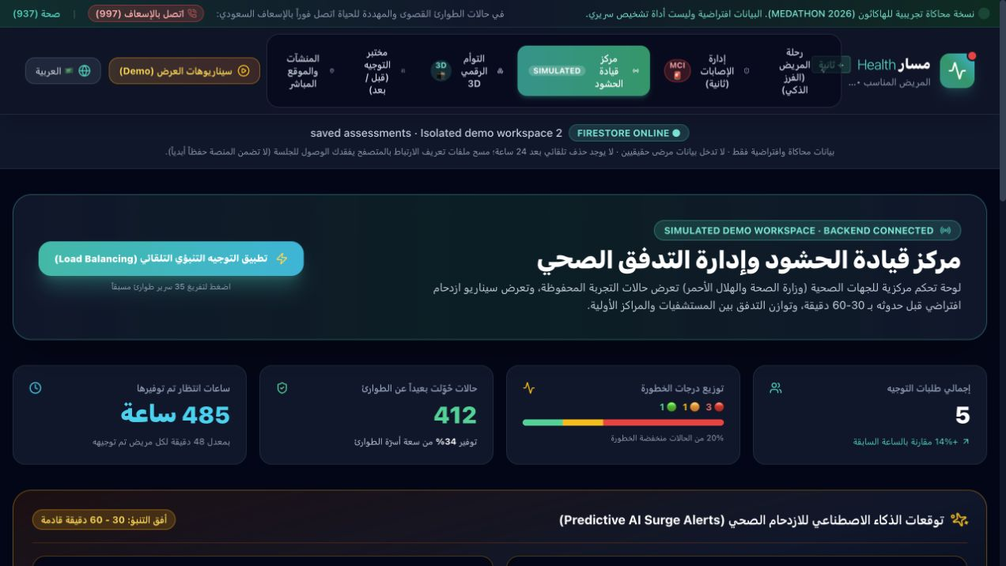
Prototype / Proof of Concept
Working web prototype: patient screening, casualty coordination, command center, routing lab and a 3D demonstration.
The public frontend calls an Express backend. Tests cover saved assessments and casualty handover.
All patient cases, capacities and forecasts are simulated. No live hospital or ambulance integration.
https://masar-thaniya-flowcare.ai.studio/
Notes:
Actual application screenshot captured on 10 November 2026. Synthetic demonstration data only.

Slide 8
Data & Tools Used
Frontend: React and TypeScript with Vite; Firebase anonymous sign-in provides a browser-persistent demo identity.
Backend: Express verifies the Firebase ID token, applies demo triage and coordinates dispatch and handover. Firestore REST stores each owner's workspace with atomic version-checked updates.
Controls: owner-isolated rules, input validation, stale-write rejection and duplicate-handover protection. Owners can modify their own synthetic workspace; this is not clinical authentication.
Retention: no automatic 24-hour deletion. Clearing browser/site data can lose access. Permanent retention is not guaranteed.
Scope: simulated data only. No clinical validation or real hospital/ambulance integration. SQLite is an explicit local test option.

Slide 9
Testing & Validation
Verified on 10 November 2026
Public API connectivity, high- and low-acuity demo paths, and saved state after browser reload. Hospital handover updated occupied and reserved beds together.
Automated technical checks
HTTP integration tests, TypeScript checks and production build passed. Tests cover isolated workspaces, stale writes, red flags and duplicate handover.
What this demonstrates
A working frontend and backend for synthetic scenarios.
Not yet established
Clinical accuracy, field usability, predictive performance, real integrations or improved patient outcomes.

Slide 10
Feasibility & Risks
Requirements
A clinical lead, EMS and hospital workflow owners, secure hosting, verified capacity feeds and an agreed escalation process.
Main risks and proposed controls
Under-triage: clinician-approved rules, red-flag escalation and prospective safety tests.
Stale capacity: timestamps, expiry rules and manual confirmation.
Connectivity loss: clear fallback instructions and coordinator oversight.
Privacy and misuse: minimum data, access controls and audit logs before any real deployment.
The current prototype is for demonstration, not clinical operation.

Slide 11
Adoption & Sustainability
Beneficiaries: pilgrims and visitors, field teams, hospital coordinators and event command centers.
Potential adopters: health clusters, event medical providers and emergency coordination organizations. No partnership or purchasing commitment is confirmed.
Adoption route: supervised simulation, usability review, then an authorized pilot with clinical governance.
Value to measure: routing time, capability mismatches, workload distribution and safety failures.
Sustainability proposal: an institutional subscription or event contract covering support, hosting and integrations. Pricing and willingness to pay remain untested.

Slide 12
Business model
Key Partners
Key Activities
Value Proposition
Customer Relationships
Customer Segments
Potential EMS and hospital partners
Event operators
Clinical reviewers
Workflow design
Safety testing
Integration maintenance
Urgency-aware routing
Shared incident status
Capacity visibility
Benefits require pilot evidence
Pilot onboarding
Training and support
Feedback reviews
Health clusters
Event medical providers
Emergency coordinators
Patients use the service
Key Resources
Channels
Clinical oversight
Engineering
Verified facility data
Event partnerships
Institutional pilots
Direct procurement
Cost Structure
Revenue Streams
Hosting and API usage, engineering, clinical review, security, integration and training
Proposed annual institutional subscription or event license. No revenue or validated price yet.

Slide 13
Next Steps
1. Clinical review — Ola
Recruit an emergency-care reviewer and define a synthetic test set with expected pathways.
2. Visitor and usability checks — Ghaida
Test Safari, Chrome and WhatsApp entry on independent devices. Record completion and failure points.
3. Incident simulation — Alanoud
Run a tabletop surge exercise with explicit capacity changes and handover events.
4. Engineering and pilot readiness — Zayed
Resolve defects, review privacy and arrange an authorized pilot. All milestones are proposed, subject to reviewer and partner availability.

Slide 14
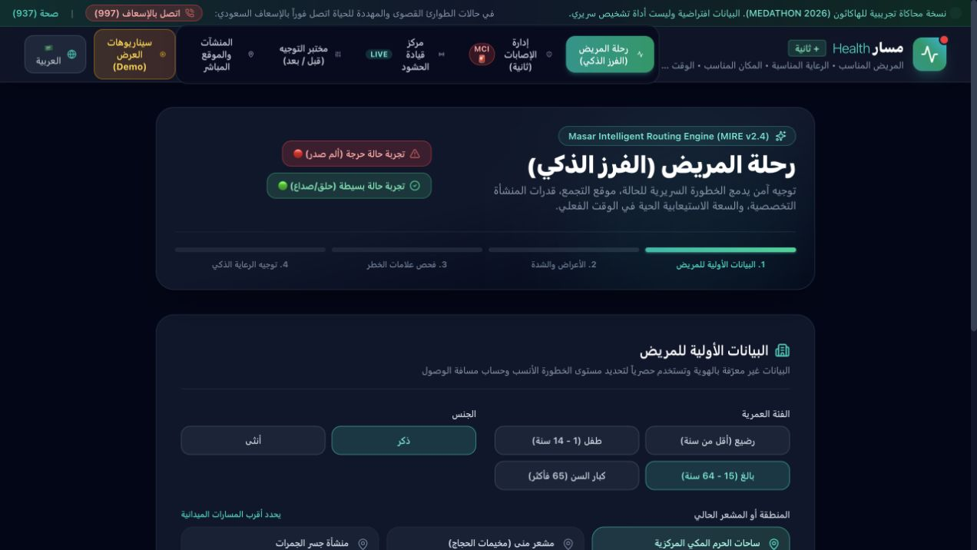
Team Members
FlowCare: proposed project responsibilities
Ola Mustafa
Alhashim
Clinical review
coordination
غيداء
عمر
الشريف
User research
and usability
Alanoud Khalid
Albanna
Incident workflow
and testing
Zayed Mohameed
alnefaie
Product and
prototype delivery

Slide 15
Sources
[1] WHO: Mass Casualty Management
https://www.who.int/teams/integrated-health-services/clinical-services-and-systems/emergency-and-critical-care/mass-casualty-management
[2] WHO: Managing health risks during mass gatherings
https://www.who.int/activities/managing-health-risks-during-mass-gatherings
[3] WHO: Interagency Integrated Triage Tool
https://www.who.int/tools/triage
References checked 10 November 2026. They support the problem context, not clinical validation of this prototype.
Live demonstration and source code links appear on the final slide.
Notes:
References verified 10 November 2026. WHO IITT is a facility-based tool and is cited as an existing alternative, not as a claim that this prototype implements or validates WHO protocols.

Slide 16
Demo & Technical Review
FlowCare / MED-GWPYB3
Live Demo
https://masar-thaniya-flowcare.ai.studio/
GitHub: Frontend + Backend source and tests
https://github.com/zayedalnefaie-spec/masar-thaniya-medathon

