Slide 1
Morse Code encoder
Jonathan Ceis
ENGR121 – Spring 22 – Final Project

Slide 2
Project Objective
Integrate a computer, microprocessor, and amateur radio to facilitate the encoding and transmission of morse code.

Slide 3
Inspiration & Concept
General Class Amateur Radio License Issued 3/4/2019
Morse code is a common method of communicating on Amateur radio bands
Amateur radio has a long history of experimentation and many major wireless advancements

Slide 4
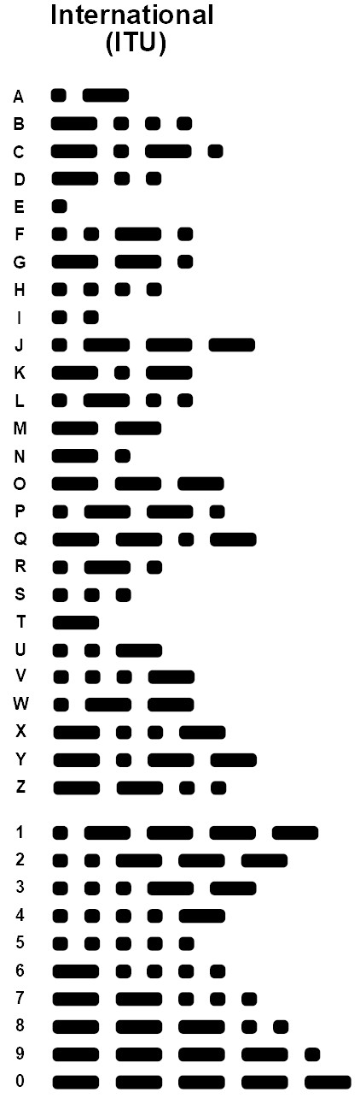
Morse Code Basics
Morse code is comprised of short (dit) and long (dah) 1kHz tones
Each character is comprised of at least 1 or more tones evenly spaced between silent periods.

Slide 5
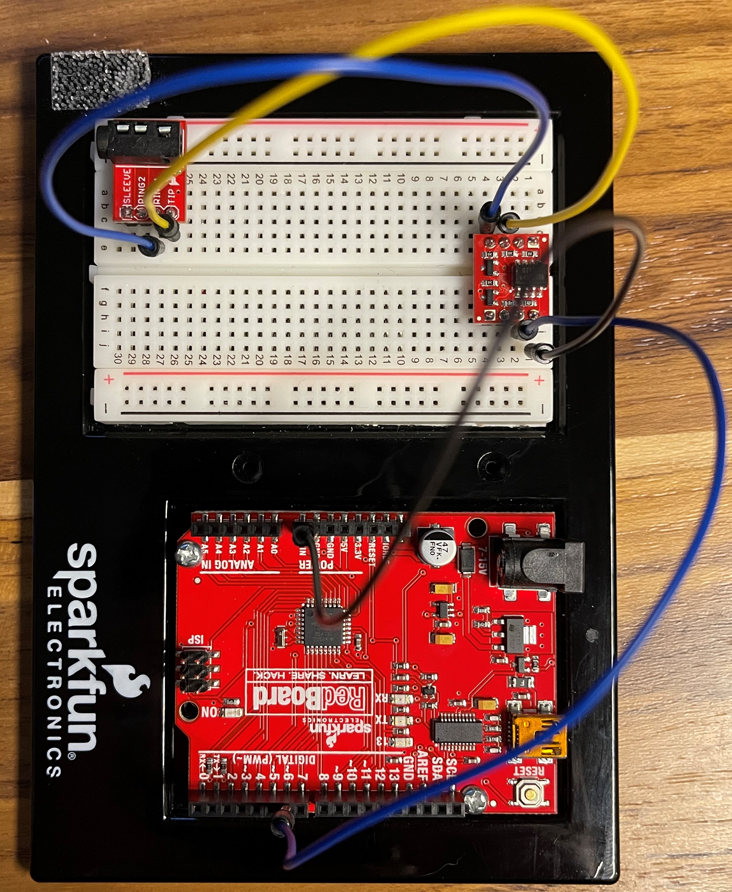
Architecture - Circuit
A computer is connected to a SparkFun Redboard via USB
The Morse code is sent from a Redboard output pin using PWM
That signal is relayed to the amateur radio via an opto isolator.
Notes:
An opto isolator is a component that allows a signal to be passed between two separate circuits without there being an electrical connection between the circuits
It essentially is a very small LED and photo resistor packaged inside of a chip.
The input powers the LED which in turn changes the resistance of the photo resistor on the other side of the chip
This is what allows the signal to be passed without an electrical connection

Slide 6
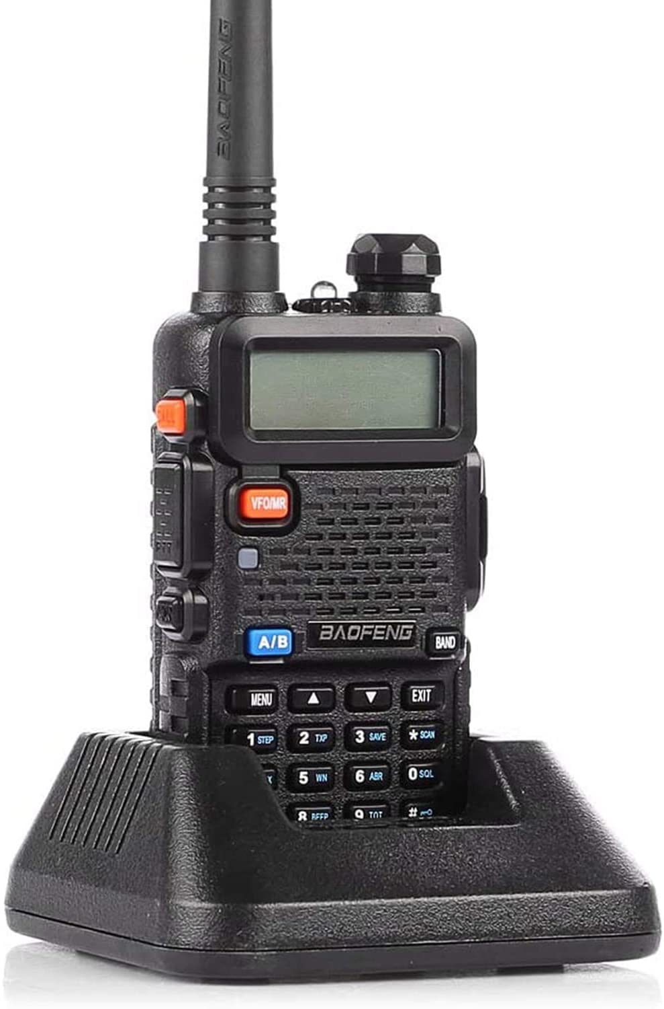
Architecture - Circuit
The Redboard and radio is interfaced via a custom audio cable
A Baofeng UV-5R radio will transmits the morse code communications

Slide 7
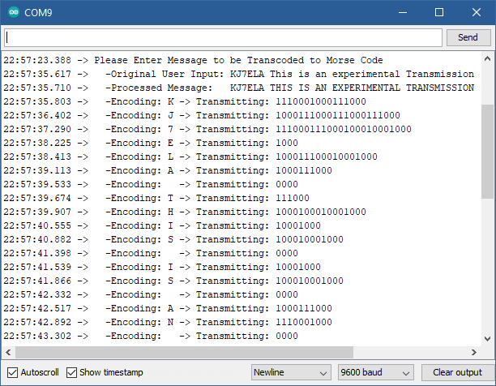
Architecture - Code
Program user is prompted to enter text via the serial monitor
Text is parsed for illegal characters and length
Parsed text is stored within an array as individual characters

Slide 8
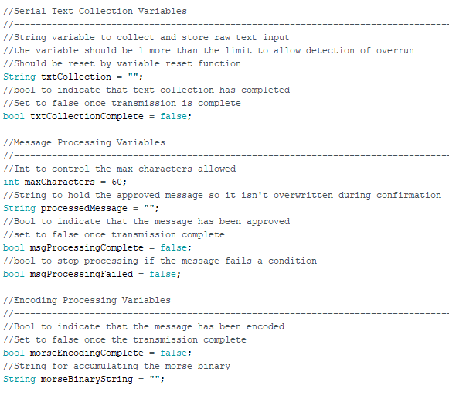
Architecture - Code
Array of text character is iterated over, encoded, and transmitted as morse code
The program is reset and prompts the user to enter additional text.

Slide 9
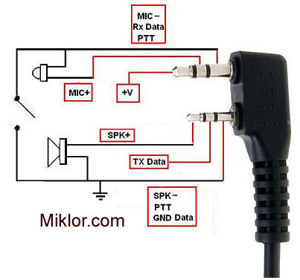
Stretch Goal – Push to Talk
Automatically Triggering PTT functionality
In order to transmit on an amateur radio, you must push a button on the radio
Push-to-talk functionality can be triggered by grounding Mic- to Spk-
Code will set a pin on the Redboard to HIGH prior to transmitting and LOW when transmission is complete
A switch or relay will connect Mic- to Spk- to activate push-to-talk functionality
Notes:
Image Source: http://www.miklor.com/COM/UV_Technical.php

Slide 10
Final Design & Demonstration
it is illegal to transmit on Amateur (“Ham”) radio frequencies without a license!
I hold a general class amateur radio license, and I am conducting this Demonstration using frequencies dedicated to experimental transmissions at low power.

Slide 11
Problem 1 – encoding Morse
Problem: Encoding a single text character into a properly timed series of audio tones
Answer: Binary Representation
Short Tone (Dit) = 1
Long Tone (Dah) = 111
Character Spacing = 000
Word Spacing = 0000000
Binary bit time = 40 milliseconds
Approximately 30 WPM
Solution: Create an excel file to quickly generate required variables and the function to perform the transcoding of morse code.
Character | Morse (Combined)
A | Dit Dah
Morse
Dit | Dah
Binary (Individual Values)
1000 | 111000
Binary (Combined)
1000111000
Arduino Variable Name
mcA
Notes:
Source: https://en.wikipedia.org/wiki/Morse_code#Representation,_timing,_and_speeds

Slide 12
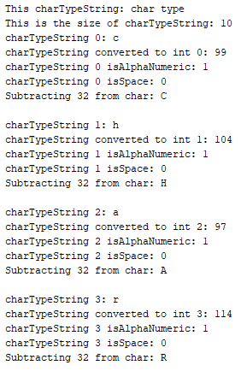
Problem 2 – Parsing Characters
Problem: Text must be processed and stored in an array. The data type of the variables used must allow for this processing and parsing into an array.
Answer: Exploratory Data Type Program
Identify potential data types to store text and parsed data.
Observe the results of data manipulated as that data type
Observe the results of data converted from one data type to another
Solution: Store all data a “String” objects. This allows for the use of “String” class functions.
Notes:
Source: https://en.wikipedia.org/wiki/Morse_code#Representation,_timing,_and_speeds

Slide 13
Problem 3 – PTT Activation
Problem: Multiple circuit were built to facilitate push-to-talk functionality as part of the stretch goal. All circuits failed to reliably trigger or release PTT functionality.
Attempts:
digitalWrite & analogWrite
Resistors, transistors, capacitors
Opto isolator
Radio power/ground, microcontroller power/ground
Direct power injection
Solution: None/Failure – It was determined that the RF interference from two radios and a computer generated an electromagnetic to field strong enough to facilitate induction within the system. The current induced caused malfunction of components.
Notes:
Source: https://en.wikipedia.org/wiki/Morse_code#Representation,_timing,_and_speeds

Slide 14
Problem 4 – Memory Limitations
Problem: The Redboard has a very limited amount of memory. Storing many strings of data utilized too much of the dynamic memory leading to errors with the transcoding function
Answer: Memory Optimization
Store static text is flash memory rather than dynamic memory
Eliminate duplicative variables
Combine processes where possible
Solutions:
“F” function
Eliminate duplicative variables
Combine encode and transmit steps to reduce memory demand
Notes:
Source: https://en.wikipedia.org/wiki/Morse_code#Representation,_timing,_and_speeds

Slide 15
What Would I do Differently
Integration
I would not choose a project which integrated an external system
Research - Components
Additional research into components in advance would have decreased the development time required.
Research – Parsing/Memory
Researching how parsing will occur with the program in advance would have eliminated wasted time
I would not choose to integrate a system that emits radio waves (Electromagnetic Radiation)
Research and understanding of the effects of EMI on components would have eliminated wasted time
Knowledge of data types and objects would have reduced development time.

Slide 16
Questions?

Slide 17
Resources
Github Repository with Code and Resources
ARRL Amateur Radio Band Chart
ARRL Band Plan
CFR Part 97 – Amateur Radio Service
Wikipedia – Morse Code
Transistor Information
Wikipedia - Opto Isolator
Arduino.cc – String Objects

