Slide 1


Slide 2


E-SHOPPING MALL mini project 1st review
Under the Esteemed guidence of
MR.K.SRINIVAS B.Tech,M.Tech
Asst.Professor
1).Sunanda .K -12M61A0515
2).Manjula.M -12M61A0522
3).Deepika.T - 12M61A0537
4)Jyothi .Y - 12M61A0542
DEPARTMENT OF COMPUTER SCIENCE & ENGINEERING
SWARNA BHARATHI INSTITUTE OF SCIENCE & TECHNOLOGY

Slide 3
INTRODUCTION
Our Shopping Cart application allows visitors to shop on-line to collect items in a virtual shopping cart over multiple product web pages without losing the items ordered
Our cart keeps track of what the shopper has ordered with a UID (User I.D). There are no cookies used, so our software will work through a firewall and with older browsers.
In order for a shopping cart is to be useful, customers need to be able to add items to their shopping carts as they browse web site. Shopping cart need to have a link next to each product you sell that allows customers to add that particular product to their shopping carts.

Slide 4
System Analysis
1. Existing System
The motivation behind this project is to overcome all the defects in the existing system.
Some defects in existing system are:
Customers need to go shop for purchasing items
Customers can view a limited range of products
Cannot compare prices with the other stores
Limited customer reach. Customers from a certain area go for shopping

Slide 5
2. Proposed System
Features of proposed system:
Customers can shop from their home
Customers can view a large number of products available in a store
Customer reach for a shop is wider and customers around the globe can visit the store and purchase products

Slide 6
Modules
Modules in the Shopping Cart system
Store Front Module
Administration Module
Product Search Module
Billing Module

Slide 7
1. Store Front
In this module the store administrator will add new products to the site. Here the products will be grouped into various categories.

Slide 8
2. Administration Module
Administrator will enter all the information about product including its brand, price, discount, manufacture date and its category. The admin can update already added products.

Slide 9
3. Product Search Module
In this module products are grouped into various categories. Products from a particular category will be displayed when the user clicks a particular category. Here this categorization is made at the time of product entry by admin. He will insert a product into its category. The result of this search is the list of products from a selected category.

Slide 10
4. BILLING MODULE
This is the cart module where it contains all the products which the user has shopped. As the customer browse through the products he can add products to the cart. The cart contains product information and its billing information along with discount. And these details will be present to the user for check out. The cart contents will be saved into the database once the user checks out.

Slide 11
CLASS DIAGRAM

Slide 12
LOGIN SEQUENCE

Slide 13
Manager Adding new Product

Slide 14
HARDWARE AND SOFTWARE REQUIREMENTS
Hardware Requirements
Processor :: Pentium-III (or) Higher
Ram :: 64MB (or) Higher
Cache :: 512MB
Hard disk :: 10GB
Software Requirements
Tools :: Micro Soft Front
Operating System :: Windows 7
Server Side :: JSP with Tomcat Server
Client Side :: HTML ,JavaScript
Services :: JDBC
Database :: My SQL

Slide 15
BIBLIOGRAPHY
Advanced Java Programming - Dietel and Dietel
Mastering JAVA 2 - John Zukowski
Java Server Programming - Apress
Software Engineering - Roger S Pressman
Análysis & Design of InformationSystems – Senn
Websites
www.google.com
www.apeci.com
www.askjeeves.com
www.javatpoint.com
www.w3school.com

Slide 16
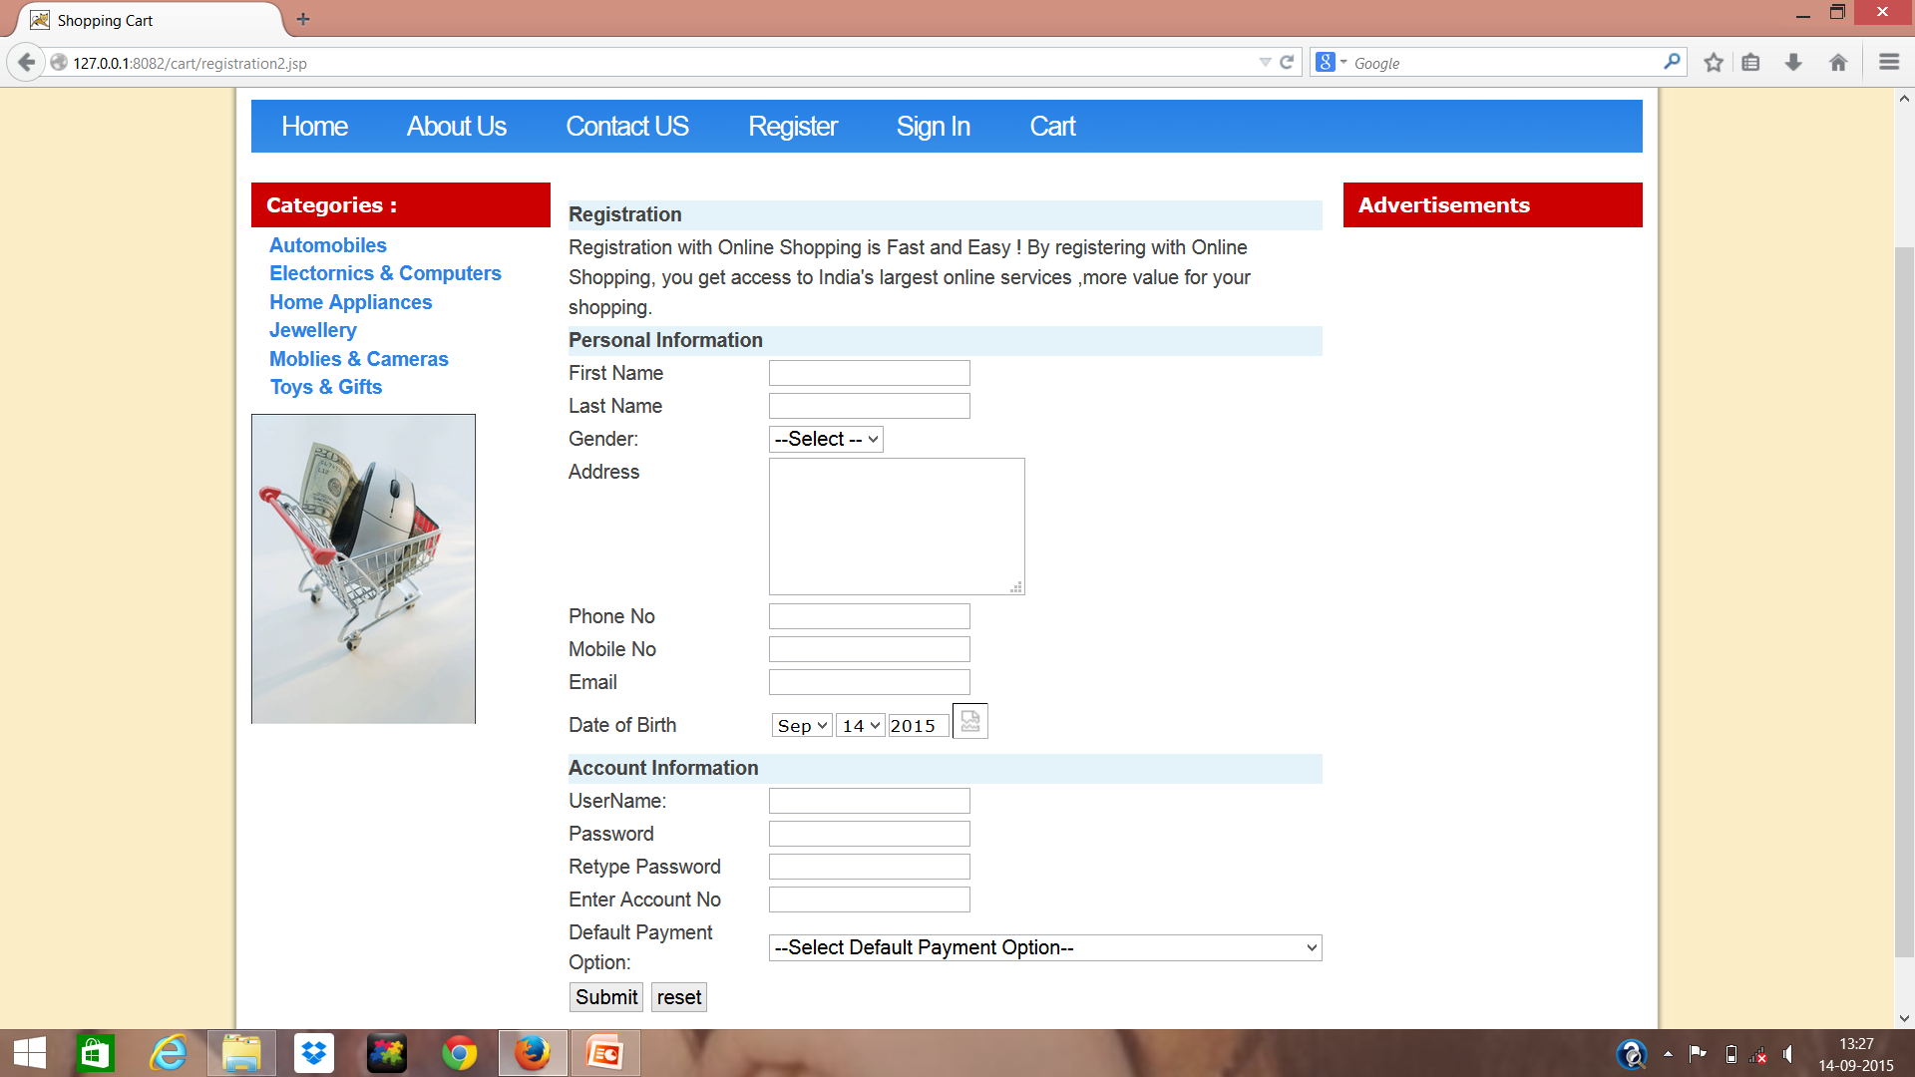

Slide 17
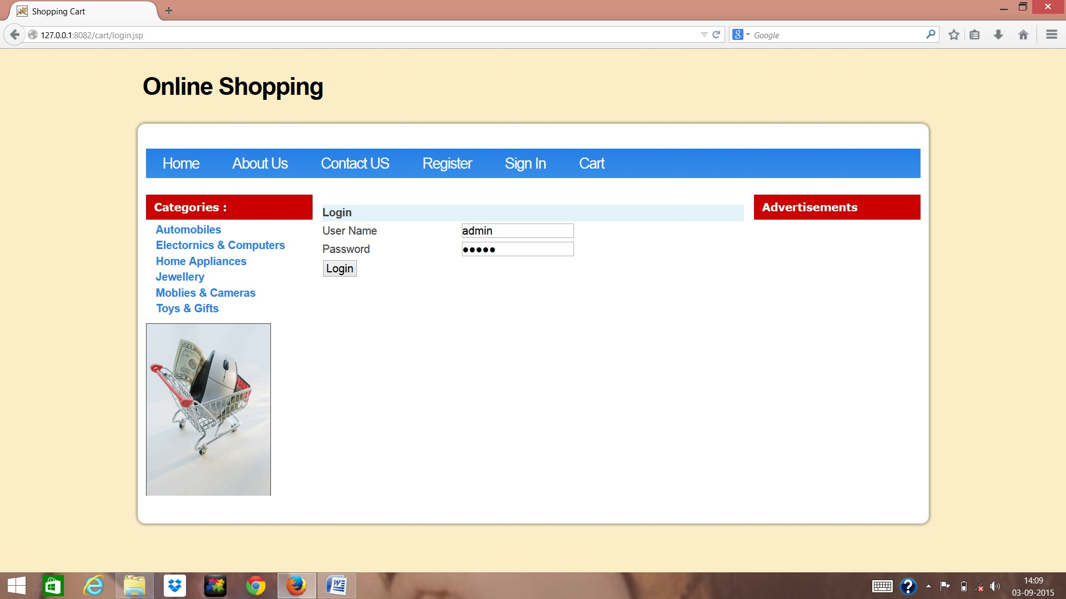

Slide 18
CONCLUSION
The Shopping Mall project is developed in this manner that is user friendly and required help is provided at different levels.
The primary objective is to provide the interactive service to all the Users. Different types of services are provided to both the admin and users. User can avail this service any time.

Slide 19
ThANK YOU

