Slide 1

University Of Buea
Faculty of Engineering And Technology.
CEF440
Internet Programming and Mobile Programming
TASK 3

Slide 2
Instructor: Dr Nkemeni Valery
Presented By..
Name Of Student | Matriculation Number
IHIMBRU ZADOLF ONGUM | FE21A203
FONJI DANIEL KUKUH | FE21A194
NFOUA EUGENE MGBA | FE21A257
EPIE MUKEH SANDRA | FE21A185
CHE KASSINA KUM | FE21A158

Slide 3
REQUIREMENT ANALYSIS
BIOMETRIC STUDENT ATTENDANCE MOBILE APPLICATION

Slide 4
OUTLINE
Understanding the project scope and objectives.
Requirement Gathering and Techniques
Identifying key stakeholders and their requirements.
Requirement Analysis and processes
Interprete And Record Requirements
Requirement categorization
Conclusion

Slide 5
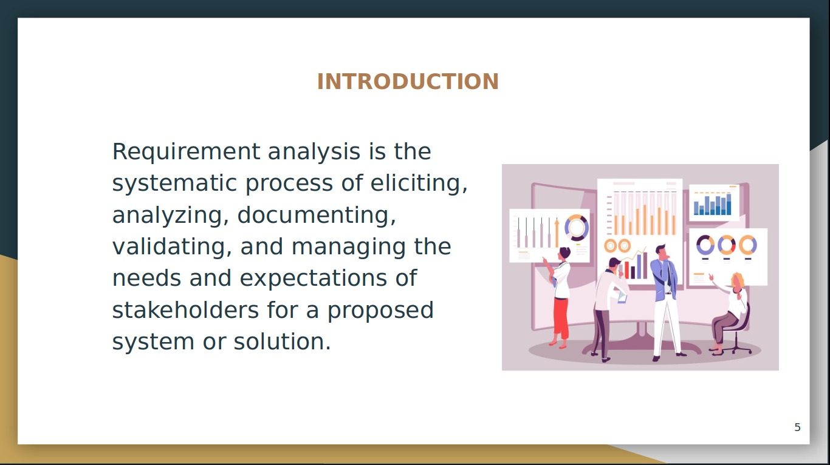
INTRODUCTION
To begin the requirements analysis process, we communicate with stakeholders to gather the requirements. This phase is also known as "eliciting requirements." We use different techniques to gather the requirements, including:

Slide 6
Overview
This document aims at analyzing the requirements gotten from the stakeholder to come up with a list of requirements that this system will have.

Slide 7
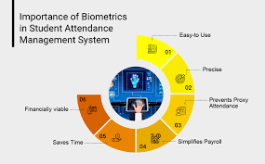
Defining the Project scope
Objectives:
Automate Attendance Tracking
Enhance Accuracy and Reliability
Improve Efficiency
Ensure Data Security and Privacy
Facilitate Integration

Slide 8
REQUIREMENT GATHERING TECHNIQUES
Interviews
Reverse Engineering
REQUIREMENT GATHERING TECHNIQUES
Surveys/Questionnaires
Workshops/ Joint Application Development
Brainstorming
Use Cases/Scenarios
8

Slide 9
REQUIREMENT ANALYSIS PROCESSES
Identify Key Stakeholders and End-Users
Capture Requirements
Interpret and Record Requirements
Modeling the Requirements

Slide 10
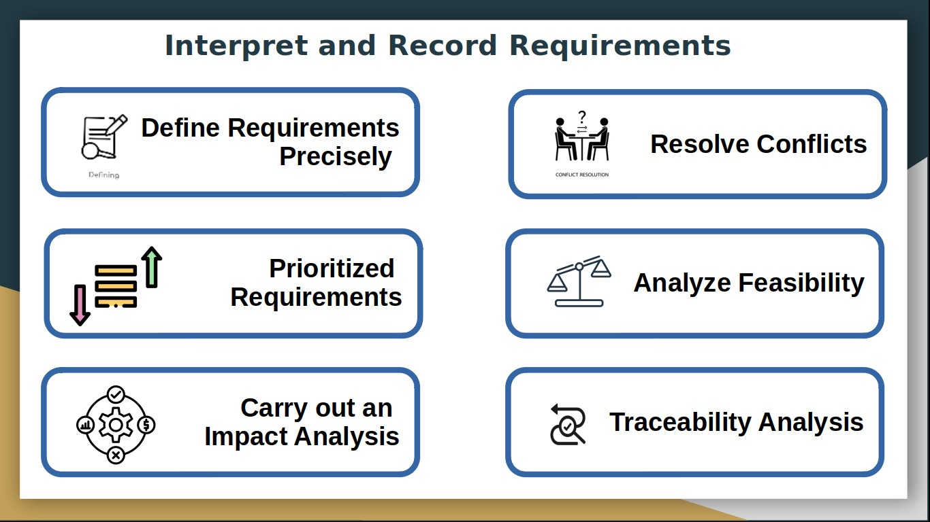






Interpret and Record Requirements
Define Requirements Precisely
Resolve Conflicts
Prioritized
Requirements
Analyze Feasibility
Carry out an
Impact Analysis
Traceability Analysis

Slide 11
REQUIREMENT MODELING
Registration
FUNCTIONAL REQUIREMENT
Biometric data capture
Report Generation
Attendance Activation
Lecturers Register Students

Slide 13
SYSTEM REQUIREMENTS
HARDWARE REQUIREMENTS

Slide 15
CONCLUSION
The requirement analysis phase for the development of a biometric attendance tracking system is paramount in ensuring the successful deployment and operation of the system while safeguarding the privacy and security of users' biometric information

Slide 16
THANKS FOR YOUR KEEN ATTENTION

