Slide 1


Multi-Label Movie Genre Classification
Zariff Danial
Data Science Capstone Project

Slide 2
Introduction
Movies often belong to multiple genres, reflecting their diverse storytelling elements and appeal to various audiences. Accurately classifying these genres can enhance user experience in streaming services, recommendation systems, and content organization. Traditional methods of movie genre classification involve manual annotation by experts, which is time-consuming and subjective.
Automated multi-label genre classification can streamline this process, providing consistent and efficient categorization. Such a model can handle the complexity of multiple genres for a single movie, improving the accuracy of genre tagging.
There is a need for a reliable, efficient, and accurate predictive model that can assist in the automated classification of movie genres, ultimately enhancing user experience, content recommendation, and overall content management in the film industry.

Slide 3
Data Overview
Data: Obtained from IMDB
How the Model Works?
Collecting Data: The model gathers information about movies, like their titles and plot summaries, from a large database.
Finding Patterns: It looks at these plot summaries to find clues that can help decide what genres the movies belong to, like action, comedy, or drama.
Training: The model learns from a lot of examples to understand which words and phrases are linked to certain genres.
Predicting: When given a new movie's plot summary, the model uses what it has learned to guess which genres fit that movie.
Checking Accuracy: Finally, we check how well the model is doing by comparing its guesses to the actual genres and see if it can improve.

Slide 4









Who might care?
Online Streaming Companies
Movie Review Websites

Slide 5

Model

Slide 6
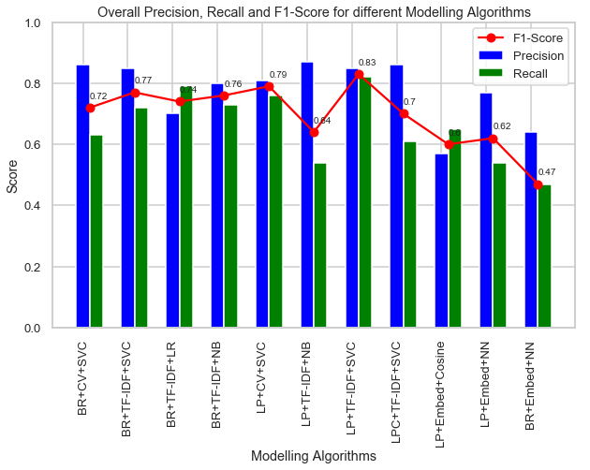
Result Summary
Best predicting Model: Label Powerset + TF-IDF + Linear SVC (Overall F1-Score = 0.83)
Models using Sentence Embedding performance is worse compared to other Vectorizers and ML models
BR: Binary Relevance
LP: Label Powerset
LPC: Label Powerset with Clustering
CV: Count Vectorizer
Embed: Sentence Embedding via USE
SVC: Linear Support Vector Classifier
LR: Logistic Regression
NB: Naïve Bayes
Cosine: Cosine Similarity
NN: Neural Networks

Slide 7
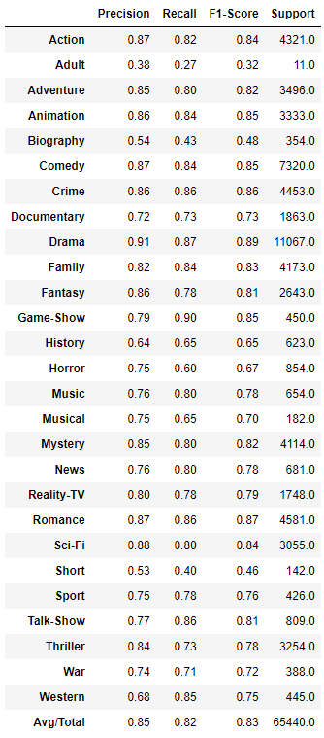
Label Powerset + TF-IDF + Linear SVC
Hyperparameters
TF-IDF
Ngram = (1, 2)
Min_df = 2
Max_df = 0.5
LinearSVC
C = 10
Overall F1-score = 0.83
Poorest performing Genre = Adult
F1-score = 0.32, but only 11 samples

Slide 8
Conclusions
Out of the 11 models considered, the best predicting model uses TF-IDF Vectorizer, Linear Support Vector Classifier and Label Powerset approach to achieve an overall F1-score of 0.83
Sentence Embedding doesn’t provide any benefit (yet)

Slide 9
Limitations and Ideas
Improving Sentence Embedding
Sentence embedding doesn’t require the sentence lemmatization, or stop word removal, or in fact any of the text preprocessing steps. Use the original text before preprocessing to obtain sentence embedding
Use Sentence Embedding with Linear SVC (since Linear SVC was the best model)

Slide 10
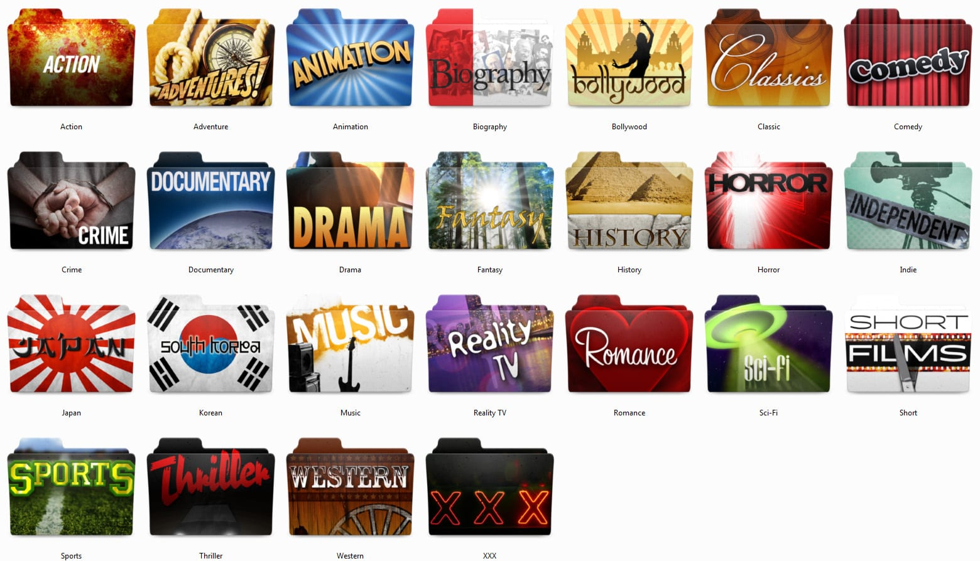
Thank You!

