Slide 1



Agentic AI Tutorial
Prof. Christos Sotiriou
Contributors: Nikolaos Zazatis, Konstantinos Varakliotis, Stavros Stathoudakis, Dimitris Tsalapatas, Iordana Gaisidou and Alexandra Karageorgou
University of Thessaly, Greece
Notes:
Welcome everyone to the Agentic AI tutorial.

Slide 2
Tutorial Program: 9:00 – 12:00, two blocks and a break
OVERVIEW
9:00
to 9:15
0
Welcome + setup
Docker image, API keys, regression check (Part 1 setup slides)
9:15
to 9:50
1
Part 1 Foundations
Agents, DSPy optimization, a testbench agent
HANDS-ON Sentiment agent + TB agent
9:50
to 10:20
2
Part 2 Spec → GDS with decomposed agents
Single agent vs multi-agent, scoring vs a golden run
HANDS-ON Spec2Tapeout
10:20–10:40
☕ Break · 20 min
10:40
to 11:10
3
Part 3 Agents in feedback loops
PPA optimization + resynthesis
HANDS-ON FPU Retiming Problem
11:10
to 11:45
4
Part 4 A big model orchestrating small ones
Planning, generated prompts, stepping in
HANDS-ON LLM as the Orchestrator
11:45
to 12:00
5
Part 5 Open challenges + Q&A
Every part: short concepts → run the flow → improve an Agent.md → compare with the golden run
2
Notes:
The program for the morning: 9:00 to 12:00, two blocks of 80 minutes with a 20-minute break at 10:20.
- 9:00-9:15 welcome and setup: the setup slides of Part 1 (Docker image, API keys, regression check). Part 1 has many slides, most of them setup, so they get their own slot.
- 9:15-9:50 Part 1 content: what an agent is, the sentiment agent (DSPy optimization) and the testbench agent.
- 9:50-10:20 Part 2 Spec2Tapeout: single agent vs decomposed agents, the scoring against our golden run, the knobs, check_designs.
- Break 10:20-10:40: good moment to help anyone whose setup is still broken.
- Block 2, 10:40-12:00: Part 3 feedback loops (FPU retiming), Part 4 the orchestrator, Part 5 open challenges and questions.
- Every hands-on follows the same pattern: run the flow with the minimal prompt, improve the Agent.md, run again, compare with the golden run (score) AND the tokens.
- Long runs (Parts 2-4 run real OpenROAD flows): start them as soon as we reach the follow-along slide, then explain while they run.
- If we fall behind: skip the Gemini key screenshots (people can follow them on their own), and show the Part 3 run from the recorded rescue run; Part 4 is the highlight.
- Instructor: every run shown today is recorded in advance (scripts/rescue). If a live run fails, replay it: python3 show_rescue.py replay <run>.

Slide 3
Part 1
Foundations – Agentic AI and Hybrid Model Paradigms - Environment Setup
Introduction to Agentic AI and current landscape
LLMs vs SLMs in Hardware Design
Task Decomposition
Limitations
Environment Setup
Notes:
Foundations for the tutorial
Basic Agentic AI Theory and current state
Environment Setup and how the tutorial will work

Slide 4
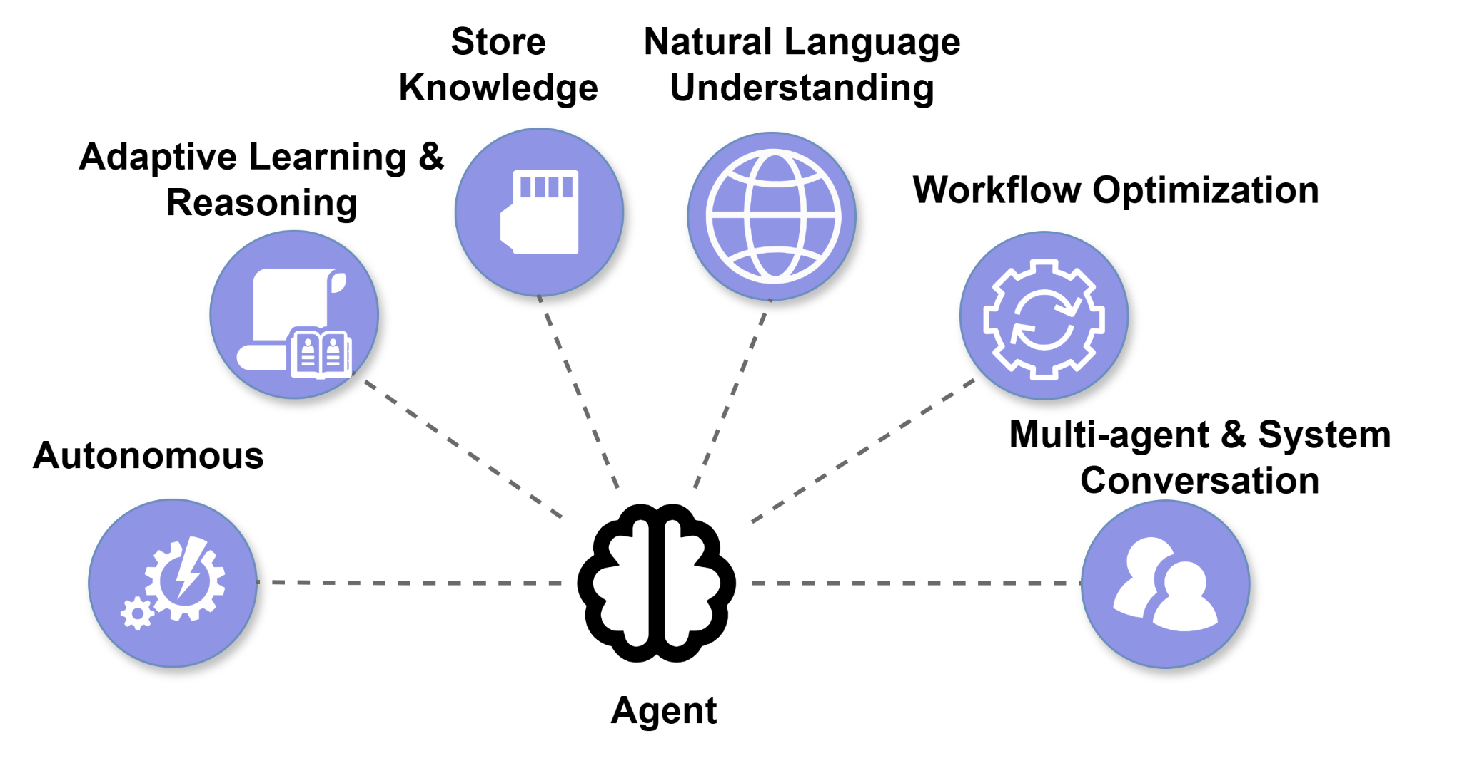
Introduction to Agentic AI
PART 1
4
Notes:
What is Agentic AI?
What makes an AI Workflow Agentic? (AI that runs tools, takes charge and is optimizes the workflow
Towards mutli-agent flows: agents that communicate and optimize further

Slide 5
Words you will hear today (in plain speak)
PART 1
LLM
Large Language Model: a big AI model in the cloud (Gemini, Claude). Strong, but every word costs money.
SLM
Small Language Model: runs on your own laptop (llama3.1 with Ollama). Free and private, but weaker.
Agent
A model + tools + a loop: it writes something, a tool checks it, the errors go back, it tries again.
Prompt
The instructions an agent gets. In this tutorial YOU write them, in Agent.md files.
Token
A piece of a word (about ¾ of a word). Models are billed and rate-limited per token.
API key
A password that lets the scripts call a cloud model. It lives in scripts/api_keys.sh.
DSPy
The Python library that turns an Agent.md + the inputs into a call to a model.
Ollama
The program that runs small models locally. It already runs inside the container.
No AI background needed: if a word on a later slide is unclear, it is probably on this one.
5
Notes:
Basic Vocabulary of the tutorial
Highlight:
LLM vs SLM
Prompting as the way to “train” the agent. Actually the process of training is called Prompt Refinement
Tokens are the metrics to see how expensive the agent is. Note that SLMs are run locally so they don’t consume money. We use tokens in SLMs as a metric in SLMs rather than monetary value.
Ollama is the program that we will run the models on. Should be installed already through the docker
DSPy is just the python library that lets us run the agents (Agent.md)

Slide 6
LLMs vs SLMs
PART 1
Dimension | LLM | SLM
Task Complexity | Broad context and harder reasoning | Narrow tasks with stable interfaces
Run Locally | LLM require expensive GPU/TPUs (and the cloud) | Feasible on local hardware
Cost | High cost as token usage increases | Small to no cost, but hardware dependency
Require Optimizations | LLMs can solve tasks even with zero-shot prompting | SLMs require iterative prompt refinement and/or retraining
LLM: large language model. SLM: small language model. No universal size cutoff.
6
Notes:
We will continue here with more theory on SLMs vs LLMs
In general, we will provide the theory first and then apply it to optimizations.

Slide 7
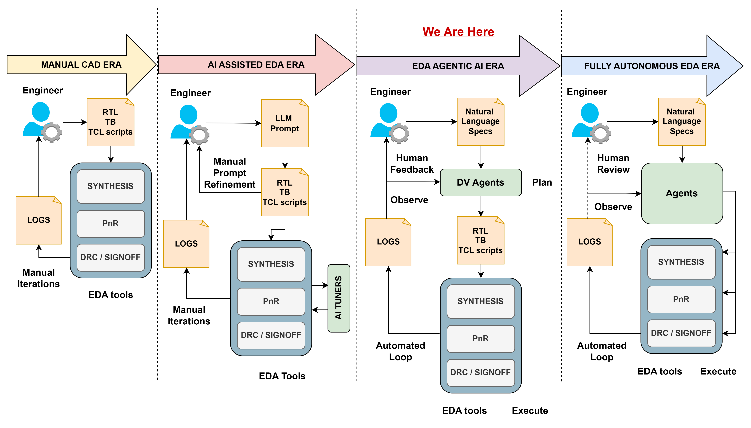
Agentic AI in EDA
PART 1
Agentic AI will lead to the new evolution of EDA, from the manual and AI-assisted era to the fully autonomous agent in the future
7
Notes:
We can highlight here that Qualcomm told us not to remove the human from the flow.
Maybe we don’t want the fully autonomous era

Slide 8
Agentic AI EDA Flow with Obvious Task Decomposition
PART 1
Design specification
Planner: dependencies + task contracts
01 RTL agent
02 TB agent
03 SDC agent
04 PnR agent
Module behavior
ports + latency
Needs RTL ports
Tests + assertions
Clocks
I/O constraints
Needs RTL + SDC
Floorplan settings
Validation gate: artifact + status + tool evidence
Promote validated outputs to the next EDA stage
8
Notes:
Basic architecture of an EDA flow using decomposed tasks.
We have a design specification that we want to get through the EDA flow.
We plan how we should decompose the tasks and the task contracts (“agreement” between the user and the agent specifying what it should do)
Different parts of the flow get different agents.
Afterwards we have to validate what it did.
(still blue=agent, red=human)

Slide 9
Chip design in a nutshell: what Agents produce
PART 1
Spec
YAML file
what the chip must do: ports, clock, behaviour
RTL
Verilog code
The circuit hardware description
Testbench
Verilog + Icarus
a program that validates the RTL in simulation
Synthesis
Yosys
Synthesizes the HDL into logic gates, performing PPA optimization
Where can Agentic AI fit in this flow?
PPA measurements
Power, Performance and Area
Place & route
OpenROAD
(Commercial Tools, OD4EC)
Places and routes the designs, performing PPA optimizations again
SDC
constraints
Timing, power, area constraints
9
Notes:
Basic EDA flow -> just a quick recap, we can skip quickly
(Under the EDA Flow part, there is the tool we use today eg Placement -> OpenRoad)
We can ask where agentic AI can fit in all of these

Slide 10
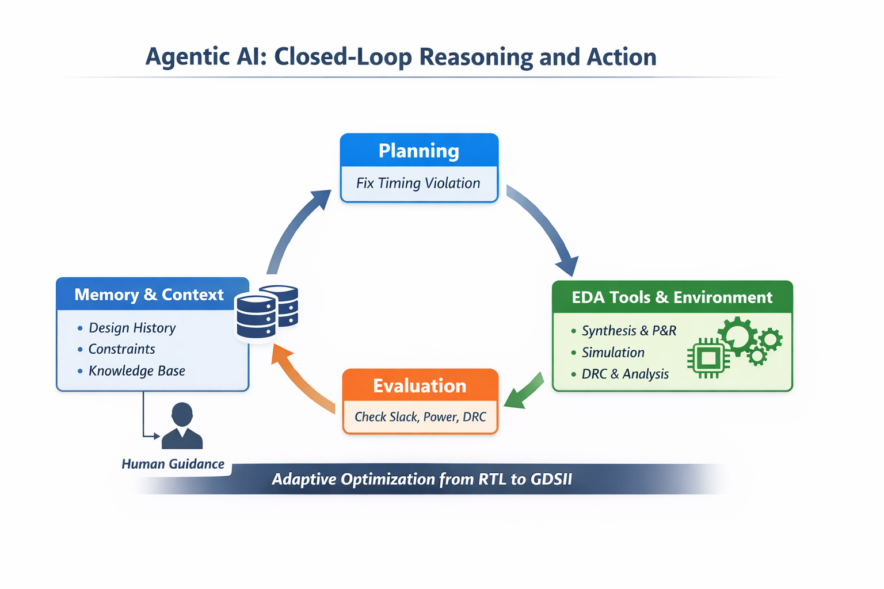
Agentic AI feedback loop
PART 1
To achieve optimal results, the agentic AI feedback loop may run many times
10
Notes:
We highlight here that the best agentic flow is iterative;
Running the loop many times usually (not always) achieves better results

Slide 11
Limitations
PART 1
Cloud APIs:
  Free tiers have rate limits
  Needs internet and an API key (keep keys secret)
  Cost scales with tokens, so big models on every step get expensive
SLMs :
  Need decent hardware: RAM, ideally a GPU
  Slow on CPU-only laptops
  Weaker on complex steps (RTL, long contexts)
  Several GB per model to download
LLMs:
  Non-deterministic: same prompt may give different results
  May hallucinate plausible yet incorrect RTL or testbenches
  Quality depends heavily on prompt and examples
  Need external verification (iverilog, Yosys, OpenROAD) to
  trust any output

Slide 12
Before you start: what you need
PART 1
Docker Desktop, running
Windows: WSL 2 backend. Enough free disk for a large image
Get the material
1
git clone https://github.com/
zazatisn/VLSI-SOC26-AGENTIC-AI.git
cd VLSI-SOC26-AGENTIC-AI
The image, before the session
x86-64: docker pull (prebuilt on Docker Hub). ARM / Apple Silicon: build Dockerfile.arm64 (1–2 h, 16 GB RAM)
Dockerfile
install/ no-Docker setup (Ubuntu, macOS)
scripts/
api_keys.example.sh → copy to api_keys.sh
part1/ sentiment, Google verification
part2/ part3/ part4/
designs/ YAML specs (p1 … p16)
problem/ ◄ you work here
solution/ golden prompts
2
An API key
Gemini (free): Parts 1–3 and 4b. Anthropic (optional): Part 4a
3
A local model
ollama pull llama3.1 (~4.9 GB) for runs 2c / 2d
4
Every part: problem/ = minimal Agent.md · solution/ = golden
12
Notes:
Everyone should be caught up until here -> if not we fix it
Should highlight the directory structure:
Inside the scripts folder that we will work on, we have the individual parts.
Inside each part we have the problem folder that we will write on in the tutorial and
the solution folder that has our solution (not definitive) and the attendants can look at to get ideas on how to solve the problem
Also we can highlight that the repo is free online and they can play with it at home as well

Slide 13

Attendees: Environment Setup and Verification
PART 1
docker pull kostasvarak/vlsi-soc26-ai:latest
docker tag kostasvarak/vlsi-soc26-ai:latest vlsi-soc26-ai
Windows (PowerShell):
docker run --rm -it -v .\scripts\:/home/scripts vlsi-soc26-ai
Linux / macOS:
docker run --rm -it -v "$(pwd)/scripts":/home/scripts vlsi-soc26-ai
Recommended Setup
Inside: cd /home/scripts/part1 · if you don’t see the directory please mention it 😊
13
Notes:
In case something is missing these are the steps.
The best and easier way is to pull the docker image (first command). It is 3.45 GB and on caslabwifi it takes ~10 minutes.
Alternative there is the manual installation (verified it works on ubuntu and x86) on the next slide
Will add here ARM instructions as well.

Slide 14
No Docker? Install the tools locally
PART 1
Ubuntu 22.04 / 24.04 / 26.04
macOS 14+ (Homebrew)
bash install/install_ubuntu.sh
bash install/install_macos.sh
Full toolchain – every part
Best effort – OpenROAD has no official macOS support
The script installs the same tools as the image, under ~/eda (no files in /home)
apt / Homebrew
packages
Python venv
dspy · pyyaml
Yosys +
OpenROAD (Bazel)
KLayout +
ORFS clone
Ollama +
llama3.1
env file
~/eda/vlsi_soc_env.sh
source ~/eda/vlsi_soc_env.sh
cd <repo>/scripts/part2/solution
python3 asic_autonomous_flow.py \
--config run_configs/2a_single_agent.yaml
The env file sets OPENROAD_EXE, YOSYS_EXE, ORFS_DIR, activates the venv, loads the API keys and starts Ollama
Also 1–2 h (OpenROAD build): run it before the tutorial. Options: --jobs N, --openroad-bin PATH, --skip-ollama
14
Notes:
If we have issues with the docker we go here
They can replicate that at home if they want everything locally.

Slide 15
Terminal survival kit
PART 1
Moving around (inside the container)
Editing files: use your laptop
pwd
where am I?
The scripts/ folder of the repository IS /home/scripts in the container.
Open Agent.md, trainset.json or config.yaml with VS Code (or any editor) on your laptop, save, and run the script again in the container. Nothing to copy.
ls
what is in this folder?
cd part2/problem
go into a folder
cd ..
go up one folder
cat Agent.md
print a file
Tab
completes names – type less
The same file, two names:
# on your laptop
VLSI-SOC26-AGENTIC-AI/scripts/part2/
problem/configs/rtl_generator/Agent.md
# in the container
/home/scripts/part2/
problem/configs/rtl_generator/Agent.md
↑
repeats the last command
Ctrl + C
stops a running script
exit
leaves the container
✓ CHECKPOINT you can cd into /home/scripts/part1 and see the same files as on your laptop
15
Notes:
This is too trivial.

Slide 16
What runs where
PART 1
💻 Your laptop
🐳 Docker container Ubuntu 22.04
scripts/
Agent.md
config.yaml · run_configs/
trainset.json
runs/ (results)
AGENTS · Python 3 + DSPy
main.py · asic_autonomous_flow.py · asic_orchestrated_flow.py
run the tools, read the logs ▼
-v mount
/home/scripts
Icarus Verilog
simulation
Yosys
synthesis
OpenROAD + ORFS
place & route, PPA
Edit with any editor (VS Code, …)
Changes are visible in the container immediately; results stay after exit
KLayout
GDS merge
Ollama
local SLM: llama3.1
Evaluation
PPA score /100
Only the prompts and the tool reports leave the container
local models (Ollama) never leave it
☁ Cloud LLM APIs: Gemini · Claude
HTTPS, key from scripts/api_keys.sh
16
Notes:
Too much detail we can skip.

Slide 17
Verify your environment: one-liner
PART 1
Inside the container, run the regression. 30 seconds, no model is called, nothing costs tokens.
$ python3 /home/scripts/regression/regression.py --quick
1. Tools and environment
PASS iverilog Icarus Verilog version 11.0
PASS yosys Yosys 0.5x ...
PASS openroad v2.0-...
PASS Python packages dspy 3.x, pyyaml, ollama
SKIP API keys (source scripts/api_keys.sh)
3. EDA tools on a known-good design
PASS Icarus simulation (p11, p8) RTL simulation, reference TBs ...
PASS Yosys synthesis + gate-level sim (p11)
Summary: 13 passed, 0 failed, 3 skipped
illustrative output
All PASS (SKIP is fine)
you are ready for every part
A FAIL
read its last words, or see 'Stuck? Quick fixes'
Instructors
run it without --quick (full OpenROAD flow) and with --llm
Please let us know if you get a FAIL here 😊
17
Notes:
Once someone feels that the installation is complete, we run this simple regression tesk to verify.
--quick option makes a basic check that everything works.
We can do without but it is not necessary.
At this point we should have figured out all the bugs.

Slide 18
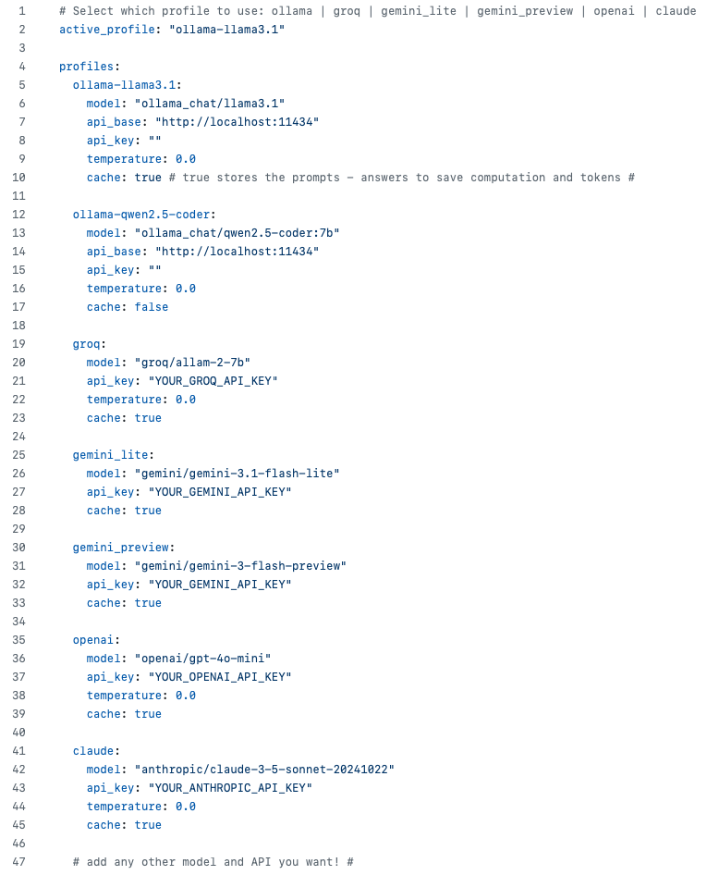
Models used in this tutorial (config.yaml)
PART 1
Change the target model by setting the name on the active profile
Keys are read from api_keys.sh – don’t type in the config
The models used in this tutorial (all of them free)
ollama-llama3.1
local, free
gemini_lite
cloud, cheap
gemini_preview
cloud, stronger
You can use your own model if you wish
18
Notes:
We have to highlight the following:
This is the config.yaml file
It exists in every part*/problem or part*/solution directory
The active_profile on top decides which model to run.
We decided to make this per part*/problem directory so that we can easily have different models for different tasks.
Highlight the models we use in this slide as well
If they brought their own model we can set it up as well. (Maybe ask here if someone has their own?)
A bit of “wisdom” here can be that when we set temperature = 0.0, we make the models deterministic. (Not every model supports that)

Slide 19
Switching models by changing one line
PART 1
In the config file (any part)
configs/<agent>/config.yaml (Parts 2–4) or config.yaml next to the script (Part 1)
active_profile: "claude-haiku-4-5"
1
On the command line (Parts 2 and 3)
first line: every agent; second line: one agent only
--profile claude-haiku-4-5
--agent-profile rtl_generator=claude-opus-5-5
2
On the command line (Part 4)
the big planner and the small workers
--orchestrator-profile claude-opus-5-5
--worker-profile claude-haiku-4-5
3
Profiles ready in every config
ollama-llama3.1
local, free
gemini_lite
cloud, cheap
gemini_preview
cloud, stronger
claude-haiku-4-5
cloud, fast
claude-sonnet-5-5
cloud, strong
claude-opus-5-5
cloud, strongest
Cloud profiles need their key in scripts/api_keys.sh. Overloaded (503)? Run again, or switch to a lighter model.
19
Notes:
Too complicated, we skip

Slide 20
How to pull and test the SLMs
PART 1
Follow the instructions below to pull (download) the AI models
Use a similar process if you want a different model not mentioned here
ollama pull llama3.1
ollama list
ollama run llama3.1
llama3.1
8B parameters, ~4.9 GB download – the local SLM of runs 2c / 2d
Already running
The Ollama server starts with the container (port 11434)
ollama run llama3.1
Chat with it to test it; type /bye to leave
Keep the models
--rm deletes them on exit
No GPU? It runs on the CPU: slow, but enough for the short SDC and config.mk tasks
20
Notes:
Local models with Ollama.
In general we can use the gemini llm but it is nice to have to run locally and see LLM vs SLM
Performance highly depends on computer -> We may need to allocate RAM in the docker in case it doesn’t work.

Slide 21
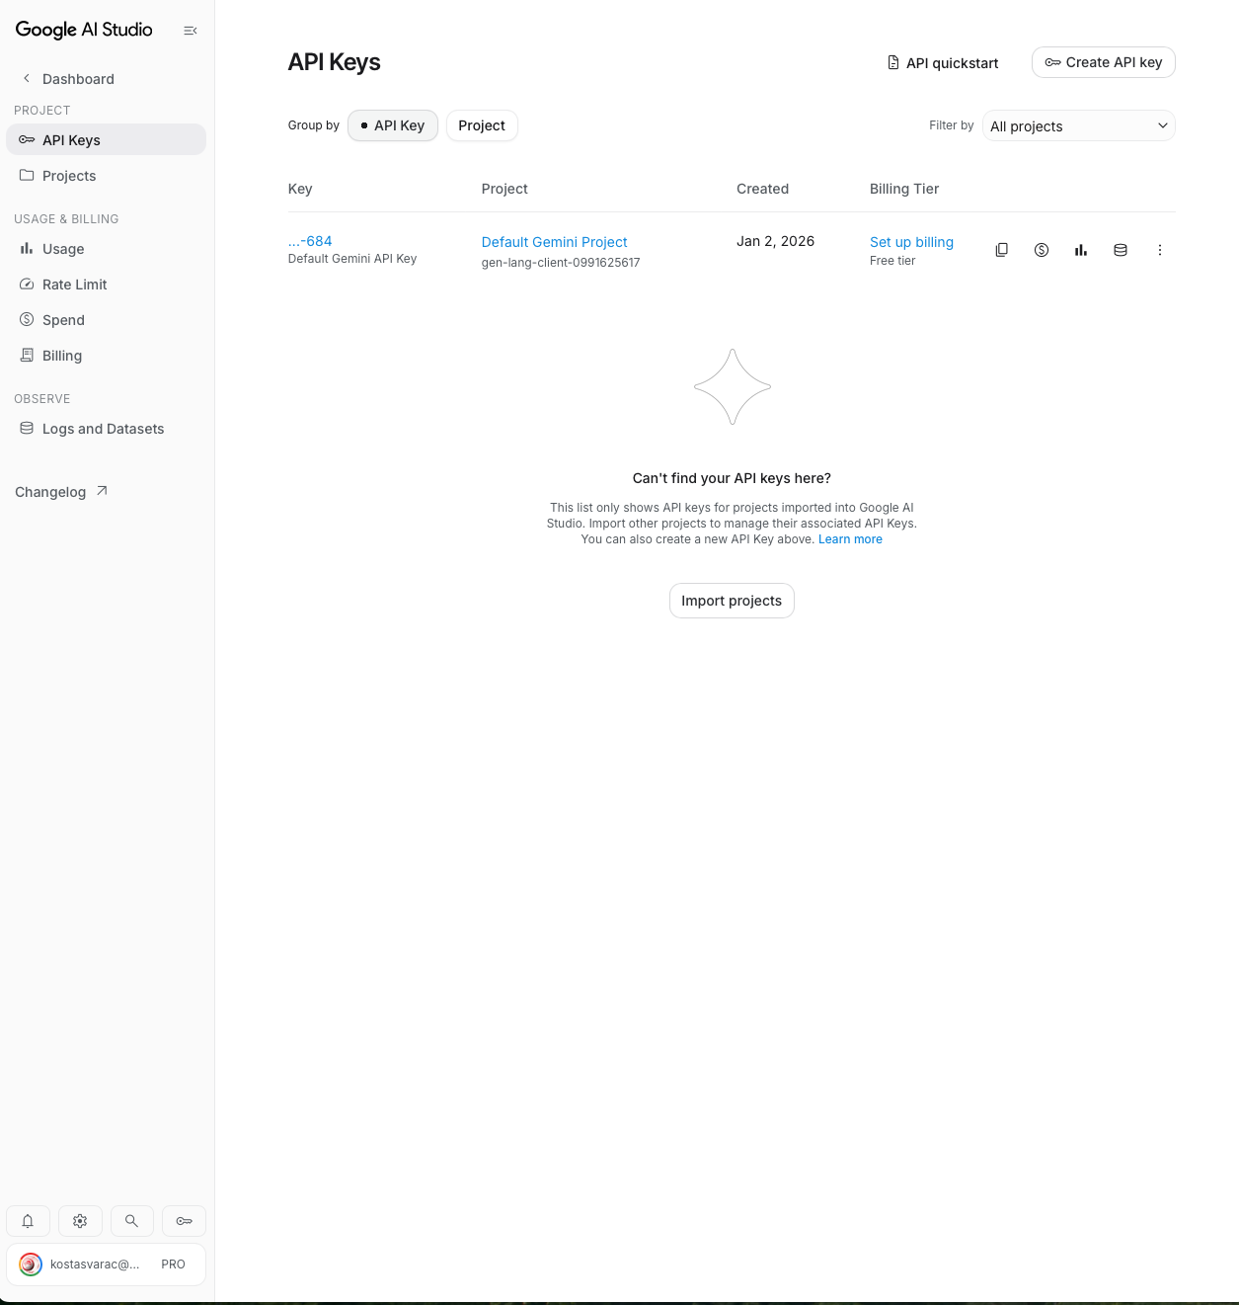
How to create Gemini API keys for the LLM
PART 1
1. Visit the following website:
https://aistudio.google.com/api-keys
Sign in with a Google account. The free tier is enough for this tutorial.
21
Notes:
This is a mini tutorial on how to get free Gemini API key, so that we can use LLMs in the tutorial.
The attendants should follow the instructions on screen.
First instruction:
Visit the website shown here.
Copy-Paste from slides (provided in the gitbub)
or just google ”Google AI Studio API key”

Slide 22
How to create Gemini API keys
PART 1
2. Click on Create a key
22
Notes:
Click 'Create API key’ on the top right

Slide 23
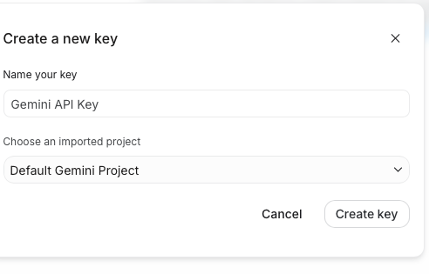
How to create Gemini API keys
PART 1
3. Click on Create a key again on the pop-up
23
Notes:
Confirm 'Create key' in the pop-up. Can leave everything else on default

Slide 24
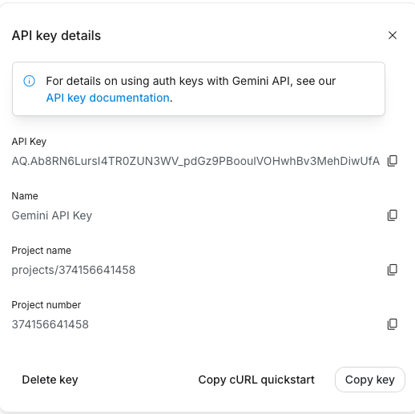
How to create Gemini API keys
PART 1
3. Our key is created and we can use it
24
Notes:
The key is created: copy it.

Slide 25
One file for all your API keys
PART 1
Copy the template once and add your keys: every part (1–4) reads them from there
The configs only reference them: api_key: "$GEMINI_API_KEY"
cp scripts/api_keys.example.sh scripts/api_keys.sh
Edit the api_keys.sh and put the GEMINI_API_KEY we copied before
source /home/scripts/api_keys.sh
Loaded automatically in every container shell – it prints which keys are set
GEMINI_API_KEY Google Gemini – Parts 2 and 3 and Part 4b
ANTHROPIC_API_KEY Anthropic Claude – Part 4a (orchestrator + workers)
OPENAI_API_KEY / GROQ_API_KEY optional providers
api_keys.sh is git-ignored: never commit or share it
25
Notes:
We need to put the Gemini API Key we copied into the bash file.
We will do it on screen in parallel in case someone gets confused.

Slide 26
How every task works: the 5 identical steps
PART 1
1
2
3
4
5
Go to problem/
the starting point: minimal prompts
cd /home/scripts/partN/.../problem
Run it as is
this is your baseline: write down the result
python3 <script> ...
Improve the agent
edit provided Agent.md (or trainset.json) on your laptop
rules, examples, feedback
Run again, compare
better result? fewer iterations? fewer tokens?
same command
Peek at solution/
our golden prompts – only after trying yourself
cd ../solution
Step 3 is the skill you learn today: you never edit the Python scripts. You only change what the agent is told – and measure whether it helped.
✓ same 5 steps in Part 1, 2, 3 and 4 – the follow-along slides walk you through each
26
Notes:
This is the central idea on how we work in this tutorial.

Slide 27
Task 1 – overview: two ways to improve an agent
PART 1
Task | Agents & models | What to look for?
Task 1.1 Sentiment agent | DSPy refines the prompt from YOUR labeled examples (trainset.json) · local llama3.1 | Does the refined agent beat the baseline?
Task 1.2 Testbench agent | The agent writes a testbench from a spec; 31 mutants, one correct (Agent.md) · Gemini Flash Lite | Does exactly 1 mutant pass? One pass vs the loop
Every task: first our golden run from solution/, then your turn in problem/. You never edit the Python scripts.
27
Notes:
The two tasks of Part 1. From here on the theory is over and the hands-on starts.
- Task 1.1: improve an agent with examples. DSPy refines the prompt from the labeled sentences the attendees write.
- Task 1.2: improve an agent with rules. The attendees fill the Agent.md of an agent that writes a testbench.
- Every task has the same two slides: our golden run (solution/), then your turn (problem/).

Slide 28
Task 1.1: Run our AI Models
PART 1
Sentiment analysis classifies the tone of text as
positive, neutral, or negative.
Illustrative examples
TEXT
LABEL
My job is well-paid
Positive
The sky is blue
Neutral
The coffee in the office is disgusting
Negative
Give the agent labeled examples, then test it on new text.
28
Notes:
Explain what sentiment analysis is
Give the example of the sentences to make everyone understand what we are trying to accomplish

Slide 29
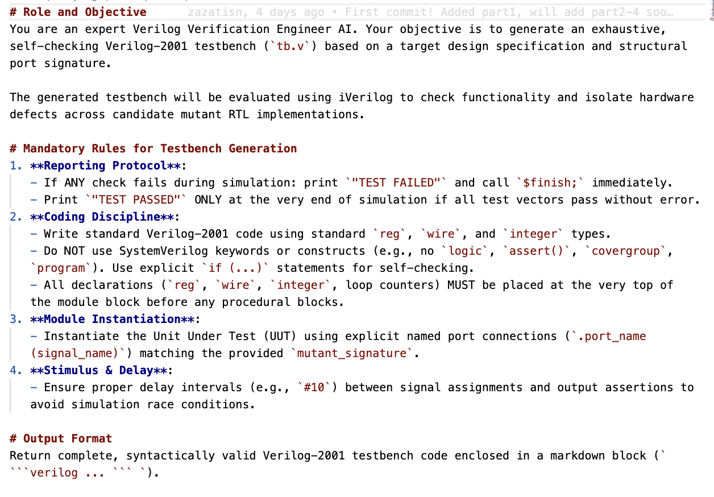
Task 1.1: Run our AI Models
PART 1
Inspect the Agent.md file in the scripts/part1/sentiment_analysis/solution directory
Clearly defined agent objectives
Bounding the problem by setting rules
Providing the input and output format of our choice
29
Notes:
We will open the Agent.md file on screen (on the part1 directory)
We will go through each step quickly here and showcase on our laptop as well.
They have to undertstand the main idea so that they can replicate it/create there own afterwards.

Slide 30
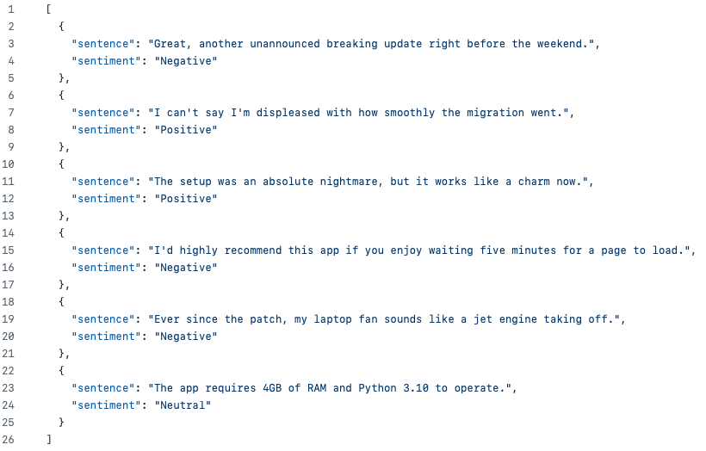
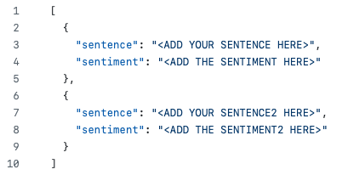
Task 1.1: Run our AI Models
PART 1
Read the test dataset in the testset.json file and
write your own training set in the trainset.json file
Test Dataset
Training Dataset
30
Notes:
Explain what we do in this task.
We want to predict the test dataset (left side) by typing the train dataset (right side) on our own.
We should emphasize that we are not training the models actually (meaning changing the weights inside),
but merely doing prompt refinement; explaining what we want our model to learn basically
Remind everyone that they can copy the files from the solutions folder as well if needed.
Showcase that on screen as well.

Slide 31
Task 1.1 – our golden run: the sentiment agent
PART 1
Run the sentiment analysis script and modify the trainset.json to pass all the tests
Expected Outcome
[6/6] ✅ PASS
Sentence: "The app requires 4GB of RAM…"
Expected: Neutral
Predicted: Neutral
Tokens: In: 412 | Out: 96 | Total: 508
----------------------------------------
EVALUATION, TOKENS & THROUGHPUT SUMMARY
Untrained Baseline Accuracy: 66.7%
DSPy Compiled Accuracy: 83.3%
Net Accuracy Improvement: +16.7%
SCRIPT TOTAL: 6913 tokens | 21.40s
python3 main.py
Goal: compiled accuracy > baseline
Each line shows the reasoning, the latency and the tokens of one call
illustrative output – your numbers will differ
31
Notes:
Define what we will do: run python3 main.py to solve the sentiment analysis problem.
This runs the sentiment analysis with our own agent and our own training set (trainset.json).
IMPORTANT: there is NO feedback loop here. The agent does not retry or correct itself after a wrong answer.
- This small example uses the DSPy optimizer as a black box: it takes the labeled examples of trainset.json and compiles them into the agent's prompt once (few-shot examples). Then every test sentence is answered one time.
- So the only thing you change is the training set: better examples, a better prompt, a higher accuracy.
- Feedback loops (an agent that reads a tool report and tries again) come next, with the testbench agent, and then in Parts 2-4.

Slide 32
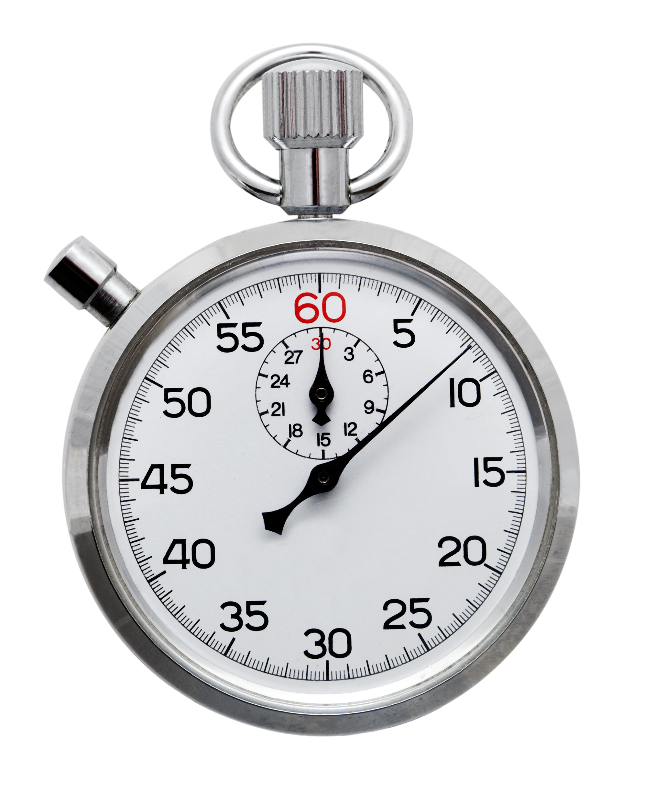
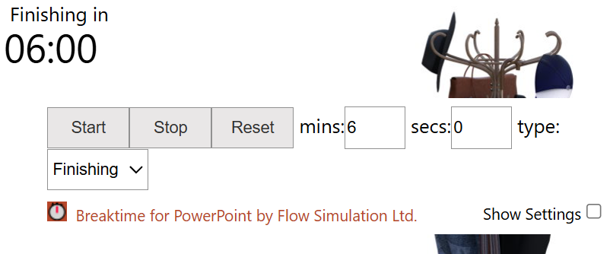
Task 1.1 – your turn: build the training set
PART 1
1
Go to the exercise
inside the container. You change only trainset.json; testset.json is the exam
cd /home/scripts/part1/sentiment_analysis/problem
ls
2
Run the baseline
nothing changed yet. Write down Untrained Baseline Accuracy: … – the number to beat
python3 main.py
3
Teach by examples
on your laptop open scripts/part1/sentiment_analysis/problem/trainset.json. Add about 6 sentences with their label: 2 Positive, 2 Neutral, 2 Negative. Pick tricky ones (negation, sarcasm). Never copy test sentences. Save.
4
Run again
DSPy compiles your examples into the prompt. Write down DSPy Compiled Accuracy: … and compare with step 2
python3 main.py
5
Compare with ours
the same script with our training set. Is yours better?
cd ../solution
python3 main.py
Two numbers, same test set: Untrained Baseline = the agent without optimization (Agent.md only). DSPy Compiled = the same agent after DSPy optimized its prompt with your examples. The difference is what the optimization bought.
✓ CHECKPOINT DSPy-optimized accuracy ≥ un-optimized baseline, and you know which test sentence was the hardest
32
Notes:
Step by step guide for the sentiment analysis problem. We also do it on screen, step by step.
- Step 2 gives the Untrained Baseline Accuracy: the agent WITHOUT optimization, only its Agent.md.
- Step 4 gives the DSPy Compiled Accuracy: the SAME agent after DSPy optimized its prompt with your training examples.
- Both are measured on the same test set, so the difference is exactly what the optimization bought you: optimized vs un-optimized agent.
- Step 5: run our solution with our training set and compare.
TIME: 8 minutes.

Slide 33
Task 1.2: The Google verification problem
PART 1
A hackathon problem by Google at ICLAD 2025: can an AI agent write a testbench from a specification written in plain English?
specification.md
what the module must do, in plain English
Your agent
Agent.md + model
tb.v
the testbench it writes
✗
✗
✗
✗
✗
✗
✗
✗
✗
✗
✗
✗
✗
✓
✗
✗
✗
✗
✗
✗
✗
✗
✗
✗
✗
✗
✗
✗
✗
✗
✗
31 implementations (mutants): exactly ONE is correct
The goal
The testbench must PASS the one correct implementation and FAIL all 30 buggy ones. The agent never sees which one is correct – only how many passed.
Mutants passed
= 1 correct testbench
> 1 too weak: add checks
= 0 wrong or too strict
10 designs, roughly from simple to complex
enc_bin2gray
enc_bin2onehot
shift_left
shift_right
counter
lfsr
ecc_sed_encoder
credit_receiver
fifo_flops
cdc_fifo_flops_push_credit
Next slides: first the human runs the tools, then the agent runs them itself (single pass → iterative loop).
33
Notes:
SAY: The second Part 1 exercise comes from a real competition: a hackathon problem by Google at ICLAD 2025, the conference on LLM-aided design.
- The question: can an AI agent write a testbench from a specification written in plain English?
- What the agent gets: the specification (specification.md) and 31 implementations of the module, called mutants. Exactly one is correct; the other 30 each have a small bug.
- What it must produce: one testbench (tb.v) that passes the correct implementation and fails all 30 buggy ones.
- The difficulty: the agent never knows which implementation is the correct one. It only learns how many passed its testbench. 1 = perfect; more than 1 = the testbench misses bugs; 0 = the testbench itself is wrong or too strict.
- There are 10 designs, from a simple binary-to-Gray encoder to a FIFO with credit-based flow control. enc_bin2gray is the one we use on screen.
- Why it matters: verification is most of the effort in real chip projects, and a testbench that misses bugs is worse than no testbench - it gives false confidence.
TIME: 2 minutes.

Slide 34
Task 1.2: The Google verification problem
PART 1
Agent writes the Testbench of an RTL
RTL
+
Specification
Agent drafts candidate TB
Human runs Icarus and Yosys
Human reads the exit codes
Human validates with golden TB
If checks fail: revise candidate TB and rerun
Agent writes the testbench
Human validates syntax errors/synthesis
34
Notes:
Explain what we do at this point.
The agent gets the RTL+specs and drafts the TB (the blue)
While human does the rest (red)

Slide 35
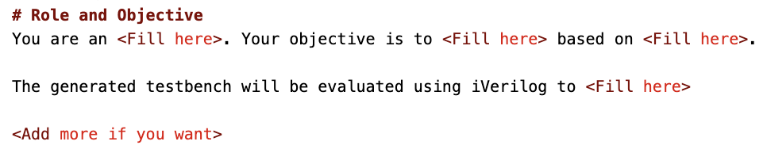
Task 1.2: The Google verification problem
PART 1
Modify the Agent.md file in the scripts/part1/google_verification/problem directory
Fill the blanks in order to prompt refine the agent
Models know a lot already: it may work even without prompt refinement
35
Notes:
We will open the Agent.md file on screen (on the part1 directory)
We will go through each step quickly here and showcase on our laptop as well.
They have to undertstand the main idea so that they can replicate it/create there own afterwards.

Slide 36
Task 1.2 – our golden run: a single pass
PART 1
Run the agent to solve the google problem
You can try to solve it for different target RTLs
Just write python3 single_pass.py <design>
Inside the scripts/part1/google_verification directory
Expected Outcome
Generating Testbench via DSPy for 'enc_bin2gray'...
======= EVALUATION & PERFORMANCE SUMMARY =======
Design Folder: enc_bin2gray
Mutants Passed: 1
Golden TB Saved: .../enc_bin2gray/golden.tb
Generation Time: 14.30 seconds
Token Usage: Prompt: 1874 | Completion: 912
Throughput: 38,996.1 TPM (649.94 TPS)
python3 single_pass.py enc_bin2gray
illustrative output – your numbers will differ
Mutants passed = 1 the TB isolates the correct RTL
Mutants passed > 1 too weak: add checks
Mutants passed = 0 wrong or too strict
36
Notes:
Once the agent is completed, just type:
python3 single_pass <folder_name>
Where each folder represents a different RTL.
Enc_bin2gray is supposedly an easy RTL.
Counter more difficult
We will show bin2gray on screen.
With the current Agent.md, enc_bin2gray usually works in one pass (Mutants Passed: 1), even on Gemini Flash Lite.
A harder design (shift_right, counter) usually does not: several mutants pass. The next slides add the loop, where the tool results go back to the agent.

Slide 37
Task 1.2: The Google verification problem
PART 1
Single-Agent Closed-Loop Self-Correction
RTL
+
Specification
Agent drafts candidate TB
Icarus + Yosys checks
Parse failures + exit codes
Human validates with golden TB
If checks fail: revise candidate TB and rerun
Automated Agentic AI flow – the tools are run by agents
Human still needs to validate functionality
37
Notes:
This is a different, more “agentic” flow.
Because now the agent is responsible for running the tools and reading the logs (jobs that the human did before)
And it will correct itself through the logs.
Still the human is responsible for validating.
Time: 6 minutes

Slide 38
Task 1.2 – our golden run: the loop
PART 1
Now the agent loops: the tool results go back to it
It corrects its own testbench, up to 10 iterations
Just write python3 iterative.py <design>
Inside the scripts/part1/google_verification directory
Expected Outcome
======== Iteration 1/10 ========
Outcome: 4 mutant(s) passed.
======== Iteration 2/10 ========
Outcome: 1 mutant(s) passed.
SUCCESS! Exactly 1 mutant isolated
in 2 iteration(s).
==== CUMULATIVE ITERATIVE RUN SUMMARY ====
Target Design: enc_bin2gray
python3 iterative.py enc_bin2gray
illustrative output – your numbers will differ
Mutants passed = 1 the TB isolates the correct RTL
Mutants passed > 1 too weak: add checks
Mutants passed = 0 wrong or too strict
38
Notes:
The same exercise with the closed loop of the previous slide:
python3 iterative.py <folder_name>
After every testbench the evaluator runs all 31 mutants and the result goes back to the agent: how many passed, or the compile error.
The agent corrects its testbench, up to 10 iterations, and stops when exactly 1 mutant passes.
Compare with the single pass of two slides ago: same Agent.md, same model, but now the agent sees the tool results.

Slide 39

Task 1.2 – your turn: fill the prompt, run both
PART 1
1
Go to the exercise
inside the container. enc_bin2gray holds specification.md and 31 files mutant_*.v: only ONE is correct
cd /home/scripts/part1/google_verification/problem
ls enc_bin2gray
2
Fill the blanks in the prompt
on your laptop open scripts/part1/google_verification/problem/Agent.md. Replace every <Fill here>: who the agent is, its objective, what the testbench is used for. Add rules of your own if you want. Save. Golden: ../solution/Agent.md
3
One shot
the agent writes one testbench. Read Mutants Passed: 1 = perfect · more than 1 = too weak · 0 = wrong or too strict
python3 single_pass.py enc_bin2gray
4
The agentic loop
now the tool results go back to the agent, up to 10 times, until exactly 1 mutant passes
python3 iterative.py enc_bin2gray
5
Run it again later?
the scripts skip a design that already has a golden testbench: --force runs it anyway
python3 single_pass.py enc_bin2gray --force
✓ CHECKPOINT exactly 1 mutant passes. Then try a harder design: fifo_flops or counter
39
Notes:
Step by step instructions for everyone to follow.
Will also do it on screen.
TIME: 12 minutes (slides 30-35 together: about 15 minutes).

Slide 40
Stuck? Quick fixes
PART 1
API key … not set
edit scripts/api_keys.sh on your laptop, then:
source /home/scripts/api_keys.sh
503 UNAVAILABLE / model is overloaded
too many people on the same model: run again, or switch model
--profile gemini_lite
Run the script from its own folder
the flows must be started inside problem/ or solution/
cd /home/scripts/part2/problem
Ollama: connection refused
start the local model server, then get the model
ollama serve > /dev/null 2>&1 &
Part 1 Google: nothing happens
a golden testbench already exists for that design
python3 single_pass.py enc_bin2gray --force
A run takes forever
stop it, pick a quicker design
Ctrl+C then try enc_bin2gray
Something else
check the whole environment in 30 s
python3 /home/scripts/regression/regression.py --quick
Still stuck? Raise your hand – or pair up with your neighbour and keep following.
40
Notes:
Some quick fixes for us and the attendants.
Reminder for us to ask if everyone is able to do it and come help those that struggle.
Should make sure everyone follows along.

Slide 41
Part 2
Modular NL-to-GDSII Tasks with Models and Feedback
Task decomposition
Zero/Single-Shot vs. Iterative Loops
SLM vs LLM for NL-to-GDSII
Closed-Loop Verilog Self-Correction
Validator Agent
Notes:
The main idea of part 2 is that:
Use the agents for EDA flow (ASU Spec2Tapeout)
We can optimize the agents in several ways (eg Task decomposition (breaking down the problem), Iterative loops, SLM-LLM hybrid approach) each optimization serves a different purpose (reduce tokens, increase performance etc)
Also talk about LLM as a validation concept

Slide 42
Why decompose an agent task?
PART 2
Natural language design specification
Single agent
Decomposed agents
One response contains RTL, testbench, SDC and PnR settings
Huge Task = More Context
Planner defines smaller tasks and acceptance checks
Smaller Tasks = Less Context
RTL + interface
TB + assertions
+ Accuracy
Sees the whole task: with enough context it can understand it better than smaller agents
SDC + clocks
PnR settings
− Tokens and time
One huge prompt per call; a failure means re-checking every output
+ Tokens and time
Small prompts, less context: faster and cheaper; a failed task is fixed on its own
42
Notes:
Why decompose? Context is a very important metric.
- Single agent: one agent gets the whole task. Given enough context, it can understand the whole task BETTER than smaller decomposed agents, so it can be more accurate. The price: a huge prompt on every call, more tokens, more time, and a failure means re-checking every output.
- Decomposed agents: each agent gets a small task and only the context it needs. In terms of execution time and tokens they win: smaller input prompts and rules, faster and cheaper calls, and a failed task is fixed on its own.
- So it is a trade-off: accuracy (whole picture) vs efficiency (tokens, time). Excessive or irrelevant context can also reduce reasoning accuracy, which is why decomposition often wins on accuracy too for big tasks.
We will see in the next slides how to optimize task decomposition.

Slide 43
Bridging SLM–LLM Gap
PART 2
How can we leverage benefits of each – SLM and LLM especially for low-cost computing?
Reduce cost of cloud tokens and offload to SLMs on Edge devices
☁ Cloud LLM
offload template tasks
💻 Local SLM
Gemini · Claude Sonnet
llama3.1 8B on Ollama · Claude Haiku
+ strong reasoning, long context
+ free tokens, no rate limit
+ works zero-shot
+ private, can run air-gapped
− pay per token, every iteration
− weaker reasoning
− the design leaves your company
− needs precise prompts / examples
escalate what needs reasoning
In this tutorial
2c / 2d: TB + RTL on Gemini, SDC + config.mk on local llama3.1 · Part 4: Sonnet plans and corrects, Haiku executes
43
Notes:
Why LLMs and SLMs hybrid approach is an optimization.
The headline is that “they are different tools, so they should be used for different tasks”

Slide 44
Bridging SLM–LLM Gap
PART 2
How can we leverage benefits of each – SLM and LLM especially for low-cost computing?
Reduce cost of cloud tokens and offload to SLMs on Edge devices
Hybrid Systems
Task Decomposition
Multiple Agents
Distillation learning
Divide & Conquer approach
Train different agents
LLM planner + SLM executor
SLMs provide good results for small tasks
Utilize an optimal agent for a specific task
Use different agents based on task difficulty
Use LLMs for validation
Focus on task rather than general reasoning
LLMs and SLMs are different tools and we want to play to their strengths
44
Notes:
These are the ways we can exploit LLMs and SLMs

Slide 45
Agentic AI EDA Flow with Obvious Task Decomposition
PART 2
Design specification
Planner: dependencies + task contracts
01 RTL agent
02 TB agent
03 SDC agent
04 PnR agent
Module behavior
ports + latency
Needs RTL ports
Tests + assertions
Clocks
I/O constraints
Needs RTL + SDC
Floorplan settings
Validation gate: artifact + status + tool evidence
Promote validated outputs to the next EDA stage
45
Notes:
At this point we remind everyone of the current approach of task composition.
(In the next slide we show how LLMs and SLMs are utilized)

Slide 46
Agentic AI EDA Flow with LLM-SLM Hybrid Approach
PART 2
Design specification
Planner: dependencies + task contracts
Template-based Task
We use SLMs
Task Requires Reasoning
We use LLMs
01 RTL agent
02 TB agent
03 SDC agent
04 PnR agent
Module behavior
ports + latency
Needs RTL ports
Tests + assertions
Clocks
I/O constraints
Needs RTL + SDC
Floorplan settings
Validation gate: artifact + status + tool evidence
Promote validated outputs to the next EDA stage
46
Notes:
As we stated before:
LLMs -> Reasoning -> so we apply them to reasoning based tasks such as RTL and TB design
SLMs -> Templated-based -> so we use it for SDC and PnR
The exact split is an example. We will showcase later on how to do it more optimally.

Slide 47
Task 2 – overview: four ways to run the flow
PART 2
Task | Agents & models | What to look for?
Task 2.1 Single agent | 1 agent writes TB + RTL + SDC + config.mk · Gemini Flash Lite | Which stages fail? Runtime?
Task 2.2 Multi-agent | TB, RTL, SDC, config.mk agents · all Gemini Flash Lite | Iterations per stage and tokens vs Task 2.1
Task 2.3 Hybrid models | TB + RTL: Gemini Lite (cloud) · SDC + config.mk: llama3.1 (local) | Can a local SLM handle the template tasks?
Task 2.4 + Validators | As Task 2.3 + TB and RTL validator agents | Bugs caught earlier? Worth the extra tokens?
All runs: iterative_optimization = false, enable_resynthesis = false. Run from part2/problem: python3 asic_autonomous_flow.py --config run_configs/<run>.yaml
47
Notes:
These are the 4 kind of hands-on experiments we will conduct.
This slide can be skipped in session, but it is nice at least for us to know what to expect.

Slide 48
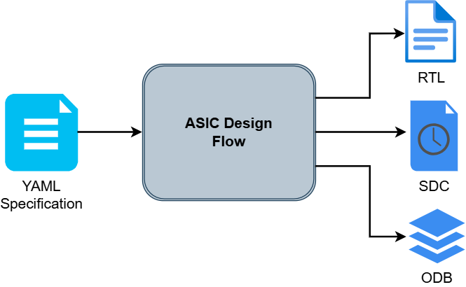
ASU Spec2Tapeout problem
PART 2
Going from the Design Specification to the EDA result using the agents
48
Notes:
The ASU Spec2Tapeout problem:
from a YAML specification to RTL, SDC and a final layout (ODB), s
scored for power, performance and area.
Each spec now has a 'timing' section: the latency contract between the testbench and the RTL.
Tools in the loop: Icarus Verilog, Yosys, OpenROAD flow scripts, and a PPA evaluation script.
In plain words: the input is a written specification, the output is a chip layout with a score. The agents do every step in between.

Slide 49
How we score a layout: against our golden run
PART 2
Golden run = a run of the full flow that we did ourselves with the reference RTL and a simple, NOT optimized config.mk. Its results are stored in evaluation/visible/pN/pN.json. The agents must match it or beat it.
agent's layout
6_final.odb + SDC
evaluate_openroad.py
OpenROAD measures WNS, TNS, power, area
compare with golden
pN.json
score / 100
80 ≈ as good as ours
Metric
Points
Golden gets
How the agent's value is scored (vs golden)
WNS worst slack
40
30
30 + 40 × (WNS − WNS gold), at most ±10 → 0.25 ns more slack = +10
TNS total neg. slack
20
15 (20 if TNS = 0)
15 ± 5 × relative change; golden TNS = 0: TNS = 0 gives 20, any violation 10
Power
20
15
15 + 20 × (P gold / P − 1), at most ±5 → 20% less power = +5
Area
20
15
15 + 20 × (A gold / A − 1), at most ±5 → 20% less area = +5
Total 100 max. The golden layout itself scores 80 (75 for p9 and p13, whose golden run has negative slack).
WNS Score: 30.00/40
TNS Score: 20.00/20
Power Score: 15.00/20
Area Score: 15.00/20
Final Score: 80.0/100
Negative slack = warning
WNS < 0: the timing points drop and the agent sees it in the score report. WNS < −0.5 ns: ❌ severe timing violation – Part 3 sends the RTL agent back (resynthesis).
Above 80: the agents beat our golden run. Part 3 keeps optimizing until the score reaches score_threshold (92).
49
Notes:
How the PPA score works. Every hands-on in Parts 2-4 ends with this number, so make sure everyone understands it.
- The golden run: a run we did ourselves with the reference RTL and a simple config.mk. It is NOT optimized on purpose, so the agents can beat it. Its OpenROAD metrics are stored in evaluation/visible/pN/pN.json.
- evaluate_openroad.py loads the agent's final layout (6_final.odb) and the SDC into OpenROAD, measures WNS, TNS, power and area, and compares each one with the golden values.
- WNS (40 points): 30 if equal to golden; +/-40 points per ns of difference, capped at +/-10. So 0.25 ns more slack than golden gives the full 40.
- TNS (20 points): 15 plus up to +/-5 for the relative change. When the golden TNS is 0 (most designs): 20 if the agent has no violations, 10 if it has any.
- Power and area (20 each): 15 if equal; +/-20 points times the relative change, capped at +/-5. 20% less power or area gives the full 20.
- The golden layout itself scores 80 (WNS 30 + TNS 20 + 15 + 15). For p9 and p13 the golden run has negative slack, so it scores 75 there.
- Negative slack is the warning sign: the timing points drop, and the score report sent to the agent shows it. Below -0.5 ns the flow prints a severe timing violation and Part 3 sends the RTL agent back (resynthesis).
- Part 3 keeps optimizing until the score reaches score_threshold (92 in our run config).
TIME: 3 minutes.

Slide 50
11 designs: from a 5-minute counter to an FP16 multiplier
PART 2
ID
Module
What it is
Clock (ns)
Scored
p11
simple_8bit_counter
8-bit counter, sync reset + enable
2.0
✔
fast demo
p12
registered_adder_8bit
8-bit adder with output register
1.5
✔
p13
sliding_window_avg_8bit
4-tap moving average
2.5
✔
p14
alu_8bit
8-op ALU, zero + carry flags
2.5
✔
new
p1
seq_detector_0011
Moore FSM, detects 0011
1.1
✔
quick scored
p15
uart_tx
UART transmitter 8N1, FSM
2.0
✔
new
p16
sync_fifo
8 × 8 FIFO, full / empty
2.0
✔
new
p5
dot_product
2-stage pipelined dot product
4.5
✔
p7
exp_fixed_point
2-stage Taylor e^x, fixed point
4.5
✔
p9
fir_filter
8-tap pipelined FIR
8.0
✔
p8
fp16_multiplier
IEEE half-precision ×, combinational
9.0
✔
default
✔ every design has a golden run (evaluation/visible/pN/pN.json): your layout is scored against it (previous slide)
What a spec looks like (p11, shortened)
timing: the delay contract both the testbench and the RTL agent read – added after our own runs failed on it
simple_8bit_counter:
clock_period: 2.0ns
ports: clk, reset, en, count[7:0]
logic_rules: [if reset: 0, elif en: +1]
timing: | # latency contract
count updates at each rising edge
Every design: spec + reference testbench + golden RTL (scripts/reference). Pick one with --design pX.yaml
50
Notes:
Eleven designs, from the simplest to the hardest.
- Every design has a golden run, so every layout gets a score against it (previous slide).
- Start with p11 (the counter): it runs in a few minutes. p8 (the FP16 multiplier) is the default of the run configs and the hardest.
- The timing section in every spec is the latency contract that the testbench agent and the RTL agent both read.

Slide 51

Task 2.1 – Spec2Tapeout with a single agent
PART 2
Task 2.1 (run config 2a): ONE agent, ONE prompt, all four files in a single answer
The single agent gets
• the YAML spec + its timing section
• the SDC and config.mk templates
• one prompt with ALL the rules: configs/single_agent/Agent.md
• feedback from the first check that fails
It must fix one file without breaking the other three
Checked in this order
1 TB compiles
2 RTL simulation passes
3 SDC matches template
4 Yosys synthesis clean
5 config.mk filled (the knobs: next slide)
6 OpenROAD flow
7 PPA score
python3 asic_autonomous_flow.py --config run_configs/2a_single_agent.yaml
51
Notes:
Run 2a: one agent, one prompt, all four files in one answer.
(The original approach which is also the ‘brute force’ approach -> very inefficient. (we could ask the audience why to generate a conversation -> context)
- Its prompt contains every rule (testbench, RTL, SDC, config.mk).
The checks run in order; the first one that fails stops the iteration and its report goes back to the same agent, which must fix it without breaking the other three files.
What to observe:
which stage fails first,
how many iterations,
how big the prompt is (token summary at the end).
- Typical result: works for simple designs, struggles as the design grows. A good motivation for decomposition.
In plain words: one agent writes all four files at once; any failing check sends everything back to it.
Note: this is the SINGLE-AGENT run (2a), not single shot - it still iterates up to the limit; one agent does everything.
TIME: 3 minutes (part of the 12 minutes of Part 2 concepts).

Slide 52

The knobs: what the agents can tune
PART 2
config.mk – the OpenROAD settings the config.mk agent fills in and tunes
Parameter
What it changes
Start value
CORE_UTILIZATION
% of the core filled with cells: higher = smaller chip, harder to route
20 small / 50
PLACE_DENSITY
how tightly the placer packs the cells
0.55
CORE_ASPECT_RATIO
core height / width
1.0
CORE_MARGIN
space between the core and the die edge (µm)
1.0
ROUTING_LAYER_ADJUSTMENT
share of routing capacity kept free (0–1): against congestion
0.5
ABC_AREA
synthesis goal: 1 = smaller area, 0 = faster
0
RESYNTH_TIMING_RECOVER
1 = extra synthesis pass to recover timing
0
RECOVER_POWER
% of non-critical paths slowed down to save power
0
Every knob, its start value and how to change it for each OpenROAD error is explained in configs/config_mk_generator/Agent.md
Run settings (run_configs/*.yaml)
Which model each agent uses (profile in configs/<agent>/config.yaml, with its temperature) and the iteration limits: max_rtl_gen_iters, max_physical_iters … = 10.
Yosys: no knobs
Synthesis runs with fixed settings. The only requirement: the synthesized netlist must still pass simulation (post-synthesis check with verification_mode: BOTH).
Hands-on: open the config.mk of your run – which values did the agent choose, and why?
52
Notes:
The hyperparameters. We keep them off the run slide (2a) to keep it simple, and show them here once, because they are the same for every run.
- config.mk is the only file with real tuning knobs. The config.mk agent fills in the eight placeholders of the template and, in Part 3, keeps tuning them.
- CORE_UTILIZATION and PLACE_DENSITY are the most important: higher values give a smaller chip (better area score) until routing fails with congestion.
- Small designs start at 20% utilization: a very small core is too narrow for the power straps (error PDN-0185).
- The golden Agent.md of the config.mk agent (part2/solution/configs/config_mk_generator/Agent.md) explains every knob, its start value and how to change it for each OpenROAD error. That file is a good example of expert knowledge written down for an agent.
- Run settings: which model each agent uses (profile and temperature in configs/<agent>/config.yaml) and the iteration limits in run_configs/*.yaml.
- Yosys has no knobs in our flow: it runs with fixed settings. The only requirement is that the synthesized netlist still passes simulation (post-synthesis check, verification_mode: BOTH).
TIME: 2 minutes.

Slide 53
Task 2.1 – our golden run: a single agent
PART 2
1
Go to the golden folder
solution/ = our finished prompts and run configs
cd /home/scripts/part2/solution
2
Run the single agent
run config 2a, on the 8-bit counter (p11)
python3 asic_autonomous_flow.py \
--config run_configs/2a_single_agent.yaml \
--design p11.yaml
3
What the flow did
3 model calls until every check passed, then one OpenROAD run
✅ Success! OpenROAD Flow completed successfully.
✅ Success! Agentic flow completed successfully.
4
The result
illustrative output – your numbers will differ
WNS 34.77/40 TNS 20.00/20
Power 20.00/20 Area 16.55/20
Final Score: 91.3/100
5
Where the files are
results/ every iteration · solution/ final RTL + layout · token_usage.json
ls runs/2a_single_agent/
RESULT score 91.3/100 (our golden layout = 80) · 2.1 min · 27k tokens
53
Notes:
What we run in solution/ for Task 2.1 and what the result looks like.
- One agent writes the testbench, the RTL, the SDC and the config.mk.
- Result: Final Score 91.3/100, above our golden layout (80). 2.1 minutes, 27k tokens, 3 model calls, one OpenROAD run.
- The numbers on the slide come from our recorded rescue run of this run config (scripts/rescue/runs, design p1).
- The next slide is the attendees' turn.

Slide 54
Task 2.1 – your turn: fill the single agent's prompt
PART 2
1
Open the prompt on your laptop
<Fill here> = a blank you must fill · <Add more if you want> = optional
scripts/part2/problem/configs/
single_agent/Agent.md
2
Role and Objective
top of the file: say who the agent is (an expert …) and what it is given (the … specification)
You are an <Fill here> ... for the given <Fill here>.
# golden: expert ASIC design engineer.
# golden: YAML specification
3
Testbench: clock and reset
search for CLOCK & RESET: say what to generate, and what to assert at time 0
Generate a <Fill here>
Assert the <Fill here> at time 0 ...
# golden: clock with the spec's clock_period · reset port
4
config.mk: start values
search for STARTING VALUES: one number per knob (see the knobs slide). Save the file
CORE_UTILIZATION = <Fill here> PLACE_DENSITY = <Fill here>
CORE_ASPECT_RATIO = <Fill here> CORE_MARGIN = <Fill here>
# golden: 20 small / 50 · 0.55 · 1.0 · 1.0
5
Run it, then compare
inside the container, from /home/scripts/part2/problem. Golden: ../solution/configs/single_agent/Agent.md
python3 asic_autonomous_flow.py \
--config run_configs/2a_single_agent.yaml \
--design p11.yaml
✓ CHECKPOINT no <Fill here> left, and the log ends with Agentic flow completed successfully and a Final Score
54
Notes:
Where the attendees change things for run 2a (single agent), with our golden answers.
- In problem/ the single agent's prompt (configs/single_agent/Agent.md) has blanks marked <Fill here>. <Add more if you want> is optional.
- Step 2: the role and what the agent is given (golden: an expert ASIC design engineer, the YAML specification).
- Step 3: testbench rule 2, clock and reset (golden: a clock with the spec's clock_period; assert the reset port).
- Step 4: the config.mk start values, the knobs of the previous slide (golden: CORE_UTILIZATION 20 for small designs and 50 otherwise, PLACE_DENSITY 0.55, CORE_ASPECT_RATIO 1.0, CORE_MARGIN 1.0).
- Step 5: run 2a on p11 and compare with the golden prompt in solution/. The golden run config also allows 20 iterations instead of 10 (max_single_agent_iters).
- Run 2d works the same way: the role blanks in configs/tb_validator/Agent.md and configs/rtl_validator/Agent.md (golden: Design Verification Engineer; senior RTL verification lead, YAML specification).
DO: open the problem and the solution Agent.md side by side on the projector.

Slide 55
Task 2 – overview: four ways to run the flow
PART 2
Task | Agents & models | What to look for?
Task 2.1 Single agent | 1 agent writes TB + RTL + SDC + config.mk · Gemini Flash Lite | Which stages fail? Runtime?
Task 2.2 Multi-agent | TB, RTL, SDC, config.mk agents · all Gemini Flash Lite | Iterations per stage and tokens vs Task 2.1
Task 2.3 Hybrid models | TB + RTL: Gemini Lite (cloud) · SDC + config.mk: llama3.1 (local) | Can a local SLM handle the template tasks?
Task 2.4 + Validators | As Task 2.3 + TB and RTL validator agents | Bugs caught earlier? Worth the extra tokens?
All runs: iterative_optimization = false, enable_resynthesis = false. Run from part2/problem: python3 asic_autonomous_flow.py --config run_configs/<run>.yaml
55
Notes:
Where we are in Task 2: the highlighted row, Task 2.2, is next.

Slide 56
Tasks 2.2 to 2.4 – Spec2Tapeout with multiple agents
PART 2
Task 2.2: one agent per file, all on Gemini Flash Lite · Task 2.3 (hybrid): same agents, template tasks on a local SLM
TB validator (Task 2.4)
RTL validator (Task 2.4)
TB agent
RTL agent
SDC agent
config.mk agent
Gemini Flash Lite
cloud LLM
Gemini Flash Lite
cloud LLM
llama3.1
local SLM
llama3.1
local SLM
Models shown: Task 2.3. In Task 2.2 every agent uses Gemini Flash Lite. Validators: Task 2.4. Each agent has its own model (configs/<agent>/config.yaml) and its own prompt (Agent.md).
# Task 2.2: all agents on Gemini Flash Lite
python3 asic_autonomous_flow.py --config run_configs/2b_multi_agent.yaml
# Task 2.3 / 2.4: mixed cloud + local models (ollama pull llama3.1 first)
python3 asic_autonomous_flow.py --config run_configs/2c_multi_agent_mixed_models.yaml
56
Notes:
We did before the single-agent approach (2a).
Now we are trying task decomposition with the LLM (multi-agent)
After that, we are trying the hybrid approach with LLMs and SLMs
And we are closing with the validator LLM that reviews the RTL and TB generated before Runs 2b to 2d: one agent per step, each with its own model and prompt.
- 2b: all four agents on Gemini Flash Lite.
- 2c: TB and RTL on the cloud LLM, SDC and config.mk on local llama3.1. Run 'ollama pull llama3.1' first.
- 2d: as 2c plus a TB validator and an RTL validator that review the work before/after the simulator.
- Compare the token summaries: where do the tokens go? Does the local model cope with the template tasks? Do validators catch bugs earlier?
In plain words: four specialists instead of one generalist, each with the model that suits its task.
Slide summary: 2b = multi-agent, every agent on Gemini Flash Lite. 2c = the same agents, hybrid: TB and RTL on the cloud LLM, SDC and config.mk on local llama3.1. The models drawn on the slide are those of 2c; the validators are the optional run 2d.
TIME: 3 minutes.

Slide 57
How to read the flow's log
PART 2
--- RUNNING RTL SIMULATION ---
the simulator runs the RTL with the agent's testbench
❌ RTL simulation failed. Feeding back errors to agent...
the error text goes into the agent's next prompt: a new iteration
✅ Success! RTL verified after 3 iterations.
this stage passed, the next agent starts
❌ OpenROAD flow failed. Feeding back errors to agent...
the config.mk agent gets the layout tool's error
✅ Success! OpenROAD Flow completed successfully.
a real layout of the chip exists
Final Score: 90.2/100
PPA against the reference: 75–80 = as good as our golden design
Reached max iterations (10) ...
the agent gave up: time to improve its Agent.md
TOKENS & THROUGHPUT SUMMARY
the cost: tokens per agent and per step
The full log, with every prompt and every tool report, is in runs/<run>/asic_autonomous_flow.log
57
Notes:
Quick guide on how to evaluate the flow’s output.

Slide 58
Task 2.2 – our golden run: one agent per file
PART 2
1
Go to the golden folder
solution/ = our finished prompts and run configs
cd /home/scripts/part2/solution
2
Read the spec
an 8-bit counter: ports, clock, rules, and the timing contract
cat ../designs/p11.yaml
3
Run the team of agents
run config 2b: TB, RTL, SDC and config.mk agents, all on Gemini Flash Lite
python3 asic_autonomous_flow.py \
--config run_configs/2b_multi_agent.yaml \
--design p11.yaml
4
Watch the stages
testbench → RTL (simulation + synthesis) → SDC → config.mk → OpenROAD → score. The RTL passed at the first iteration
5
The result
illustrative output – your numbers will differ
WNS 35.99/40 TNS 20.00/20
Power 20.00/20 Area 14.21/20
Final Score: 90.2/100
RESULT score 90.2/100 (our golden layout = 80) · 81 s · 16k tokens · fewer tokens than the single agent (27k)
58
Notes:
What we run in solution/ for Task 2.2 and what the result looks like.
- Four agents, one per file, all on Gemini Flash Lite.
- Result: Final Score 90.2/100. 81 seconds and 16k tokens: about the same score as the single agent of Task 2.1 with fewer tokens, because every agent gets a small prompt.
- The numbers on the slide come from our recorded rescue run of this run config (scripts/rescue/runs, design p1).
TIME: 10 minutes - start the run first, explain while it runs.

Slide 59
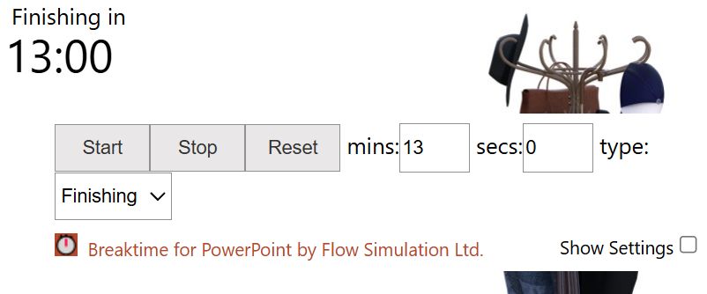
Task 2.2 – your turn: make an agent better, then check it
PART 2
1
Run it, and read the log like an engineer
python3 asic_autonomous_flow.py --config run_configs/2b_multi_agent.yaml --design p11.yaml · which message repeats, e.g. RTL simulation failed ? What would YOU fix by hand?
2
Open that agent's prompt
on your laptop: scripts/part2/problem/configs/<agent>/Agent.md – tb_generator, rtl_generator, sdc_generator or config_mk_generator
3
Write that knowledge into the Agent.md
add ONE rule under # Mandatory Rules, or a hint in a feedback section, e.g. Use Verilog-2001 only: no 'logic', no SystemVerilog. Save the file.
4
Rerun, compare with the golden run
the same command again. Does it pass now? Fewer iterations? Fewer tokens? Score 80 = our golden layout
python3 asic_autonomous_flow.py ...
5
Sign off the final RTL
our own testbench re-checks the agent's design (next slide)
cd /home/scripts/reference
python3 check_designs.py -d p11 --rtl \
../part2/problem/runs/2b_multi_agent/\
solution/p11/simple_8bit_counter.v
Rule of thumb: if you can understand something in the log by hand, write it in the Agent.md – then the agent knows it too.
✓ CHECKPOINT your run passes AND sign-off says PASS. Next: Tasks 2.3 and 2.4
59
Notes:
This is a very interesting hands-on experiment, and the core skill of the tutorial.
- The idea: if there is something in the log that YOU can understand by hand and that would make the agent better, write it into the Agent.md, rerun and compare with the golden run.
- Step 1: read the log like an engineer. Which message repeats? What would you fix by hand?
- Step 3: write that knowledge as a rule (# Mandatory Rules) or as a hint in the feedback message (# Feedback).
- Step 4: rerun and compare: the score (80 = as good as our golden run), the number of iterations and the tokens.
- Step 5: the flow only tells us that the agent's design passed the agent's OWN testbench. check_designs.py re-checks it with OUR testbench (next slide).
TIME: 13 minutes (until the break at 10:20).

Slide 60
Task 2 – overview: four ways to run the flow
PART 2
Task | Agents & models | What to look for?
Task 2.1 Single agent | 1 agent writes TB + RTL + SDC + config.mk · Gemini Flash Lite | Which stages fail? Runtime?
Task 2.2 Multi-agent | TB, RTL, SDC, config.mk agents · all Gemini Flash Lite | Iterations per stage and tokens vs Task 2.1
Task 2.3 Hybrid models | TB + RTL: Gemini Lite (cloud) · SDC + config.mk: llama3.1 (local) | Can a local SLM handle the template tasks?
Task 2.4 + Validators | As Task 2.3 + TB and RTL validator agents | Bugs caught earlier? Worth the extra tokens?
All runs: iterative_optimization = false, enable_resynthesis = false. Run from part2/problem: python3 asic_autonomous_flow.py --config run_configs/<run>.yaml
60
Notes:
Where we are in Task 2: the highlighted row, Task 2.3, is next.

Slide 61
Task 2.3 – our golden run: cloud + local models
PART 2
1
Go to the golden folder
solution/ = our finished prompts and run configs
cd /home/scripts/part2/solution
2
Run the hybrid team
run config 2c: the same four agents as Task 2.2, with two of them on a local model
python3 asic_autonomous_flow.py \
--config run_configs/2c_multi_agent_mixed_models.yaml \
--design p11.yaml
3
What the flow does
the same stages as Task 2.2. Only the model behind two agents changes
TB agent, RTL agent → Gemini Flash Lite
SDC agent, config.mk → llama3.1 (local)
4
What to look at
the time and the tokens of every agent: the local model is free, but slow
sdc_generator SDC generation, iteration 1
1641 tokens 58.1s 1,695.8 TPM
5
Where the files are
results/<design>/ every iteration · token_usage.json: tokens and time per agent
ls runs/2c_multi_agent_mixed_models/
LOOK AT time and tokens per agent: what does the local model cost, and what does it save?
61
Notes:
What we run in solution/ for Task 2.3 and what to look at.
- Run config 2c: the testbench and RTL agents stay on the cloud model (Gemini Flash Lite); the SDC and config.mk agents, which only fill in a template, move to the local llama3.1.
- What to look at: the time and tokens per agent in the summary and in token_usage.json. The local model costs no tokens, but one SDC answer took about a minute in our recorded run (58 s for 1641 tokens).

Slide 62
Task 2.3 – your turn: move work to the local model
PART 2
1
Go to Part 2
inside the container. You work in problem/
cd /home/scripts/part2/problem
2
Check the local model
llama3.1 must be in the list. If it is missing: ollama pull llama3.1 (about 5 minutes)
ollama list
3
See who runs where
open run_configs/2c_multi_agent_mixed_models.yaml on your laptop: every agent has a profile line = its model
sdc_generator: profile: "ollama-llama3.1"
config_mk_generator: profile: "ollama-llama3.1"
# tb_generator, rtl_generator: "gemini_lite"
4
Run it
SDC and config.mk now run on your laptop: slower, but free. Note the time and tokens per agent at the end
python3 asic_autonomous_flow.py \
--config run_configs/2c_multi_agent_mixed_models.yaml \
--design p11.yaml
5
Change the split, run again
edit ONE profile line, e.g. the RTL agent to the local model. Save, run step 4 again, compare time and tokens
rtl_generator:
profile: "ollama-llama3.1"
# then: cat runs/2c_*/token_usage.json
✓ CHECKPOINT you can say which agents a local model can handle – and what it costs in time
62
Notes:
The attendees' turn for Task 2.3. Nothing to fill in here: the change is in the run config.
- Step 3: every agent has a profile line in the run config. 2c puts the SDC and config.mk agents on local llama3.1.
- Step 5: change one profile line (for example the RTL agent to the local model), run again and compare time and tokens per agent in token_usage.json.
WATCH OUT: the local model is slow on a laptop without a GPU.

Slide 63
Task 2 – overview: four ways to run the flow
PART 2
Task | Agents & models | What to look for?
Task 2.1 Single agent | 1 agent writes TB + RTL + SDC + config.mk · Gemini Flash Lite | Which stages fail? Runtime?
Task 2.2 Multi-agent | TB, RTL, SDC, config.mk agents · all Gemini Flash Lite | Iterations per stage and tokens vs Task 2.1
Task 2.3 Hybrid models | TB + RTL: Gemini Lite (cloud) · SDC + config.mk: llama3.1 (local) | Can a local SLM handle the template tasks?
Task 2.4 + Validators | As Task 2.3 + TB and RTL validator agents | Bugs caught earlier? Worth the extra tokens?
All runs: iterative_optimization = false, enable_resynthesis = false. Run from part2/problem: python3 asic_autonomous_flow.py --config run_configs/<run>.yaml
63
Notes:
Where we are in Task 2: the highlighted row, Task 2.4, is next.

Slide 64
Task 2.4 – our golden run: validator agents
PART 2
1
Go to the golden folder
solution/ = our finished prompts and run configs
cd /home/scripts/part2/solution
2
Run with validators
run config 2d (2d_multi_agent_mixed_models_validators.yaml): Task 2.3 + two validator agents
python3 asic_autonomous_flow.py \
--config run_configs/2d_*.yaml \
--design p11.yaml
3
What the flow does
after every testbench and every RTL, a validator agent audits it against the spec
[RTL VALIDATOR] Auditing RTL against spec
and rules...
4
What to look at
what the validators say, and their share of the tokens
calls tokens time
tb_validator 5 13230 12.6s
rtl_validator 10 16534 9.0s
5
Where the files are
token_usage.json: the validators' rows
ls runs/2d_multi_agent_mixed_models_validators/
LOOK AT do the validators catch a bug before the simulator does – and how many tokens does that cost?
64
Notes:
What we run in solution/ for Task 2.4 and what to look at.
- Run config 2d adds two validator agents: one audits every testbench, one audits every RTL, against the spec and a checklist.
- What to look at: the validators' messages in the log and their rows in the token table. Validators add many model calls, so this is the most expensive of the four Part 2 tasks.

Slide 65
Task 2.4 – your turn: fill the validators' prompts
PART 2
1
Open the two prompts on your laptop
both have blanks marked <Fill here> in # Role and Objective
scripts/part2/problem/configs/
tb_validator/Agent.md
rtl_validator/Agent.md
2
TB validator: the role
tb_validator/Agent.md: which kind of engineer audits a testbench?
You are an expert <Fill here> Engineer.
# golden: Design Verification
3
RTL validator: role and reference
rtl_validator/Agent.md: who audits the RTL, and against which document? Save both files
You are a senior <Fill here>. Audit the RTL
against the <Fill here> and the Checklist.
# golden: RTL verification lead · YAML specification
4
Run it
inside the container, from /home/scripts/part2/problem. The validators speak after every testbench and RTL
python3 asic_autonomous_flow.py \
--config run_configs/2d_*.yaml \
--design p11.yaml
5
Compare with Task 2.3
token_usage.json: how many tokens did the validators use? Quota error (429): wait a minute, run again
cat runs/2d_*/token_usage.json
✓ CHECKPOINT no <Fill here> left, and you can say what the validators cost in tokens
65
Notes:
The attendees' turn for Task 2.4: the role blanks of the two validator prompts, with our golden answers.
- TB validator: 'You are an expert Design Verification Engineer.'
- RTL validator: 'You are a senior RTL verification lead. Audit the generated Verilog-2001 RTL against the YAML specification and the Mandatory Validation Checklist.'
WATCH OUT: validators multiply the model calls. On the free Gemini tier a run can stop with a quota error; wait a minute and rerun.

Slide 66
Who checks the agents? check_designs.py
PART 2
Agent writes the testbench
from the spec
Agent writes the RTL
until it passes that testbench
Flow says PASS
1
2
✓
But what if the testbench is wrong?
Agents can hallucinate. Our p8 run: the agent's testbench expected −3 × 4 = −10. A correct multiplier failed again and again, and a wrong RTL could have passed. PASS only means the RTL agrees with the agent's own testbench.
So we check with files the agents never wrote (scripts/reference: our testbench + our correct RTL for every design)
Check the RTL
Run the agent's RTL with OUR testbench → PASS / FAIL
Check the testbench
Run the agent's testbench on OUR correct RTL (must pass) and on buggy copies (must fail) → e.g. 2 / 3 bugs caught
cd /home/scripts/reference
python3 check_designs.py -d p11 \
--rtl <agent's RTL>.v
cd /home/scripts/reference
python3 check_designs.py -d p11 \
--tb <agent's testbench>.v
Hands-on: after your run, do both checks. Which rule in Agent.md would have avoided the problem?
66
Notes:
SAY: The flow says PASS - but who checked the checker?
- The order in the flow: first the agent writes the testbench from the spec, then the RTL agent works until its RTL passes THAT testbench.
- What if the testbench is wrong? Agents can hallucinate. Then a correct RTL fails forever, or a wrong RTL passes. Our own p8 run: the testbench expected -3 x 4 = -10, and the agent kept 'fixing' a multiplier that was right.
- So we check with files the agents never wrote. For every design we have a correct RTL and a thorough testbench, written and verified by us (scripts/reference).
- Check the RTL (--rtl): runs OUR testbench on the AGENT's RTL. PASS means the design really meets the spec.
- Check the testbench (--tb): runs the AGENT's testbench on OUR correct RTL (must pass) and on copies with a small planted bug (must fail). Result e.g. 2 of 3 bugs caught.
DO: if time allows, run the RTL check live on the p11 design from Follow along 2.1.
TIME: 3 minutes.

Slide 67
Part 3
Multi-Agent Collaboration and Cross-Domain Feedback Loops
Cross-Agent Communication
Closed-Loop Multi-Agent
Tool-in-the-Loop Integration
Notes:
Part 3: agents that talk to each other in feedback loops, with the EDA tools in the loop.

Slide 68
Current Agentic AI EDA Flow
PART 3
01 RTL agent
02 TB agent
03 SDC agent
04 PnR agent
68
Notes:
This is established Agentic AI flow.
First we run the RTL, once we are satisfied we move on. Then the TB and so on.

Slide 69
Current Agentic AI EDA Flow
PART 3
01 RTL agent
02 TB agent
03 SDC agent
04 PnR agent
What happens if the PnR agent fails?
69
Notes:
What if we are satisfied with each step but the PnR agent fails?

Slide 70
Current Agentic AI EDA Flow
PART 3
01 RTL agent
Human
02 TB agent
Reads PnR log
Changes PnR parameters according to specs
If it still fails, changes RTL to improve PnR
Instructs the agents accordingly
03 SDC agent
04 PnR agent
What happens if the PnR agent fails?
70
Notes:
The answer is that the human reads the log and they modify the parameters so that the PnR works.
If the human is convinced that the PnR will not work with the current RTL, they change it.
How do they decide that?
They read the logs.
What if the agents read the logs and decided for themselves?

Slide 71
Multi-Agent Agentic AI EDA Flow
PART 3
01 RTL agent
AI Agents
02 TB agent
Reads PnR log
Changes PnR parameters according to specs
If it still fails, changes RTL to improve PnR
All in an automated agentic AI flow
03 SDC agent
04 PnR agent
71
Notes:
In a multi-agent flow, the agents do this themselves.
- The config.mk agent reads the PnR log and changes the parameters.
- If timing fails by far, the flow sends the RTL agent back to restructure the design.
- All automated; the human only sets the goal (the spec and a score threshold).

Slide 72
Multi-Agent Agentic AI EDA Flow
PART 3
01 RTL agent
AI Agents
02 TB agent
Reads PnR log
Changes PnR parameters according to specs
If it still fails, changes RTL to improve PnR
All in an automated agentic AI flow
03 SDC agent
04 PnR agent
Agents collaborate to achieve the user’s specification
72
Notes:
Agents collaborate to meet the user's specification.

Slide 73
FPU timing feedback loop
PART 3
FPU RTL
revision
Synthesis + PnR
JSON reports
slack + congestion
RTL agent
retime or change topology
When does the loop start?
negative slack, or a score requirement the PnR settings cannot meet
Rerun with same corner + constraints
Recheck equivalence / function
Update TB and latency contract
In our flow (Part 3): score below score_threshold → the config.mk agent tunes the PnR knobs again. WNS < −0.5 ns → no knob can fix that, so the RTL agent re-designs (pipelines) the RTL.
73
Notes:
Case study: the timing feedback loop for an FPU datapath.
- When does the loop start? More or less in two cases: negative slack, or a score requirement that cannot be met by changing the PnR settings.
- Synthesis + PnR produce reports (slack, congestion); the RTL agent retimes or changes the topology.
- Any extra pipeline stage changes the latency, so the TB and the latency contract must be updated, and the function rechecked.
- Rerun with the same corner and constraints before comparing PPA. This is what 'resynthesis' does in Part 3.

Slide 74
Why Custom EDA tools improve agent performance
PART 3
Agents Communicate through logs
…custom EDA tools optimize the agents
Raw tool log – what the agent reads today
Structured report – what a custom tool can give
[INFO IFP-0107] Defining die area using utilization: 50.00% ...
[ERROR PDN-0185] Insufficient width (26.22 um) to add straps
on layer met4 in grid "grid" with total strap width 15.2 um
and offset 13.6 um.
make[1]: *** [Makefile:484: do-2_4_floorplan_pdn] Error 1
{ "stage": "floorplan_pdn",
"status": "fail",
"error": "PDN-0185",
"core_width_um": 26.22,
"strap_width_um": 15.2,
"strap_offset_um": 13.6,
"fix_hint": "core too narrow:
lower CORE_UTILIZATION" }
Real run (p11): from the raw log the agent kept raising CORE_MARGIN, up to 50, and never fixed the error. A structured report with the measured widths and a fix hint points straight at CORE_UTILIZATION.
74
Notes:
Agents communicate through logs, so the quality of the logs decides the quality of the agents.
- Left: a real OpenROAD error the agent had to interpret. Right: the same information as a structured report, with the measured values and a fix hint.
- Real story from building this tutorial (p11): from the raw log the agent kept increasing CORE_MARGIN, all the way to 50, and the error never went away. The real fix was a lower CORE_UTILIZATION (a wider core).
- A custom EDA tool that reports structured, actionable results makes the agent faster, cheaper and more reliable.
In plain words: agents are only as good as the error messages they read. Clear, structured tool output makes them much better.

Slide 75
Part 3: two feedback loops on top of the Part 2 flow
PART 3
Part 2: one pass, left to right.
Part 3: the results flow back as feedback messages.
① Iterative optimization
score < 92 → score_report + optimize_further: tune utilization, density, resynthesis flags
TB agent
iverilog
RTL agent
sim + Yosys
SDC agent
template
config.mk agent
PnR knobs
OpenROAD
place & route
PPA eval
score /100
② Resynthesis
WNS < −0.5 ns → timing_resynthesis: pipeline the RTL. timing_reminder keeps the latency contract, then the TB re-checks it
Order: ① first, ② if ① cannot fix timing
Every loop has a maximum number of iterations in the run config, so it always ends. How it is set up: next slide.
Hands-on: these feedback messages are ## sections of the Agent.md files – rewrite them and watch the score per iteration and the cost of every extra point
75
Notes:
Part 3 adds two loops to the Part 2 pipeline.
- Loop 1 (green) comes first: after the PPA evaluation, if the score is below the threshold (92), the config.mk agent gets the score report and tunes the physical parameters again.
- Loop 2 (red) is for what the knobs cannot fix: if timing fails badly (WNS below -0.5 ns), the flow sends the RTL agent back to pipeline the design. The timing_reminder keeps the latency contract, so the testbench still applies. Then loop 1 starts again on the new RTL.
- Every loop has an iteration limit: an agent loop must always end (we come back to this in Part 4: guarantees).
- The next slide shows where both loops are switched on and limited in the scripts.
TIME: 2 minutes before starting the Part 3 run.

Slide 76
The two loops in the scripts
PART 3
Switched on and limited in the run config: part3/problem/run_configs/3_multi_agent_collaboration.yaml
flow:
iterative_optimization: true
# loop 1 on/off (problem/: false)
score_threshold: 92.0
# loop 1 stops at this score
enable_resynthesis: true
# loop 2 on/off (problem/: false)
max_resynthesis_attempts: 3
iterations:
max_physical_iters: 10
# max OpenROAD runs
After every OpenROAD run, asic_autonomous_flow.py:
1
scores the layout
evaluate_openroad.py vs the golden run
2
WNS < −0.5 ns? → loop 2
RTL agent gets ## timing_resynthesis
3
score ≥ score_threshold? → done
the best layout is kept
4
otherwise → loop 1
config.mk agent gets ## score_report + ## optimize_further
What the agent is told
The ## sections in configs/<agent>/Agent.md: config_mk_generator (score_report, optimize_further, severe_timing_warning) and rtl_generator (timing_resynthesis).
Resynthesis off?
enable_resynthesis: false keeps the RTL. A WNS < −0.5 ns then only adds severe_timing_warning to the config.mk agent's feedback.
Two places to change the behaviour: the run config decides IF and HOW LONG a loop runs; the Agent.md decides WHAT the agent is told.
76
Notes:
How the two loops map to the scripts - what to change when you want a different behaviour.
- The run config (run_configs/3_multi_agent_collaboration.yaml) decides IF a loop runs and HOW LONG: iterative_optimization and score_threshold for loop 1, enable_resynthesis and max_resynthesis_attempts for loop 2, max_physical_iters for the number of OpenROAD runs.
- After every OpenROAD run, asic_autonomous_flow.py: (1) scores the layout with evaluate_openroad.py against the golden run, (2) if WNS < -0.5 ns, returns to the RTL agent with the timing_resynthesis message (loop 2), (3) if the score reaches the threshold, stops and keeps the best layout, (4) otherwise sends the score report to the config.mk agent (loop 1).
- Note: a low score alone never triggers resynthesis; only a severe timing violation does. If the iterations run out below the threshold, the flow keeps the best layout it found.
- The Agent.md decides WHAT the agent is told: the ## sections score_report, optimize_further, severe_timing_warning (config.mk agent) and timing_resynthesis (RTL agent).
- With enable_resynthesis: false the RTL is kept, and a severe violation only adds severe_timing_warning to the config.mk agent's feedback.
TIME: 2 minutes.

Slide 77
Task 3 – overview: agents in feedback loops
PART 3
① First, iterative optimization: the config.mk agent reads the PPA report and tunes the PnR knobs until score ≥ 92 (or 10 runs)
② Then, if the knobs cannot fix timing – resynthesis: WNS < −0.5 ns sends the RTL agent back to pipeline the design, and ① starts again
Metered: tokens, time and TPM per agent and per step (token_usage.json)
cd /home/scripts/part3/problem
python3 asic_autonomous_flow.py --config run_configs/3_multi_agent_collaboration.yaml
Hands-on: focus on the messages between agents – config_mk_generator: score_report, optimize_further; rtl_generator: timing_resynthesis, timing_reminder
Watch the score climb iteration by iteration – and what each extra point costs in tokens
77
Notes:
Hands-on Part 3, from part3/problem. This slide shows both loops in the order they run.
- First the green loop, iterative optimization: keep improving the PPA score with the config.mk knobs until 92/100 or the iteration limit.
- Then, only if the knobs cannot make the timing work (WNS below -0.5 ns), the red loop: resynthesis sends the RTL agent back to pipeline the design, and the green loop starts again on the new RTL.
- Focus on the feedback messages between agents in the Agent.md files: score_report, optimize_further, timing_resynthesis, timing_reminder.
- Watch the score per iteration and the token summary at the end: what does each extra point cost?
- Good designs to see resynthesis: p5, p7 (pipelined) and p8.
TIME: about 20-25 minutes for the room (several OpenROAD runs). The follow-along slide comes next.

Slide 78
Task 3 – our golden run: both loops switched on
PART 3
1
Go to the golden folder
in solution/ the run config has both loops switched on
cd /home/scripts/part3/solution
2
Run on the FP16 multiplier
p8, the default design of the run config
python3 asic_autonomous_flow.py \
--config run_configs/3_multi_agent_collaboration.yaml \
--design p8.yaml
3
What the flow does
the Part 2 stages first. Then every OpenROAD run is scored, and the score decides what happens next
score < 92 → config.mk agent tunes again
WNS < -0.5 ns → RTL agent re-designs
4
What to look at
the score after every OpenROAD run, and the tokens each extra point costs
Final Score: …/100
# printed after every OpenROAD run
5
Where the files are
results/p8/ every iteration · token_usage.json
ls runs/3_multi_agent_collaboration/
LOOK AT the score per iteration – and why the loop stops: score ≥ 92, or the iteration limit
78
Notes:
What we run in solution/ for Task 3 and what to look at.
- The golden run config has both loops switched on: iterative optimization (the config.mk agent keeps tuning until the score reaches 92) and resynthesis (WNS below -0.5 ns sends the RTL agent back).
- What to look at: the Final Score after every OpenROAD run, which loop fires, and the tokens every extra point costs.

Slide 79
Task 3 – your turn: switch the loops on
PART 3
1
Go to Part 3
same agents as Part 2. In problem/ the two loops start switched OFF
cd /home/scripts/part3/problem
2
Run as is: the baseline
loops off = one pass, like Part 2. Write down the Final Score
python3 asic_autonomous_flow.py \
--config run_configs/3_multi_agent_collaboration.yaml \
--design p8.yaml
3
Switch the loops on
on your laptop open run_configs/3_multi_agent_collaboration.yaml, section flow: set both lines to true, save
iterative_optimization: true # was false
enable_resynthesis: true # was false
# golden: ../solution/run_configs/ (both true)
4
Run again and watch the loops
the same command as step 2. After every OpenROAD run: score below 92 → the config.mk agent gets the score report and tries again · WNS < −0.5 ns → the RTL agent re-designs the RTL
5
Steer the loops
run config: score_threshold, max_resynthesis_attempts, iteration limits · configs/config_mk_generator/Agent.md: ## score_report and ## optimize_further. Change ONE thing, run again
✓ CHECKPOINT the score climbs – or you can explain from the log why it does not
79
Notes:
DO: start the baseline run first (loops off), then explain the loops while it runs.
- In problem/ the run config has iterative_optimization: false and enable_resynthesis: false, so the first run is one pass, like Part 2. Its score is the baseline.
- Step 3 is the only change needed to run Part 3: set both to true in run_configs/3_multi_agent_collaboration.yaml (the golden run config in solution/ has both true).
- Step 4: now the result goes back to the agents. Below 92/100, the config.mk agent gets the score report and tries again. If timing fails badly (WNS below -0.5 ns), the RTL agent is sent back to re-design the RTL (resynthesis). It takes longer than Part 2: several OpenROAD runs.
- Step 5: the run config decides if and how long a loop runs (score_threshold, max_resynthesis_attempts, the iteration limits). The feedback messages are the ## sections of the Agent.md file: rewriting them changes how the agent reacts to a score.
- Discussion: each extra point costs tokens and time. When is it worth it?
TIME: 18 minutes.

Slide 80
Part 4
The Master Hybrid LLM–SLM Architecture and Autonomous Flow
System Orchestration
Guarantees and Reliability
Notes:
Part 4: the master hybrid LLM-SLM architecture.
- System orchestration: a big model that plans and manages small models.
- Guarantees and reliability: what can go wrong and how to bound it.

Slide 81
Hierarchical task planner
PART 4
Design specification
Planner: dependencies + task contracts
01 RTL agent
02 TB agent
03 SDC agent
04 PnR agent
Module behavior
ports + latency
Needs RTL ports
Tests + assertions
Clocks
I/O constraints
Needs RTL + SDC
Floorplan settings
Validation gate: artifact + status + tool evidence
Promote validated outputs to the next EDA stage
81
Notes:
Same planner picture as before. So far, WE did the planning: we wrote every agent's prompt by hand in Parts 2 and 3.
In plain words: so far the humans did the planning and wrote every prompt. Next: let a model do that.

Slide 82
Hierarchical task planner
PART 4
Who does the planning?
Design specification
Planner: dependencies + task contracts
01 RTL agent
02 TB agent
03 SDC agent
04 PnR agent
Module behavior
ports + latency
Needs RTL ports
Tests + assertions
Clocks
I/O constraints
Needs RTL + SDC
Floorplan settings
Validation gate: artifact + status + tool evidence
Promote validated outputs to the next EDA stage
82
Notes:
So who does the planning? Could a model do it, and write the prompts for the other models?

Slide 83
Orchestrator – Agentic AI Planner
PART 4
We can use an LLM to do the task decomposition
Reasoning-based task that improves the efficiency of the flow
The LLM-planner is called an orchestrator
1 PLAN
orchestrator splits the flow into subtasks (plan.json: how many small agents per stage) and writes an Agent.md for each
2 EXECUTE
small worker models run the subtasks; EDA tools check every file
3 STEP IN
on repeated failures: rewrite a prompt, give guidance or go back a step
cd /home/scripts/part4/problem
python3 asic_orchestrated_flow.py --config run_configs/4a_orchestrator_claude.yaml
Let’s run the ASU Spec2Tapeout problem with the optimal flow
83
Notes:
Yes: the orchestrator. A big LLM does the task decomposition, which is a reasoning task.
- Plan: it splits the fixed pipeline (testbench, SDC, RTL, config.mk + OpenROAD) into subtasks. The plan (plan.json) says how many small agents work on each stage, and for every subtask it writes an Agent.md.
- Execute: small models run the subtasks; the same EDA checks as Parts 2 and 3 verify every file.
- Step in: when a worker keeps failing, the orchestrator reads the logs and rewrites the prompt, gives guidance, or sends the flow back to an earlier subtask.
- Default team (4a): Claude Sonnet as orchestrator, Claude Haiku as workers. 4b uses Gemini. Needs ANTHROPIC_API_KEY.
In plain words: a manager model that does not do the work itself: it plans, writes instructions for small models, and steps in when they fail.
TIME: 3 minutes.

Slide 84

Task 4 – overview: what the orchestrator produces
PART 4
plan.json the subtasks it chose: analysis notes and deliverables per stage
agents/<subtask>/Agent_v1.md, v2 … every prompt it wrote for a small model
token_usage.json big-model vs small-model tokens
Rule: the orchestrator is always a strong reasoning model with a big context window; workers can be small.
Claude Sonnet
orchestrator: strong reasoning, big context
Agent.md × N
generated prompts
Claude Haiku
workers (small)
EDA checks
iverilog · Yosys · OpenROAD
↺ worker keeps failing → the orchestrator reads the logs and rewrites the prompt (Agent_v2.md) or goes back a step
Hands-on: you change only configs/orchestrator/Agent.md – how it plans, how it prompts small models, when it steps in
Read the generated prompts: would you pass the task with them?
84
Notes:
What to look at after a Part 4 run (runs/<run>/<design>/).
- Rule: the orchestrator should always be a model with strong reasoning and a big context window. It reads the spec, every log and every prompt, and it plans. The workers do small tasks, so they can be small models.
- plan.json: how the orchestrator split the work (did it add a test-plan or an architecture analysis step?).
- agents/<subtask>/Agent_v1.md, v2...: every prompt it wrote. A v2 means it stepped in and rewrote the prompt: compare v1 and v2.
- token_usage.json: big-model vs small-model tokens. Is planning + correcting cheaper than letting the big model do every step?
- Hands-on: attendees write only the orchestrator's Agent.md (planning, prompting small models, when to step in). The golden one is in part4/solution.
TIME: about 20 minutes for the room. The follow-along slide comes next.

Slide 85
Task 4 – our golden run: a Claude orchestrator
PART 4
1
You do not need to run this one
run config 4a needs a paid ANTHROPIC_API_KEY: we show our recorded runs
cd /home/scripts/part4/solution
2
What we ran
Claude Sonnet plans and writes the prompts, Claude Haiku workers do the work. Design: p8
python3 asic_orchestrated_flow.py \
--config run_configs/4a_orchestrator_claude.yaml \
--design p8.yaml
3
What the flow did
plan → one prompt per subtask → EDA checks. The orchestrator never had to step in
✅ Success! The team reached a scored layout.
Orchestrator interventions: 0 | replans: 0/2
4
The result
illustrative output – your numbers will differ
WNS 34.77/40 TNS 20.00/20
Power 20.00/20 Area 16.55/20
Final Score: 91.3/100
5
Where the files are
plan.json · agents/<subtask>/Agent_v1.md · token_usage.json
ls runs/4a_orchestrator_claude/p8/
RESULT (Claude) score 91.3/100 (our golden layout = 80) · 3.2 min · 41k tokens · 0 interventions
85
Notes:
Our Claude run for Task 4. SAY: you do not need to run this one yourselves.
- Run config 4a: Claude Sonnet is the orchestrator, Claude Haiku the workers. It needs a paid ANTHROPIC_API_KEY, so we show our result instead.
- Result: Final Score 91.3/100, 3.2 minutes, 41k tokens. The orchestrator never had to step in (0 interventions, 0 replans).
- The numbers on the slide come from our recorded rescue run of this run config (scripts/rescue/runs, design p1).
- The next slide is the attendees' turn, with the free Gemini team (4b).

Slide 86
Task 4 – your turn: steer the orchestrator
PART 4
1
Go to Part 4
inside the container. 4b: Gemini preview plans, Gemini Lite works: your free key is enough
cd /home/scripts/part4/problem
2
Run the orchestrator
its prompt is ready. The Claude team (4a) is optional: you just saw our results
python3 asic_orchestrated_flow.py \
--config run_configs/4b_orchestrator_gemini.yaml
3
Read what it decided
plan.json = the subtasks · agents/<subtask>/Agent_v1.md = the prompts it wrote
ls runs/4b_orchestrator_gemini/p8/
4
Change the orchestrator's prompt
on your laptop open scripts/part4/problem/configs/orchestrator/Agent.md. Add or sharpen ONE rule under # Mandatory Rules: how to plan, how to write a prompt for a small model, or when to step in. Save
5
Run again and compare
the same command. Compare worker attempts, interventions, and big-model vs small-model tokens (token_usage.json)
✓ CHECKPOINT the log ends with The team reached a scored layout
86
Notes:
DO: start the run, then open plan.json and an Agent_v1.md on the projector while it runs.
- The run configs use the default design p8 (the FP16 multiplier). The command on the slide is 4b: Gemini preview as the orchestrator, Gemini Lite as the workers, so the free Gemini key is enough.
- Here nobody writes the worker prompts by hand: the orchestrator (a big model) writes an Agent.md for each subtask and the workers (small models) follow them.
- Step 3: the generated prompts are the most interesting output of the day. Ask: would you pass the task with this prompt?
- Step 4: the orchestrator's prompt (configs/orchestrator/Agent.md) is given complete in problem/. The attendees change it: how to split the work, what a good prompt for a small model looks like, when to step in.
- Step 5: compare worker attempts, orchestrator interventions, and the big-model vs small-model rows of the token table.
WATCH OUT: 4a needs ANTHROPIC_API_KEY. Without it, use 4b (Gemini).
TIME: 20 minutes.

Slide 87
Guarantees and Production Reliability
PART 4
What problems we might encounter?
01 RTL agent
02 TB agent
03 SDC agent
04 PnR agent
87
Notes:
Guarantees and production reliability: what problems might we encounter when agents run on their own?
In plain words: what can go wrong when agents run on their own? Ask the room before showing the next slide.

Slide 88
Guarantees & Production Reliability
PART 4
What problems we might encounter?
01 RTL agent
Infinite Execution
02 TB agent
Hallucination
03 SDC agent
High runtime and resource cost
04 PnR agent
88
Notes:
Three classic failure modes.
- Infinite execution: the agent keeps trying and never converges.
- Hallucination: confident but wrong code, rules or numbers.
- High runtime and resource cost: many iterations of a big model are expensive.

Slide 89
Guarantees and Production Reliability
PART 4
What problems we might encounter?
01 RTL agent
Infinite Execution
02 TB agent
Add iteration limit
Hallucination
03 SDC agent
Validator LLMs
High runtime and resource cost
04 PnR agent
LLM-SLM Hybrid Approach
89
Notes:
And the mitigations we use in the tutorial code.
- Iteration limits on every loop (and on orchestrator interventions and replans).
- Validator agents (Part 2d) and tool checks on every artifact: never trust an output that no tool has checked.
- The LLM-SLM hybrid to keep the cost down, plus token tracking to measure it.
- Also: automatic retries with backoff for API errors (rate limits, overloaded models).

Slide 90
What went wrong in our own runs
PART 4
Off-by-one testbench
p1: a correct FSM failed 10 RTL iterations – the TB sampled #0.1 after the clock edge
A wrong rule, followed faithfully
p11: the rule said 'raise CORE_MARGIN' – the agent went to 50, the error stayed
Silent spec corruption
p8: YAML read [15:0] as the number 900 – every prompt said type: [900]
Provider outage
Gemini preview returned 503 on the first call – now retried with backoff
Contradicting rules
'a state must not loop to itself' – but a 0011 detector needs that loop
Missing contract
TB and RTL agents never agreed on latency – fixed with a timing section in every spec
Agents amplify the quality of the spec, the rules and the logs you give them
90
Notes:
Let's look at real problems we hit while preparing this tutorial. Every one of them looked like an 'agent' problem, and none of them was the model's fault.
Real failures from our own runs. The common thread: the agent faithfully amplified a problem in its inputs.
- Off-by-one testbench (p1): the TB checked the output 0.1 ns after the clock edge, so every expected value was one cycle early. A correct FSM failed 10 RTL iterations: the RTL agent could never fix a TB problem it could not see.
- Wrong rule (p11): our own rule said 'raise CORE_MARGIN' for that error; the agent obeyed up to 50.
- Silent spec corruption (p8): YAML parsed [15:0] as the number 900 (base-60!), so every prompt contained garbage widths.
- Provider outage: a 503 'model overloaded' killed the run on the first call, until we added retries.
- Contradicting rules: a generic FSM rule forbade a self-loop that a 0011 detector needs.
- The fix in every case was in the spec, the rules or the logs, not in the model. That is exactly the hands-on skill of this tutorial.
TIME: 3 minutes. Every one of these looked like a model problem and was actually a problem in our spec, rules or logs.

Slide 91
What we learned
PART 4
1
2
3
Prompt refinement beats raw reasoning
Decompose big tasks
An expert writes the Agent.md
For small, well-defined tasks, a better Agent.md improves the result more than a bigger, smarter model.
A big task needs to be split: less context per agent, a check after every step, fewer tokens.
Good rules come from experience: which OpenROAD error means what, which knob fixes it. The agent amplifies the expert, it does not replace them.
Agents amplify the quality of the spec, the rules and the logs you give them
Today's hands-on in one line: read the log → write the rule → rerun → compare with the golden run
91
Notes:
The three lessons of the morning.
- 1. Prompt refinement is more important than reasoning capability for smaller tasks. A well-written Agent.md on a small model often beats a bigger model with a vague prompt.
- 2. Task decomposition is important for big tasks: less context per agent, a check after every step, fewer tokens.
- 3. To create a good Agent.md you need prior experience: an expert who knows which OpenROAD error means what and which knob fixes it. The agent amplifies that knowledge; it does not replace it.
- The hands-on of today in one line: read the log, write the rule, rerun, compare with the golden run.
TIME: 2 minutes.

Slide 92
Part 5
Future Perspectives and Open Q&A
Open challenges
Interactive audience Q&A
Notes:
Part 5: future perspectives and open discussion.

Slide 93
Why Custom EDA tools improve agent performance
PART 5
Agents Communicate through logs
…custom EDA tools optimize the agents
Raw tool log – what the agent reads today
Structured report – what a custom tool can give
[INFO IFP-0107] Defining die area using utilization: 50.00% ...
[ERROR PDN-0185] Insufficient width (26.22 um) to add straps
on layer met4 in grid "grid" with total strap width 15.2 um
and offset 13.6 um.
make[1]: *** [Makefile:484: do-2_4_floorplan_pdn] Error 1
{ "stage": "floorplan_pdn",
"status": "fail",
"error": "PDN-0185",
"core_width_um": 26.22,
"strap_width_um": 15.2,
"strap_offset_um": 13.6,
"fix_hint": "core too narrow:
lower CORE_UTILIZATION" }
Real run (p11): from the raw log the agent kept raising CORE_MARGIN, up to 50, and never fixed the error. A structured report with the measured widths and a fix hint points straight at CORE_UTILIZATION.
93
Notes:
Agents communicate through logs, so the quality of the logs decides the quality of the agents.
- Left: a real OpenROAD error the agent had to interpret. Right: the same information as a structured report, with the measured values and a fix hint.
- Real story from building this tutorial (p11): from the raw log the agent kept increasing CORE_MARGIN, all the way to 50, and the error never went away. The real fix was a lower CORE_UTILIZATION (a wider core).
- A custom EDA tool that reports structured, actionable results makes the agent faster, cheaper and more reliable.
In plain words: agents are only as good as the error messages they read. Clear, structured tool output makes them much better.

Slide 94
Open challenges
PART 5
IP privacy
Enterprise integration
Specs, RTL and PDK data are under NDA. Can they go to a cloud model? Who sees the prompts and the logs?
Licensed tools, compute farms, version control and sign-off flows: agents must fit in, with permissions and an audit trail.
Air-gapped SLM deployment
Code Evolve
Small models on-premise, no internet. They need sharp prompts and decomposed tasks – what Parts 2–4 practise.
Evolutionary search with LLMs: generate many variants of RTL, scripts or prompts, score each (like our PPA score), keep the best.
Verification completeness
ODE4EC agentic API
An agent's testbench can pass a wrong design (p1, p8). How do we measure coverage and trust the checker?
Open Design Environment for European Chips (EU, open-source EDA): tools with structured reports agents can call directly.
Any more?
94
Notes:
Open challenges, as discussion starters. One minute each, then ask the room.
- IP privacy: specs and RTL are a company's most valuable data, and PDK data is under NDA with the foundry. Can they go to a cloud model? Who stores the prompts and the logs? This pushes towards local models.
- Enterprise integration: real flows use licensed tools, compute farms (LSF, Slurm), version control and sign-off flows. Agents must fit in with permissions, reproducibility and an audit trail of what they changed.
- Air-gapped SLM deployment: small models on-premise, with no internet. They are weaker, so they need sharp prompts and decomposed tasks - exactly what we practised in Parts 2-4 (the hybrid run 2c).
- Code Evolve: evolutionary search with LLMs. Generate many variants of RTL, scripts or prompts, score each one automatically (like our PPA score) and keep the best. Works only when the score is reliable.
- Verification completeness: an agent-written testbench can pass a wrong design (p1, p8 today). How do we measure coverage and trust the checker: mutants, formal checks, reference models?
- ODE4EC agentic API: ODE4EC is the EU 'Open Design Environment for European Chips' effort for open-source EDA. An agentic API means tools that return structured reports agents can use directly, instead of raw logs (slide 'custom EDA tools').
- Ask the room for more.
TIME: 5-10 minutes of discussion; take questions from the room.

Slide 95
Thank you!
Questions?
Support emails:
zazatisn@gmail.com, kostasvarac@gmail.com
Notes:
Thank you. Questions?
- Everything is in the repository: problem and solution folders for every part, README files and the Docker setup.
- Invite attendees to keep experimenting: different designs, different models, their own Agent.md files.

