Slide 1
P
PACTA
01 / 07
PACTA
Trust, written in code.
Send money freely. Protect the payments that matter.
A non-custodial money app on Stellar: hold, send, receive, and convert. When a payment matters, send it Protected: a staged, bond-backed escrow, provable on-chain.
Non-custodial
Live on Mainnet
Provable on-chain
getpacta.app · Trust, written in code.
Notes:
HOOK (20s): "Every day in Southeast Asia, people send money to someone they do not fully trust, and just hope. PACTA turns that hope into something enforceable. It is a non-custodial wallet, and when a payment matters, you send it protected."

Slide 2
P
PACTA
02 / 07
The Problem: Money Moves on Blind Trust
"Marco paid P10,000 upfront for a logo. Three days later, the designer vanished. No work, no refund."
$35.6B
6.36%
millions of freelancers and buyers face this daily in SEA
PH remittance & services market
avg fee to send $200 home
Pay & pray: direct transfers leave buyers unprotected the moment funds leave the wallet.
Platforms own your trust: Upwork/Fiverr take 10-20% and keep your reputation; PayPal protection does not cover most PH service deals.
Connectivity drops: signal loss in emerging markets strands payments mid-flow.
66%
18-19M
underserved by banks
Filipinos offline daily
Wallets move money but offer no protection. Platforms protect but own your trust and take a cut. Neither lets you do both.
getpacta.app · Trust, written in code.
Notes:
PROBLEM (40s): Money today moves on blind trust. Wallets move funds but offer zero protection. Platforms protect but take up to 20% and own your reputation. In a $35B market where two-thirds are underbanked and millions go offline daily, neither is enough.

Slide 3
P
PACTA
03 / 07
The Solution: Send Now, or Send Protected
create -> recipient posts bond -> deposit -> staged milestone release -> complete (bond returned) / refund + bond to sender
Staged release
Recipient bond
Deadline refund
On-chain reputation
Funds release milestone by milestone, so only a slice is ever exposed at a time.
The recipient posts a security bond, real skin in the game, earned back only on delivery.
No delivery by the deadline? The sender reclaims the unreleased funds PLUS the bond.
Every Pact builds a portable trust record the user owns, not a platform.
Honest by design. Naive "lock the money" escrow is not actually safe: once funds reach someone, code cannot claw them back. PACTA protects with the two things that ARE enforceable on-chain: staged release (limits exposure) and the bond (collateralizes the released portion).
getpacta.app · Trust, written in code.
Notes:
SOLUTION (50s): PACTA is a normal wallet, hold/send/receive/convert on Stellar. The difference is one button, Send Protected, which creates a Pact, a Soroban escrow. Honest part: naive escrow is not safe because code cannot claw back money once sent. So we protect with the two enforceable mechanics: staged release and the recipient bond. Deliver and they earn it back; walk away and the sender reclaims funds plus the bond. Every Pact builds reputation the user owns.

Slide 4
P
PACTA
04 / 07
Why PACTA Wins
Live on mainnet
REAL
Hardened contract
AUDITED
Non-custodial: we never hold your keys or funds. Deployed and verified on Stellar mainnet, while most rivals are testnet-only.
We ran an adversarial security review of our own escrow, found and fixed real economic bugs, and verified the fixes on-chain.
Owned reputation = moat
MOAT
Fair revenue model
BUSINESS
Reputation is portable and user-owned, a network effect platforms capture and we deliberately do not.
A small protocol fee on protected sends only, a fraction of Upwork/Fiverr 10-20%. Everyday wallet use stays free.
The trust stack: Recipient bond · On-chain reputation · AI Risk Lens · Wallet-linked KYC
getpacta.app · Trust, written in code.
Notes:
WHY WE WIN (40s): Three things. One, it is a money contract so we treated it like one: adversarial security review, found real bugs where a bond could be seized or stranded, fixed them, verified on mainnet. Two, non-custodial and the only trust play here, not privacy, not a gateway. Three, reputation users build is theirs, which is the moat. And we monetize fairly: a small fee on protected payments.

Slide 5
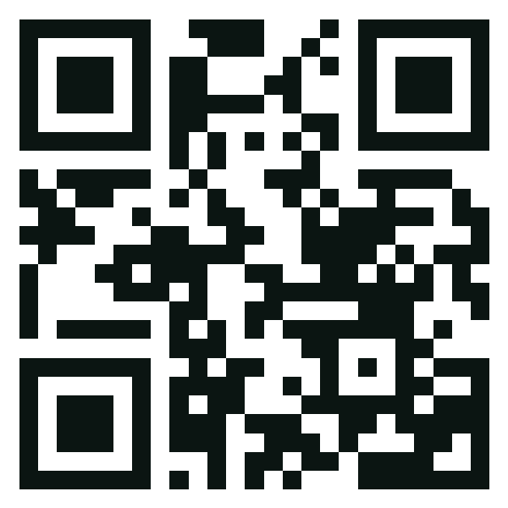
P
PACTA
05 / 07
Experience PACTA: Live on Mainnet
APAC STELLAR GRAND FINALE
SCAN TO TRY IT NOW
getpacta.app
A fully functional, non-custodial money app with protected escrow, live on Stellar mainnet.
Contract (mainnet): CBPA2JBUH5ASTCSP63QPSHGI6HD73YJGQS3SMJHLVZS2PG5GRSOTLEON
getpacta.app
Non-custodial
DEX Convert
Works offline
Trust, written in code.
Built by Zarrah Exekiel Valles & Jecyn Vallirie Turbanos · Philippines
getpacta.app · Trust, written in code.
Notes:
CLOSE (30s): Tonight you have seen ways to move money privately, cheaply, and automatically. PACTA is the only one that makes it SAFE when you do not trust who you are paying, live on mainnet right now at getpacta.app. Trust, written in code. Thank you.

Slide 6
P
PACTA
06 / 07
Tech Stack & Architecture (Appendix)
Client / PWA mobile-first SPA
React + Vite
TypeScript
Tailwind
Offline Outbox
Adapter / AI stateless seam
ChainAdapter (multi-chain seam)
Gemini 2.5 Risk Lens
Supabase KYC
Stellar / Soroban core on-chain execution
Rust escrow (WASM)
DEX path payments
Horizon / RPC
Wallets Kit
Non-custodial: keys never stored
~3-5s finality
soroban-sdk v26
getpacta.app · Trust, written in code.
Notes:
APPENDIX: pull up only if a technical judge asks. Emphasize: contract logic hand-reviewed and hardened; Risk Lens stats are deterministic in code, AI only translates.

Slide 7
P
PACTA
07 / 07
Where PACTA Sits (Appendix)
Privacy pools (Tukar, OLIO, Stellar Private Pool): hide payments. Privacy is not protection.
Payoes: a B2B merchant payment gateway. Infrastructure, not a consumer app.
PalengkePay: vendor micropayments and credit. A vertical, with no deliverable protection.
Pundar: group savings, but custodial (stores user seeds).
PACTA: the consumer TRUST LAYER: the only one that makes paying a stranger safe.
Q&A ready:
Revenue: small protocol fee on protected sends; later premium reputation + Pay-with-Pacta SDK (roadmap).
Sybil: addresses are free, collateral is not; every identity must post a forfeitable bond. KYC adds a real-identity gate.
Moat: portable, user-owned reputation network effect + neutral non-custodial trust layer.
Why Stellar: non-custodial, cheap, fast finality, native DEX, SEA remittance rails, live on mainnet.
getpacta.app · Trust, written in code.
Notes:
Speaker backup: use for judge Q&A. Blocs: Noether founders = rigor; Spartan/DWF = business & moat; Stellar DevRel = adoption & native execution.

