Slide 1
P
PACTA
01 / 05
01 · PROBLEM STATEMENT
Money Moves on Blind Trust
"Marco paid ₱10,000 upfront for a logo. Three days later, the designer vanished. No work, no refund."
$35.6B
6.36%
millions of freelancers and buyers face this daily in SEA
PH remittance & services market
avg fee to send $200 home
Pay & pray: direct transfers leave buyers unprotected the moment funds leave the wallet.
Platforms own your trust: Upwork/Fiverr take 10-20% and keep your reputation; PayPal protection excludes most PH service deals.
Connectivity drops: signal loss in emerging markets strands payments mid-flow.
66%
18-19M
underserved by banks
Filipinos offline daily
Wallets move money but offer no protection. Platforms protect but own your trust and take a cut. Nobody lets you do both.
getpacta.app · Trust, written in code.
Notes:
PROBLEM (35s): Money moves on blind trust. Wallets = no protection. Platforms = up to 20% and own your reputation. $35B market, two-thirds underbanked, millions offline daily. Neither is enough.

Slide 2
P
PACTA
02 / 05
02 · INTRODUCTION / SOLUTION
PACTA: Trust, Written in Code
PACTA is a non-custodial money app on Stellar. Hold, send, receive, and convert like any wallet, and when a payment matters, choose Send Protected instead of Send Now. A Protected send creates a Pact: a Soroban escrow that keeps both sides honest.
create → recipient posts bond → deposit → staged milestone release → complete (bond back) / refund + bond to sender
1
Staged release
2
Recipient bond
3
Deadline refund
4
Owned reputation
Funds release milestone by milestone, so only a slice is ever exposed.
A security bond, real skin in the game, earned back only on delivery.
No delivery in time? The sender reclaims funds PLUS the bond.
Every Pact builds a portable trust record the user owns.
Non-custodial
Live on Mainnet
Provable on-chain
getpacta.app · Trust, written in code.
Notes:
SOLUTION (45s): PACTA is a normal wallet; the difference is one button, Send Protected, which creates a Pact (Soroban escrow). Honest framing: naive escrow is not safe because code cannot claw funds back once sent, so we protect with the two enforceable mechanics, staged release + recipient bond. Deliver, earn it back; walk away, sender reclaims funds plus bond. Monetization: small protocol fee on protected sends, a fraction of Upwork 20%.

Slide 3
P
PACTA
03 / 05
03 · FUNCTIONALITIES & FEATURES
Full Feature Set
WALLET LAYER
PROTECTION LAYER · A PACT
Your everyday money hub
Trust made enforceable
[object Object],[object Object],[object Object]
[object Object],[object Object],[object Object]
[object Object],[object Object],[object Object]
[object Object],[object Object],[object Object]
[object Object],[object Object],[object Object]
[object Object],[object Object],[object Object]
[object Object],[object Object],[object Object]
[object Object],[object Object],[object Object]
[object Object],[object Object],[object Object]
[object Object],[object Object],[object Object]
[object Object],[object Object],[object Object]
[object Object],[object Object],[object Object]
What sets it apart: Live on mainnet · Non-custodial · Security-hardened contract · Reputation you own
getpacta.app · Trust, written in code.
Notes:
FEATURES: Wallet layer = everyday hub (non-custodial, send/receive/convert, offline, PWA). Protection layer = the Pact (staged release, bond, reputation, Risk Lens, KYC, provable). Bottom strip = differentiators. All shipped and live on mainnet.

Slide 4
P
PACTA
04 / 05
04 · TECH STACK & SYSTEM ARCHITECTURE
How It Is Built
Client / PWA mobile-first SPA
React + Vite
TypeScript
Tailwind
Offline Outbox
Adapter / AI stateless seam
ChainAdapter (multi-chain seam)
Gemini 2.5 Risk Lens
Supabase KYC
Stellar / Soroban core on-chain execution
Rust escrow (WASM)
DEX path payments
Horizon / RPC
Wallets Kit
Hardened & non-custodial. Contract security-reviewed, bugs fixed, verified on Stellar mainnet. Keys never stored. ~3-5s finality. soroban-sdk v26.
getpacta.app · Trust, written in code.
Notes:
ARCHITECTURE (30s): three layers. No backend for money: the Soroban contract is the backend; wallet layer takes no custody. Only server code = stateless Risk Lens (Gemini) + off-chain KYC (Supabase). Contract logic hand-reviewed and hardened; Risk Lens stats deterministic in code, AI only translates.

Slide 5
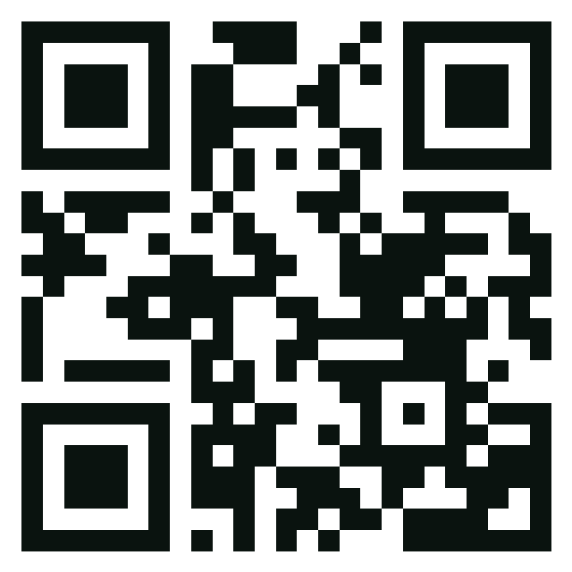
P
PACTA
05 / 05
05 · WORKING MODEL
Jump Into the Live Demo
LIVE ON STELLAR MAINNET
SCAN TO TRY IT NOW
getpacta.app
mainnet: CBPA2JBUH5ASTCSP63QPSHGI6HD73YJGQS3SMJHLVZS2PG5GRSOTLEON
In the demo:
Connect a Stellar wallet, no signup.
Send Protected, creating a Pact.
Recipient posts bond, sender deposits.
Release the final milestone, bond auto-returns, Pact completes.
getpacta.app
Trust, written in code.
Built by Zarrah Exekiel Valles & Jecyn Vallirie Turbanos · Philippines
getpacta.app · Trust, written in code.
Notes:
CLOSE / DEMO (35s): "Tonight you have seen ways to move money privately, cheaply, and automatically. PACTA is the only one that makes it SAFE when you do not trust who you are paying, live on mainnet at getpacta.app." Then run the flow (or show the recorded backup). End: "Trust, written in code. Thank you."

