Slide 1
JAN JEEVAN · BIT N BUILD HACKATHON 2026
Government services are organized
by department.
People's lives are not.
ल
LabhSathi
From document to benefit checklist.
TEAM · 404 JACKPOT!
Yash Sharma (Team Lead) · Aryan Achuthan · Krishna Mahesh Kolhapur
labhsathi.info
github.com/zb8ne/labhsathi

Slide 2
01 · THE PROBLEM
Meena needs help from three departments.
She only gets to explain her situation once.
M
Agriculture
Healthcare
Financial inclusion
Meena, 34
Bihar, rural
Land records, occupation proof, a separate scheme PDF per ministry office.
SECC deprivation criteria, not income alone. A different portal to verify.
No bank account yet. Pension and insurance schemes assume one already exists.
Agricultural worker, no landholding
Household income: ₹1.4 lakh / year
One daughter, age 6
One household. Three essential needs.
No bank account
Zero connected journeys.
Lives in a kutcha house
Government services are organized by department. People's lives are not.
One profile. Three departments' worth of need.
02 / 06

Slide 3
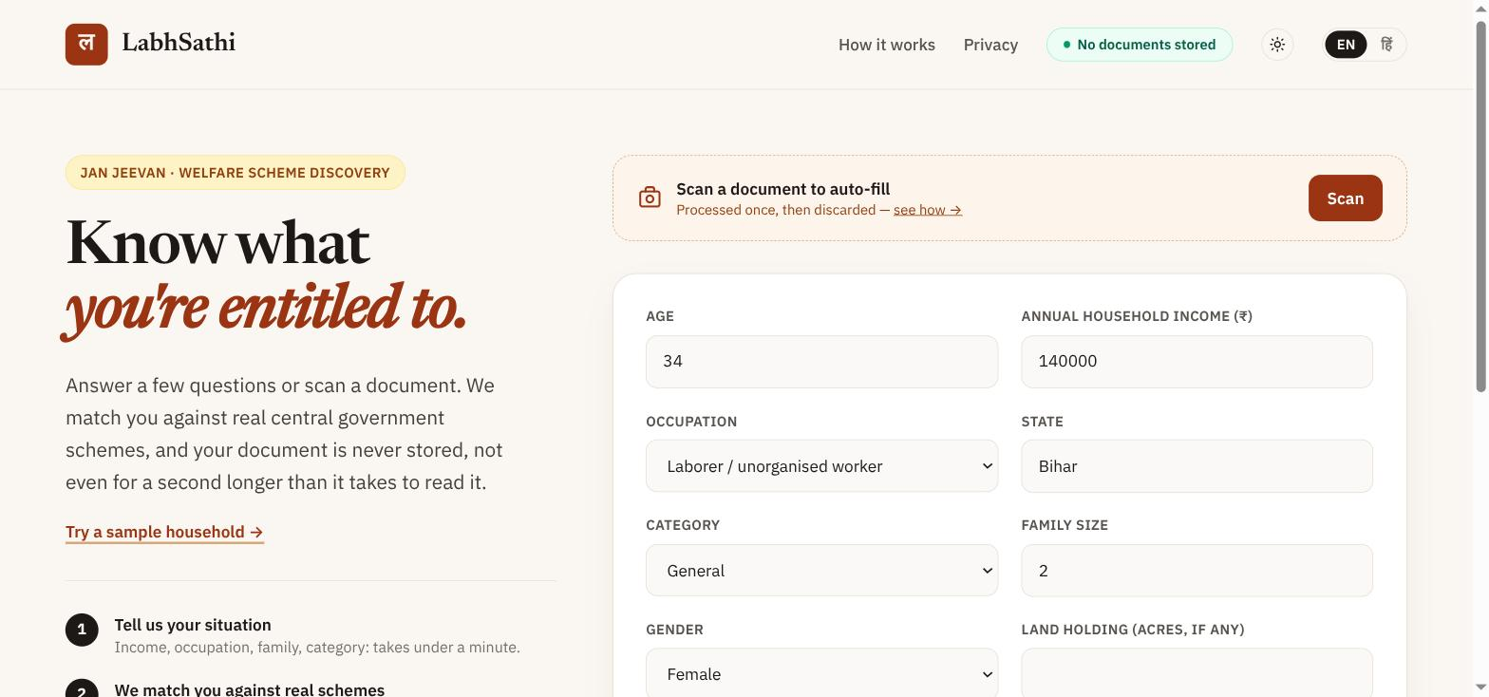
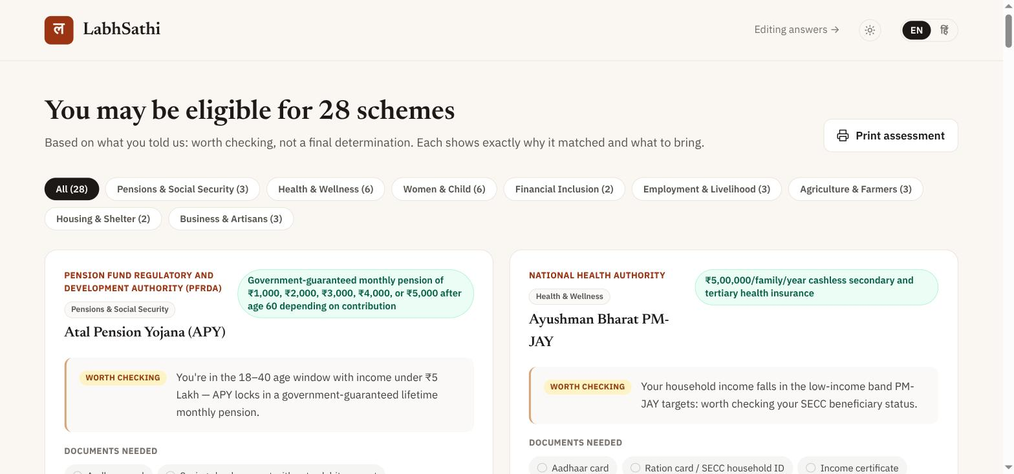
02 · ONE ASSISTED JOURNEY
Scan once. See everything you qualify for.
Her situation, entered once
28 schemes, sorted by category, each with a reason
Agriculture & livelihood
Healthcare
Financial inclusion
MGNREGA, PM-SYM pension
Ayushman Bharat PM-JAY
Jan Dhan, Atal Pension Yojana
The document scan is the common intake layer: it extracts age, income, occupation, state, category and land holding once, and the rules engine checks every domain against those same facts.
03 / 06

Slide 4
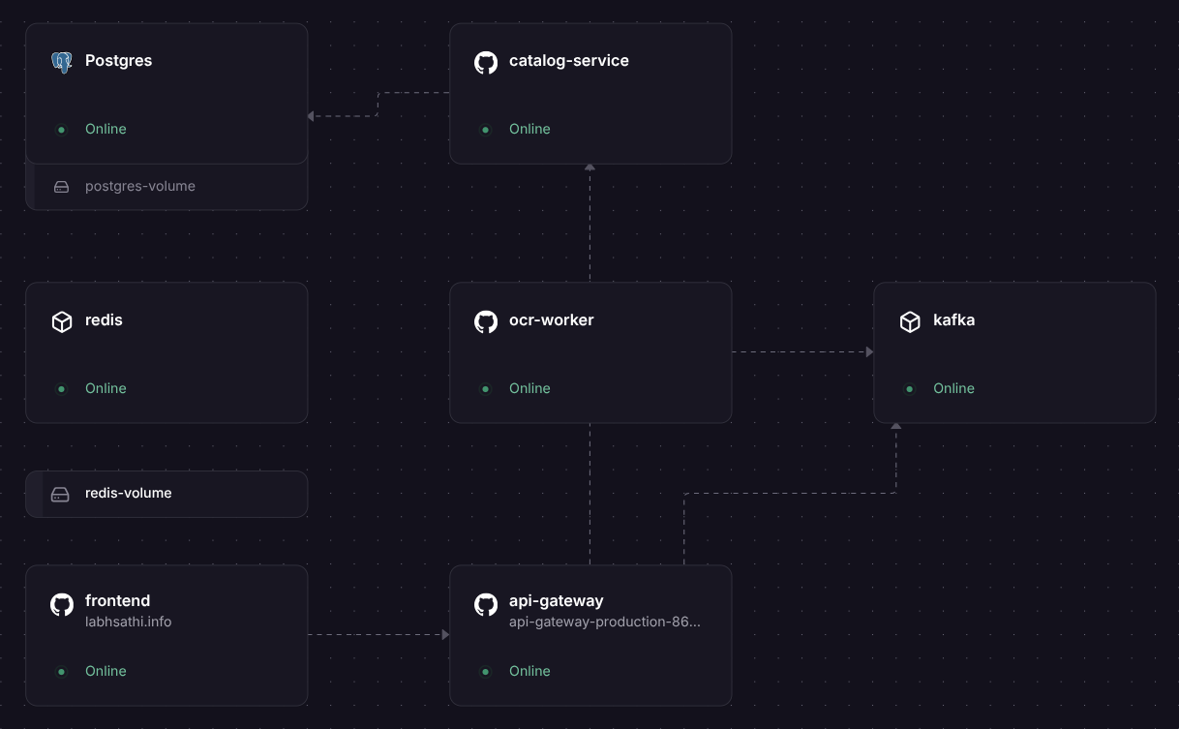
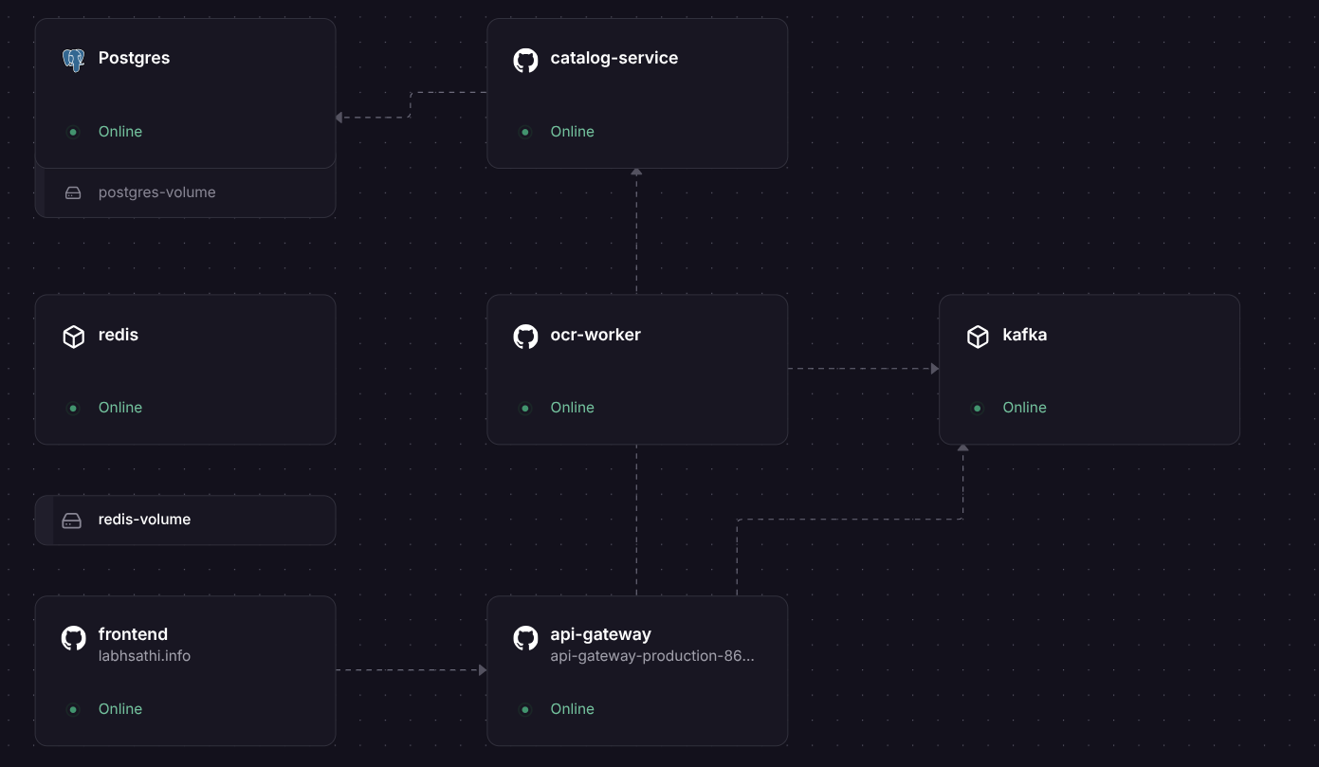
03 · VERIFIABLE ARCHITECTURE
The privacy promise is structural, not a policy.
labhsathi-core/src/events.rs
pub struct DocumentJobCompleted {
pub job_id: JobId,
pub status: JobStatus,
pub fields: Option<ExtractedFields>,
pub ts: i64,
}
no Vec<u8> -- nowhere for an image to go
< 2s
0
independent
eligibility result, measured live
image-shaped fields in either schema
ocr-worker scales apart from matching
Behind the scan -- one AI call, bounded on both sides:
The real stack, live: Rust/Axum · Kafka · Redis (60s TTL, GETDEL) · Postgres
Upload → Redis → Kafka → Claude Vision → Result
Graceful failure by design: if the OCR worker is unavailable, /api/match still runs. Eligibility checking has zero dependency on the vision pipeline.
04 / 06

Slide 5
04 · FEASIBILITY, SCALABILITY & IMPACT
One household today. Every CSC and NGO desk tomorrow.
51 / 51
100 / 100
3
Rust unit tests passing
schemes with a cited official source
deploy targets: Railway, Docker Compose, kind + Helm
2
1 → 2
0
languages fully wired end to end: English, Hindi
ocr-worker replicas, HPA-scaled under real load
PII leaked
Scale is the same flow, more desks.
1
One household, self-assessing at home
Scope, stated plainly
2
A Common Service Centre operator, same form
100 central government schemes, hand curated and web-verified, not exhaustive. Every match reads worth checking, not approved, and links to the official portal to verify.
3
An NGO field worker, same checklist output
Expected impact: at roughly 50 people per desk per day (one assisted worker's daily rounds), reach scales with desks opened, not engineering added.
05 / 06

Slide 6
05 · PROTOTYPE & FUTURE SCOPE
From document
to benefit checklist.
labhsathi.info
github.com/zb8ne/labhsathi
Bit N Build Hackathon 2026 · Jan Jeevan track
What's next
→
Hindi for the dynamically generated why-you-matched sentences
→
A real household-member model, not one shared income field
→
SMS / WhatsApp front-end for low-smartphone-literacy users
→
KEDA autoscaling and 3-broker Kafka for production durability
06 / 06

