Slide 1
Autonomous Rendezvous & Docking Ground Robot
By: Zein Barakat, Justin Puran, Santiago Calderon-Rueda, Ryan Flowers

Slide 2
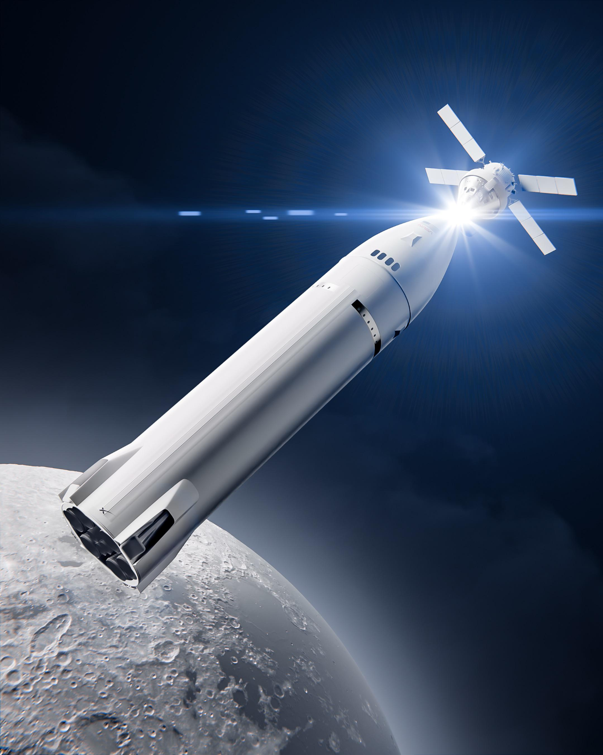
Guidance, Navigation, & Control: The Problem
Guidance, Navigation, and Control (GNC) is needed for many space missions in which spacecraft typically needs to:
Rendezvous with another spacecraft
Approach a space station or satellite
Deliver cargo or payloads
Dock for crew or cargo transfer
Service, repair, or refuel satellites
Land or operate autonomously when direct human control is difficult
For these missions, the spacecraft must be able to:
know where it is -> know where to go -> navigate how to reach it -> control and filter -> attach
Problem: Testing these ideas on a real spacecraft is expensive and difficult.
Solution: A ground robot gives us a simple, low-cost way to test the same basic GNC ideas.
Autonomous docking skills also apply to mobile robots, drones, warehouse and hospital robots, self-driving systems, and underwater vehicles. All rely on localization, planning, and precise autonomous control.
Pictured above is artwork of NASA’s Artemis mission showcasing the Orion capsule and Lunar Gateway docking to allow human transfer

Slide 3
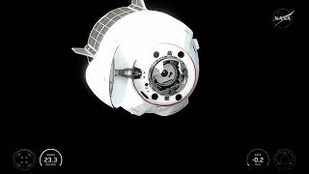
SpaceX Dragon Spacecraft/Robot

Slide 4
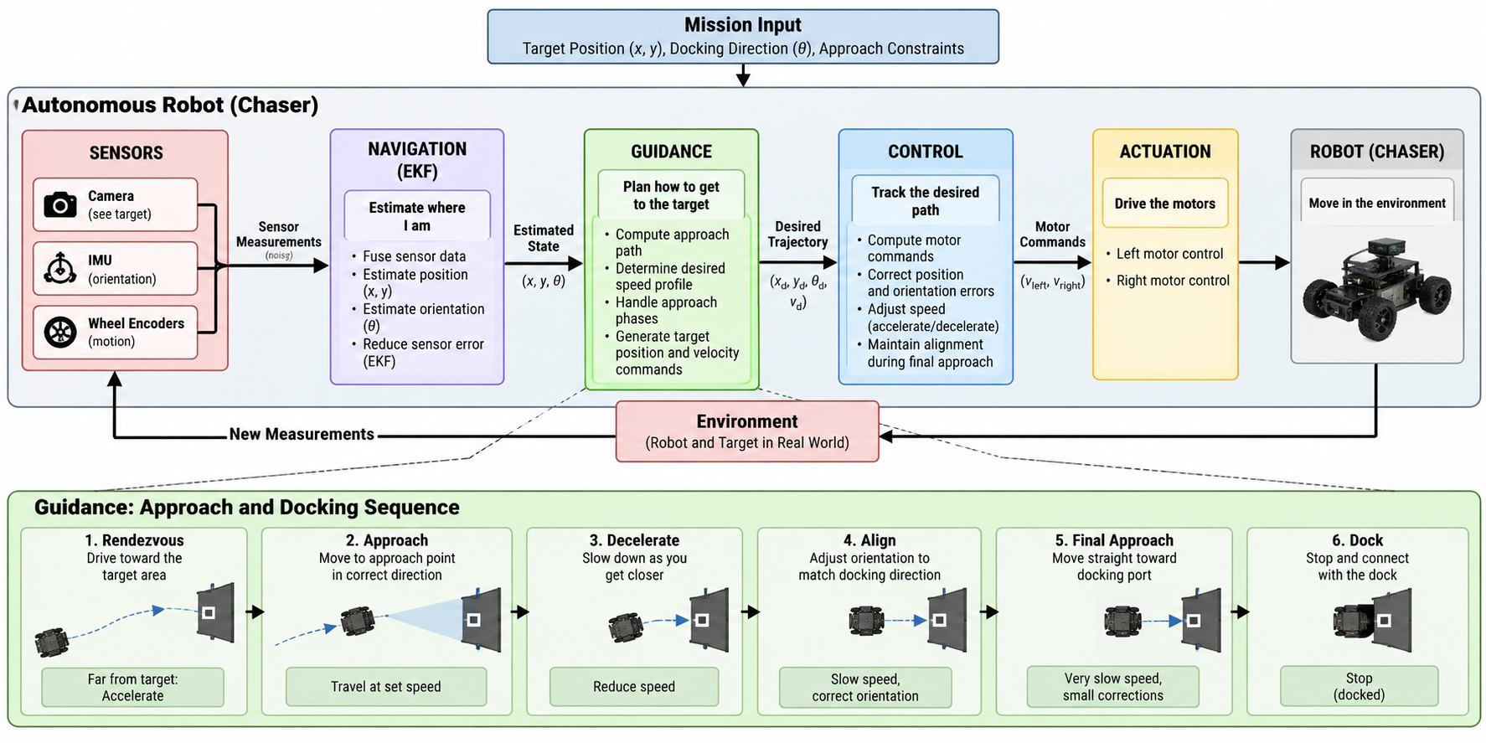
Our Project: Robotic RPOD Testbed
We will build a small autonomous mobile robot that acts as the chaser, while a docking station acts as the target. The robot will use perception, coordinate transformations, EKF-based state estimation, path planning, and closed-loop control to approach, align with, and dock to the target autonomously.
Notes:
This slide shows the overall robotics architecture for our RPOD testbed. Our mobile robot acts as the chaser, while the docking station acts as the target. The robot first collects information from its sensors, including a camera for detecting the docking target, an IMU for orientation and angular motion, and wheel encoders for odometry.
Since each of those measurements can have noise or drift, we use an Extended Kalman Filter to fuse the sensor data and estimate the robot’s state, mainly its \(x\)-position, \(y\)-position, and heading angle, \(\theta\). We also use coordinate transformations so measurements from the camera or robot frame can be related to the common world frame.
Once the robot knows where it is, the guidance layer determines where it should go. It generates an approach path, chooses an approach point in front of the dock, and sets the desired speed profile. Because this is a differential-drive robot, the control system then converts position and heading error into left and right wheel commands.
The important part is that this is a closed-loop system. The robot moves, takes new measurements, updates its state estimate, and corrects its motion continuously.
At the bottom is the actual docking sequence. The robot first performs the rendezvous by moving toward the target area, then travels to the approach point, slows down, aligns its heading with the docking direction, and performs a very slow final approach before stopping at the dock.
So instead of simply programming the robot to drive to a fixed point, we are combining perception, localization, state estimation, planning, kinematics, and feedback control to make the docking behavior autonomous.

Slide 5
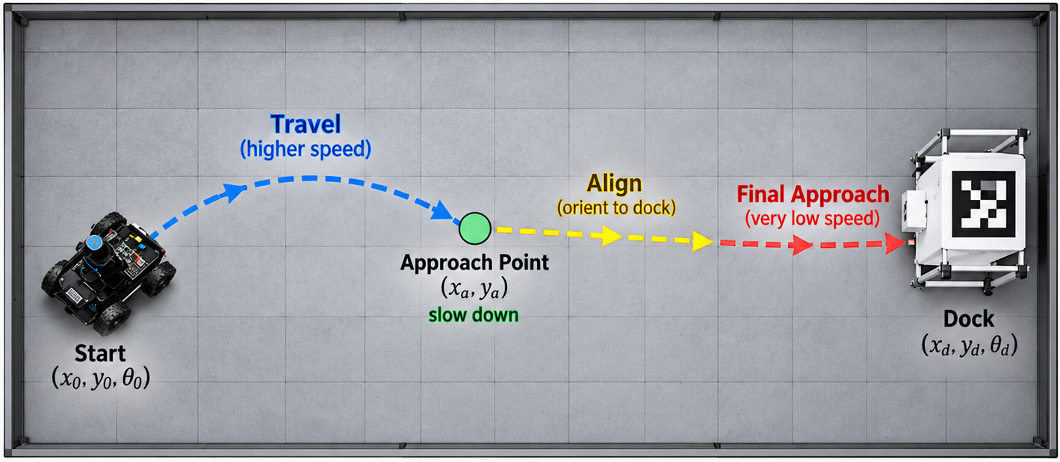
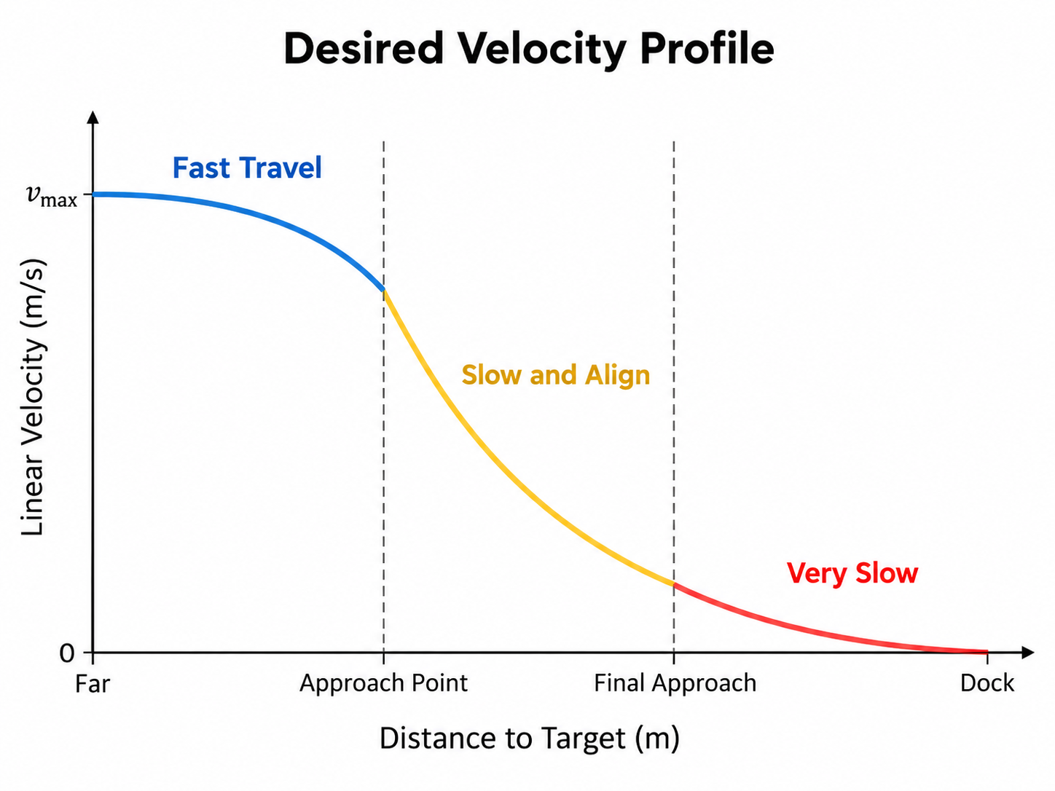
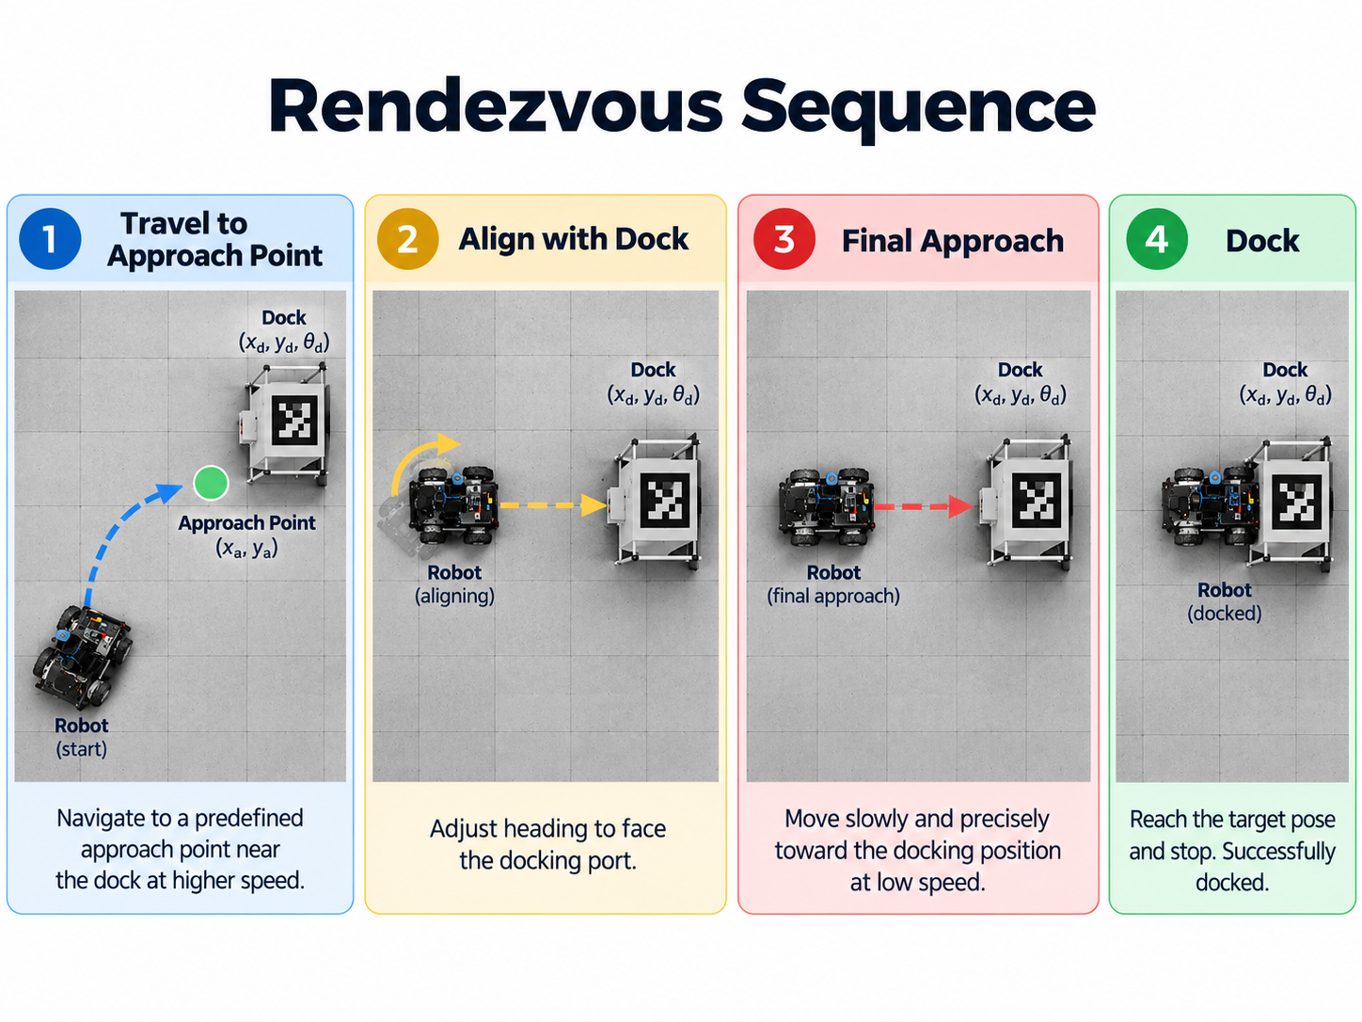
Mission Scenario & Success Criteria
Mission:
Robot begins from a variable starting position and orientation
Given target pose: (x_{d}, y_{d}, θ_{d})
Navigate to an approach point
Align with docking direction
Decelerate during final approach
Dock autonomously
Success Metrics:
Docking position error
Heading/alignment error
Docking success rate
Completion time
Path/trajectory tracking error

Slide 6
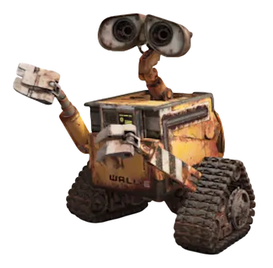
Implementation, Feasibility, & Framework
Hardware:
Differential-drive chassis + motors/encoders
Camera
IMU (accelerometer + gyro)
Raspberry Pi/Arduino/Microcontroller
AprilTag docking target
Physical docking mechanism (magnet)
Software:
Visual target detection
Odometry + IMU + camera sensor fusion
EKF State estimation
Telemetry
Path/approach planning
Closed-loop motor control
MATLAB
PID
Budget:
< $200
Available resources
Future goals:
Moving target for dynamic rendezvous
Expanded DOF parameters (6-DOF)

Slide 7

Questions?

