Slide 1
Web Services 15-213: Introduction to Computer Systems 21st Lecture, Nov. 4, 2010
Instructors:
Randy Bryant and Dave O’Hallaron

Slide 2
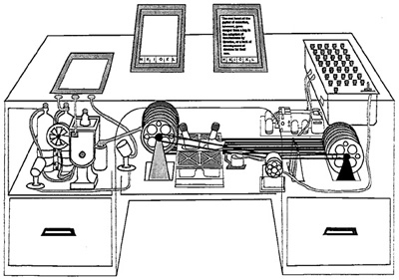
Web History
“Consider a future device for individual use, which is a sort of mechanized private file and library. It needs a name, and to coin one at random, "memex" will do. A memex is a device in which an individual stores all his books, records, and communications, and which is mechanized so that it may be consulted with exceeding speed and flexibility. It is an enlarged intimate supplement to his memory.”
1945:
Vannevar Bush, “As we may think”, Atlantic Monthly, July, 1945.
Describes the idea of a distributed hypertext system.
A “memex” that mimics the “web of trails” in our minds.

Slide 3
Web History
1989:
Tim Berners-Lee (CERN) writes internal proposal to develop a distributed hypertext system.
Connects “a web of notes with links.”
Intended to help CERN physicists in large projects share and manage information
1990:
Tim BL writes a graphical browser for Next machines.

Slide 4
Web History (cont)
1992
NCSA server released
26 WWW servers worldwide
1993
Marc Andreessen releases first version of NCSA Mosaic browser
Mosaic version released for (Windows, Mac, Unix).
Web (port 80) traffic at 1% of NSFNET backbone traffic.
Over 200 WWW servers worldwide.
1994
Andreessen and colleagues leave NCSA to form “Mosaic Communications Corp” (predecessor to Netscape).

Slide 5
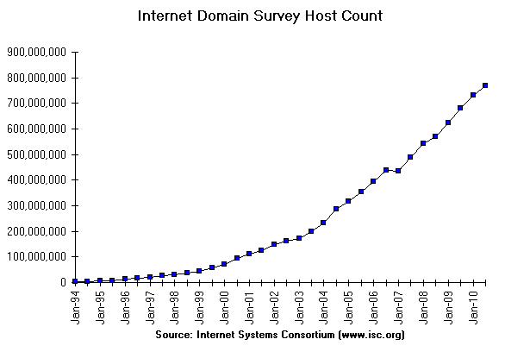
Internet Hosts
How many of the 2³² IP addresses have registered domain names?

Slide 6
Web Servers
Web
client
(browser)
HTTP request
Web
server
Clients and servers communicate using the HyperText Transfer Protocol (HTTP)
Client and server establish TCP connection
Client requests content
Server responds with requested content
Client and server close connection (eventually)
Current version is HTTP/1.1
RFC 2616, June, 1999.
HTTP response
(content)
HTTP
Web content
TCP
Streams
IP
Datagrams
http://www.w3.org/Protocols/rfc2616/rfc2616.html

Slide 7
Web Content
Web servers return content to clients
content: a sequence of bytes with an associated MIME (Multipurpose Internet Mail Extensions) type
Example MIME types
text/html HTML document
text/plain Unformatted text
application/postscript Postcript document
image/gif Binary image encoded in GIF format
image/jpeg Binary image encoded in JPEG format

Slide 8
Static and Dynamic Content
The content returned in HTTP responses can be either static or dynamic.
Static content: content stored in files and retrieved in response to an HTTP request
Examples: HTML files, images, audio clips.
Request identifies content file
Dynamic content: content produced on-the-fly in response to an HTTP request
Example: content produced by a program executed by the server on behalf of the client.
Request identifies file containing executable code
Bottom line: All Web content is associated with a file that is managed by the server.

Slide 9
URLs
Each file managed by a server has a unique name called a URL (Universal Resource Locator)
URLs for static content:
http://www.cs.cmu.edu:80/index.html
http://www.cs.cmu.edu/index.html
http://www.cs.cmu.edu
Identifies a file called index.html, managed by a Web server at www.cs.cmu.edu that is listening on port 80.
URLs for dynamic content:
http://www.cs.cmu.edu:8000/cgi-bin/proc?15000&213
Identifies an executable file called proc, managed by a Web server at www.cs.cmu.edu that is listening on port 8000, that should be called with two argument strings: 15000 and 213.

Slide 10
How Clients and Servers Use URLs
Example URL: http://www.cmu.edu:80/index.html
Clients use prefix (http://www.cmu.edu:80) to infer:
What kind of server to contact (Web server)
Where the server is (www.cmu.edu)
What port it is listening on (80)
Servers use suffix (/index.html) to:
Determine if request is for static or dynamic content.
No hard and fast rules for this.
Convention: executables reside in cgi-bin directory
Find file on file system.
Initial “/” in suffix denotes home directory for requested content.
Minimal suffix is “/”, which all servers expand to some default home page (e.g., index.html).

Slide 11
Anatomy of an HTTP Transaction
unix> telnet www.cmu.edu 80 Client: open connection to server
Trying 128.2.10.162... Telnet prints 3 lines to the terminal
Connected to www.cmu.edu.
Escape character is '^]'.
GET / HTTP/1.1 Client: request line
host: www.cmu.edu Client: required HTTP/1.1 HOST header
Client: empty line terminates headers.
HTTP/1.1 301 Moved Permanently Server: response line
Location: http://www.cmu.edu/index.shtml Client should try again
Connection closed by foreign host. Server: closes connection
unix> Client: closes connection and terminates

Slide 12
Anatomy of an HTTP Transaction, Take 2
unix> telnet www.cmu.edu 80 Client: open connection to server
Trying 128.2.10.162... Telnet prints 3 lines to the terminal
Connected to www.cmu.edu.
Escape character is '^]'.
GET /index.shtml HTTP/1.1 Client: request line
host: www.cmu.edu Client: required HTTP/1.1 HOST header
Client: empty line terminates headers.
HTTP/1.1 200 OK Server: responds with web page
Date: Fri, 29 Oct 2010 19:41:08 GMT
Server: Apache/1.3.39 (Unix) mod_pubcookie/3.3.3 ...
Transfer-Encoding: chunked
Content-Type: text/html
... Lots of stuff
Connection closed by foreign host. Server: closes connection
unix> Client: closes connection and terminates

Slide 13
HTTP Requests
HTTP request is a request line, followed by zero or more request headers
Request line: <method> <uri> <version>
<version> is HTTP version of request (HTTP/1.0 or HTTP/1.1)
<uri> is typically URL for proxies, URL suffix for servers.
A URL is a type of URI (Uniform Resource Identifier)
See http://www.ietf.org/rfc/rfc2396.txt
<method> is either GET, POST, OPTIONS, HEAD, PUT, DELETE, or TRACE.

Slide 14
HTTP Requests (cont)
HTTP methods:
GET: Retrieve static or dynamic content
Arguments for dynamic content are in URI
Workhorse method (99% of requests)
POST: Retrieve dynamic content
Arguments for dynamic content are in the request body
OPTIONS: Get server or file attributes
HEAD: Like GET but no data in response body
PUT: Write a file to the server!
DELETE: Delete a file on the server!
TRACE: Echo request in response body
Useful for debugging.
Request headers: <header name>: <header data>
Provide additional information to the server.

Slide 15
HTTP Versions
Major differences between HTTP/1.1 and HTTP/1.0
HTTP/1.0 uses a new connection for each transaction.
HTTP/1.1 also supports persistent connections
multiple transactions over the same connection
Connection: Keep-Alive
HTTP/1.1 requires HOST header
Host: www.cmu.edu
Makes it possible to host multiple websites at single Internet host
HTTP/1.1 supports chunked encoding (described later)
Transfer-Encoding: chunked
HTTP/1.1 adds additional support for caching

Slide 16
HTTP Responses
HTTP response is a response line followed by zero or more response headers.
Response line:
<version> <status code> <status msg>
<version> is HTTP version of the response.
<status code> is numeric status.
<status msg> is corresponding English text.
200 OK Request was handled without error
301 Moved Provide alternate URL
403 Forbidden Server lacks permission to access file
404 Not found Server couldn’t find the file.
Response headers: <header name>: <header data>
Provide additional information about response
Content-Type: MIME type of content in response body.
Content-Length: Length of content in response body.

Slide 17
GET Request to Apache Server From Firefox Browser
URI is just the suffix, not the entire URL
GET /~bryant/test.html HTTP/1.1
Host: www.cs.cmu.edu
User-Agent: Mozilla/5.0 (Windows; U; Windows NT 6.0; en-US; rv:1.9.2.11) Gecko/20101012 Firefox/3.6.11
Accept: text/html,application/xhtml+xml,application/xml;q=0.9,*/*;q=0.8
Accept-Language: en-us,en;q=0.5
Accept-Encoding: gzip,deflate
Accept-Charset: ISO-8859-1,utf-8;q=0.7,*;q=0.7
Keep-Alive: 115
Connection: keep-alive
CRLF (\r\n)

Slide 18
GET Response From Apache Server
HTTP/1.1 200 OK
Date: Fri, 29 Oct 2010 19:48:32 GMT
Server: Apache/2.2.14 (Unix) mod_ssl/2.2.14 OpenSSL/0.9.7m mod_pubcookie/3.3.2b PHP/5.3.1
Accept-Ranges: bytes
Content-Length: 479
Keep-Alive: timeout=15, max=100
Connection: Keep-Alive
Content-Type: text/html
<html>
<head><title>Some Tests</title></head>
<body>
<h1>Some Tests</h1>
. . .
</body>
</html>

Slide 19
Tiny Web Server
Tiny Web server described in text
Tiny is a sequential Web server.
Serves static and dynamic content to real browsers.
text files, HTML files, GIF and JPEG images.
226 lines of commented C code.
Not as complete or robust as a real web server

Slide 20
Tiny Operation
Read request from client
Split into method / uri / version
If not GET, then return error
If URI contains “cgi-bin” then serve dynamic content
(Would do wrong thing if had file “abcgi-bingo.html”)
Fork process to execute program
Otherwise serve static content
Copy file to output

Slide 21
Tiny Serving Static Content
/* Send response headers to client */
get_filetype(filename, filetype);
sprintf(buf, "HTTP/1.0 200 OK\r\n");
sprintf(buf, "%sServer: Tiny Web Server\r\n", buf);
sprintf(buf, "%sContent-length: %d\r\n", buf, filesize);
sprintf(buf, "%sContent-type: %s\r\n\r\n",
buf, filetype);
Rio_writen(fd, buf, strlen(buf));
/* Send response body to client */
srcfd = Open(filename, O_RDONLY, 0);
srcp = Mmap(0, filesize, PROT_READ, MAP_PRIVATE, srcfd, 0);
Close(srcfd);
Rio_writen(fd, srcp, filesize);
Munmap(srcp, filesize);
From tiny.c
Serve file specified by filename
Use file metadata to compose header
“Read” file via mmap
Write to output

Slide 22
Serving Dynamic Content
Client sends request to server.
If request URI contains the string “/cgi-bin”, then the server assumes that the request is for dynamic content.
GET /cgi-bin/env.pl HTTP/1.1
Client
Server

Slide 23
Serving Dynamic Content (cont)
The server creates a child process and runs the program identified by the URI in that process
Client
Server
fork/exec
env.pl

Slide 24
Serving Dynamic Content (cont)
Client
Server
The child runs and generates the dynamic content.
The server captures the content of the child and forwards it without modification to the client
Content
Content
env.pl

Slide 25
Issues in Serving Dynamic Content
How does the client pass program arguments to the server?
How does the server pass these arguments to the child?
How does the server pass other info relevant to the request to the child?
How does the server capture the content produced by the child?
These issues are addressed by the Common Gateway Interface (CGI) specification.
Request
Client
Server
Content
Content
Create
env.pl

Slide 26
CGI
Because the children are written according to the CGI spec, they are often called CGI programs.
Because many CGI programs are written in Perl, they are often called CGI scripts.
However, CGI really defines a simple standard for transferring information between the client (browser), the server, and the child process.

Slide 27
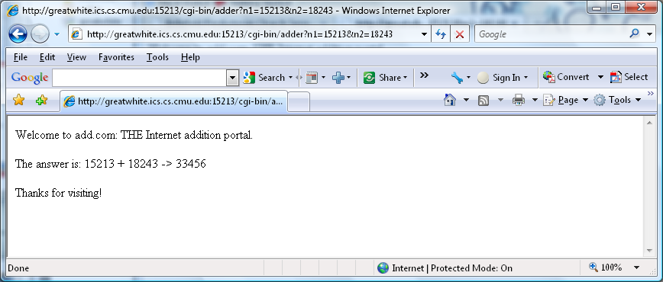
The add.com Experience
input URL
host
port
CGI program
args
Output page

Slide 28
Serving Dynamic Content With GET
Question: How does the client pass arguments to the server?
Answer: The arguments are appended to the URI
Can be encoded directly in a URL typed to a browser or a URL in an HTML link
http://add.com/cgi-bin/adder?n1=15213&n2=18243
adder is the CGI program on the server that will do the addition.
argument list starts with “?”
arguments separated by “&”
spaces represented by “+” or “%20”
URI often generated by an HTML form
<FORM METHOD=GET ACTION="cgi-bin/adder">
<p>X <INPUT NAME="n1">
<p>Y <INPUT NAME="n2">
<p><INPUT TYPE=submit>
</FORM>

Slide 29
Serving Dynamic Content With GET
URL:
cgi-bin/adder?n1=15213&n2=18243
Result displayed on browser:
Welcome to add.com: THE Internet addition portal. The answer is: 15213 + 18243 -> 33456
Thanks for visiting!

Slide 30
Serving Dynamic Content With GET
Question: How does the server pass these arguments to the child?
Answer: In environment variable QUERY_STRING
A single string containing everything after the “?”
For add: QUERY_STRING = “n1=15213&n2=18243”
From adder.c
if ((buf = getenv("QUERY_STRING")) != NULL) {
if (sscanf(buf, "n1=%d&n2=%d\n", &n1, &n2) == 2)
sprintf(msg, "%d + %d -> %d\n", n1, n2, n1+n2);
else
sprintf(msg, "Can't parse buffer '%s'\n", buf);
}

Slide 31
Additional CGI Environment Variables
General
SERVER_SOFTWARE
SERVER_NAME
GATEWAY_INTERFACE (CGI version)
Request-specific
SERVER_PORT
REQUEST_METHOD (GET, POST, etc)
QUERY_STRING (contains GET args)
REMOTE_HOST (domain name of client)
REMOTE_ADDR (IP address of client)
CONTENT_TYPE (for POST, type of data in message body, e.g., text/html)
CONTENT_LENGTH (length in bytes)

Slide 32
Even More CGI Environment Variables
In addition, the value of each header of type type received from the client is placed in environment variable HTTP_type
Examples (any “-” is changed to “_”) :
HTTP_ACCEPT
HTTP_HOST
HTTP_USER_AGENT

Slide 33
Serving Dynamic Content With GET
Question: How does the server capture the content produced by the child?
Answer: The child generates its output on stdout. Server uses dup2 to redirect stdout to its connected socket.
Notice that only the child knows the type and size of the content. Thus the child (not the server) must generate the corresponding headers.
/* Make the response body */
sprintf(content, "Welcome to add.com: ");
sprintf(content, "%sTHE Internet addition portal.\r\n<p>",
content);
sprintf(content, "%sThe answer is: %s\r\n<p>",
content, msg);
sprintf(content, "%sThanks for visiting!\r\n", content);
/* Generate the HTTP response */
printf("Content-length: %u\r\n", (unsigned) strlen(content));
printf("Content-type: text/html\r\n\r\n");
printf("%s", content);
From adder.c

Slide 34
Serving Dynamic Content With GET
linux> telnet greatwhite.ics.cs.cmu.edu 15213
Trying 128.2.220.10...
Connected to greatwhite.ics.cs.cmu.edu (128.2.220.10).
Escape character is '^]'.
GET /cgi-bin/adder?n1=5&n2=27 HTTP/1.1
host: greatwhite.ics.cs.cmu.edu
<CRLF>
HTTP/1.0 200 OK
Server: Tiny Web Server
Content-length: 109
Content-type: text/html
Welcome to add.com: THE Internet addition portal.
<p>The answer is: 5 + 27 -> 32
<p>Thanks for visiting!
Connection closed by foreign host.
HTTP request sent by client
HTTP response generated by the server
HTTP response generated by
the CGI program

Slide 35
Tiny Serving Dynamic Content
/* Return first part of HTTP response */
sprintf(buf, "HTTP/1.0 200 OK\r\n");
Rio_writen(fd, buf, strlen(buf));
sprintf(buf, "Server: Tiny Web Server\r\n");
Rio_writen(fd, buf, strlen(buf));
if (Fork() == 0) { /* child */
/* Real server would set all CGI vars here */
setenv("QUERY_STRING", cgiargs, 1);
Dup2(fd, STDOUT_FILENO); /* Redirect stdout to client */
Execve(filename, emptylist, environ);/* Run CGI prog */
}
Wait(NULL); /* Parent waits for and reaps child */
From tiny.c
Fork child to execute CGI program
Change stdout to be connection to client
Execute CGI program with execve

Slide 36
Data Transfer Mechanisms
Standard
Specify total length with content-length
Requires that program buffer entire message
Chunked
Break into blocks
Prefix each block with number of bytes (Hex coded)

Slide 37
Chunked Encoding Example
HTTP/1.1 200 OK\n
Date: Sun, 31 Oct 2010 20:47:48 GMT\n
Server: Apache/1.3.41 (Unix)\n
Keep-Alive: timeout=15, max=100\n
Connection: Keep-Alive\n
Transfer-Encoding: chunked\n
Content-Type: text/html\n
\r\n
d75\r\n
<html>
<head>
.<link href="http://www.cs.cmu.edu/style/calendar.css" rel="stylesheet" type="text/css">
</head>
<body id="calendar_body">
<div id='calendar'><table width='100%' border='0' cellpadding='0' cellspacing='1' id='cal'>
. . .
</body>
</html>
\r\n
0\r\n
\r\n
First Chunk: 0xd75 = 3445 bytes
Second Chunk: 0 bytes (indicates last chunk)

Slide 38
Proxies
A proxy is an intermediary between a client and an origin server.
To the client, the proxy acts like a server.
To the server, the proxy acts like a client.
1. Client request
2. Proxy request
Client
Proxy
Origin
Server
4. Proxy response
3. Server response

Slide 39
Why Proxies?
Can perform useful functions as requests and responses pass by
Examples: Caching, logging, anonymization, filtering, transcoding
Client
A
Request foo.html
foo.html
Request foo.html
Origin
Server
Proxy
cache
foo.html
Request foo.html
Slower more
expensive
global network
Client
B
foo.html
Fast inexpensive local network

Slide 40
For More Information
Study the Tiny Web server described in your text
Tiny is a sequential Web server.
Serves static and dynamic content to real browsers.
text files, HTML files, GIF and JPEG images.
220 lines of commented C code.
Also comes with an implementation of the CGI script for the add.com addition portal.
See the HTTP/1.1 standard:
http://www.w3.org/Protocols/rfc2616/rfc2616.html

