Slide 1
Thread-Level Parallelism 15-213: Introduction to Computer Systems 26th Lecture, Nov. 30, 2010
Instructors:
Randy Bryant and Dave O’Hallaron

Slide 2
Today
Parallel Computing Hardware
Multicore
Multiple separate processors on single chip
Hyperthreading
Replicated instruction execution hardware in each processor
Maintaining cache consistency
Thread Level Parallelism
Splitting program into independent tasks
Example: Parallel summation
Some performance artifacts
Divide-and conquer parallelism
Example: Parallel quicksort

Slide 3
Multicore Processor
Core 0
Core n-1
Regs
Regs
L1
d-cache
L1
i-cache
…
L1
d-cache
L1
i-cache
L2 unified cache
L2 unified cache
L3 unified cache
(shared by all cores)
Main memory
Intel Nehalem Processor
E.g., Shark machines
Multiple processors operating with coherent view of memory

Slide 4
Memory Consistency
int a = 1;
int b = 100;
Thread consistency
constraints
Wa
Rb
Thread1:
Wa: a = 2;
Rb: print(b);
Thread2:
Wb: b = 200;
Ra: print(a);
Wb
Ra
What are the possible values printed?
Depends on memory consistency model
Abstract model of how hardware handles concurrent accesses
Sequential consistency
Overall effect consistent with each individual thread
Otherwise, arbitrary interleaving

Slide 5
Sequential Consistency Example
Thread consistency
constraints
int a = 1;
int b = 100;
Wa
Rb
Thread1:
Wa: a = 2;
Rb: print(b);
Thread2:
Wb: b = 200;
Ra: print(a);
Wb
Ra
Rb
Wb
Ra
100, 2
Wa
Rb
Ra
200, 2
Wb
Ra
Rb
2, 200
Ra
Wa
Rb
1, 200
Wb
Ra
Rb
2, 200
Wa
Rb
Ra
200, 2
Impossible outputs
100, 1 and 1, 100
Would require reaching both Ra and Rb before Wa and Wb

Slide 6
Non-Coherent Cache Scenario
int a = 1;
int b = 100;
Write-back caches, without coordination between them
Thread1:
Wa: a = 2;
Rb: print(b);
Thread2:
Wb: b = 200;
Ra: print(a);
Thread1 Cache
Thread2 Cache
a: 2
b:100
a:1
b:200
print 1
print 100
Main Memory
a:1
b:100

Slide 7
Snoopy Caches
int a = 1;
int b = 100;
Tag each cache block with state
Invalid Cannot use value
Shared Readable copy
Exclusive Writeable copy
Thread1:
Wa: a = 2;
Rb: print(b);
Thread2:
Wb: b = 200;
Ra: print(a);
Thread1 Cache
Thread2 Cache
E
a: 2
E
b:200
Main Memory
a:1
b:100

Slide 8
Snoopy Caches
int a = 1;
int b = 100;
Tag each cache block with state
Invalid Cannot use value
Shared Readable copy
Exclusive Writeable copy
Thread1:
Wa: a = 2;
Rb: print(b);
Thread2:
Wb: b = 200;
Ra: print(a);
Thread1 Cache
Thread2 Cache
E
S
a: 2
a: 2
S
a:2
print 2
S
b:200
E
S
b:200
b:200
print 200
Main Memory
When cache sees request for one of its E-tagged blocks
Supply value from cache
Set tag to S
a:1
b:100

Slide 9
Out-of-Order Processor Structure
Instruction Control
Instruction
Cache
Instruction Decoder
Registers
Op. Queue
PC
Functional Units
Data Cache
Integer
Arith
Integer
Arith
FP
Arith
Load /
Store
Instruction control dynamically converts program into stream of operations
Operations mapped onto functional units to execute in parallel

Slide 10
Hyperthreading
Instruction Control
Instruction
Cache
Instruction Decoder
Reg A
Op. Queue A
Reg B
Op. Queue B
PC A
PC B
Functional Units
Data Cache
Integer
Arith
Integer
Arith
FP
Arith
Load /
Store
Replicate enough instruction control to process K instruction streams
K copies of all registers
Share functional units

Slide 11
Summary: Creating Parallel Machines
Multicore
Separate instruction logic and functional units
Some shared, some private caches
Must implement cache coherency
Hyperthreading
Also called “simultaneous multithreading”
Separate program state
Shared functional units & caches
No special control needed for coherency
Combining
Shark machines: 8 cores, each with 2-way hyperthreading
Theoretical speedup of 16X
Never achieved in our benchmarks

Slide 12
Summation Example
Sum numbers 0, …, N-1
Should add up to (N-1)*N/2
Partition into K ranges
⎣N/K⎦ values each
Accumulate leftover values serially
Method #1: All threads update single global variable
1A: No synchronization
1B: Synchronize with pthread semaphore
1C: Synchronize with pthread mutex
“Binary” semaphore. Only values 0 & 1

Slide 13
Accumulating in Single Global Variable: Declarations
typedef unsigned long data_t;
/* Single accumulator */
volatile data_t global_sum;
/* Mutex & semaphore for global sum */
sem_t semaphore;
pthread_mutex_t mutex;
/* Number of elements summed by each thread */
size_t nelems_per_thread;
/* Keep track of thread IDs */
pthread_t tid[MAXTHREADS];
/* Identify each thread */
int myid[MAXTHREADS];

Slide 14
Accumulating in Single Global Variable: Operation
nelems_per_thread = nelems / nthreads;
/* Set global value */
global_sum = 0;
/* Create threads and wait for them to finish */
for (i = 0; i < nthreads; i++) {
myid[i] = i;
Pthread_create(&tid[i], NULL, thread_fun, &myid[i]);
}
for (i = 0; i < nthreads; i++)
Pthread_join(tid[i], NULL);
result = global_sum;
/* Add leftover elements */
for (e = nthreads * nelems_per_thread; e < nelems; e++)
result += e;

Slide 15
Thread Function: No Synchronization
void *sum_race(void *vargp)
{
int myid = *((int *)vargp);
size_t start = myid * nelems_per_thread;
size_t end = start + nelems_per_thread;
size_t i;
for (i = start; i < end; i++) {
global_sum += i;
}
return NULL;
}

Slide 16
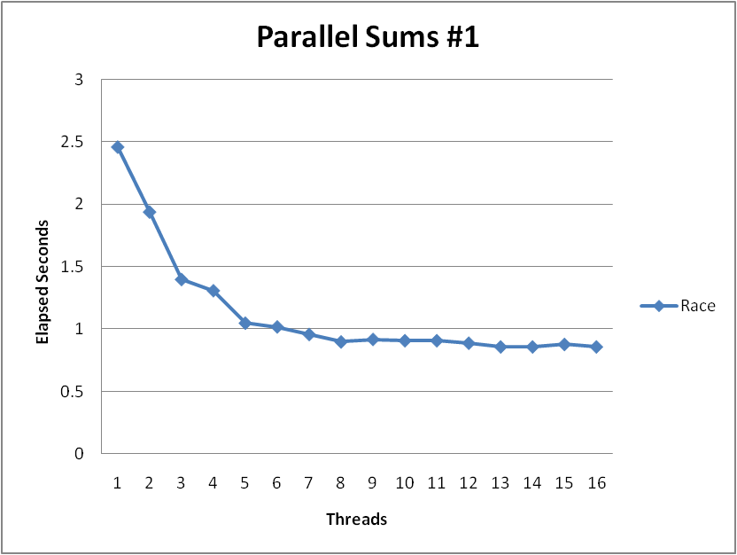
Unsynchronized Performance
N = 2³⁰
Best speedup = 2.86X
Gets wrong answer when > 1 thread!

Slide 17
Thread Function: Semaphore / Mutex
Semaphore
void *sum_sem(void *vargp)
{
int myid = *((int *)vargp);
size_t start = myid * nelems_per_thread;
size_t end = start + nelems_per_thread;
size_t i;
for (i = start; i < end; i++) {
sem_wait(&semaphore);
global_sum += i;
sem_post(&semaphore);
}
return NULL;
}
sem_wait(&semaphore);
global_sum += i;
sem_post(&semaphore);
Mutex
pthread_mutex_lock(&mutex);
global_sum += i;
pthread_mutex_unlock(&mutex);

Slide 18
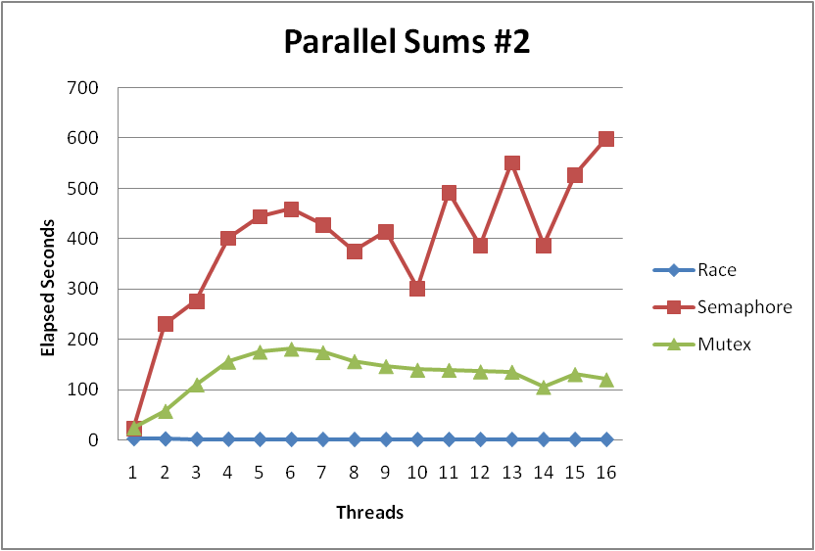
Semaphore / Mutex Performance
Terrible Performance
2.5 seconds ➔ ~10 minutes
Mutex 3X faster than semaphore
Clearly, neither is successful

Slide 19
Separate Accumulation
Method #2: Each thread accumulates into separate variable
2A: Accumulate in contiguous array elements
2B: Accumulate in spaced-apart array elements
2C: Accumulate in registers
/* Partial sum computed by each thread */
data_t psum[MAXTHREADS*MAXSPACING];
/* Spacing between accumulators */
size_t spacing = 1;

Slide 20
Separate Accumulation: Operation
nelems_per_thread = nelems / nthreads;
/* Create threads and wait for them to finish */
for (i = 0; i < nthreads; i++) {
myid[i] = i;
psum[i*spacing] = 0;
Pthread_create(&tid[i], NULL, thread_fun, &myid[i]);
}
for (i = 0; i < nthreads; i++)
Pthread_join(tid[i], NULL);
result = 0;
/* Add up the partial sums computed by each thread */
for (i = 0; i < nthreads; i++)
result += psum[i*spacing];
/* Add leftover elements */
for (e = nthreads * nelems_per_thread; e < nelems; e++)
result += e;

Slide 21
Thread Function: Memory Accumulation
void *sum_global(void *vargp)
{
int myid = *((int *)vargp);
size_t start = myid * nelems_per_thread;
size_t end = start + nelems_per_thread;
size_t i;
size_t index = myid*spacing;
psum[index] = 0;
for (i = start; i < end; i++) {
psum[index] += i;
}
return NULL;
}

Slide 22
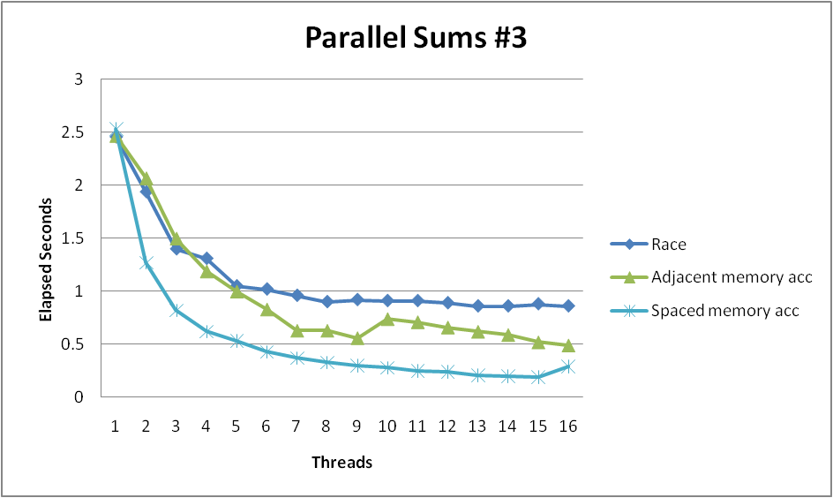
Memory Accumulation Performance
Clear threading advantage
Adjacent speedup: 5 X
Spaced-apart speedup: 13.3 X (Only observed speedup > 8)
Why does spacing the accumulators apart matter?

Slide 23
False Sharing
0
1
2
3
4
5
6
7
psum
Cache Block m
Cache Block m+1
Coherency maintained on cache blocks
To update psum[i], thread i must have exclusive access
Threads sharing common cache block will keep fighting each other for access to block

Slide 24
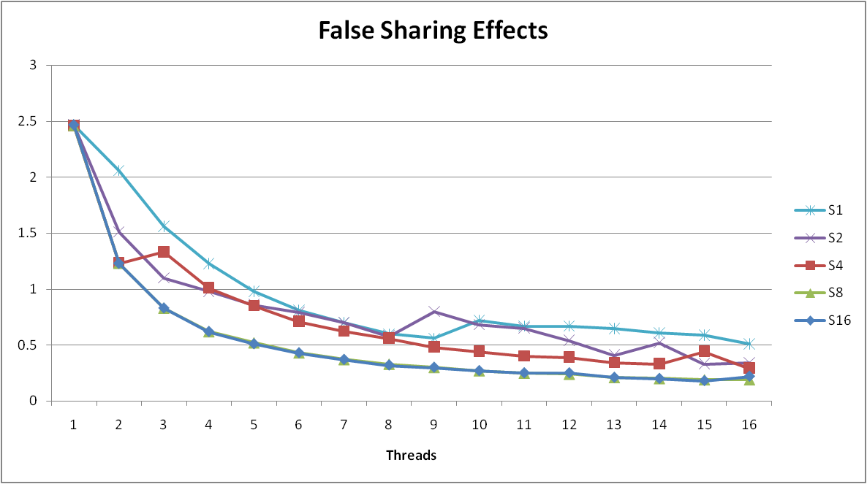
False Sharing Performance
Best spaced-apart performance 2.8 X better than best adjacent
Demonstrates cache block size = 64
8-byte values
No benefit increasing spacing beyond 8

Slide 25
Thread Function: Register Accumulation
void *sum_local(void *vargp)
{
int myid = *((int *)vargp);
size_t start = myid * nelems_per_thread;
size_t end = start + nelems_per_thread;
size_t i;
size_t index = myid*spacing;
data_t sum = 0;
for (i = start; i < end; i++) {
sum += i;
}
psum[index] = sum; return NULL;
}

Slide 26
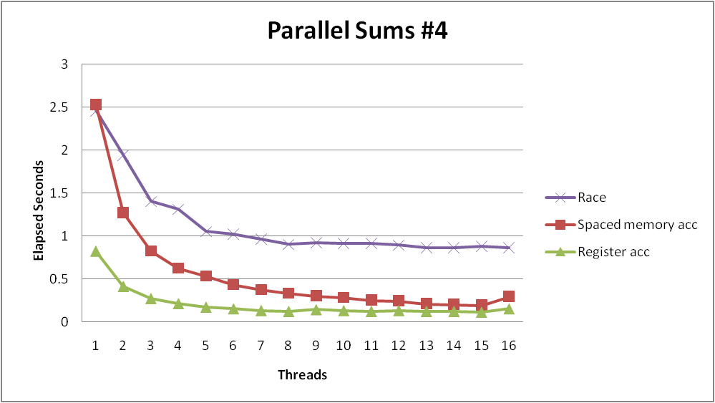
Register Accumulation Performance
Clear threading advantage
Speedup = 7.5 X
2X better than fastest memory accumulation

Slide 27
A More Interesting Example
Sort set of N random numbers
Multiple possible algorithms
Use parallel version of quicksort
Sequential quicksort of set of values X
Choose “pivot” p from X
Rearrange X into
L: Values ≤ p
R: Values ≥ p
Recursively sort L to get L′
Recursively sort R to get R′
Return L′ : p : R′

Slide 28
Sequential Quicksort Visualized
X
p
L
p
R
p2
L2
p2
R2
•
•
•
L′

Slide 29
Sequential Quicksort Visualized
X
L′
p
R
p3
L3
p3
R3
•
•
•
R′
L′
p
R′

Slide 30
Sequential Quicksort Code
void qsort_serial(data_t *base, size_t nele) {
if (nele <= 1)
return;
if (nele == 2) {
if (base[0] > base[1])
swap(base, base+1);
return;
}
/* Partition returns index of pivot */
size_t m = partition(base, nele);
if (m > 1)
qsort_serial(base, m);
if (nele-1 > m+1)
qsort_serial(base+m+1, nele-m-1);
}
Sort nele elements starting at base
Recursively sort L or R if has more than one element

Slide 31
Parallel Quicksort
Parallel quicksort of set of values X
If N ≤ Nthresh, do sequential quicksort
Else
Choose “pivot” p from X
Rearrange X into
L: Values ≤ p
R: Values ≥ p
Recursively spawn separate threads
Sort L to get L′
Sort R to get R′
Return L′ : p : R′
Degree of parallelism
Top-level partition: none
Second-level partition: 2X
…

Slide 32
Parallel Quicksort Visualized
X
p
L
p
R
p2
p3
L2
p2
R2
p
L3
p3
R3
•
•
•
•
•
•
L′
p
R′

Slide 33
Parallel Quicksort Data Structures
/* Structure that defines sorting task */
typedef struct {
data_t *base;
size_t nele;
pthread_t tid;
} sort_task_t;
volatile int ntasks = 0;
volatile int ctasks = 0;
sort_task_t **tasks = NULL;
sem_t tmutex;
Data associated with each sorting task
base: Array start
nele: Number of elements
tid: Thread ID
Generate list of tasks
Must protect by mutex

Slide 34
Parallel Quicksort Initialization
static void init_task(size_t nele) {
ctasks = 64;
tasks = (sort_task_t **) Calloc(ctasks, sizeof(sort_task_t *));
ntasks = 0;
Sem_init(&tmutex, 0, 1);
nele_max_serial = nele / serial_fraction;
}
Task queue dynamically allocated
Set Nthresh = N/F:
N Total number of elements
F Serial fraction
Fraction of total size at which shift to sequential quicksort

Slide 35
Parallel Quicksort: Accessing Task Queue
static sort_task_t *new_task(data_t *base, size_t nele) {
P(&tmutex);
if (ntasks == ctasks) {
ctasks *= 2;
tasks = (sort_task_t **)
Realloc(tasks, ctasks * sizeof(sort_task_t *));
}
int idx = ntasks++;
sort_task_t *t = (sort_task_t *) Malloc(sizeof(sort_task_t));
tasks[idx] = t;
V(&tmutex);
t->base = base;
t->nele = nele;
t->tid = (pthread_t) 0;
return t;
}
Dynamically expand by doubling queue length
Generate task structure dynamically (consumed when reap thread)
Must protect all accesses to queue & ntasks by mutex

Slide 36
Parallel Quicksort: Top-Level Function
void tqsort(data_t *base, size_t nele) {
int i;
init_task(nele);
tqsort_helper(base, nele);
for (i = 0; i < get_ntasks(); i++) {
P(&tmutex);
sort_task_t *t = tasks[i];
V(&tmutex);
Pthread_join(t->tid, NULL);
free((void *) t);
}
}
Actual sorting done by tqsort_helper
Must reap all of the spawned threads
All accesses to task queue & ntasks guarded by mutex

Slide 37
Parallel Quicksort: Recursive function
void tqsort_helper(data_t *base, size_t nele) {
if (nele <= nele_max_serial) {
/* Use sequential sort */
qsort_serial(base, nele);
return;
}
sort_task_t *t = new_task(base, nele);
Pthread_create(&t->tid, NULL, sort_thread, (void *) t);
}
If below Nthresh, call sequential quicksort
Otherwise create sorting task

Slide 38
Parallel Quicksort: Sorting Task Function
static void *sort_thread(void *vargp) {
sort_task_t *t = (sort_task_t *) vargp;
data_t *base = t->base;
size_t nele = t->nele;
size_t m = partition(base, nele);
if (m > 1)
tqsort_helper(base, m);
if (nele-1 > m+1)
tqsort_helper(base+m+1, nele-m-1);
return NULL;
}
Same idea as sequential quicksort

Slide 39
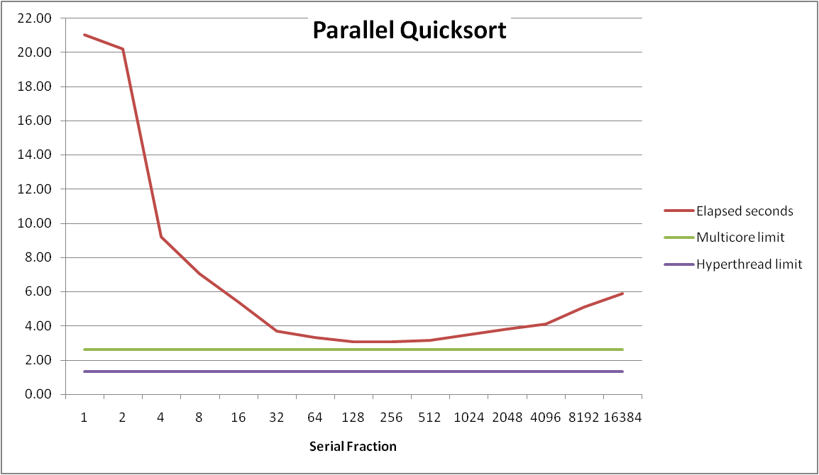
Parallel Quicksort Performance
Sort 2³⁷ (134,217,728) random values
Best speedup = 6.84X

Slide 40
Parallel Quicksort Performance
Good performance over wide range of fraction values
F too small: Not enough parallelism
F too large: Thread overhead + run out of thread memory

Slide 41
Implementation Subtleties
Task set data structure
Array of structs
sort_task_t *tasks;
new_task returns pointer or integer index
Array of pointers to structs
sort_task_t **tasks;
new_task dynamically allocates struct and returns pointer
Reaping threads
Can we be sure the program won’t terminate prematurely?

Slide 42
Amdahl’s Law
Overall problem
T Total time required
p Fraction of total that can be sped up (0 ≤ p ≤ 1)
k Speedup factor
Resulting Performance
T_{k} = pT/k + (1-p)T
Portion which can be sped up runs k times faster
Portion which cannot be sped up stays the same
Maximum possible speedup
k = ∞
T∞ = (1-p)T

Slide 43
Amdahl’s Law Example
Overall problem
T = 10 Total time required
p = 0.9 Fraction of total which can be sped up
k = 9 Speedup factor
Resulting Performance
T₉ = 0.9 * 10/9 + 0.1 * 10 = 1.0 + 1.0 = 2.0
Maximum possible speedup
T∞ = 0.1 * 10.0 = 1.0

Slide 44
Amdahl’s Law & Parallel Quicksort
Sequential bottleneck
Top-level partition: No speedup
Second level: ≤ 2X speedup
k^{th} level: ≤ 2^{k-1}X speedup
Implications
Good performance for small-scale parallelism
Would need to parallelize partitioning step to get large-scale parallelism
Parallel Sorting by Regular Sampling
H. Shi & J. Schaeffer, J. Parallel & Distributed Computing, 1992

Slide 45
Lessons Learned
Must have strategy
Partition into K independent parts
Divide-and-conquer
Inner loops must be synchronization free
Synchronization operations very expensive
Watch out for hardware artifacts
Sharing and false sharing of global data
You can do it!
Achieving modest levels of parallelism is not difficult

