Slide 1
LibTW
Thomas van Dijk
Jan-Pieter van den Heuvel
Wouter Slob

Slide 2
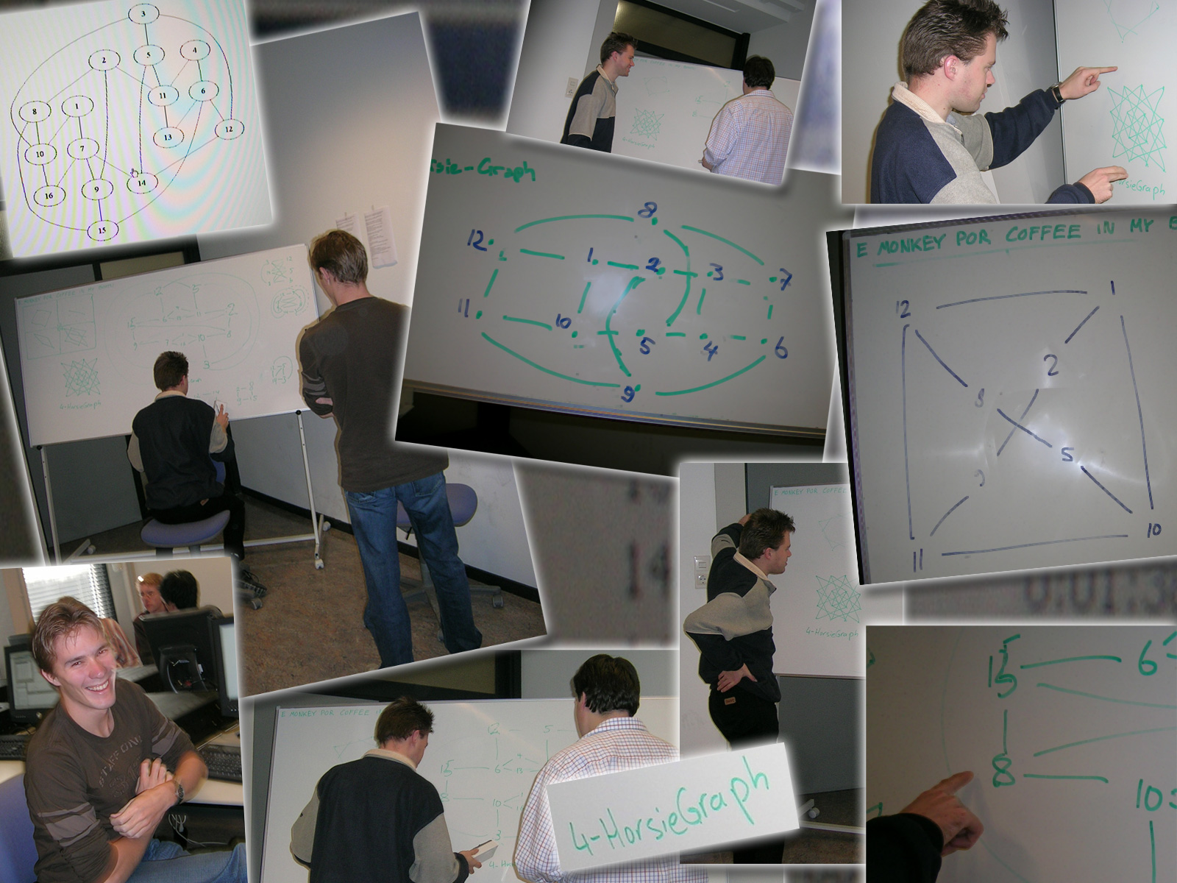
“Experimentation Project”
Title: Computing Treewidth
Supervisor: Hans Bodlaender

Slide 3
Goals:
Implement algorithms to evaluate performance and quality
The implementation should be a coherent library

Slide 4
Some statistics
Code:
  Number of classes: 101
  Lines of actual code: 5411
Algorithms:
  Number of algorithms: 30
  Lines of actual code: 2576
Coffee
  Amount consumed: ~70 L
  Code per coffee: ~77 lines / L

Slide 5
Using LibTW

Slide 6
Usage: getting a graph
NGraph<InputData> g = null;
GraphInput input = new
DgfReader( “someGraph.dgf" );
try {
g = input.get();
} catch (InputException e) {}

Slide 7
Usage: getting a graph
NGraph<InputData> g = null;
GraphInput input = new
RandomGraphGenerator(10,0.5);
try {
g = input.get();
} catch (InputException e) {}

Slide 8
Usage: getting a graph
NGraph<InputData> g = null;
GraphInput input = new
CliqueGraphGenerator(7);
try {
g = input.get();
} catch (InputException e) {}

Slide 9
Usage: getting a graph
NGraph<InputData> g = null;
GraphInput input = new
NQueenGraphGenerator(7);
try {
g = input.get();
} catch (InputException e) {}

Slide 10
Usage: running algorithms
LowerBound<InputData> algo =
new MinDegree<InputData> ();
algo.setInput( g );
algo.run();
… = algo.getLowerBound();

Slide 11
Usage: running algorithms
LowerBound<InputData> algo =
new MinorMinWidth<…>();
algo.setInput( g );
algo.run();
… = algo.getLowerBound();

Slide 12
Usage: running algorithms
UpperBound<InputData> algo =
new GreedyFillIn<InputData>();
algo.setInput( g );
algo.run();
… = algo.getUpperBound();

Slide 13
Usage: running algorithms
Permutation<InputData> algo =
new QuickBB<…>();
algo.setInput( g );
algo.run();
… = algo.getPermutation();

Slide 14
Usage: running algorithms
Exact<InputData> algo =
new TreewidthDP<InputData>();
algo.setInput( g );
algo.run();
… = algo.getTreewidth();

Slide 15
Some practical issues

Slide 16
Revision control system
Essential
We used Subversion
  which is very nice

Slide 17
Regression testing
Automated system
Currently 122 tests
  E.g. “If you run GreedyDegree on celar02.dgf, the result should be 10.”
Actually stopped us from introducing bugs once or twice
Good for confidence!

Slide 18
Visualization
Nice to draw graphs: can visualize results and even intermediate steps of an algorithm.
Complicated to implement?

Slide 19
Visualization
Complicated to implement?
  Not at all!
Just generate ‘dot’ code and pipe it though GraphViz. Really easy.

Slide 20
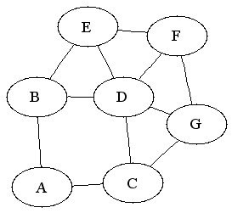
Visualization
graph G {
v1 [label="A"]
v2 [label="B"]
…
v6 -- v7
v4 -- v6
v1 -- v3
…
}

Slide 21
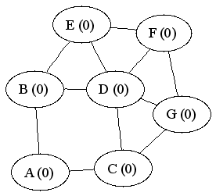
Example animation

Slide 22
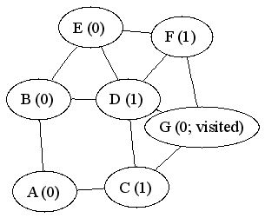
Example animation

Slide 23
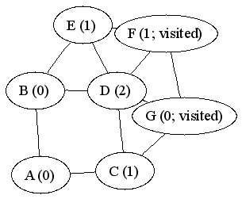
Example animation

Slide 24
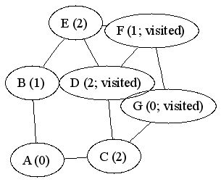
Example animation

Slide 25
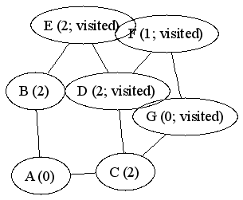
Example animation

Slide 26
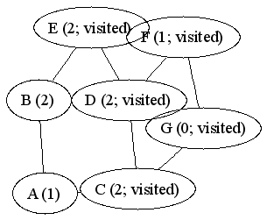
Example animation

Slide 27
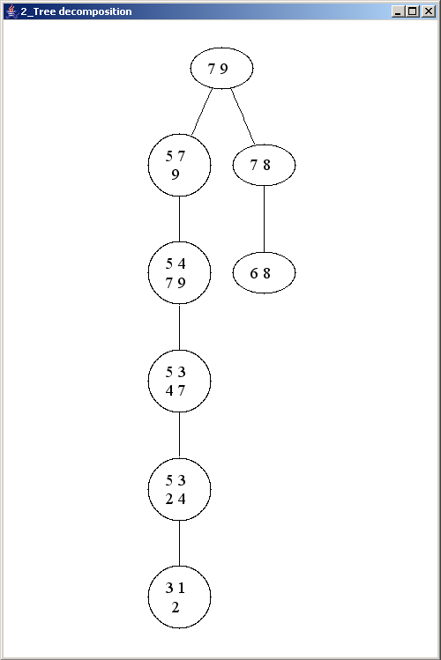
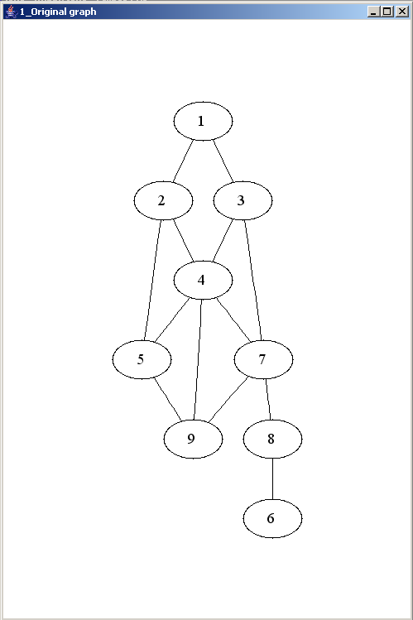
Example drawing
Even nicely draws tree decompositions

Slide 28
Experimental results

Slide 29
Lowerbounds

Slide 30
Lowerbounds
All run pretty fast
No effort was made to implement them very efficiently
Only interested in the answer
(This does hurt algorithms which calculate lowerbounds very often. More on that later.)

Slide 31
“All start” variants
Most lowerbound algorithms are not entirely specific
  “Choose the vertex of minimum degree”
In our implementation:
  Arbitrary choice, or
  Branch only on first choice: “All-start”
Full branching is not worth it

Slide 32
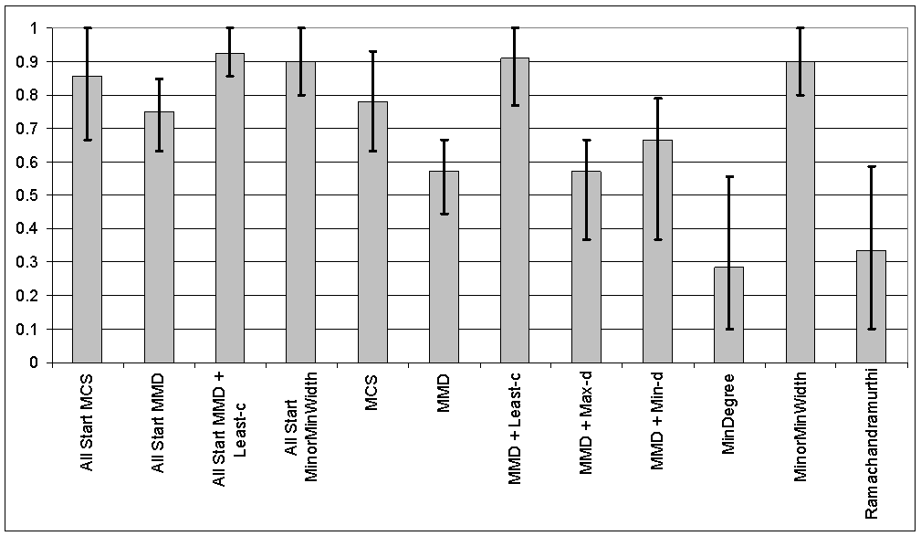
Assorted graphs
Fraction of actual treewidth

Slide 33
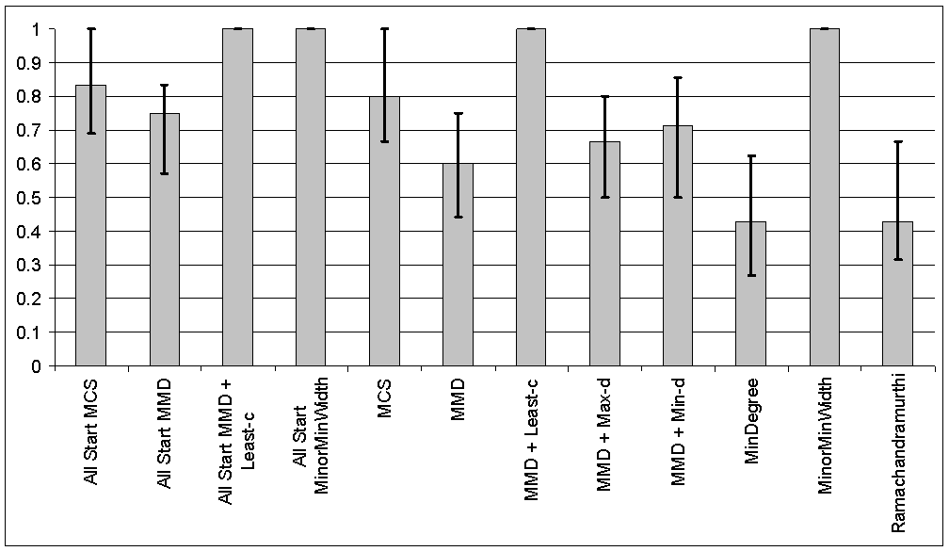
Lots of probabilistic networks
Fraction of best lowerbound

Slide 34
Lowerbound conclusions
Two clear winners
  Maximum Minimum Degree Least-C
  Minor Min Width

Slide 35
Upperbounds

Slide 36
Upperbounds
As with lowerbounds:
  all are fast
  only care about the answer
  our implementation is not for speed

Slide 37
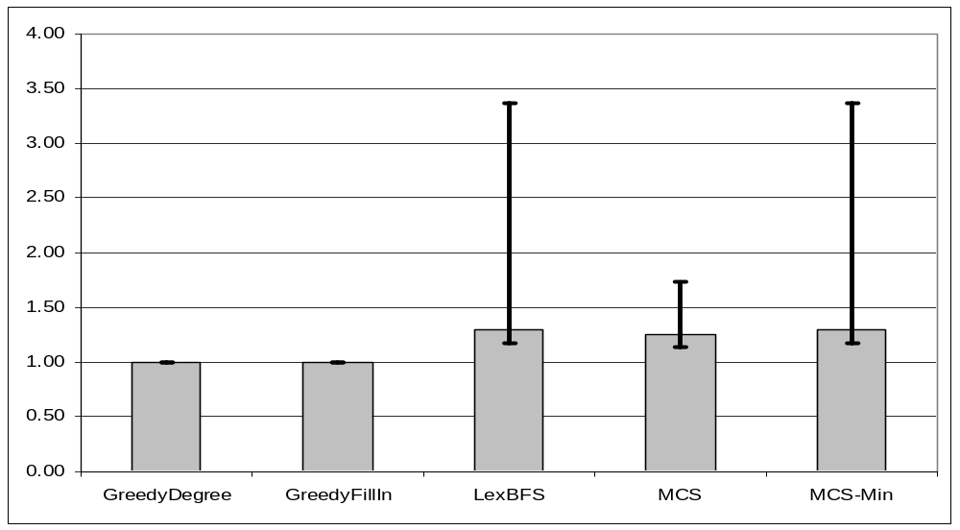
Lots of probabilistic networks
Fraction of best upperbound

Slide 38
Upperbound conclusions
GreedyDegree and GreedyFillIn are never worse than any of the others

Slide 39
GreedyDegree vs GreedyFillIn
Experience during project
  Often equal
  Sometimes FillIn is better
  Very rarely, Degree is better
On 58 probabilistic networks
  Equal: 48 times
  GreedyDegree never better
  FillIn is better:
    7 times by difference one
    3 times by difference four

Slide 40
Lowerbound = upperbound
Seemed to happen quite often on probabilistic networks
Tested on 59 probabilistic networks
  27 had lowerbound = upperbound for some combination of algorithms
  Average gap of 0.93

Slide 41
Quick-BB

Slide 42
Quick-BB
By Gogate & Dechter
Permutations of vertices give a tree decomposition: elimination order
Branch and bound
  Branch on which vertex is next in the permutation
  ‘Eliminate’ that vertex in that branch

Slide 43
Quick-BB implementation
Going into a branch involves a vertex elimination
  A different one for each branch
Solution: work with ‘diffs’
  Remember which edges were added going into a branch
  Remove them when coming out of the branch

Slide 44
Quick-BB implementation
Use minor-min-width as lowerbound in the BB nodes
MMW does edge contractions
  A typical implementation destroys the graph on the way: would require a copy
  Solution: second set of edge lists, destroy those during MMW, cheap to reset from old lists.

Slide 45
Quick-BB implementation
Don’t need to branch on simplical or almost simplicial vertices
Checking only at the start hardly makes a difference
Checking at every branch actually makes things slower
  Our implementation can probably be improved

Slide 46
Quick-BB implementation
Memorize branch-and-bound nodes
Idea by Stan van Hoesel
  We heard about it from Hans Bodlaender
Factor 15~20 speed increase!
At a memory cost, of course, but not prohibitive

Slide 47
Quick-BB implementation
Start with initial permutation from an upperbound algorithm
Doesn’t seem to matter much

Slide 48
Quick-BB evaluation
We don’t achieve the performance Gogate&Dechter report in their paper
Gogate&Dechter’s implementation is often faster than they report in their paper
But not always, and seems buggy

Slide 49
Treewidth DP

Slide 50
Treewidth DP
Bodlaender & Fomin & Koster & Kratsch & Thilikos
Existing implementation in TOL

Slide 51
TwDP implementation
Works a lot with subsets of the vertices
Implemented as BitSets, not vectors

Slide 52
TwDP implementation
Need to calculate “Q-values” a lot
  Calculated via a DFS
Actually equal within a connected component
Modify the DFS to take advantage of this

Slide 53
TwDP implementation
“Bodlaender’s Clique Trick”
Forall cliques in the graph:
exists an optimal elimination ordering with that clique at the end
Having chosen a clique, you can ignore those vertices and “dump them at the end”
Bigger clique is better
... so find maximum clique

Slide 54
Clique experiments
Funny to solve NP-hard problems as preprocessing ☺
But it really makes all the difference
We do really simple backtracking to find the clique
  Time dominated by the rest of the algorithm anyway

Slide 55
Clique experiments
“Mainuk”
  Probabilistic network with 48 vertices
  Max clique of 8
  Without trick: 62 seconds, 33 MB
  With trick: 24 seconds, 17 MB

Slide 56
Clique experiments
“Ship-ship-pp”
  Probabilistic network with 30 vertices
  Max clique of 4
  Without trick: 367 seconds, 271 MB
  With trick: 71 seconds, 77 MB

Slide 57
TwDP evaluation
Our runtime comes very close to TOL on the same machine
  About 1.5 times slower
  Sometimes faster
  Similar memory usage
We go way faster on the N-Queen graphs, somehow

Slide 58
Further work
Treewidth DP
  Dealing with out-of-memory situation
    Throw tables away
    Fall back to B&B
    …
Quick-BB
  Add the ‘clique trick’ here
  Other lowerbounds or combinations of lowerbounds

Slide 59
Further work
More graph implementations
  Framework can handle this
  Some algorithms might benefit a lot from ‘tailor-made’ data structures
Smarter checking for simplicial vertices in QuickBB

Slide 60
Questions?
Slides, report and snapshot of the software on www.treewidth.com ☺
  Should be online next week

