Slide 1

UNIVERSITY OF DANANG
SCHOOL OF INFORMATION AND COMMUNICATION TECHNOLONY
VIRTUAL ASSIsTANT
MEMBERS: 1.LE VAN TRUYEN 18IT2
2.NGUYEN ANH TRIET 18IT2
3.PHAN THANH TUNG 18IT2
INSTRUCTOR : TRUONG HOANG TU NHI
Notes:
Truyền 1234 14 15
Tùng 5 11 12 13
Triết 6789 10

Slide 2
CONTENT:
1 . What is the Virtual Assistant ?
2 . Real applications:
2.1 . What is the Siri ?
2.2 . What is the Google Assistant ?
2.3 . Compare Siri and Google Assistant: Who is better?
3 . Conclusion

Slide 3


1. What is the Virtual Assistant ?
Virtual assistants are software, tools built on the basis of artificial intelligence (AI)
Is an application program designed to "understand" voice commands in natural language and perform tasks for users.
Notes:
Virtual assistant, also known as AI assistant or digital assistant, is an application program designed to "understand" voice commands in natural language and perform tasks for users. . These tasks include reading text messages or email addresses, searching for phone numbers, scheduling, making phone calls and reminding end users about appointments.

Slide 4

2 . Real applications :

Slide 5
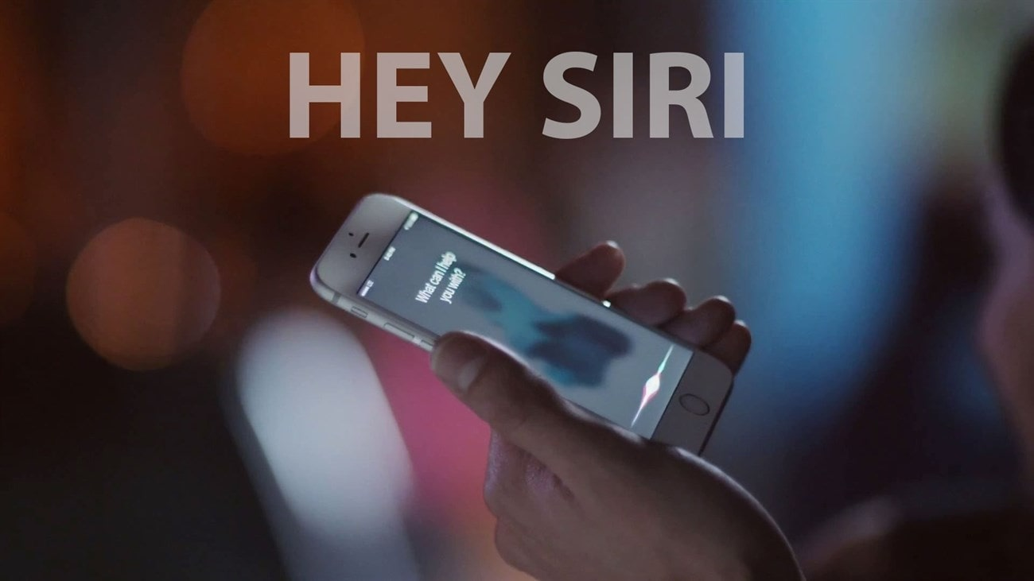
2.1 . What is the Siri ?
Siri is the "oldest" virtual assistant
Built-in on devices of the famous technology tycoon Apple
Interact with iPhone without touching
Just say , Siri will answer or you can tell Siri to do it.
Notes:
Rated as the "oldest" virtual assistant in the world when it was launched in 2011, Siri on iPhone has been built-in on devices of the famous technology tycoon Apple so that users can control via voice. talk. You can interact with iPhone without touching the screen. Instead, you just need to speak, Siri will answer or you can command Siri

Slide 6
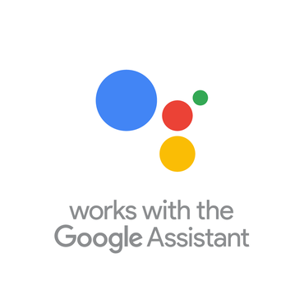
2.2 . What is the Google Assistant ?
Is a virtual assistant of Google
Is very intelligent
Smart features such as searching for information, making requests that you make, such as opening contacts, calling names in contacts, reading messages, opening music …
By your own voice

Slide 7
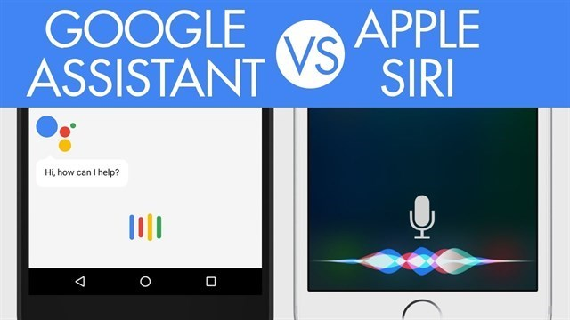
2.3 . Who is better?

Slide 8
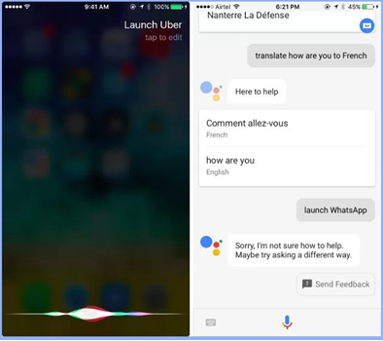
1. Launch and third-party application compatibility
Siri can easily interact with Apple apps like asking Siri to open Uber, sending messages via WhatsApp, but GG Assistant can’t.
Result : Siri > GGA

Slide 9
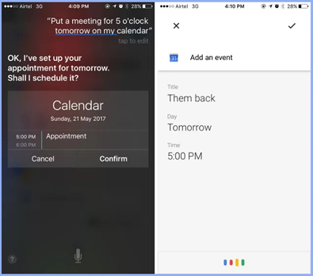
2. Create Calendar
Both make calendar entries as easy as possible, but if Siri uses Apple's calendar, GG Assistant uses Google's calendar.
Result : Siri = GGA

Slide 10
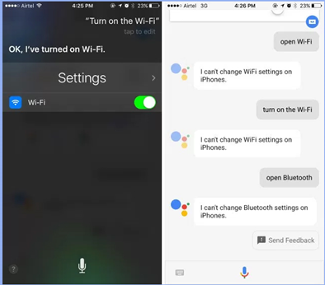
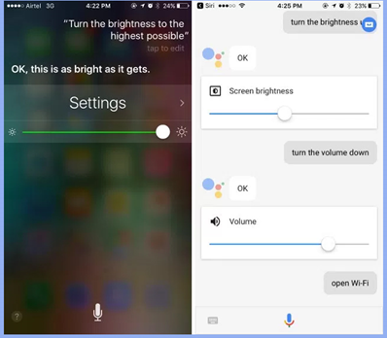
3.Setting
Apple Siri and Google Assistant both perform well when setting volume and brightness settings.
But Google's virtual assistant proved useless when ordered to activate Wifi and Bluetooth.
Result : Siri > GGA

Slide 11
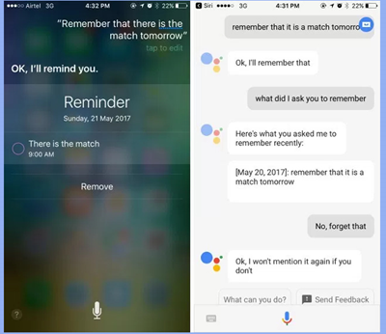
4. Reminder
Google's virtual assistant has the ability to remember everything you say to it, while Siri will form a more complex list of reminders.
Result : GGA > Siri

Slide 12
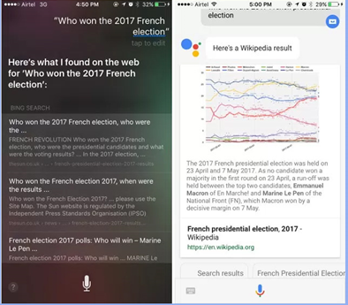
5.Questions are discussed and contextual
The GG Assistant finds quickly and produces relevant results. While Siri is slow and gives false results
Result : GGA > Siri

Slide 13
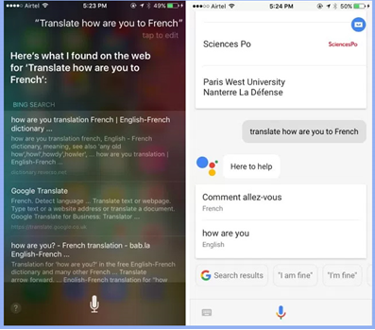
6.Translation
With the question 'How are you translating ?' into French, Google Assistant gives the exact results and Siri only gives other web page links.
Result : GGA > Siri

Slide 14
SOLUTION
When approaching information retrieval questions, Google's virtual assistant handles better. This is understandable because Assistant inherits Google's vast data warehouse and many other services.
In addition, in a contextual conversation, the Google Assistant equipped with AI has a better level of support and is smarter than Siri.

Slide 15


