Slide 1




SPORTS LEAGUE DATABASE
Zachary, Sofia, Zainab, Carlos, Ranjeevan, Annika

Slide 2




Introduction
Main goal: Enriching and straightforward to implement.
Created a database for 4 major sports leagues (NFL, MLB, NBA, NHL)
Sports data suits a database format, enabling easy viewing comparison of:
Athletes, teams, and games
Broad, inclusive look at American sports with potential for expansion.
Notes:
In determining our topic for this project, we had two things in mind: something that would be thoroughly enriching while also being simple to implement. We quickly settled on creating a database for the four major sports leagues (NFL, MLB, NBA, NHL), as sports tend to lend themselves very well to a database approach and we felt it would be incredibly useful to be able to view and compare various athletes, teams, and games. We felt that including multiple sports leagues would be useful from a sports analysis or sports media standpoint, as it would give an all inclusive look at American sports and could be expanded to include further leagues than those we considered. If an organization wanted to reduce the scope of the project to a single league, the database could also be used in a sports management environment, where different teams and players could be viewed easily and compared. The all-encompassing scope of this database helps fill a role that we really haven’t seen filled before.

Slide 3
Features
Possible adaptation to focus on a single league for sports management.
Unique scope fills a unfulfilled need in sports databases.
Valuable for sports analysis and media perspectives
Notes:
In determining our topic for this project, we had two things in mind: something that would be thoroughly enriching while also being simple to implement. We quickly settled on creating a database for the four major sports leagues (NFL, MLB, NBA, NHL), as sports tend to lend themselves very well to a database approach and we felt it would be incredibly useful to be able to view and compare various athletes, teams, and games. We felt that including multiple sports leagues would be useful from a sports analysis or sports media standpoint, as it would give an all inclusive look at American sports and could be expanded to include further leagues than those we considered. If an organization wanted to reduce the scope of the project to a single league, the database could also be used in a sports management environment, where different teams and players could be viewed easily and compared. The all-encompassing scope of this database helps fill a role that we really haven’t seen filled before.

Slide 4
Motivation
Why create a Sport Database?
Motivation for the sports community and its growth.
Team’s knowledge and interest for sports league.
Central resource for tracking diverse sports news.
Help audience stay updated on their favorite teams.
Opportunity to find new sports interest for others.
Notes:
Our motivation to create a database on this topic was the community around sports. Not only were the individual members of our team knowledgeable and interested in sports leagues, we cared about the community that surrounded it. The creation of this database would allow more people to be able to keep track of a wide range of sports news. It will encourage people to keep up with the sports teams that they care about and maybe even discover new interests.

Slide 5


Related Works: Print and Television
ESPN
Local Newspaper
ex. Dallas News
SportsCenter
Notes:
These media stalwarts often present the same information we can present, especially in the pre-Internet era, but our database is wide-ranging, providing info for any sport in the same place while also being more immediate than a print publication or a scheduled television program.

Slide 6




Related Works: Websites and Apps
NBA.com
NFL.com
Pro Football Focus
Pro Basketball Reference
Pro Baseball Reference
Pro Hockey Reference
Notes:
NBA and NFL also have respective apps. Our database can give the same team updates and information, but more straightforward and without as much advertising or irrelevant info.

Slide 7
Design & Models

Slide 8
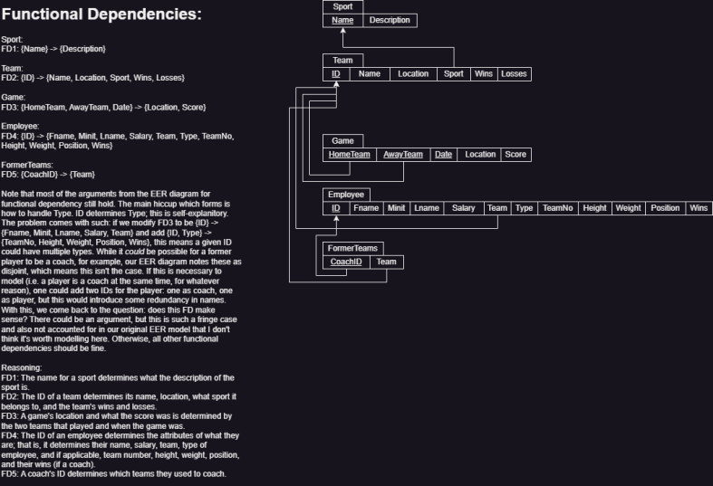
Relational Data Model

Slide 9
Functional Dependencies
Notes:
These are our functional dependencies. The functional dependency for sport is name is the determinant of description. For team it is ID is determinant on Name, Location, Sport, Wins, Losses. For game, HomeTeam, AwayTeam, Date are determinant of Location and Score. For Employee, ID is the determinant of Fname, Minit, Name, Salary, Team, Type, TeamNo, Height, Weight, Position, Wins. And then for Former Teams CoachID is the determinant of Team.

Slide 10
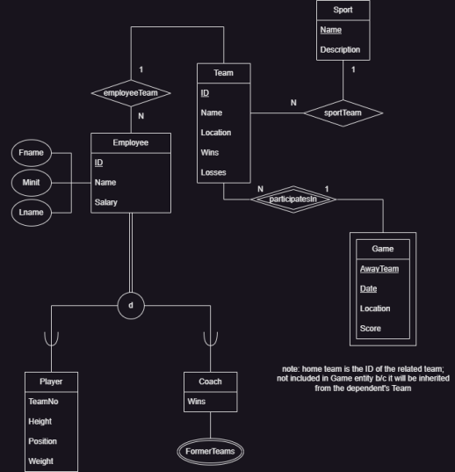
EER Conceptual Data Model

Slide 11
Implementation

Slide 12


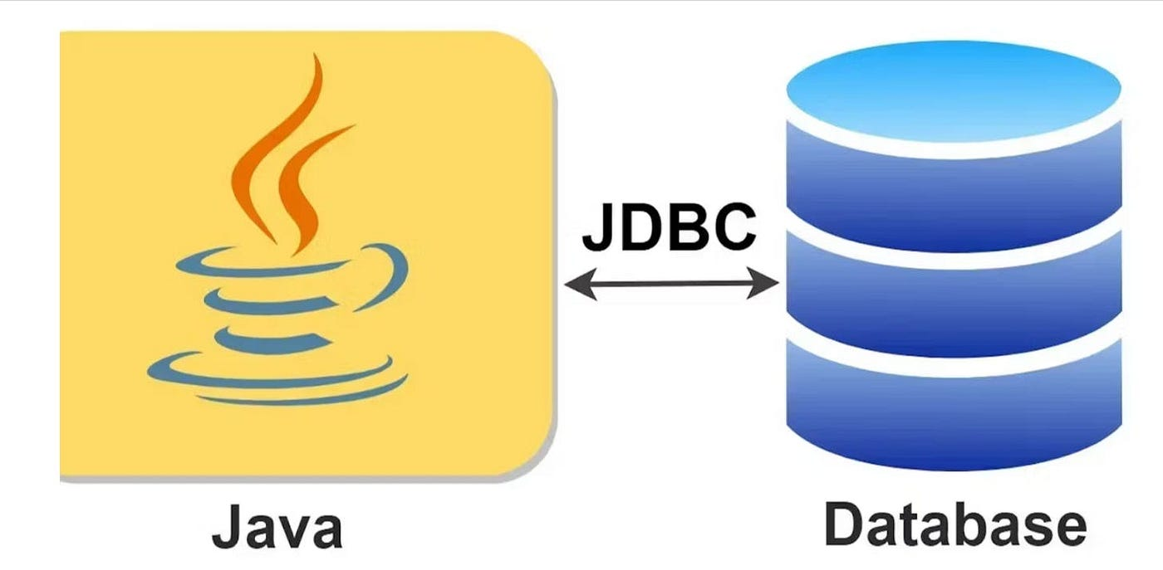

Platforms Used.
For the creation and population of the database:
MySQL workbench and
MySQL command line client
Jupyter Notebook
For the creation of the front end:
Java
For the connection of database to front end:
JDBC (Java Database Connectivity)
To store repository:
Github

Slide 13

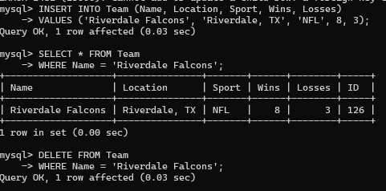
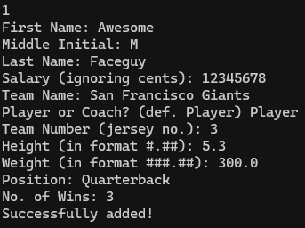
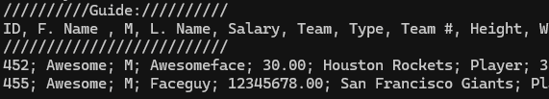
SQL Insert
Front End
Back End

Slide 14
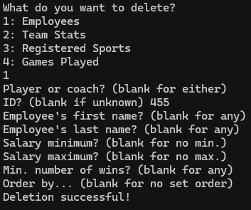
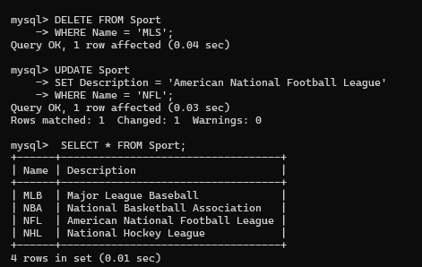
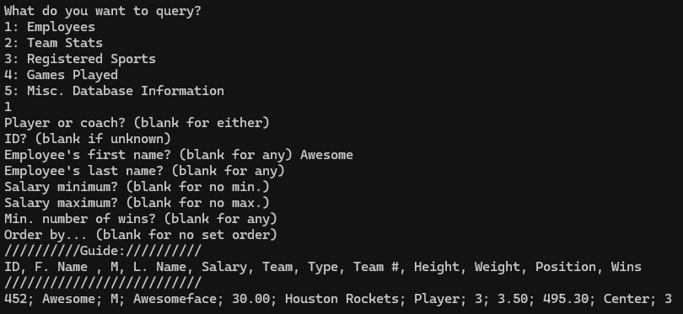
SQL Delete
Front End
Back End

Slide 15
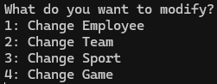
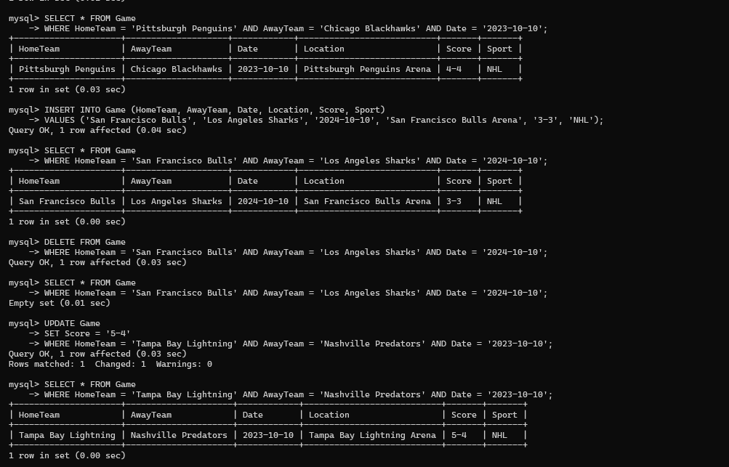
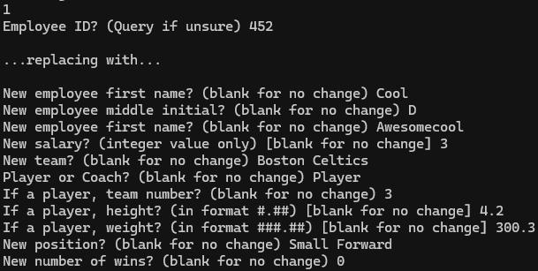

SQL Update
Front End
Back End
becomes…

Slide 16
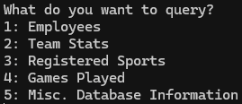
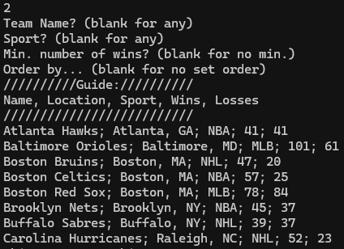
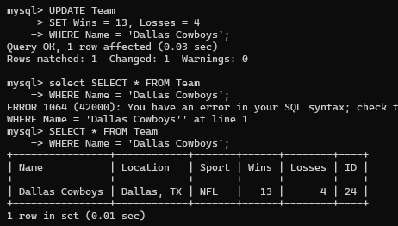
SQL Query
Front End
Back End
(the list continues…)

Slide 17
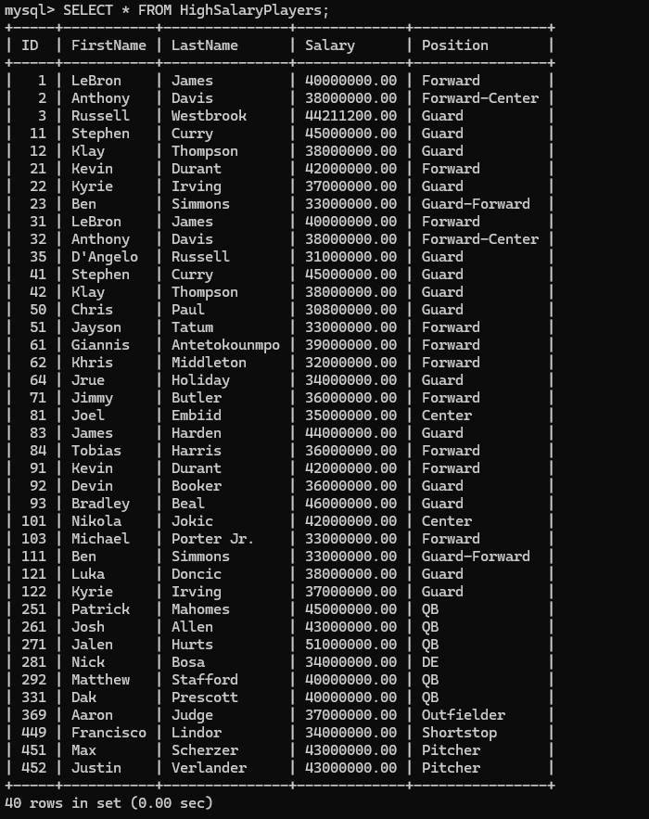
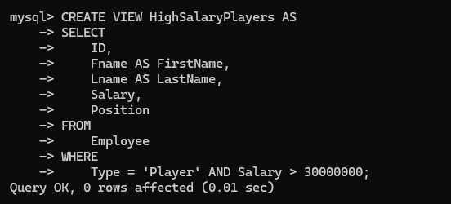
View Creation & Implementation

Slide 18
Conclusion

Slide 19
Future Work
Database Expansion
Increased Database Functionality
Sports Analysis
Notes:
We would like to expand the database to include more sports and more athletes to broaden the scope of our project and to allow our database to be used by more people. We would then like to expand the functionality of our database, adding more relevant information like player stats or upcoming rookie athletes to provide a more complete view of the sports we are looking at and to make our database useful in an even greater number of scenarios. This project could also be a springboard into a greater interest in sports as a whole, specifically looking at sports analytics.

Slide 20
Closing Remarks
Further interest in sports
Improved understanding of database creation and management

