Slide 1
Movie Genres Classification with movie plot
JONALIS BIN KAMIS （G1901299L）
Ng Zhi Yun (G1801490B)
Zhang Bo Lun (G1801984B)

Slide 2
Explotratory data analysis
02.
Introduction and background
01.
Training Models
05.
Feature engineering
04.
Data processing
03.
Conclusion
07.
Parameter Tuning
AGENDA
06.

Slide 3
Introduction & Background
01

Slide 4

INTRODUCTION
Tagging of genres to films or movies are still mostly done manually. Use supervised machine learning to help predict genres of movies based on plot description.
Dataset taken from Kaggle.com comprises of 34,892 movie titles with a total of 9 columns: ‘Release Year’, ‘Title’, ‘Origin/Ethnicity’, ‘Director’, ‘Cast’, ‘Genre’, ‘Wiki Page’, ‘Plot’, ‘Number of words’
Image taken of Popular TV Show and Movie Genre] (2020). Retrieved from https://www.imdb.com/ure/genre/

Slide 5
INTRODUCTION
Classification Approach
Classification is a predicting process for classes/labels of given data points.
In machine learning, classification is a supervised learning approach in which the computer program learns from the input data and then uses this information to classify new information.
Based on the task to find the genres for a set of movie titles based on the plot description, team decided to use the multi-label classifier.
Notes:
Classification method is usually used to predict categorical labels for example if a bank manager needs to analyse data to find out if based on profile of his customers, if they extend a loan to the customer or not.
The main goal of a classification problem is to identify the category/class to which a new data will fall under.
The team has decided to use the multi-label classification method for this project as the given data found in the plot description will be used to categorised the genres of the movies.

Slide 6
Problem
Predict Movie Genre based on the plot Description
Each Movie will have one or more Genre
Supervised Machine Learning Model will be implemented

Slide 7
Exploratory data analysis
02

Slide 8
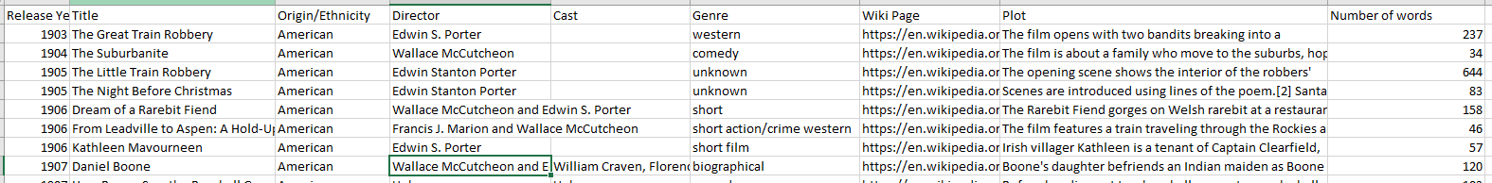
Raw Dataset
Total Data : 34896
After Processing : 28813
2015
2019
2008

Slide 9
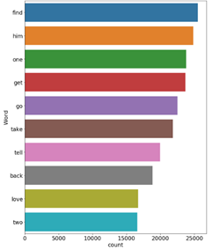
Plot
Average number of words is per plot is 383
Maximum number of word the plot has is 5224
Minimum number of word the plot has is 1
Most popular word: find, him ,one
Least popular word: Inslee, musser

Slide 10
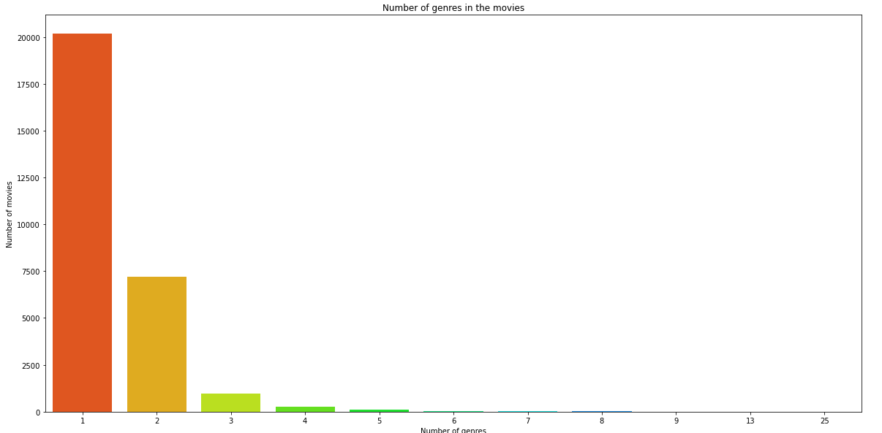
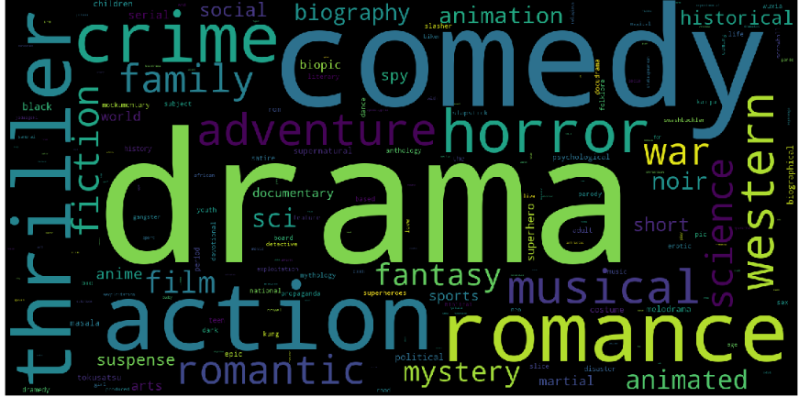
Genre
Total of 662 unique genres before data cleaning
Maximum genre a movie has is 25
Minimum genre a movie has is 1
Average 1.38 genre per Movie

Slide 11
Data Preprocessing
03

Slide 12
genre
Remove Special Characters
Remove NULL and ‘Unknown’ Genre
Remove Number
Tokenization
Remove word less than 3 character
Remove Uncommon Genre that have less than 100 count
Result : 34 Unique Genre

Slide 13
Plot
Lowercase
Lemmatize
Remove English Stop words
Remove Punctuation

Slide 14
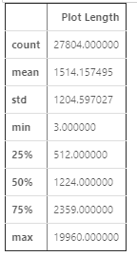
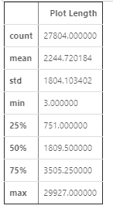
Plot
Before
After
The film is about a family who move to the suburbs, hoping for a quiet life. Things start to go wrong, and the wife gets violent and starts throwing crockery, leading to her arrest
film family move suburbs hoping quiet life thing start go wrong wife get violent start throwing crockery leading arrest

Slide 15
Feature Engineering
04

Slide 16
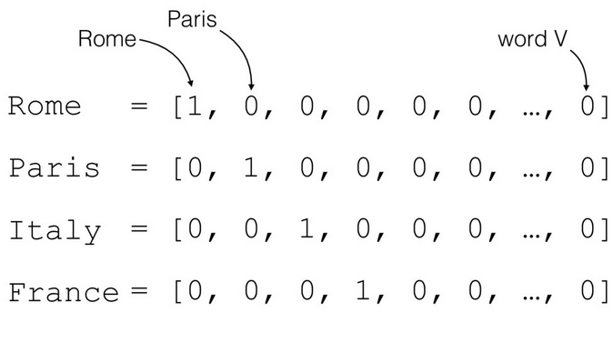
Genre – Count Vectorizer
Count vectorization is also known as one hot encoding.
Creates vectors which have the same dimensionality with the size of our vocabulary.
If the genre data features that token, we put a one in that dimension.
Each time the word appears again, we increase the count, leaving 0s everywhere else that the word does not appear.
A matrix of 0s and 1s are formed for each genre at the end of vectorization.
Source: Heidenreich, H. (2018, August 24). Natural Language Processing: Count Vectorization with scikit-learn. Retrieved from towards data science: https://towardsdatascience.com/natural-language-processing-count-vectorization-with-scikit-learn-e7804269bb5e

Slide 17
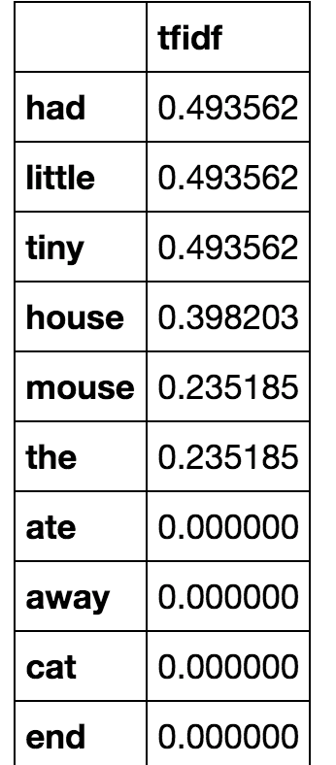
Plot - TFIDF Vectorizer
Term Frequency Inverse Document Frequency (TF-IDF) are used for the feature extraction for plot.
Term Frequency(TF) measures how common a word appears in a particular plot summary by the frequency that it appears.
Higher TF value means the word appears more frequently in a plot. IDF measures how unique a word is in the plot by how infrequent the word appears across all plot summaries.
If a word appears frequently in all plots, it will have a small IDF value and means it is not a very meaningful word across the set of plots. Hence, TF-IDF score is calculated by the product of TF and IDF.
A high score will indicate that the word occurs frequently and provide the most information in that specific plot

Slide 18
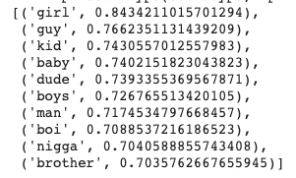
Plot - Word2vec
In the project, we have used a pre-trained Word2Vec model by Google to convert words to its corresponding vector form.
For a given plot summary, we have converted each word to vectors, sum vectors up and find the mean value to represent an average word2vec word embedding for a given plot summary.
Assume that we have n words in a plot summary {w1,w2,w3,w4,w5,w6 … , wn}.
We will convert each word to a vector, add the vectors together and divide by the total number of words (n) appearing in that particular plot.
Hence, our final vector will look like [word2vec(w1) + word2vec(w2) + word2vec(w3) …. + word2vec(wn)]/n.
Source: Tran, K. (2020, March 12). How to Solve Analogies with Word2Vec. Retrieved from towards data science: https://towardsdatascience.com/how-to-solve-analogies-with-word2vec-6ebaf2354009

Slide 19
Machine learning models
05

Slide 20
Multi-label Handling
OneVsResT
Binary Relevance
Classifier Chain

Slide 21
OneVsResT
OneVsRest breaks down a multi-label problem into multiple binary classification problems.
There are N classifiers for N labels.
In testing, the model classifies the input with the highest score among all classifiers.
For a given movie during training and testing, the model will check whether this plot is drama? Whether it is comedy? Or whether it is action.
It breaks down a multi-label problem into three binary classification problems.
At the end of the training process, it combines the result of these three problems into one single output. Hence, it is about fitting one classifier for each class. The class is fitted against all the other classes for every classifier.

Slide 22
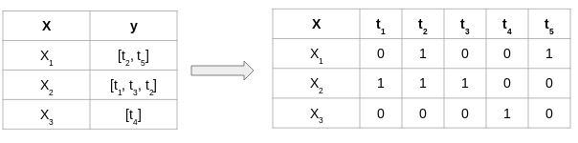
Binary Relevance
Binary Relevance is very similar to OneVsRest model.
Transforms a multi-label classification problem with n labels into n single label separate classification problems.
Every individual classifier will predict whether a genre is true or not.
Each classifier acts as a binary classifier.
At the end of the training process, the result of all the binary classifiers are combined together to form a multi-label output.
PRATEEK JOSHI, (2019, April 22), Predicting Movie Genres using NLP – An Awesome Introduction to Multi-Label Classification. Retrieved from Analytics Vidhya: https://www.analyticsvidhya.com/blog/2019/04/predicting-movie-genres-nlp-multi-label-classification/

Slide 23
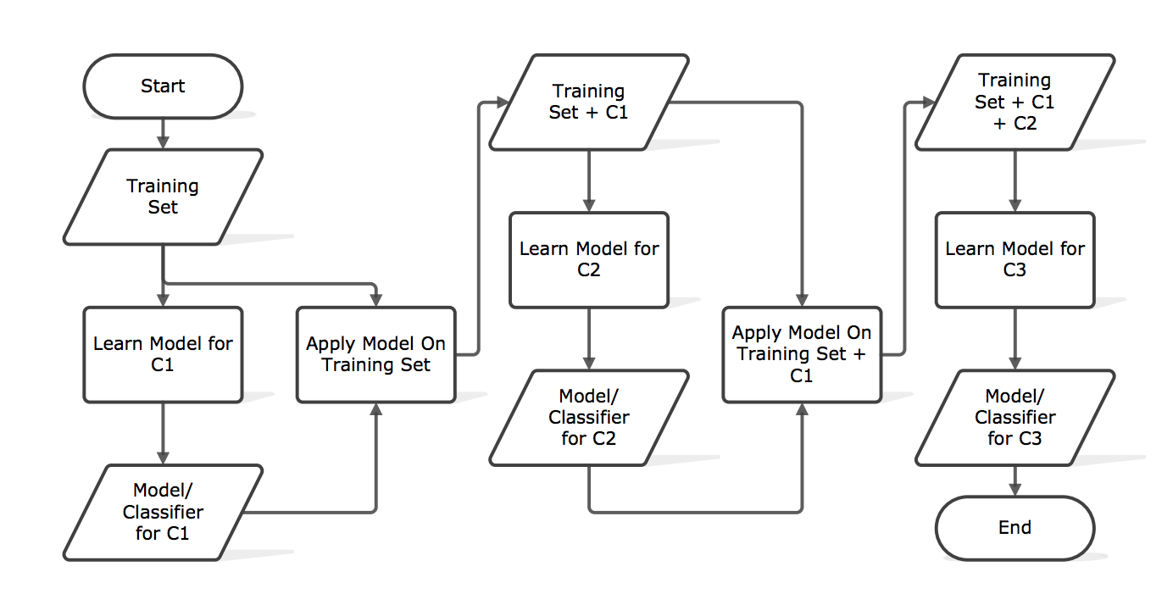
Classifier Chain
Considers one label at a time like binary relevance but it also takes label dependency into consideration.
The output of each classifier is fed into the input of the subsequent classifier. For a dataset with n labels, it has a total number of n classifiers, Cn-1 is fed into input of classifier Cn.
Each label in a dataset is not trained individually.
Kartik Nooney, (2018, June 8), Deep Dive into Multi-Label Classification ..! (With detailed Case Study). Retrieved from Medium: https://towardsdatascience.com/journey-to-the-center-of-multi-label-classification-384c40229bff

Slide 24
Training model
SGDClassification
NAÏVE BAYES
XGBOOST
K-NEAREST NEIGHBOUR

Slide 25
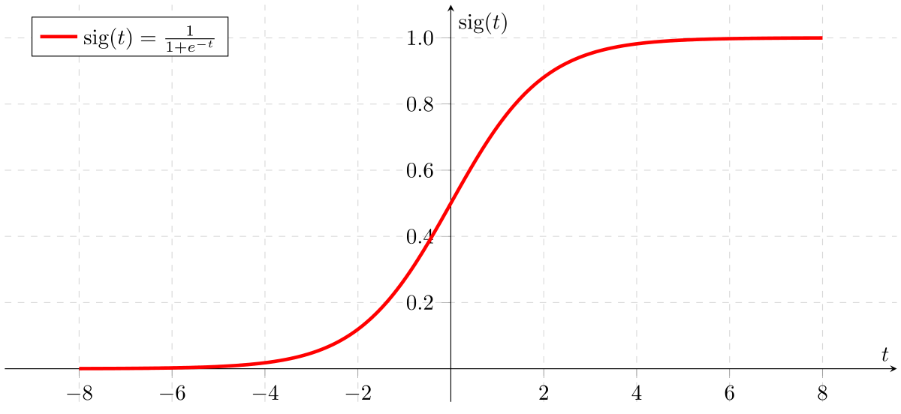
SGDClassification
SGDClassification is a classifier by sklearn. SGD stands for stochastic gradient descent. SGD is actually an optimization method which improves the speed of training models.
When we apply parameter ‘loss’ as log, SGD classifier will use Linear Regression as the training model.
It is better than linear regression as it has a faster speed in processing large dataset.
Logistic Regression model predicts the possibility of a class by utilizing a sigmoid function.
If output of sigmoid > 0.5 → Classify as 1
If output of sigmoid < 0.5 → Classify as 0
SGDClassifier has other loss functions as well, in the project, we have mainly focused on the Logistic Regression model.
Saishruthi Swaminathan, (2018, March 15) Logistic Regression — Detailed Overview. Retrieved from Towards Datascience: https://towardsdatascience.com/logistic-regression-detailed-overview-46c4da4303bc

Slide 26
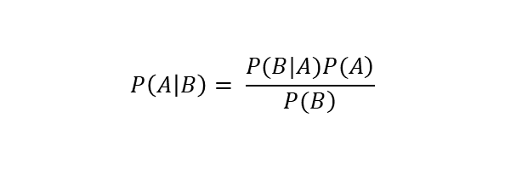
NAÏVE BAYES
Bayes theorem:
Naïve assumption that the probability of a word occurrence is independent of each other.
To classify a set of words into a category → product of the probability of each individual word to predict the likelihood of a given sentence
It is a simple algorithm that works well on small datasets.
It has the disadvantage as it assumes each feature is independent of other features. This is very unlikely in processing natural languages
$$P\left(A | B\right)= \frac{\left.P(B|A)P(A\right)}{\left.P(B\right)}$$

Slide 27
XGBOOST
Decision Tree
Graphical representation of possible solutions to a decision based on certain condition
Bagging
Ensemble meta-algorithm
Random Forest
Bagging-based algorithm
A subset of features selected at random to build a forest → collection of decision tree
Gradient Boosting
XGBoosting
Employs gradient descent algorithm to minimize errors in sequential models
Optimized gradient boosting algorithm
Combining predictions from multiple-decision trees through majority voting mechanism
Advantage
Parallel processing → Increased speed
Tree pruning
Handling missing values
Disadvantage
A large number of parameters to tune
Subjective to overfitting → if parameters not tuned properly
Vishal Morde, (2019, April 8) XGBoost Algorithm: Long May She Reign!. Retrieved from Towards Datascience: https://towardsdatascience.com/https-medium-com-vishalmorde-xgboost-algorithm-long-she-may-rein-edd9f99be63d

Slide 28
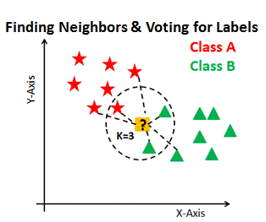
K-NEAREST NEIGHBOUR
Lazy learning algorithm → Training data is not required for model generation
Define a value of K → number of nearest point to a testing data
Calculate distance between new point and surrounding points to find K nearest data
Within K points, the new data point belongs to the group with most points
We have implemented ML-KNN as an adapted algorithm which
adapts a single label problem into multi-label algorithm by changing cost function. skmultilearn.adapt library is used for MLkNN.
Scikit-learn. Retrieved from DataCamp: https://www.datacamp.com/community/tutorials/k-nearest-neighbor-classification-scikit-learn

Slide 29
Parameter tuning
06

Slide 30
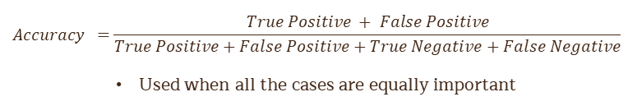
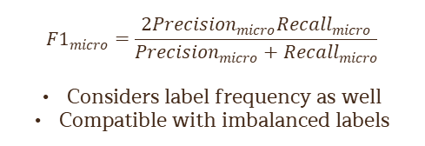
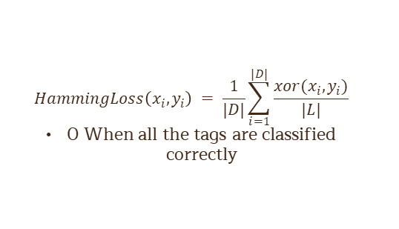
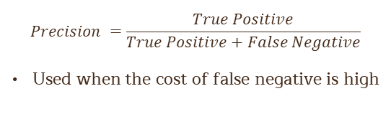
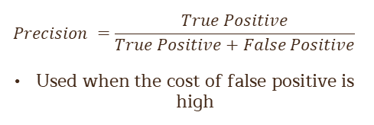
Model Evaluation
Precision
Recall
$$Precision =\frac{True Positive}{True Positive+False Positive}$$
Used when the cost of false positive is high
$$Precision =\frac{True Positive}{True Positive+False Negative}$$
Used when the cost of false negative is high
Accuracy
$$Accuracy =\frac{True Positive + False Positive}{True Positive+False Positive+True Negative+False Negative}$$
Used when all the cases are equally important
F1 Score
Hamming Loss
$${F1}_{micro}=\frac{2{Precision}_{micro}{Recall}_{micro}}{{Precision}_{micro}+{Recall}_{micro}}$$
Considers label frequency as well
Compatible with imbalanced labels
$$HammingLoss\left(x_{i},y_{i}\right) = \frac{1}{|D|}\sum_{i=1}^{|D|}{\frac{xor(x_{i},y_{i})}{|L|}}$$
0 When all the tags are classified correctly

Slide 31
Training Model
CountVectorizer for genre and TFIDF for movie plot.
Max_features of TFIDF was kept at 10000 with char n_grams and ngram_range of (6,6).
Multilabel handling method used was OneVsAll
XGBoost has achieved a higher accuracy value of 0.3625 but its F1 score is very low as compared to others.
SGDClassifier on the other hand, has a much higher F1 score of 0.3429.

Slide 32
Multi-Label handler
Parameters of TFIDF and Count Vectorizer were kept the same as previous section.
Model used for testing was SGDClassifier.
As observed from the table, Binary Relevance had the highest accuracy value with 0.3823 but lowest F1 score of 0.2917.
Classifier Chain had the highest F1 score of 0.3838 but relatively lower accuracy of 0.2990.

Slide 33
TFIDF Vectorizer
Word analyzer with F1 score was 0.3925 → ngram_range (1,3).
Char analyzer with F1 score 0.4065 → ngarm_range (6,6)
max_features from 5000 to 20000
Best F1 Score → 0.4052 with a max_feature of 15000
Ngram_range → Upper limit set at 6 lower limit was increased from 1 to 6.
Best ngram_range was 3,6 with a F1 score of 0.4210
Lower bound fixed to 3
Best upper value as achieved at 8 where the F1 score was 0.4509

Slide 34
TFIDF Vectorizer vs Word2vec
At the last step, experimented on word embedding instead of bag of words embedding with TFIDF vectorizer.
Added vector of each word in a sentence together and divided by the total number of words in a plot.
The result was saved in pickle file. This was because each vectorization process consumes a great amount of time.
Simply load the data from files when we need them.
By using Word2Vec vectorizer, our performance on F1 score has improved significantly with a result of 0.5176 as compared to 0.4643 when we used TFIDF vectorizer

Slide 35
conclusion
Findings
Future work
Best Performance
Lower F1 score → High Recall
Higher F1 score → High Precision
High Precision → Small False Positive
Small Recall → High False Negative
Not considered Neural Network so far
Could focus more on NN in the future
Training own Word2Vec model with given data
Best Result was achieved with the help of Word2Vec
F1 Score of 0.5176

Slide 36
THANKS

