Slide 1
Stattleship Hypothesis Testing Lab
Zac Boiskin

Slide 2
Abstract
It has been rumored that the Colorado Rockies’s season baseball batting stats are inflated because they play half their season in a stadium at high elevation. High elevation causes the ball to move through the air with less resistance, therefore making the ball travel further than it normally would. I will be testing the home game stats of the 14 players that have played the most games in the 2017 season, against their away game stats for significant changes.

Slide 3
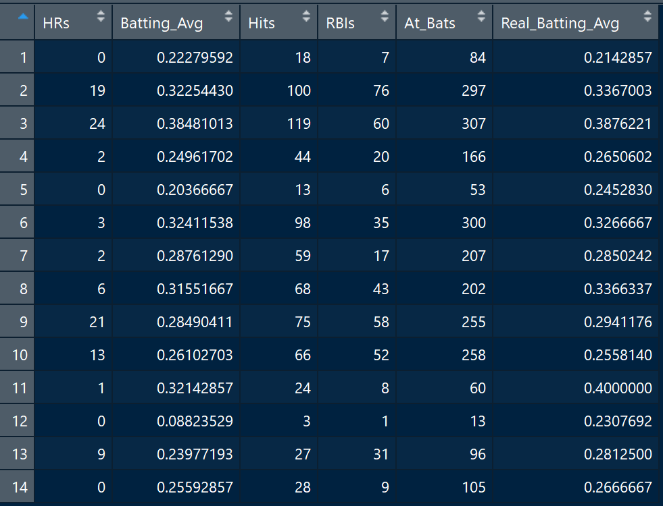
Home Games

Slide 4
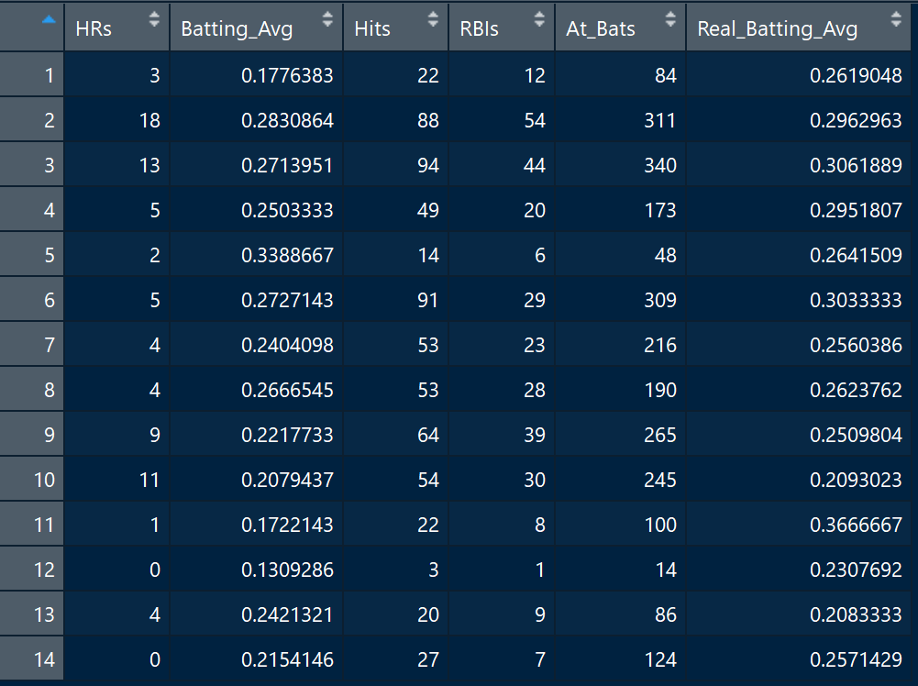
Away Games

Slide 5
T-Test 1: Home HRs vs Away HRs
Ho: mean of HRs at home <= mean of HRs away
Ha: mean of HRs at home > mean of HRs away
Looking for significance level of 80% and test statistic of p < .2
Rejection area is anything greater than the left 20% tail
Calculated test statistic =.29
Fail to reject the null hypothesis and can infer there is no significant difference between amount of HRs hit at home vs. away games

Slide 6
T-Test 2: Home Real Batting Avg vs Away Real Batting Avg
Batting Avg in data set is given per game
Taking an average of this average would be misleading
Batting Avg Example:
Game 1: Hit 1 ball in 4 attempts = .25 avg
Game 2: Hit 1 ball in 1 attempt = 1.00 avg
Real Batting Avg Example:
Games 1+2 total hits = 2
Games 1+2 total attempts = 5
.625
2/5 = .4

Slide 7
T-Test 2: Home Real Batting Avg vs Away Real Batting Avg
Ho: mean of Real Batting Avg at home <= mean of Real Batting Avg away
Ha: mean of Real Batting Avg at home > mean of Real Batting Avg away
Looking for significance level of 80% and test statistic of p < .2
Rejection area is anything greater than the left 20% tail
Calculated test statistic =.09
Reject the null hypothesis and can infer there is significant difference between Real Batting Avg hit at home vs. away games

Slide 8
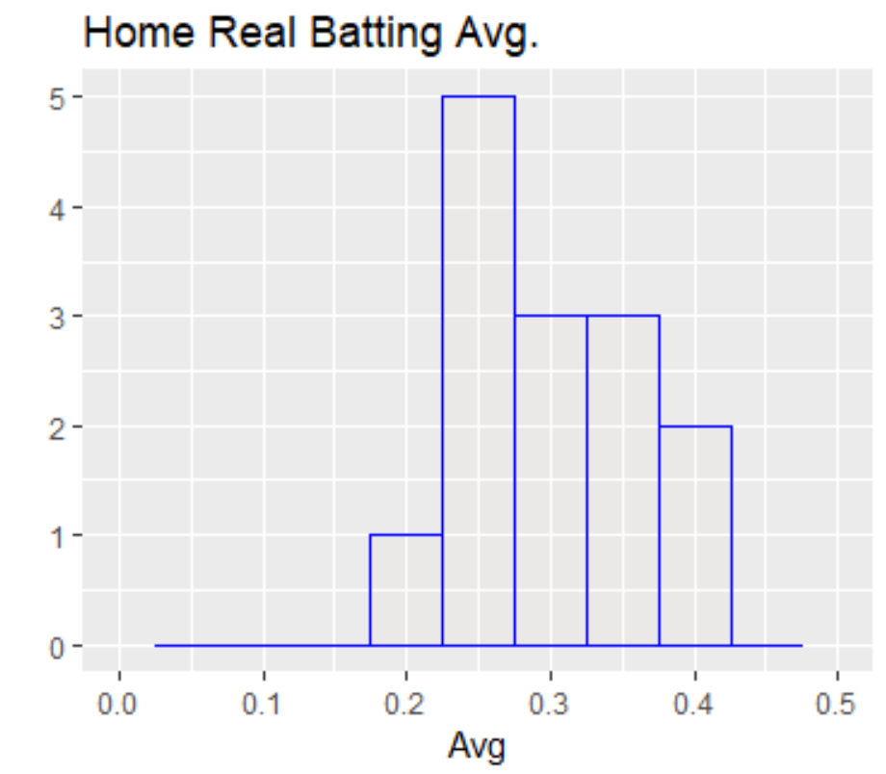
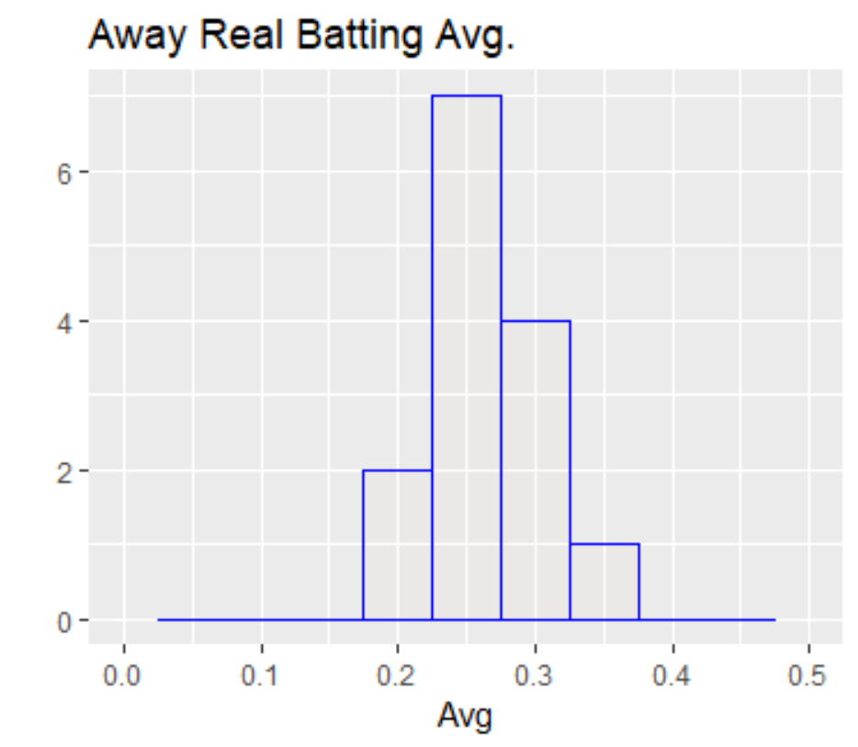
T-Test 2 Histograms

Slide 9
T-Test 3: Batting Avg vs Away Real Batting Avg
Ho: mean of Batting Avg (home/away) = mean of Real Batting Avg (home/away)
Ha: mean of Batting Avg at home DO NOT = mean of Real Batting Avg (home/away)
Looking for significance level of 80% and test statistic of p < .2
Rejection area is anything greater or less than the left or right 10% tails
Calculated test statistic
Home: .51
Away: .98
Fail to reject the null hypothesis and can infer that the means for Batting Avg vs Real Batting Avg are very similar, less for home games
Would be better to use Real Batting Avg per player, but overall team avg could use either

Slide 10
RBIs F-test for variance
Ho: Variance of RBIs at home = Variance of RBIs away
Ha: Variance of RBIs at home DO NOT = variance of RBIs away
Looking for significance level of 80% and test statistic of p < .2
Rejection area is anything greater or less than the left or right 10% tails
Calculated test statistic = .1499
Reject the null hypothesis and can infer that the variation of RBIs at home games is significantly different than RBIs at away games

Slide 11
Chi-Squared Test for Independence
Ho: Games started and Humanized salary are independent
Ha: Games started is not independent of the players’ humanized salary
Looking for significance level of 95% and test statistic of p < .05
Rejection area is anything greater than the left 5% tail
Calculated test statistic = .00000000000000022
Reject the null hypothesis and can infer that amount of Games Started does have an association with a players’ salary

Slide 12
Conclusion
For individual stats such as HRs, it doesn’t seem to have an effect home vs away
But combining individual stats into averages such as Real Batting Avg. that build on each other, does have an effect home vs away
Number of games started does have an effect on a players’ salary
Would be better to use Real Batting Avg per player, but overall team avg could use either
RBIs at home has greater variance than away games

Slide 13
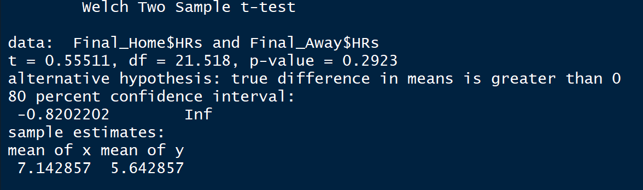
T-Test 1: Home HRs vs Away HRs

Slide 14
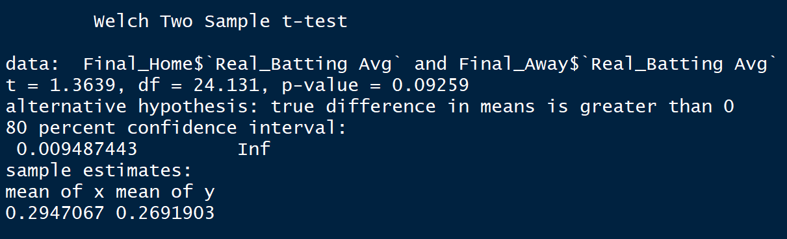
T-Test 2: Home HRs vs Away HRs

Slide 15
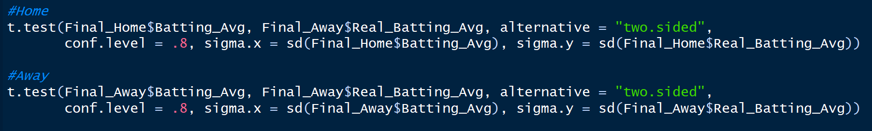
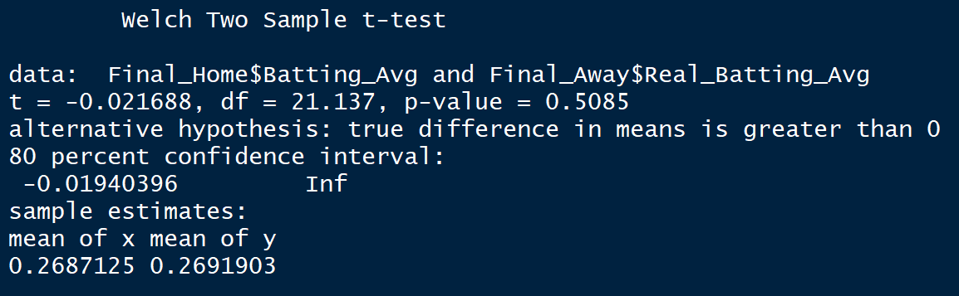
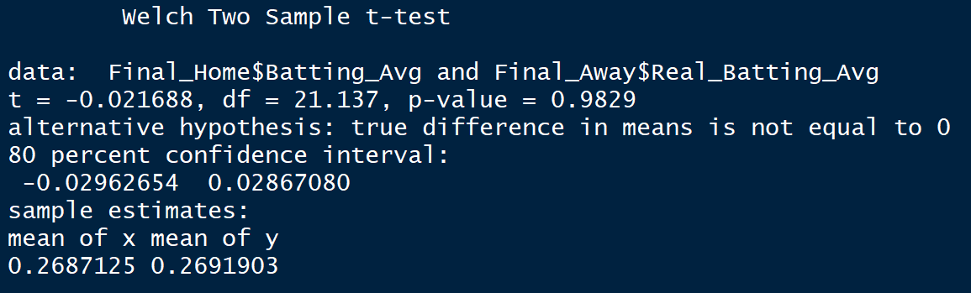
T-Test 3: Batting Avg vs Away Real Batting Avg
Home
Away

Slide 16
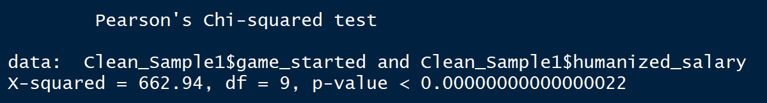
Chi-Squared Test for Independence

Slide 17
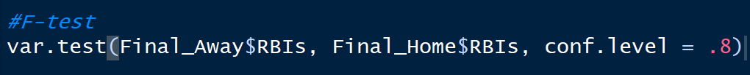
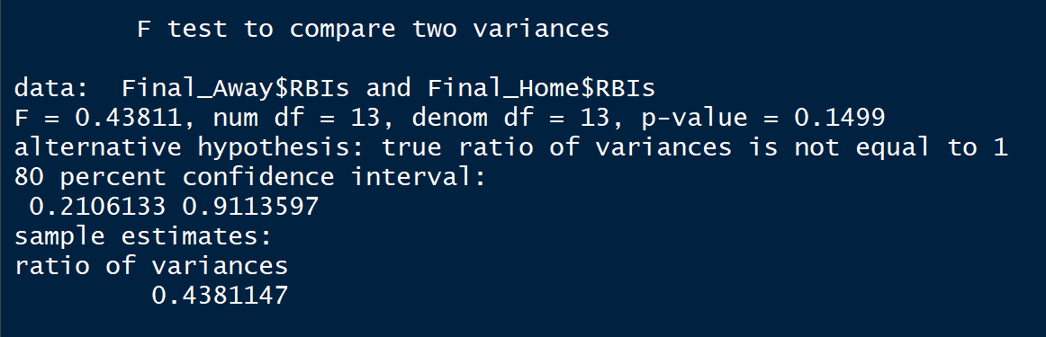
RBIs F-test for variance

