Slide 1
Lesson 2: Introduction to CSS
Notes:
Template version: 11/20/2012, for PowerPoint 2007 & 2010

Slide 2
What is CSS?
CSS stands for Cascading Style Sheets
The purpose of CSS is to describe how the elements of HTML are displayed on your website
You can add CSS to your HTML Elements in 3 different ways:
Inline – Using the style attribute
Internal – Using the <style> element in the <head> element
External – Using am external .css file
The most common way to use CSS is by having separate styling sheets, but we will learn all three.

Slide 3
Inline
Inline CSS is used to give a specific styling to a single HTML element
You will use the style attribute, as shown here:
<p style=“color: red;” >This is red</p> Result: This is red
You can also change other things besides the color, such as the styling of the fonts and the way it is displayed
There are many attributes, font-size, font-family, background-color, to name a few

Slide 4
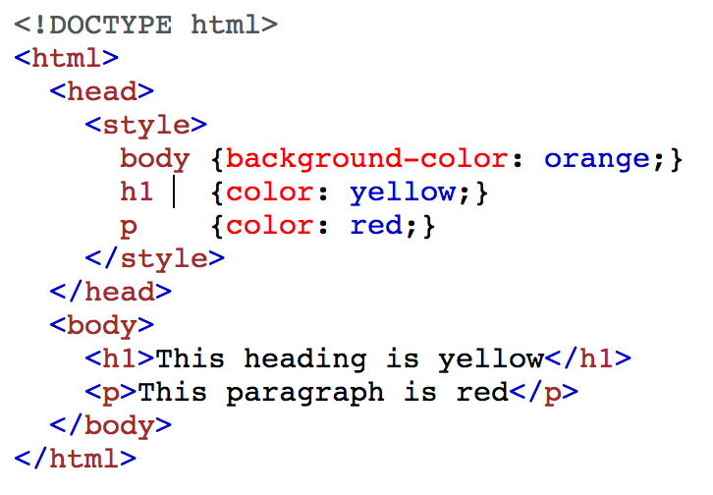
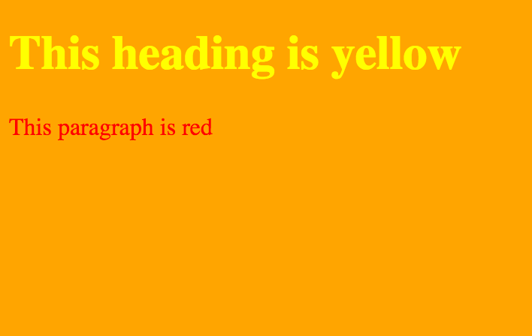
Internal
Used to define the styling for a single HTML page
The styling is defined in the <head> section within a <style> element:
Code: Result:
You define the element tag within the style element and give it the styling attributes that you would like

Slide 5
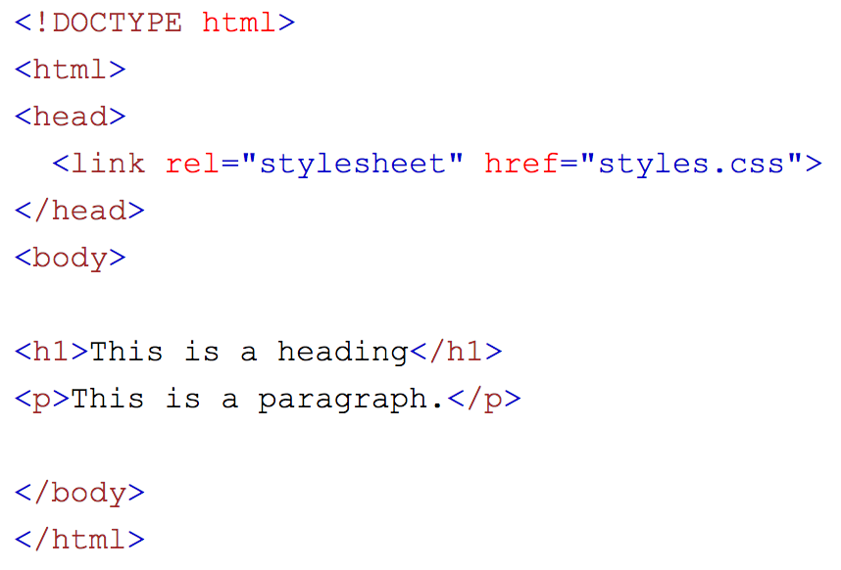
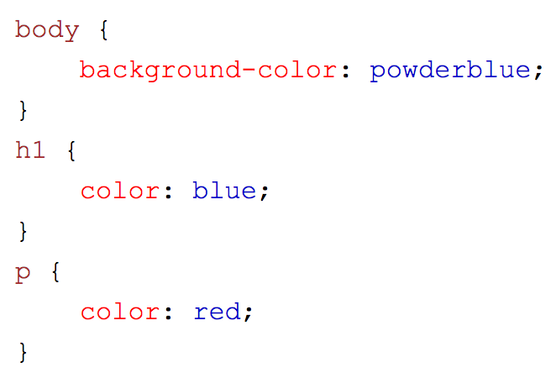
External CSS
Used to define the styling for many HTML pages
This is powerful since you can change the look of your entire website using just one file
First, add the link to the style sheet into the <head> section of your code:
fttt The href attribute is the link to your sheet. This file must be within the same folder in order to link it using just the name of the file.
An example of what your .css file could look like:

Slide 6
Example styling
Here are some things you can change on a website:
Color (color of the font)
Background-color (the color of the background)
font-size (size of the font)
font-family (font type/family)
Border (gives a border surrounding the element)

