Slide 1
Lesson 3: Creating the template
Notes:
Template version: 11/20/2012, for PowerPoint 2007 & 2010

Slide 2
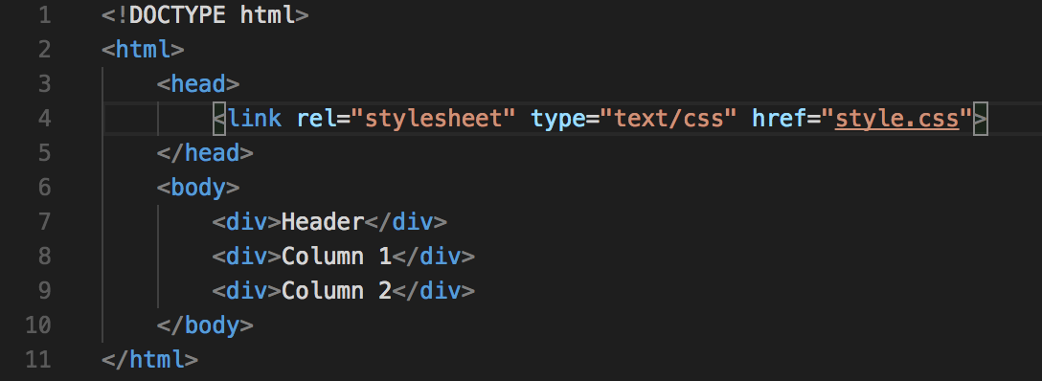
HTML
First we must create an HTML file, lets call it index.html
The basic template of the HTML file looks like this:
There are three <div> elements, one for the header and two for the columns
We also have a CSS file linked inside the <head> section

Slide 3
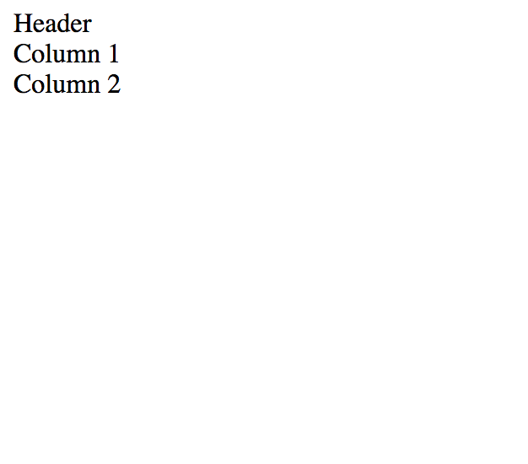
HTML continued
Your website should now look like this:

Slide 4
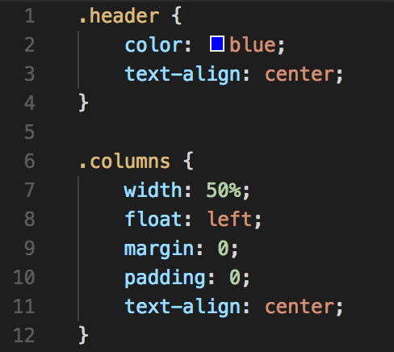
HTML continued
It looks a bit bland, lets add some styling to it.
We will be using an external CSS file to handle all of the styling
Lets call this file styles.css
Lets create some classes:

Slide 5
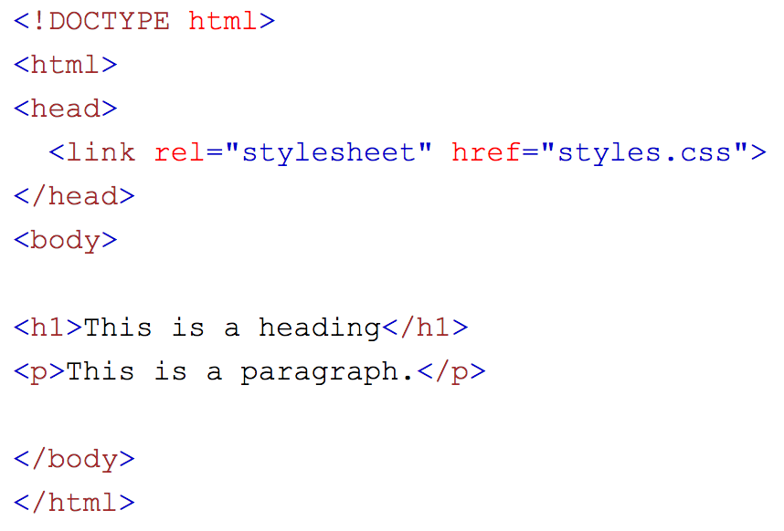
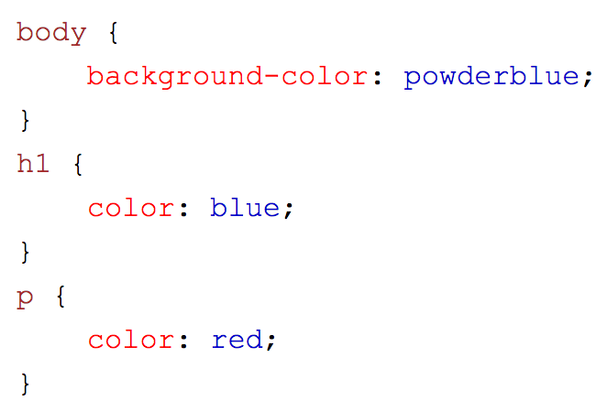
External CSS
Used to define the styling for many HTML pages
This is powerful since you can change the look of your entire website using just one file
First, add the link to the style sheet into the <head> section of your code:
fttt The href attribute is the link to your sheet. This file must be within the same folder in order to link it using just the name of the file.
An example of what your .css file could look like:

Slide 6
Example styling
Here are some things you can change on a website:
Color (color of the font)
Background-color (the color of the background)
font-size (size of the font)
font-family (font type/family)
Border (gives a border surrounding the element)

