Slide 1
Lesson 1: Introduction to HTML
Notes:
Template version: 11/20/2012, for PowerPoint 2007 & 2010

Slide 2
What is HTML?
HTML stands for Hyper Text Markup Language
HTML is used to describe the structure of a website
HTML has elements that come in tag pairs
Almost every single website you see uses HTML in some way or form
HTML

Slide 3
HTML Elements
Every HTML file is composed of html elements
For example:
The paragraph tag <p>Hello World!</p> This will print text saying “Hello World!” on the screen
Notice how the paragraph tag has an opening tag <p> and a closing tag </p>
The button tag <button>Click Me!</button> This will show a button on the screen

Slide 4
Nesting HTML Elements
HTML elements can be put inside each other and nested <div> <p>Hello World!</p> </div>
Here, the div element holds the paragraph element with our hello world text
divs are used for structure in the website like making columns of different sizes

Slide 5
Creating an HTML file
Every HTML file has a few key components
A tag at the top of the file which specifies that the file is HTML so that the browser like Google Chrome or Safari knows how to display it <!DOCTYPE html>
html opening and closing tags <html> </html>
Head opening and closing tags, where the website title and style links go <head></head>

Slide 6
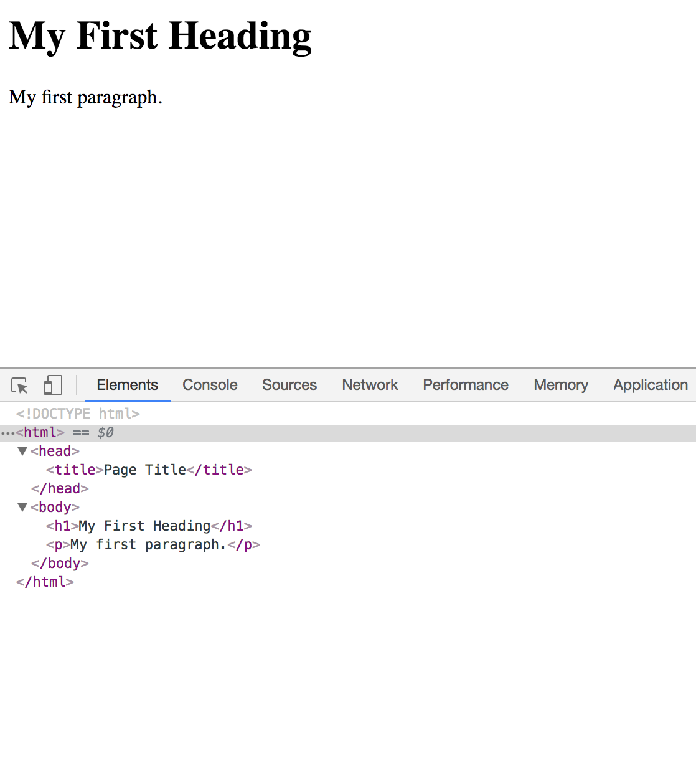
What does HTML look like? Here is an example
<!DOCTYPE html> <html> <head> <title>Page Title</title> </head> <body> <h1>My First Heading</h1> <p>My first paragraph.</p> </body> </html>
Try coping this into an index.html file and open it with your browser
Change the text, save the file and refresh the website to see your changes

Slide 7
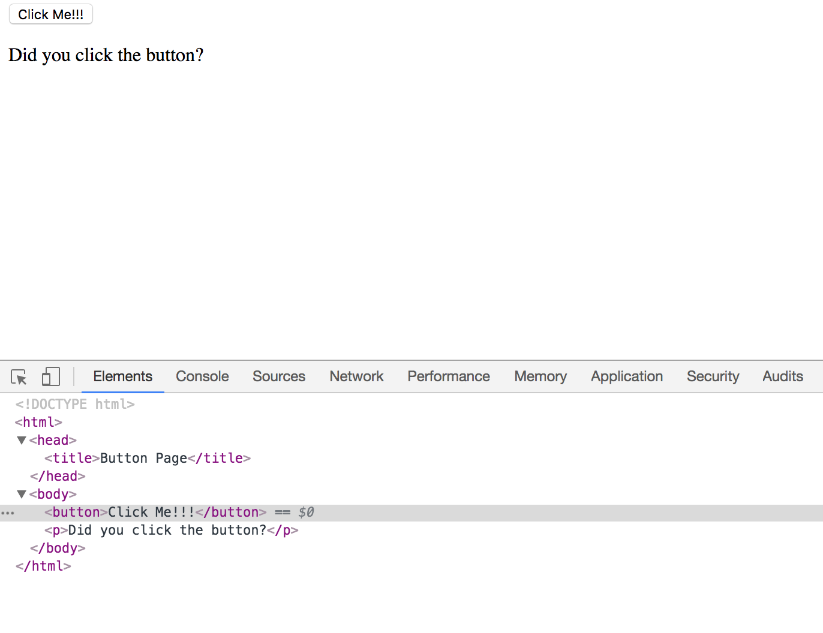
Another example
<!DOCTYPE html> <html> <head> <title>Button Page</title> </head> <body> <button>Click Me!!!</button> <p>Did you click the button</p> </body> </html>

