Slide 1
Lesson 5: Creating the options
Notes:
Template version: 11/20/2012, for PowerPoint 2007 & 2010

Slide 2
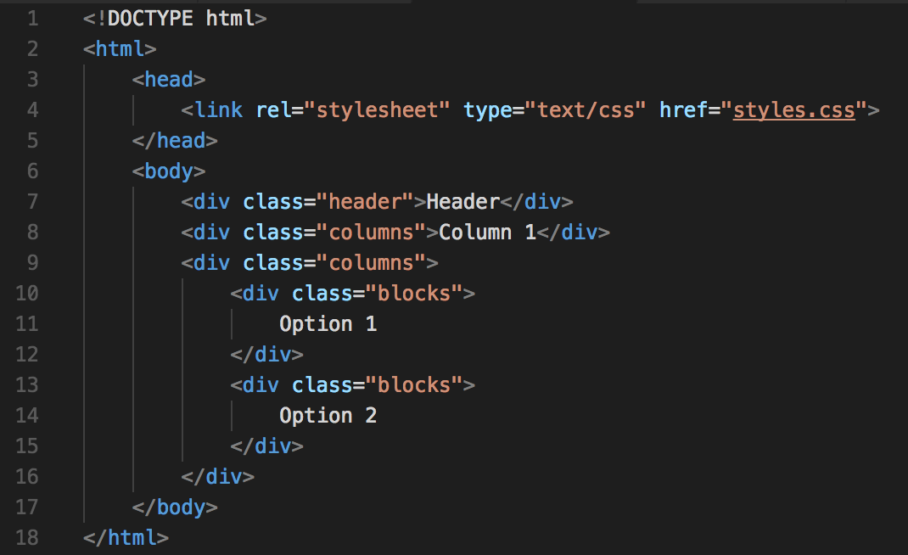
Options HTML
To create the options, we will be adding to the <div> with Column 2
In order to create these options, we need to add more <div> elements based on the number of options we want, for this game, we will just have two:
We are giving the <div> elements a class name “blocks”, which we will go over in the next slide

Slide 3
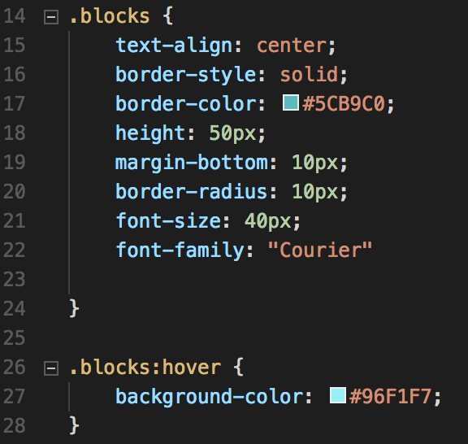
Options CSS
Inside our styles.css file we added the block class and a hover attribute to the block class:
The .blocks:hover class is a class for when that element is being hovered over by the mouse

Slide 4
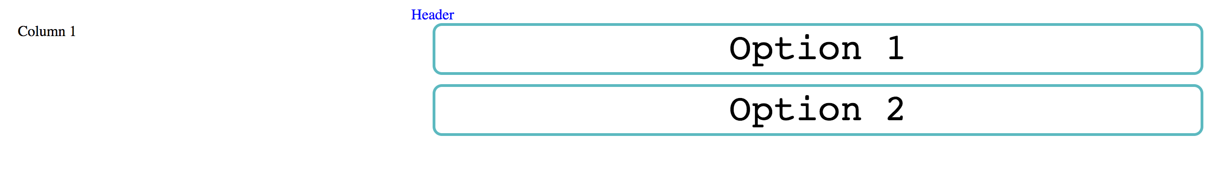
Options HTML
Your website should now look like this:

Slide 5
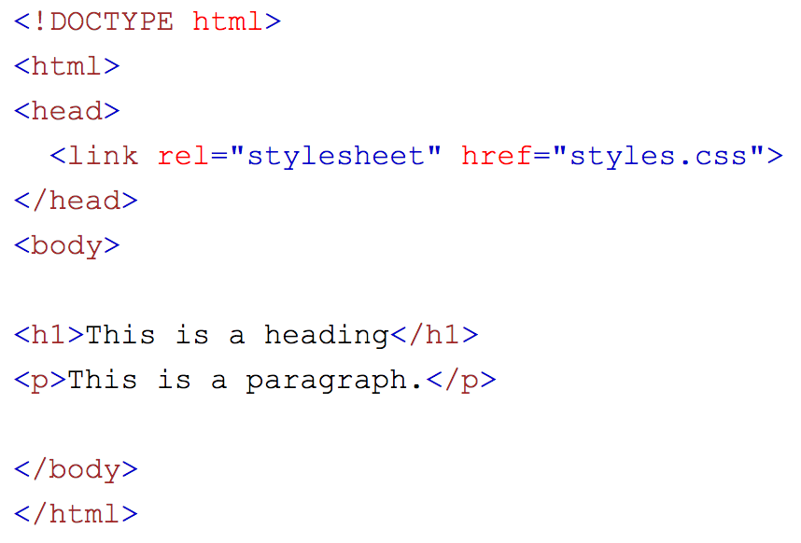
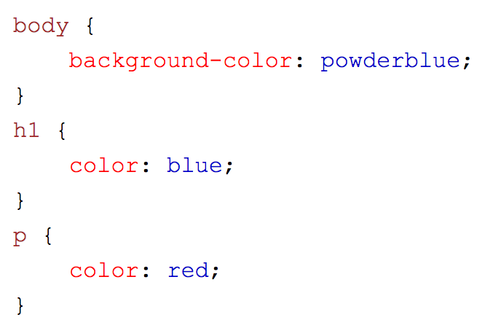
External CSS
Used to define the styling for many HTML pages
This is powerful since you can change the look of your entire website using just one file
First, add the link to the style sheet into the <head> section of your code:
fttt The href attribute is the link to your sheet. This file must be within the same folder in order to link it using just the name of the file.
An example of what your .css file could look like:

Slide 6
Example styling
Here are some things you can change on a website:
Color (color of the font)
Background-color (the color of the background)
font-size (size of the font)
font-family (font type/family)
Border (gives a border surrounding the element)

