Slide 1
Lesson 3: Creating the template
Notes:
Template version: 11/20/2012, for PowerPoint 2007 & 2010

Slide 2
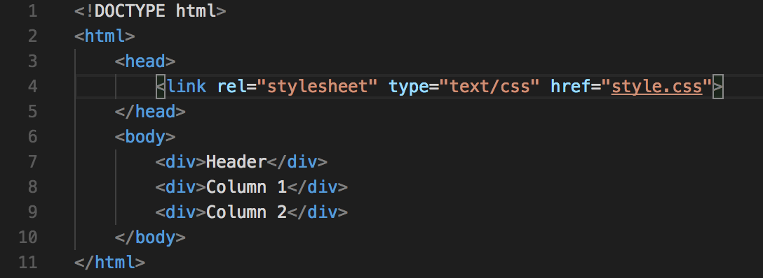
HTML
First we must create an HTML file, lets call it index.html
The basic template of the HTML file looks like this:
There are three <div> elements, one for the header and two for the columns
We also have a CSS file linked inside the <head> section

Slide 3
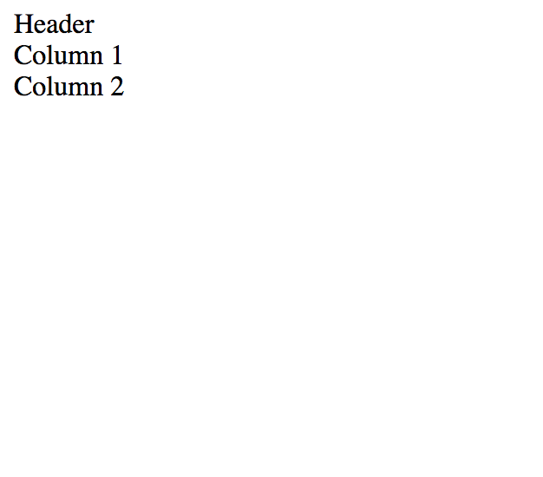
HTML continued
Your website should now look like this:

Slide 4
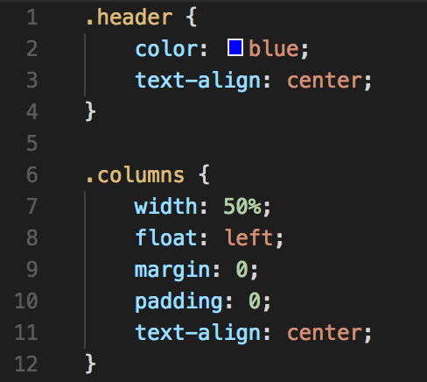
HTML continued
It looks a bit bland, lets add some styling to it.
We will be using an external CSS file to handle all of the styling
Lets call this file styles.css
Lets create some classes:

Slide 5
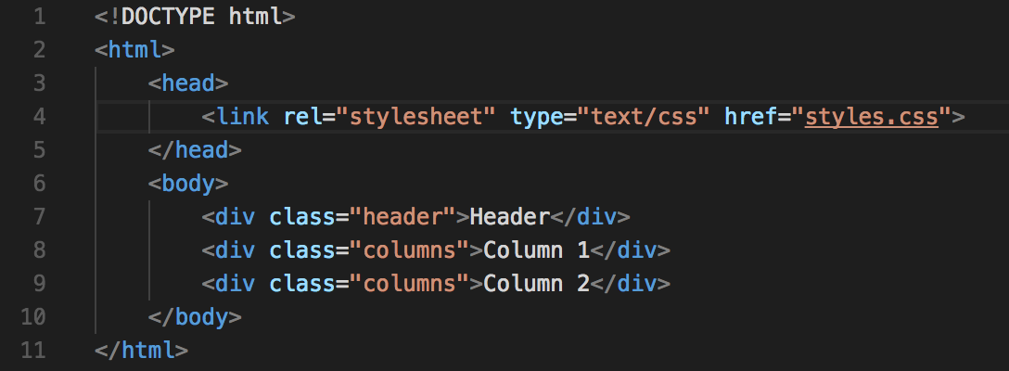
HTML continued
Now back in the index.html file, we need to add those classes in order to change the elements

Slide 6
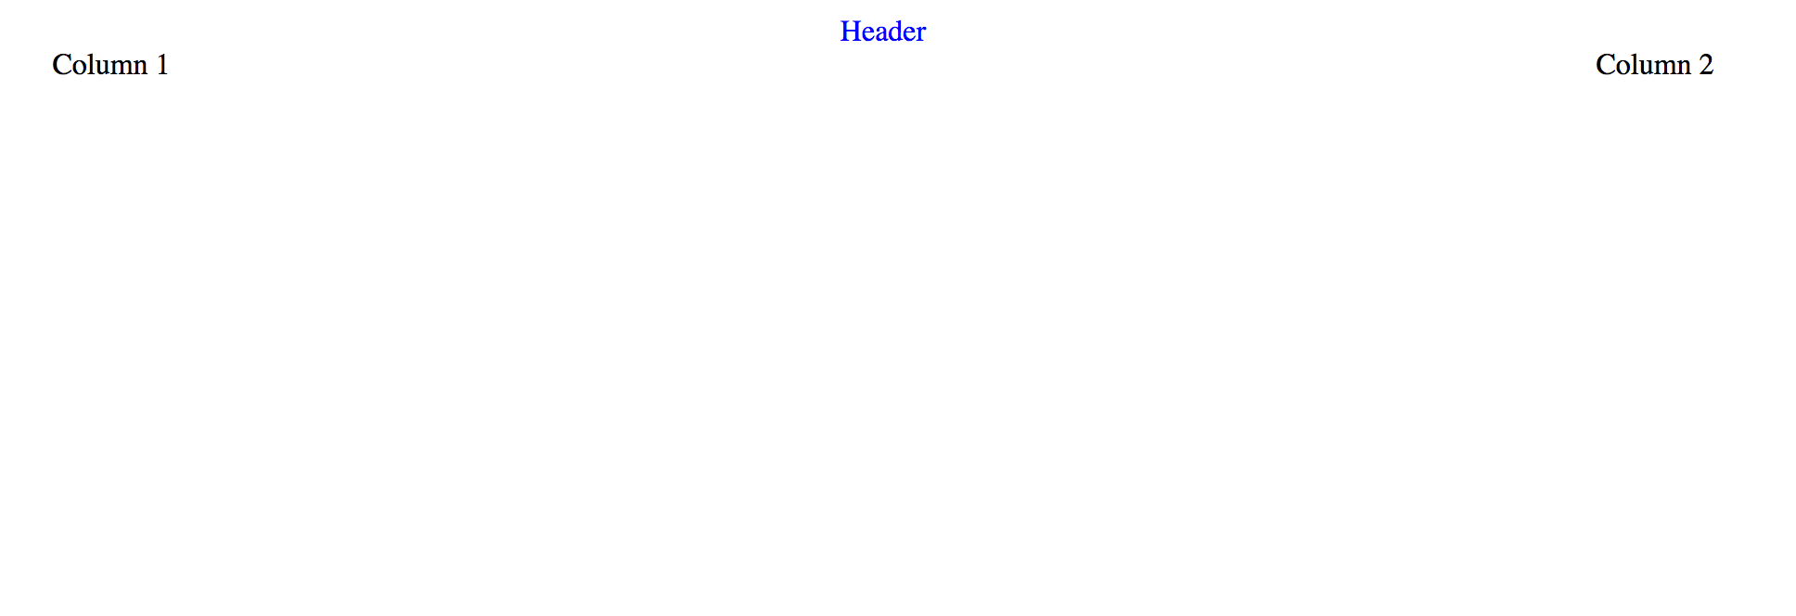
HTML continued
The website should now look like:

