Slide 1
Lesson 7: Making the Website interactive
Notes:
Template version: 11/20/2012, for PowerPoint 2007 & 2010

Slide 2
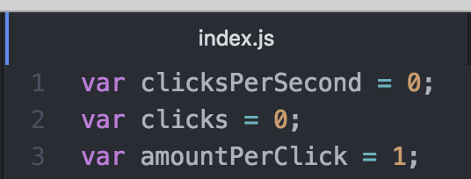
JavaScript
First we must create a JavaScript file, lets call it index.js
We want to write code that will let us click our image and increase the count of our clicks by 1
Let’s make some variables that will keep track of our score
Clicks is the number of times you have clicked the image
Clicks per second is the number of times the image is clicked per second (by non user options)

Slide 3
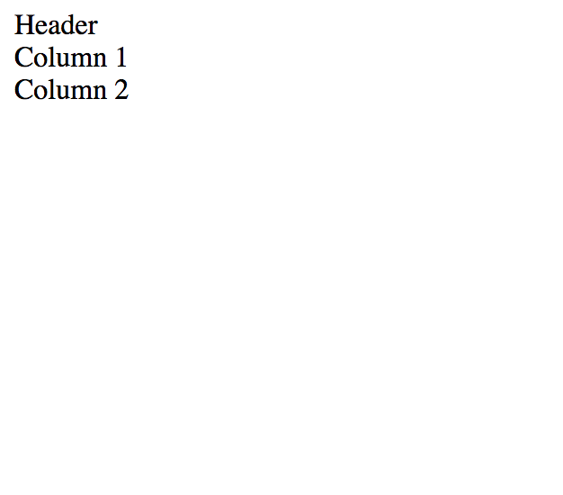
HTML continued
Your website should now look like this:

Slide 4
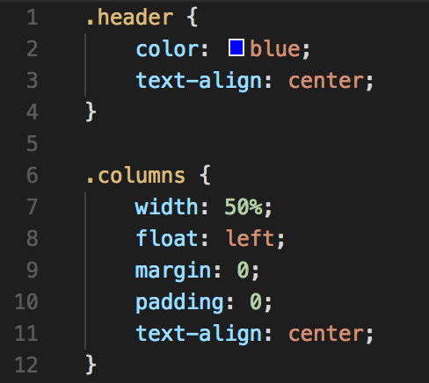
HTML continued
It looks a bit bland, lets add some styling to it.
We will be using an external CSS file to handle all of the styling
Lets call this file styles.css
Lets create some classes:

Slide 5
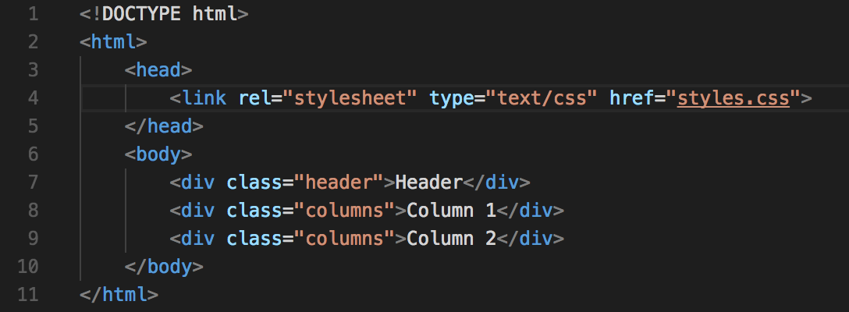
HTML continued
Now back in the index.html file, we need to add those classes in order to change the elements

Slide 6
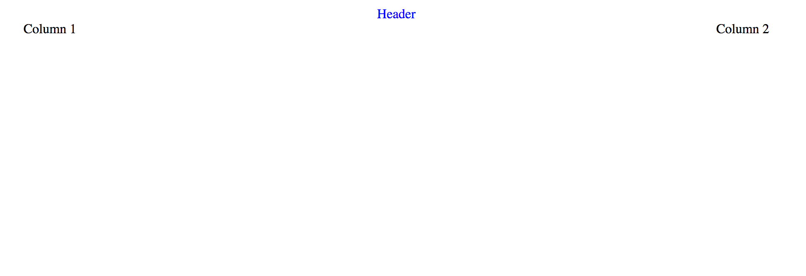
HTML continued
The website should now look like:

