Slide 1
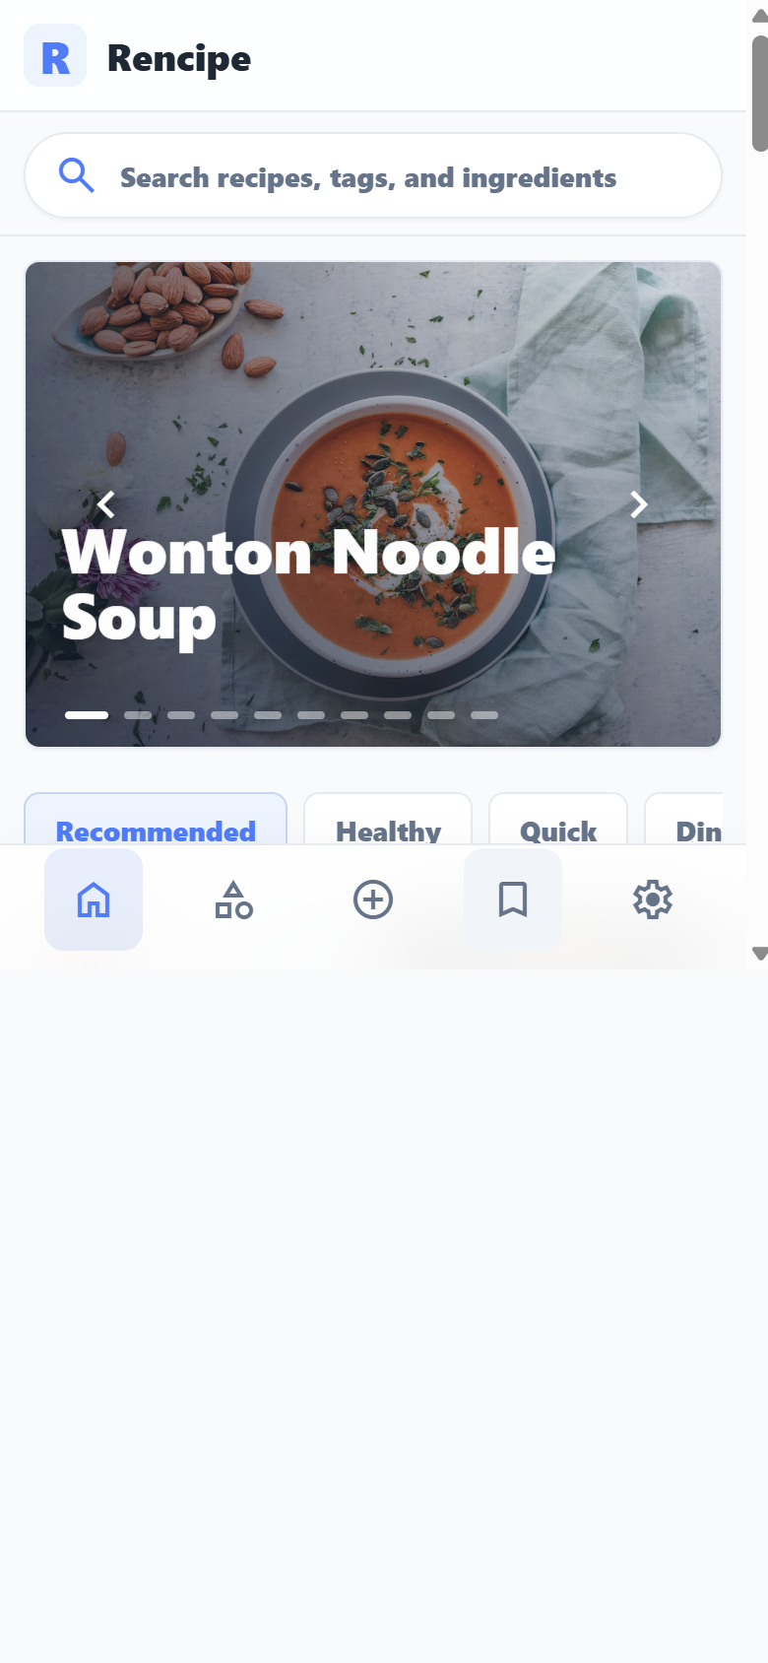
R
Rencipe
A Cloud-Based Recipe Sharing Platform for All Ages
CPSC 597 Project Presentation
Zhibin Ren
Department of Computer Science
Advisor: Christopher Ryu, Ph.D.
Reviewer: Bin Cong, Ph.D.
May 2026

Slide 2
Background
Project topic and context
Recipes, meal ideas, and cooking instructions often live in separate tools.
Households need one place to discover, save, create, and plan meals.
Rencipe focuses on everyday recipe workflows with a clean mobile-first interface.

Slide 3
Motivation
Why this project matters
Reduce repeated effort when deciding what to cook.
Make saved and user-created recipes useful beyond browsing.
Build a polished full-stack web application that can be demonstrated end to end.

Slide 4
Problem To Solve
The core user and system problem
Recipe platforms often emphasize content browsing more than personal organization.
Planning meals across days creates repeated decisions and manual ingredient tracking.
Users need account-aware data, ownership rules, and reliable saved workflows.

Slide 5
Significance
Expected value of the project
Combines recipe management and meal planning in one deployed application.
Demonstrates full-stack design, secure access, image handling, and responsive UI.
Turns planned recipes into an ingredient list that supports real household preparation.

Slide 6
Goals And Objectives
What Phase 1 set out to achieve
Build recipe browse, detail, create, edit, image upload, and draft workflows.
Add search, category browsing, saved recipes, login, and account-specific data.
Create meal plans with people, days, meal types, recipe slots, and ingredient lists.
Deploy the application publicly with HTTPS, Nginx, PM2, backend API, and database storage.

Slide 7
Approaches Used
Implementation strategy
Mobile-first Next.js and React frontend with typed components and CSS Modules.
Express, Node.js, MongoDB, and Mongoose backend for persistent application data.
JWT authentication, role-aware recipe visibility, and owner-checked editing.
Public deployment on Oracle VM using Nginx SSL proxy and PM2 managed processes.

Slide 8
Solutions And Results
What the finished Phase 1 system provides
Live English demo application is available at rencipe.renstoolbox.com.
Recipe search, category browsing, detail pages, creation, drafts, and saved recipes are working.
Personal collection and meal planning surfaces are the Phase 1 organization path.
Meal plans generate calculated ingredient lists from the recipes assigned to plan slots.

Slide 9
Goal Achievement
Whether the project goals were achieved
Achieved: core recipe management, account system, saved recipes, meal planning, and deployment.
Achieved: phone-first visual polish and current screenshot-based presentation material.
Achieved: backend-backed demo accounts and role/ownership checks for protected flows.
Deferred: deeper keto-specific nutrition features remain future scope.

Slide 10
R
Application Screenshots
The next slides use current app screens as the presentation evidence.

Slide 11
Home Page
Recipe discovery starts from a phone-first feed.
Large food imagery makes the first screen visual and recognizable.
Recipe cards show title, uploader identity, save state, and low demo view counts.
Bottom navigation keeps common flows one tap away.

Slide 12
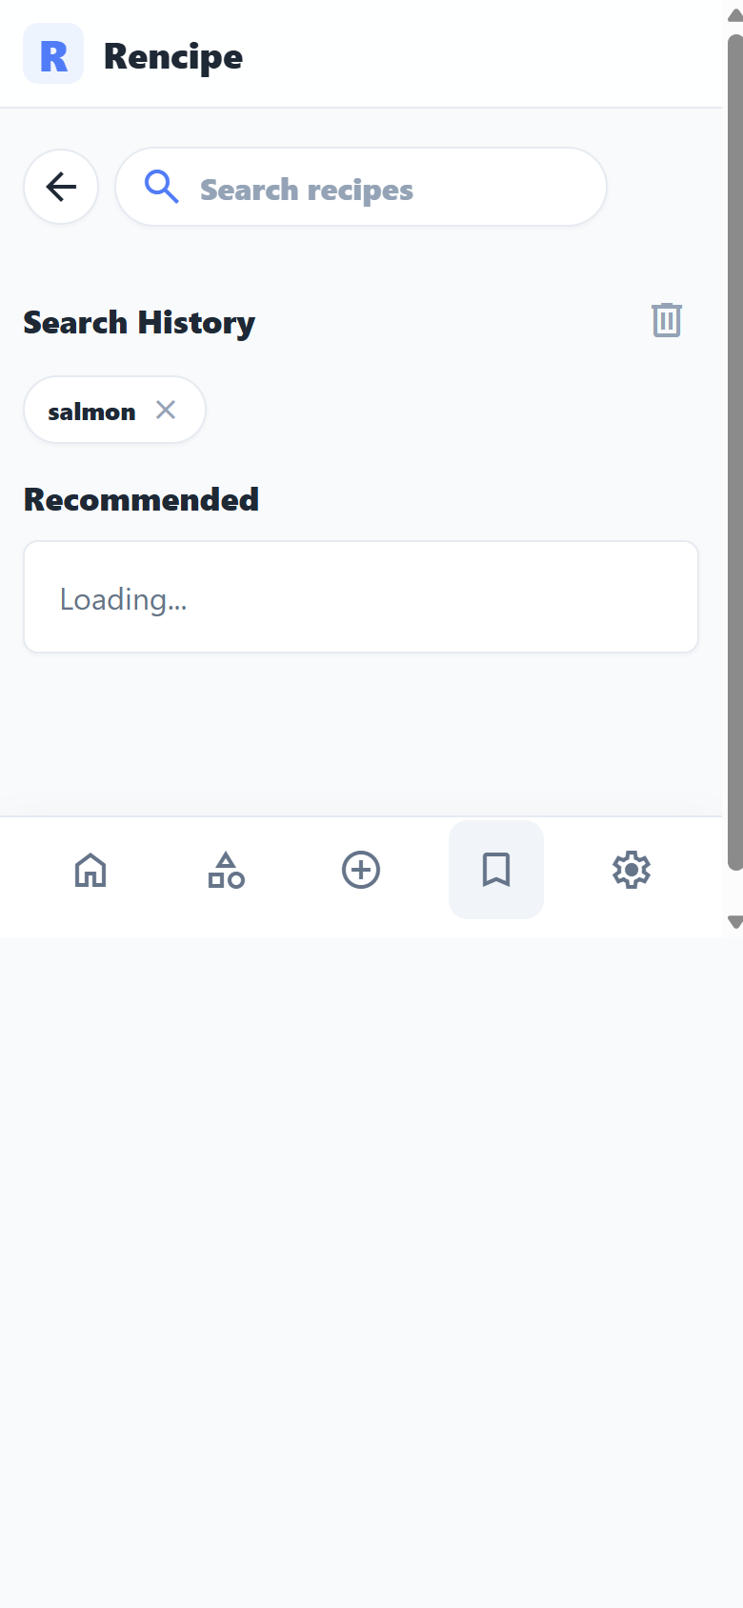
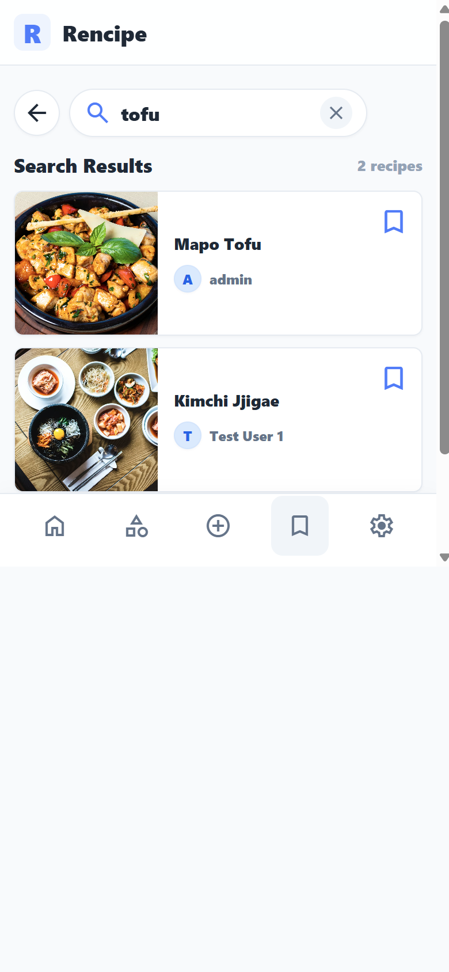
Search Page And Results
Text search is separate from category browsing.
Search page supports direct recipe queries, history, and recommendations.
Result view filters the recipe database into actionable cards.
This flow helps users jump from an idea to a recipe quickly.

Slide 13
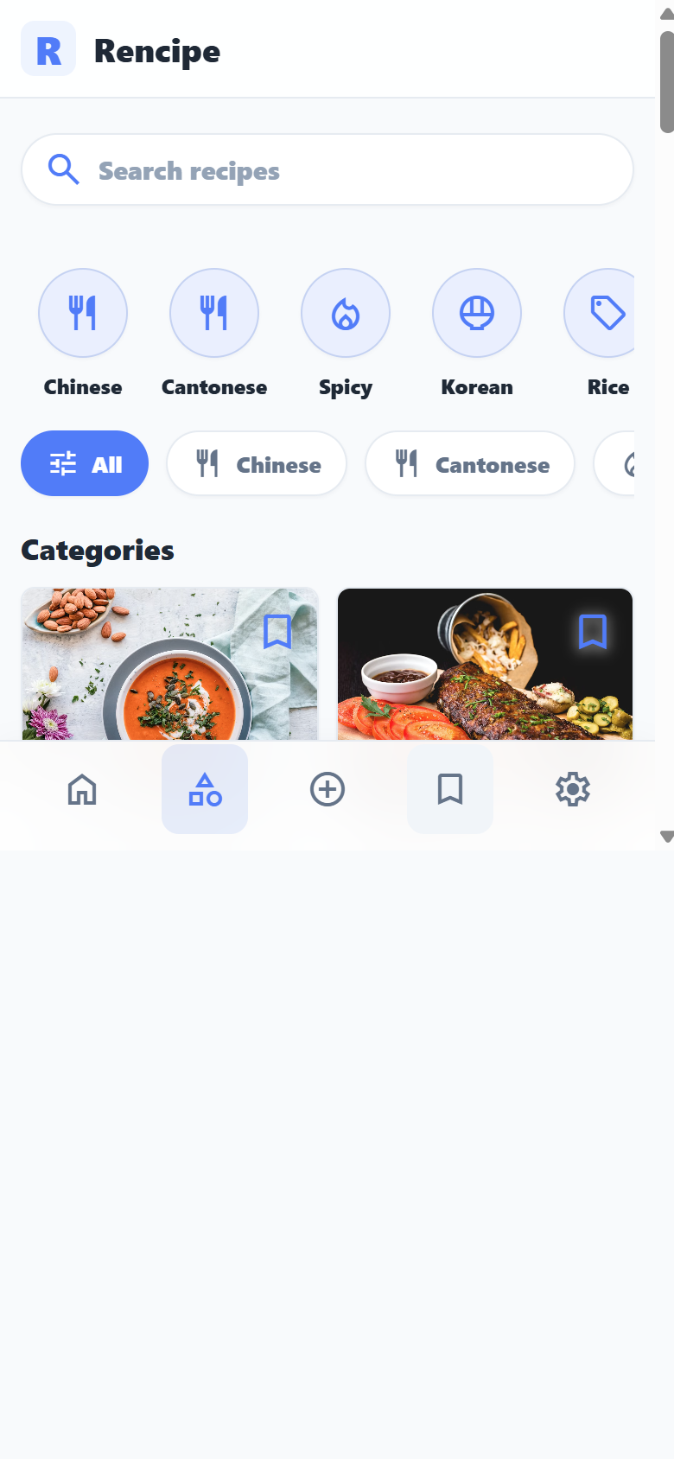
Category Page
Browsing supports exploration without typing.
Category shortcuts and filter chips support recipe discovery.
The category page stays separate from live search to keep both workflows clear.
Recipe grid layout is tuned for phone-first scanning.

Slide 14
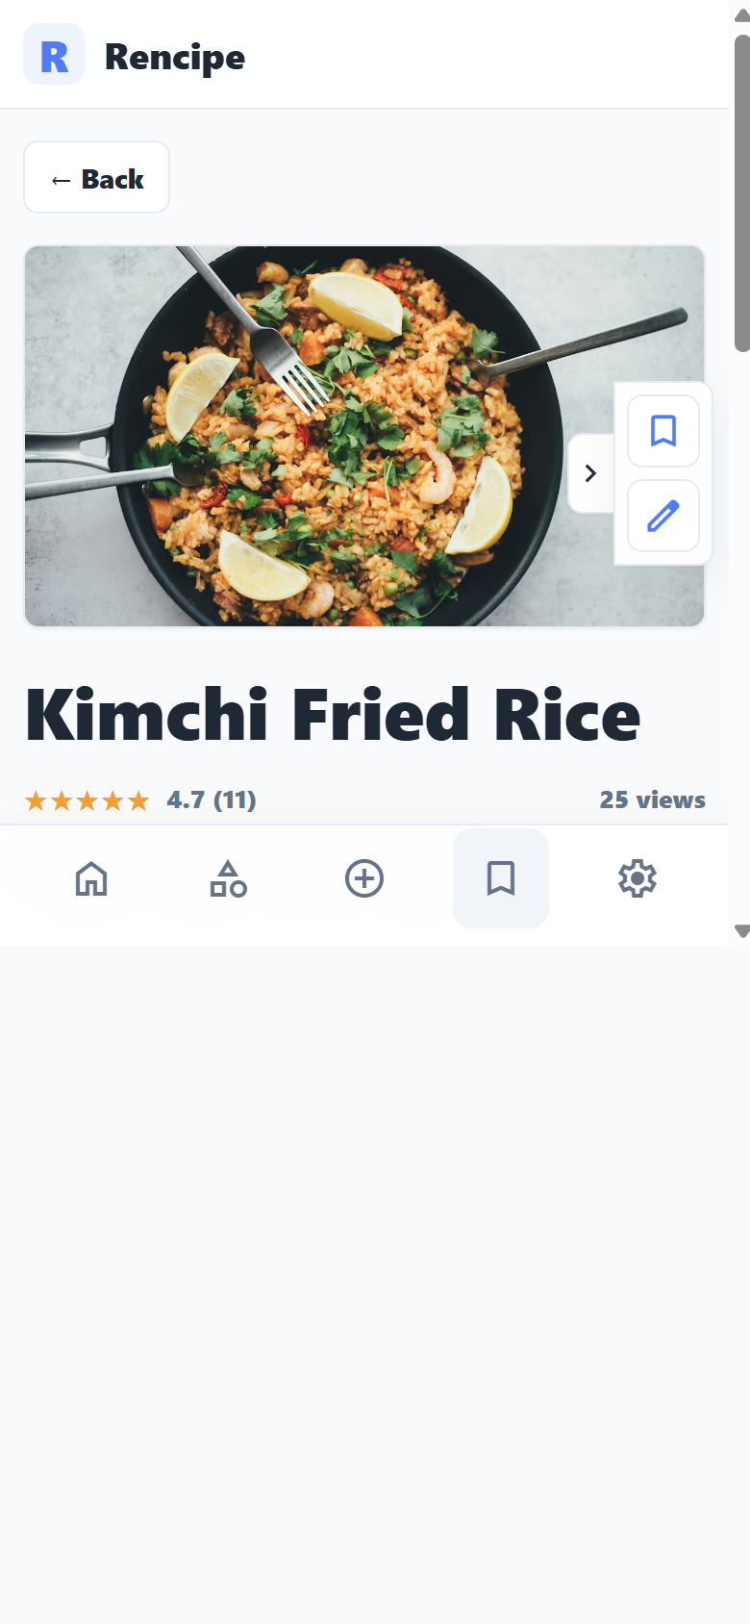
Recipe Detail Page
A recipe opens into a clear cooking reference.
The detail page combines image, metadata, ingredients, and cooking steps.
Ingredients use name-left and amount-right rows for fast reading.
Save and edit controls stay focused on recipe ownership and reuse.

Slide 15
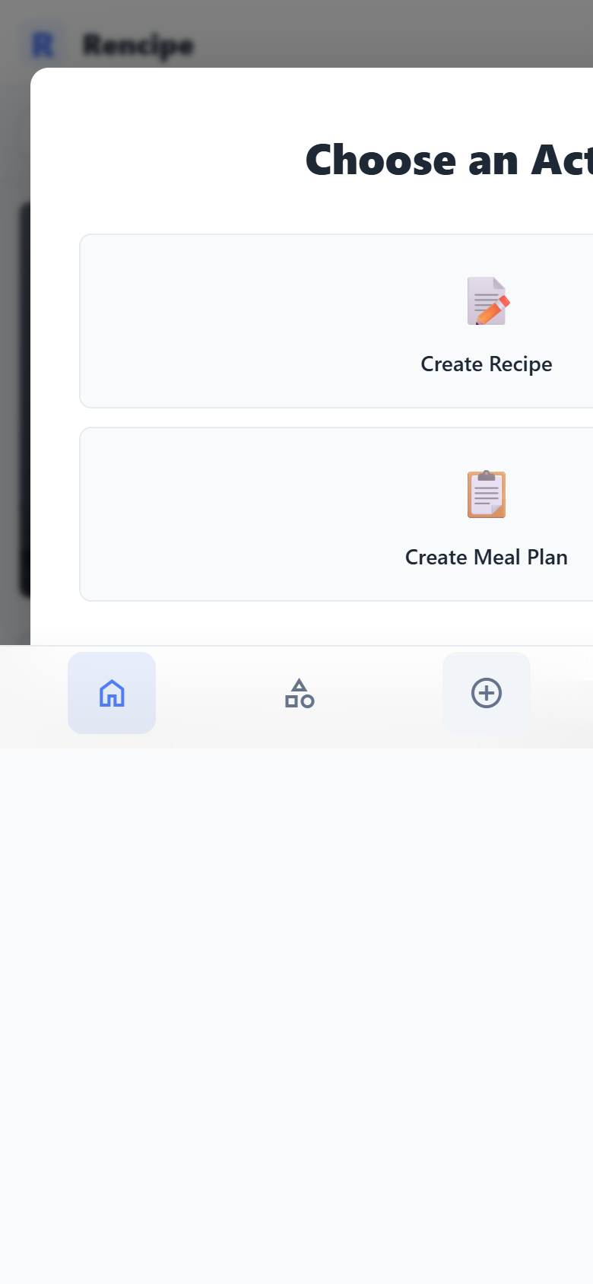
Create Entry
The create action branches into recipe or meal plan creation.
One create button keeps the main navigation compact.
The modal separates recipe creation from meal planning.
This supports fast demo navigation without crowding the app shell.

Slide 16
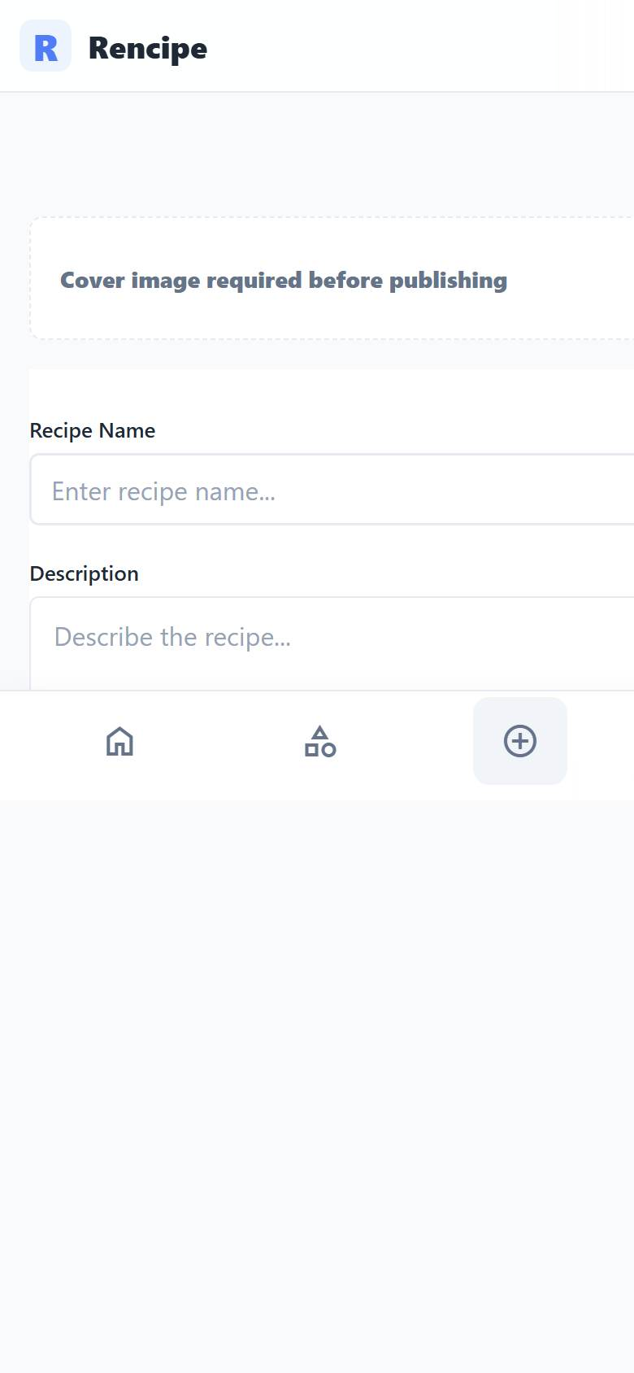
Create Recipe Page
Recipe creation collects the content needed to publish.
The form supports cover image, basics, ingredients, cooking steps, tags, and draft saving.
Draft support protects incomplete work while users build a recipe.
Publishing requires enough recipe content for a useful detail page.

Slide 17
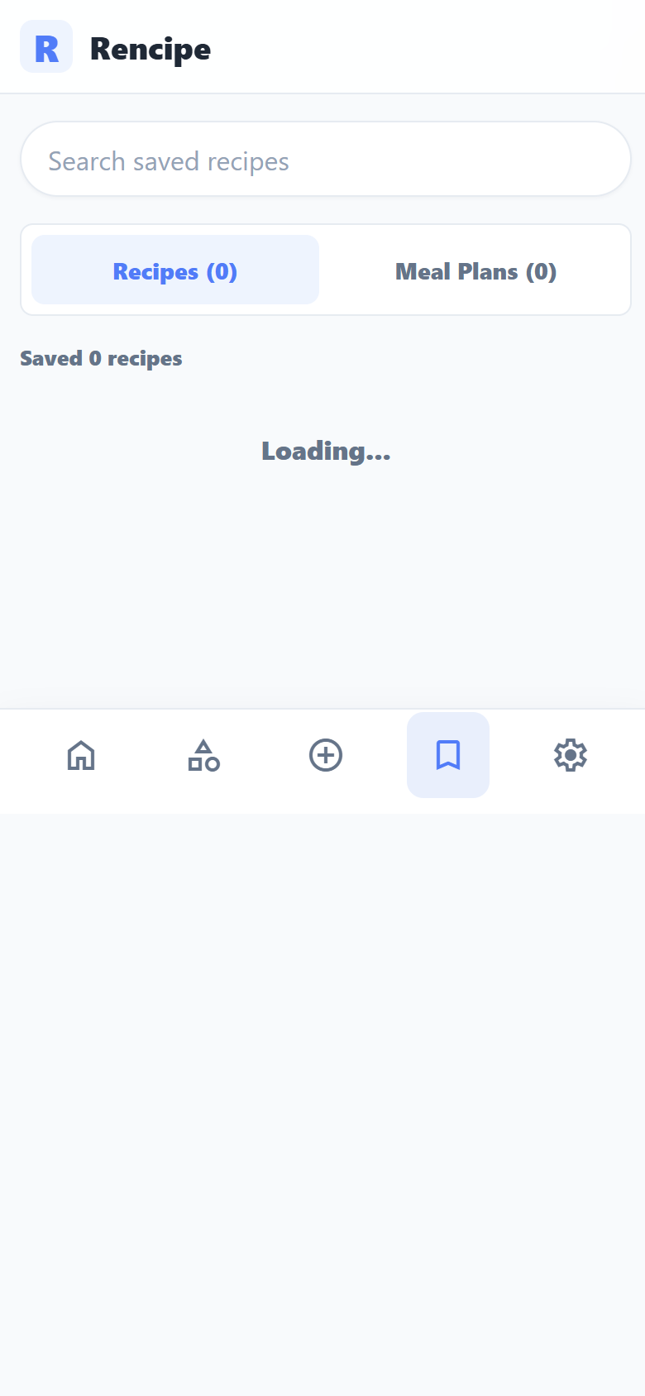
Saved Page
Saved content is the personal collection surface.
Saved recipes and meal plans give users a place to return to useful content.
Saved recipes are the Phase 1 collection path for returning to useful content.
The empty state points users back to Home when there are no saved recipes.

Slide 18
R
Supporting Features
Account, settings, and theme support the main recipe workflows.

Slide 19
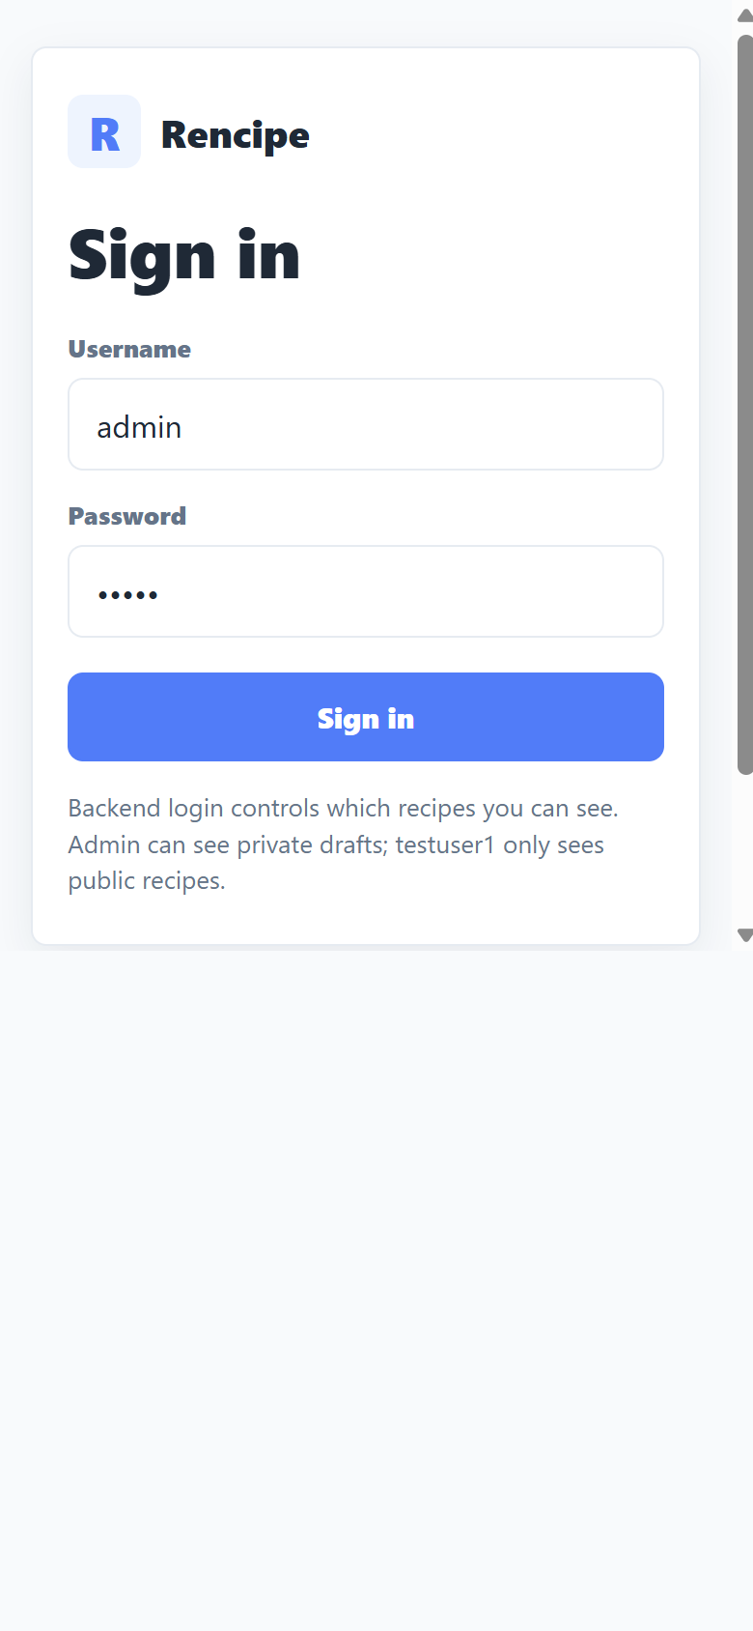
Login Page And Account System
Authentication gates the application and enables user-specific data.
Backend-backed login uses JWT session tokens.
Demo accounts: admin/admin and testuser1/testuser1.
Admin-private recipe visibility and owner edit rules are enforced for the demo.

Slide 20
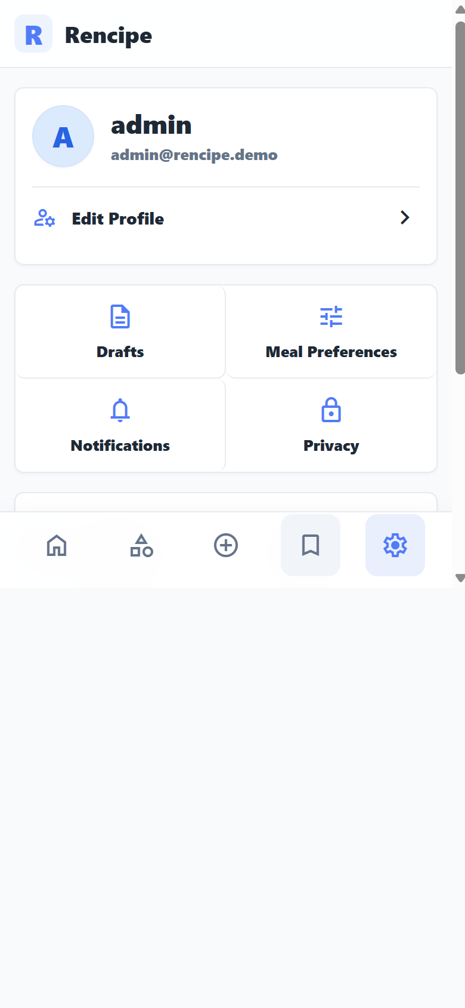
Settings Page
Account settings make the demo feel complete.
The settings page shows account identity, profile editing, and active shortcuts.
Language and theme controls are visible in the same support surface.
Unlocked shortcut buttons make the Phase 1 demo feel realistic.

Slide 21
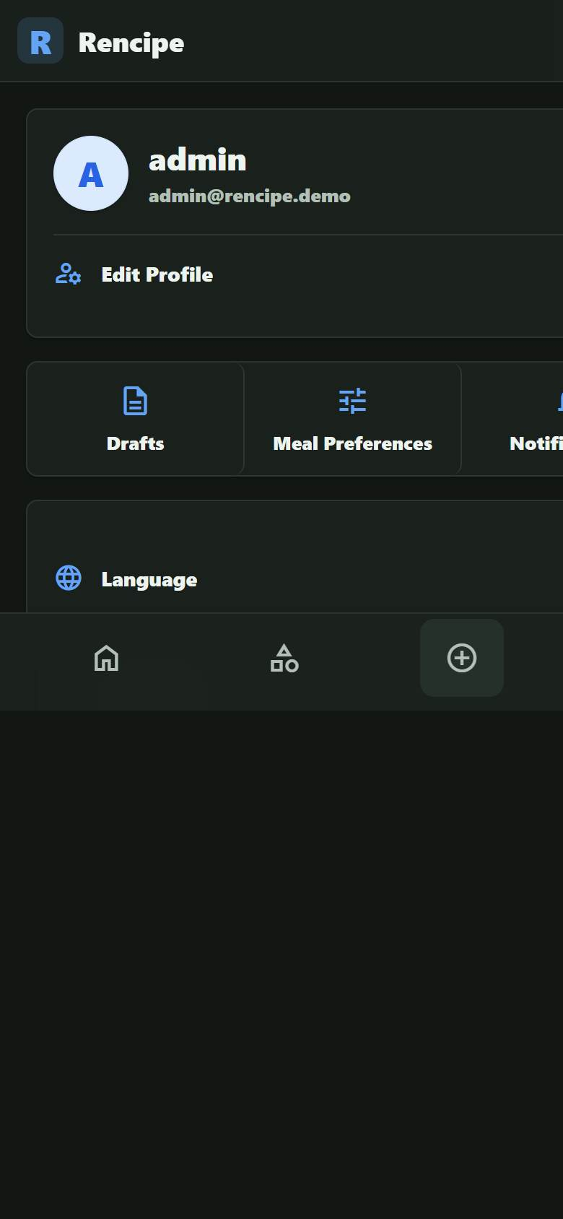
Dark Mode
The interface adapts to a darker visual theme.
Dark mode uses the same layout while changing surface and text colors.
The toggle is part of the settings workflow.
This demonstrates UI polish beyond the primary light theme.

Slide 22
R
Meal Planning
Meal plans turn saved recipe content into day-by-day decisions.

Slide 23
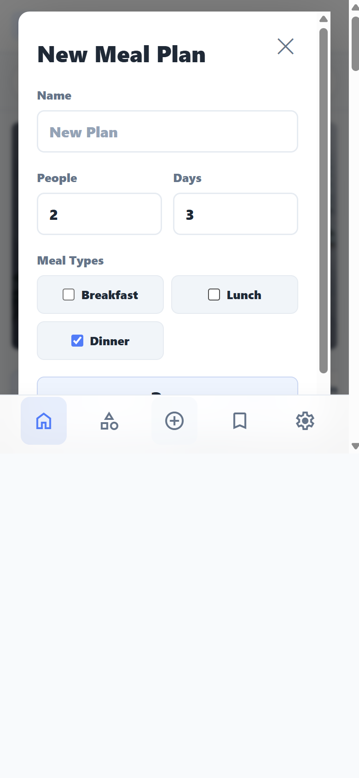
Create Meal Plan Page
A new plan starts with people, days, and meal types.
The default plan name is simple: New Plan.
People, days, and breakfast/lunch/dinner selections define the meal slots.
The form keeps planning focused on what to eat across days.

Slide 24
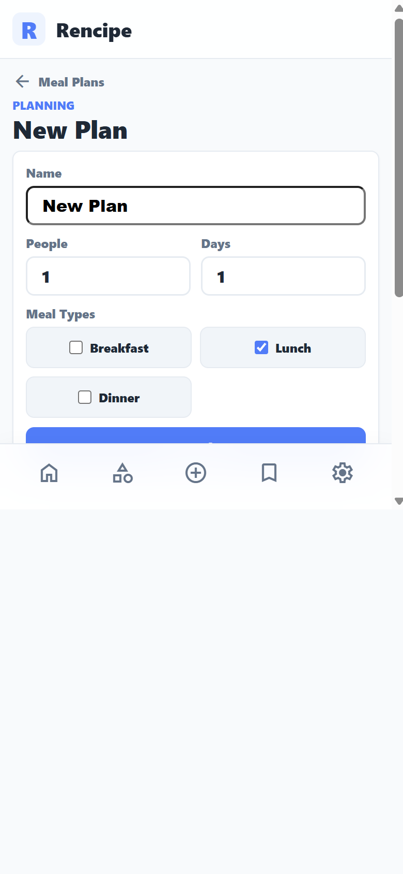
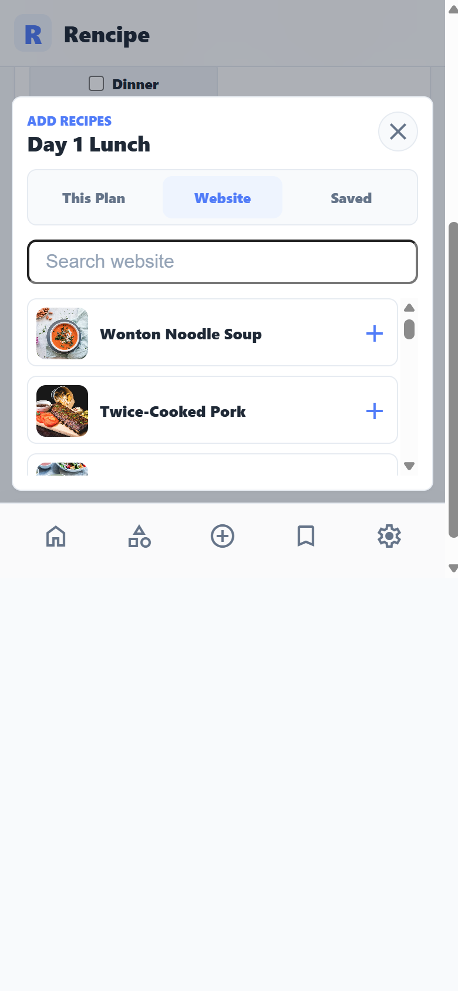
Plan Detail Page
Plans organize recipes into day-by-day meal slots.
Each day contains selected meal types and recipe slots.
Recipe selection can pull from this plan, the website recipe list, or saved recipes.
The plan detail page is the main workspace for meal decisions.

Slide 25
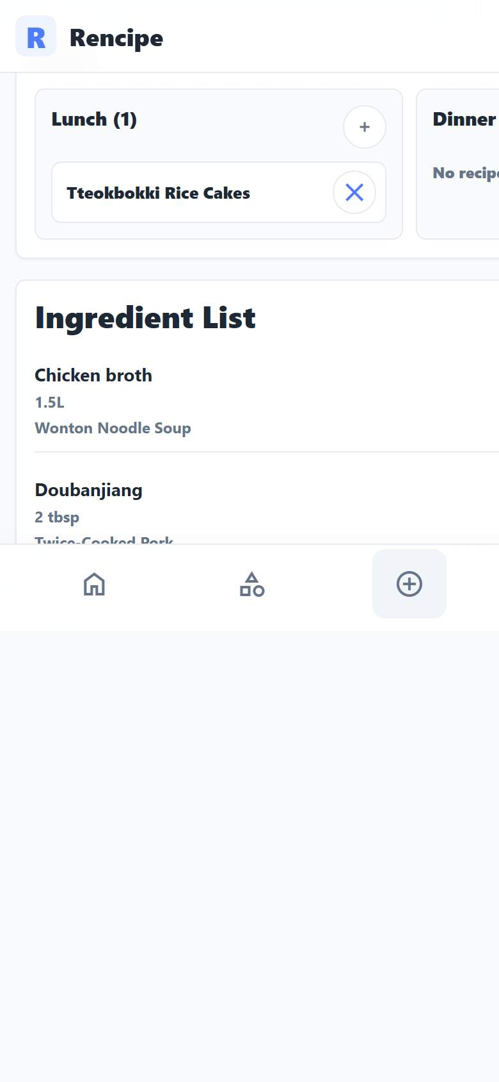
Calculated Ingredient List
Meal plan recipes produce a combined ingredient list.
The ingredient list groups recipe ingredients with quantity and source recipe.
This is the planning output that connects recipes to preparation.
It demonstrates the value of meal plans beyond simple recipe bookmarking.

Slide 26
Success Criteria
Conclusion: Phase 1 project goals were achieved
The application is publicly deployed with HTTPS and stable backend/frontend processes.
Users can log in, browse recipes, search, view details, create recipes, and save content.
Recipe visibility and edit ownership rules protect account-specific data.
Users can create meal plans, assign recipes, and view calculated ingredients.
Presentation slides now show the project directly with current screenshots.

