Slide 1


Team Lead – Zach Bray
Front End – Justin Jose
Back End – Yagmur Guzeldereli
QA – Chad Dunnam

Slide 2
Demo

Slide 3
Brainstorming
Fun? Functional? Experimental?
Fast Food in Chicago
Job Search in Chicago
APIs?
Maps
Job Search
Weather
POC / Wireframe

Slide 4
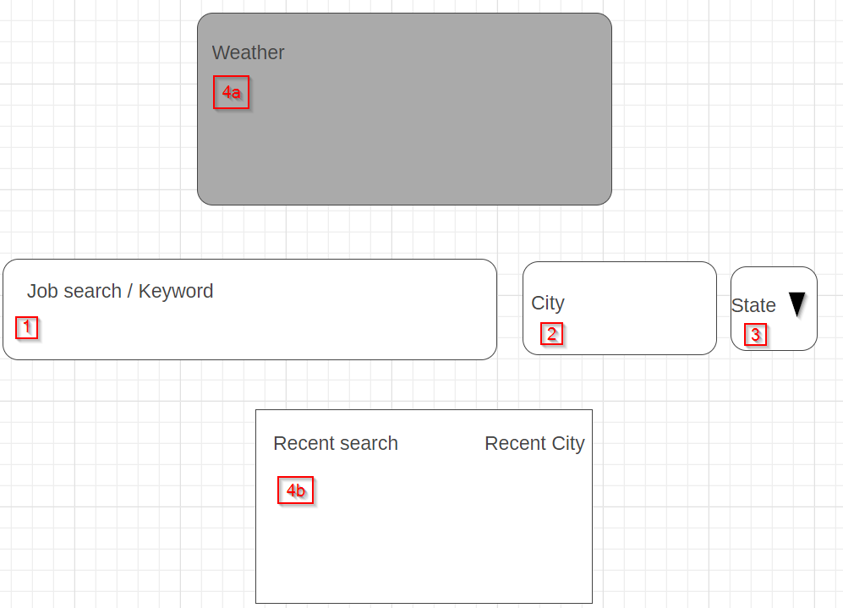
POC / Wireframe / Design Details
Enter Job Search
Enter City
Enter State
Weather details & Recent search divs appear with results

Slide 5
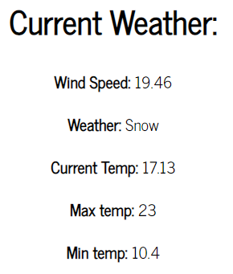
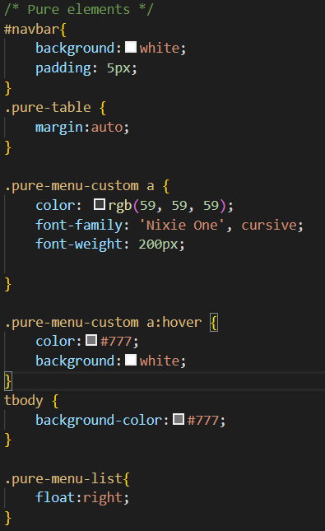
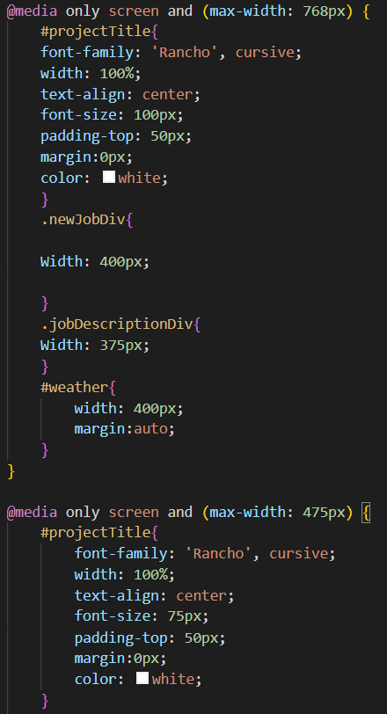
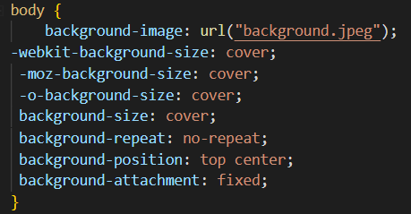
Front-End
Pure Elements
Media Queries
Body

Slide 6
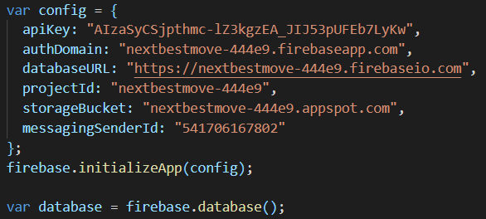
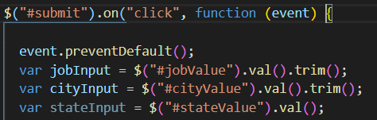
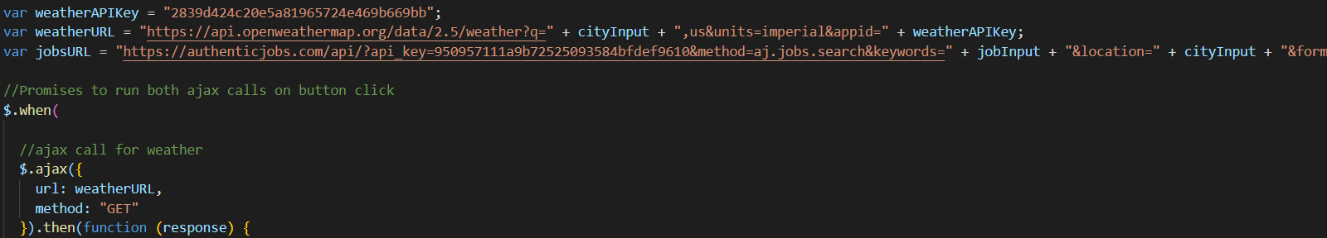
Back-End

Slide 7
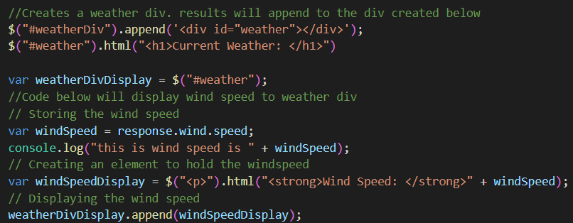
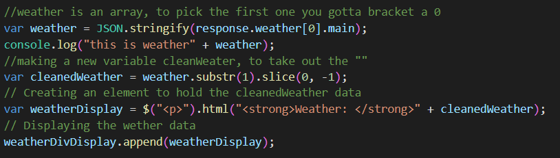
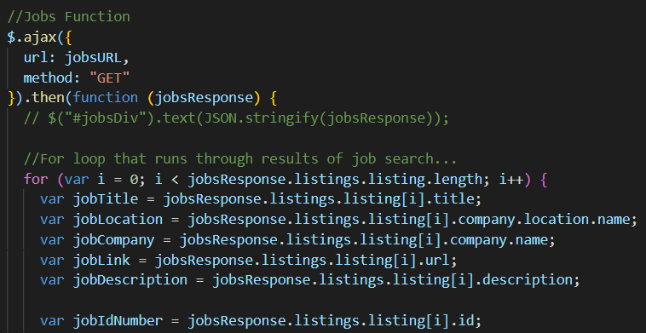
Back-End

Slide 8
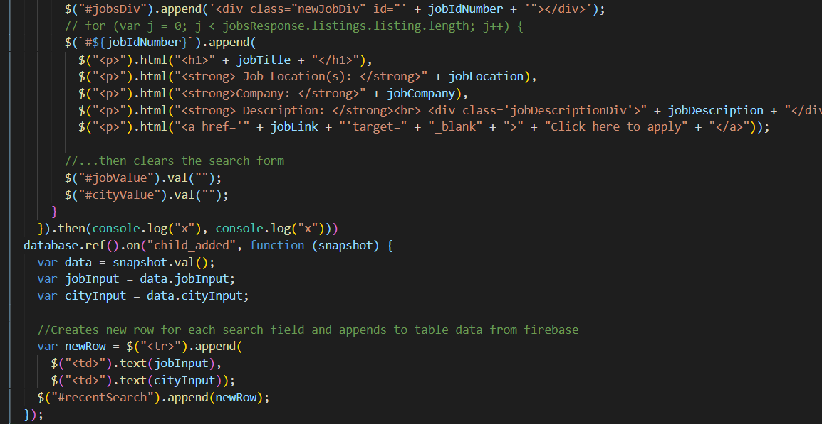
Back-End

Slide 9
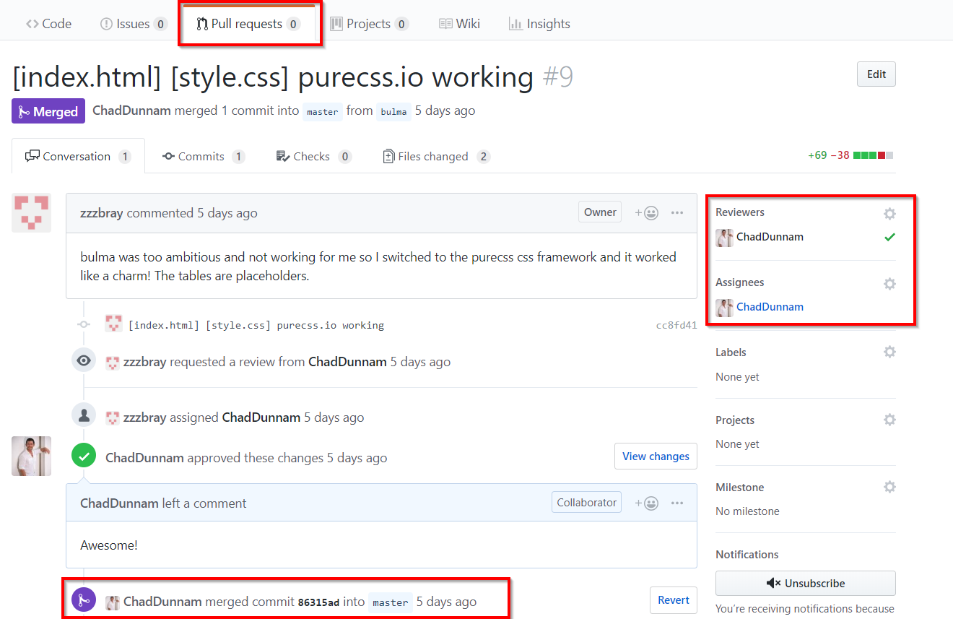
QA
Using GitHub, front-end, back-end, and Team Lead would commit and push changes from their local branches
QA would review pull requests and make any merges into master branch
Peer programming also took place in person or virtually among team members, allowing for quick on-the-spot reviews

