Slide 1
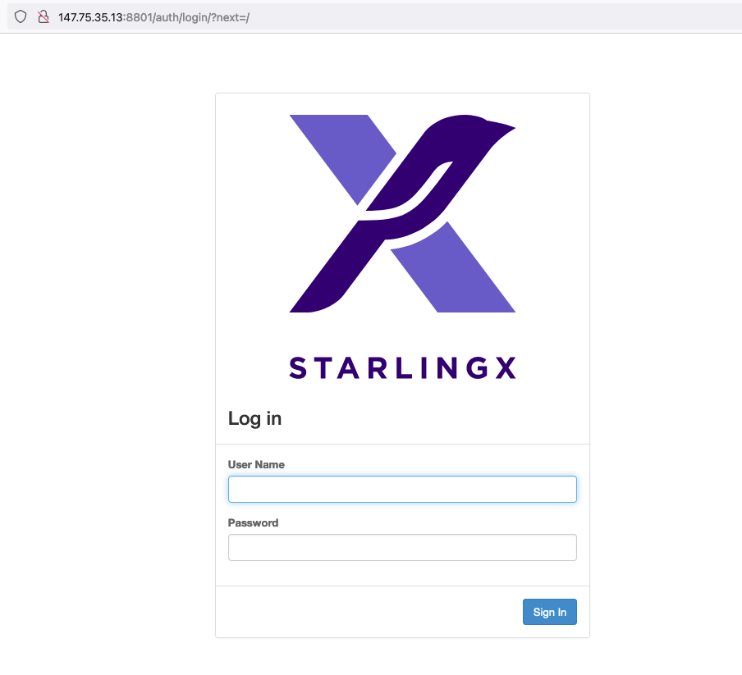
Login using
Username: admin
Password: St8rlingX*

Slide 2
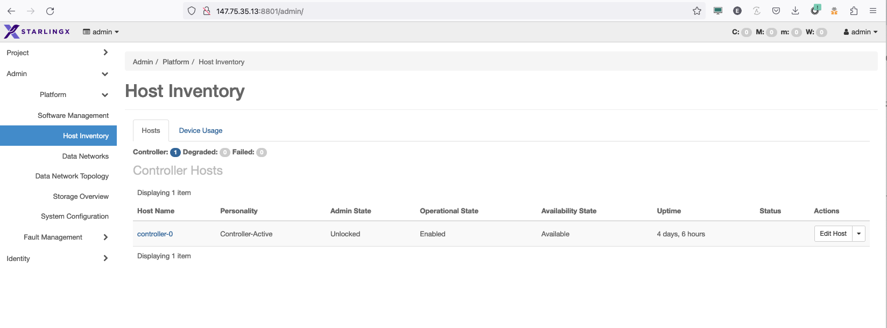
Status of current alarms
List of Hosts and status

Slide 3


Slide 4
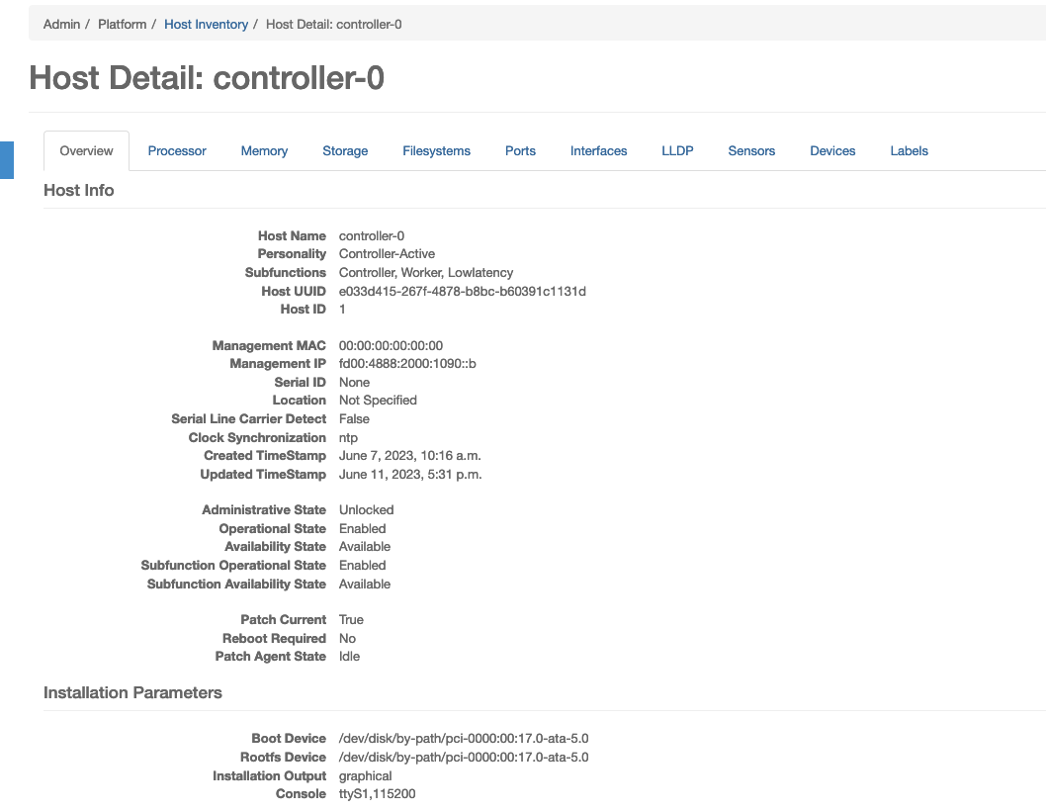
Click and explore other tabs
General overview info

Slide 5
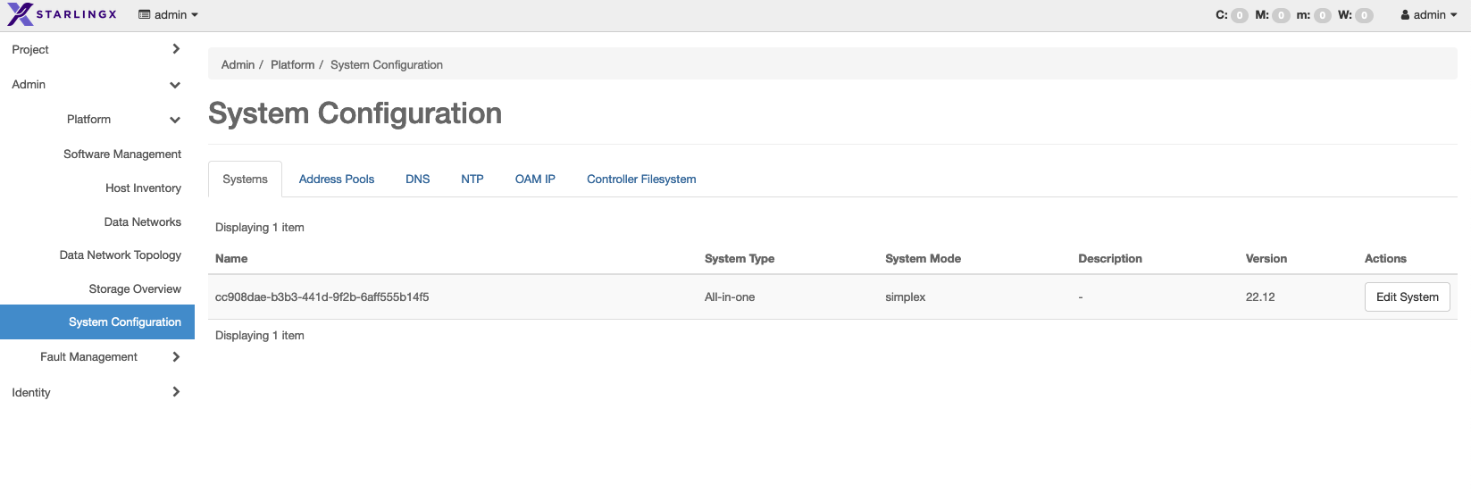
Review the Configuration options
Click on System Configuration

Slide 6


Slide 7

Edit the name filed and then click save

Slide 8


Slide 9
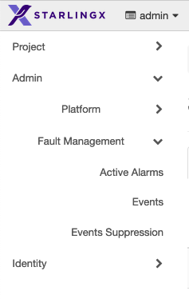

Slide 10


Slide 11
