Slide 1
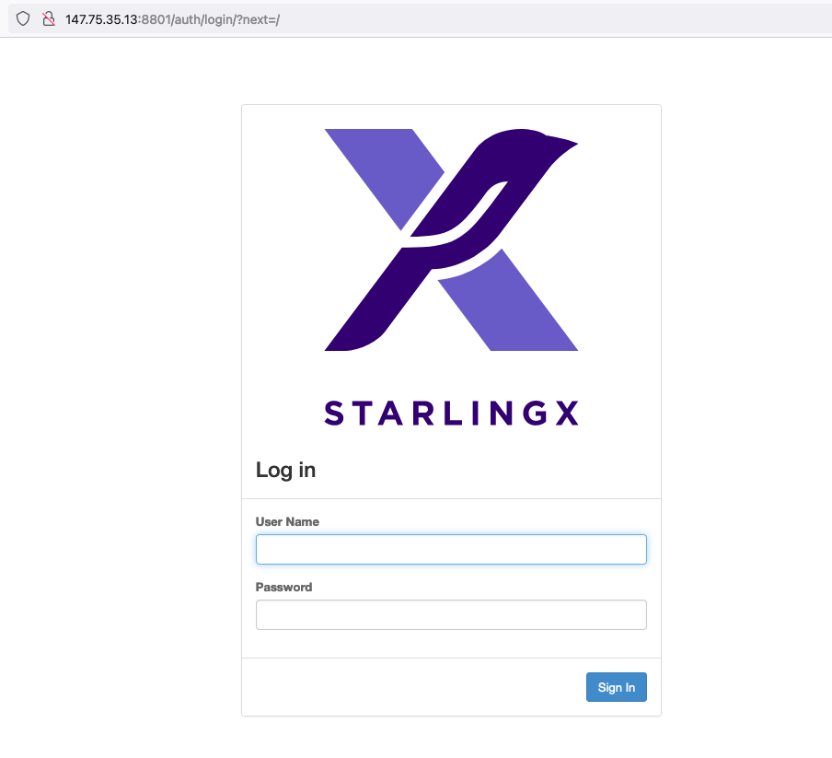
Login using
Username: admin
Password: St8rlingX*

Slide 2
