Slide 1



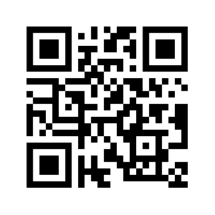
Development of Scales to Measure the Acceptance of Harm Reduction
Budesa, Z., Brown, K., Coffey, B. Ghonasgi, R., Hayes, V., Kondai, R., La Manna, A., Newman, S., Philips, S., Vance, K., Connors, L., Green, L., Lunceford, J., Smith, R., & Winograd, R. P.
OSF.IO/EJCYT

Slide 2


Harm Reduction
OSF.IO/EJCYT
Notes:
Substance Abuse and Mental Health Services Administration
Evidenced-based approach to engaging with people who use drugs
Equipping PWUD with life-saving tools
Incorporates community-driven public health strategies
Harm Reduction Coalition
Practical stratigies & ideas
Reduce negative consequences associated with drug use
Social justice movement

Slide 3
Why Measure Harm Reduction Orientation?
OSF.IO/EJCYT

Slide 4
Limitations of Existing Measures
Single ordinal items (Wild et al., 2021)
Focused on knowledge of harm reduction organizations (Baker et al., 2020)
Single substance focus (Goddard, et al. 2023)
Little validity evidence (Hofschulte, 2012)
Single population (Sulzer et al., 2021)
Narrow definition of harm reduction (Bonar & Rosenberg, 2010)
Survey methods (MacCoun, 2013)
No one uses them!
OSF.IO/EJCYT

Slide 5
Item Examples
Strategies
Principles
Police officers should have access to naloxone/NARCAN.
Sobriety should not be a requirement to access public housing.
Drug use will always be part of society.
Racism affects the health of people who use drugs.
5-point ordinal scale – “Strongly Disagree” to “Strongly Agree”
OSF.IO/EJCYT

Slide 6
The Process
Develop Items
Refine items
Repeat
Collect data (EFA)
Analyze
Collect more data (CFA & EFA)
Analyze
Collect more data (CFA)
Analyze
Retained two scales
45 Initial Items
Strategies
Principles
8 Items
7 Items
Response Process Evaluation (3 Rounds)
OSF.IO/EJCYT

Slide 7
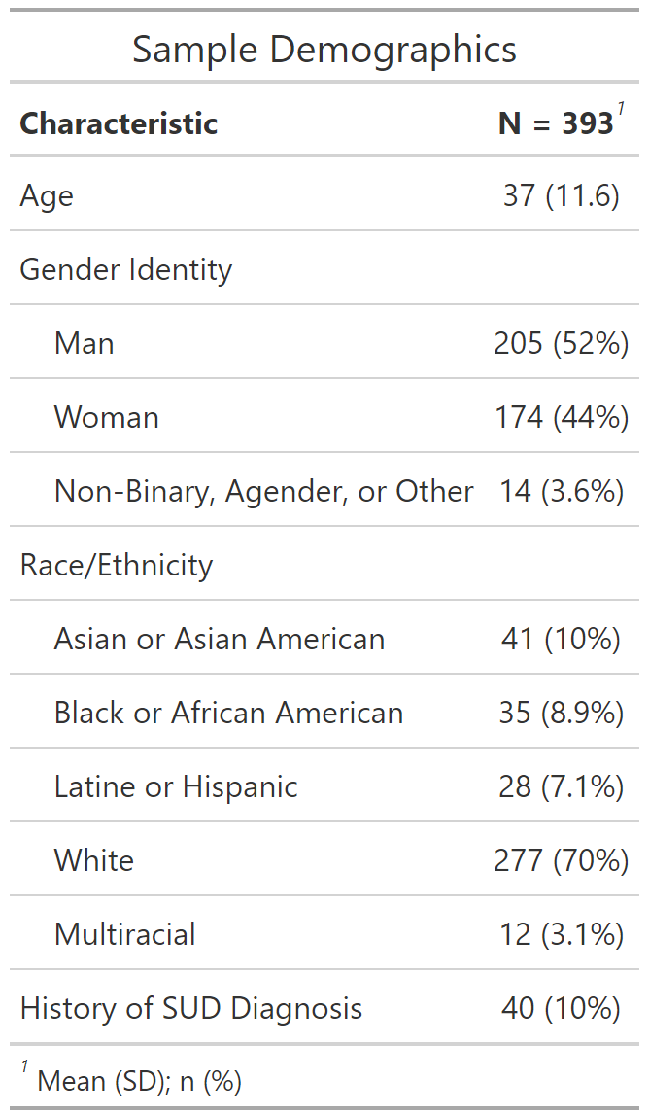
Recruitment
All samples recruited via Prolific.com
General US-based sample
Response Process Evaluation
Study 1
N = 77
Study 2
N = 35
Study 3
N = 10
Study 1 – EFA
N = 301
Study 2 – CFA & EFA
N = 402
Study 3 – CFA
N = 393
OSF.IO/EJCYT

Slide 8
Closely Related Items
Access to Naloxone
People who use drugs should….
The general public should….
Police officers should….
People who use drugs should have access to…
… safe injection supplies.
… safe inhalation supplies.
OSF.IO/EJCYT

Slide 9
Closely Related Items
Medications for Opioid Use Disorder
…are an appropriate treatment option for people who use drugs.
People who use drugs should be able to use […] for any length of time.
Involvement in Policy and Programs by Recovery Status
People who use drugs should be involved….
People in recovery from drug use should be involved….
OSF.IO/EJCYT

Slide 10
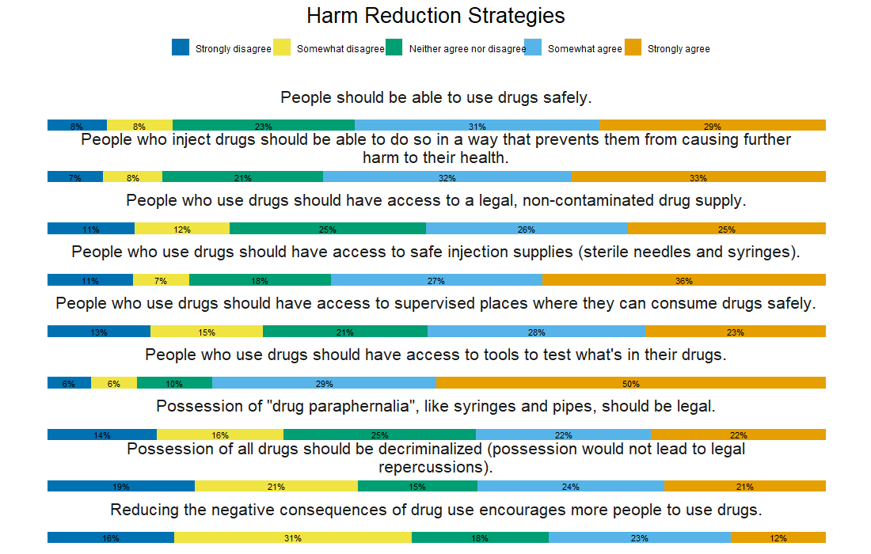
OSF.IO/EJCYT

Slide 11
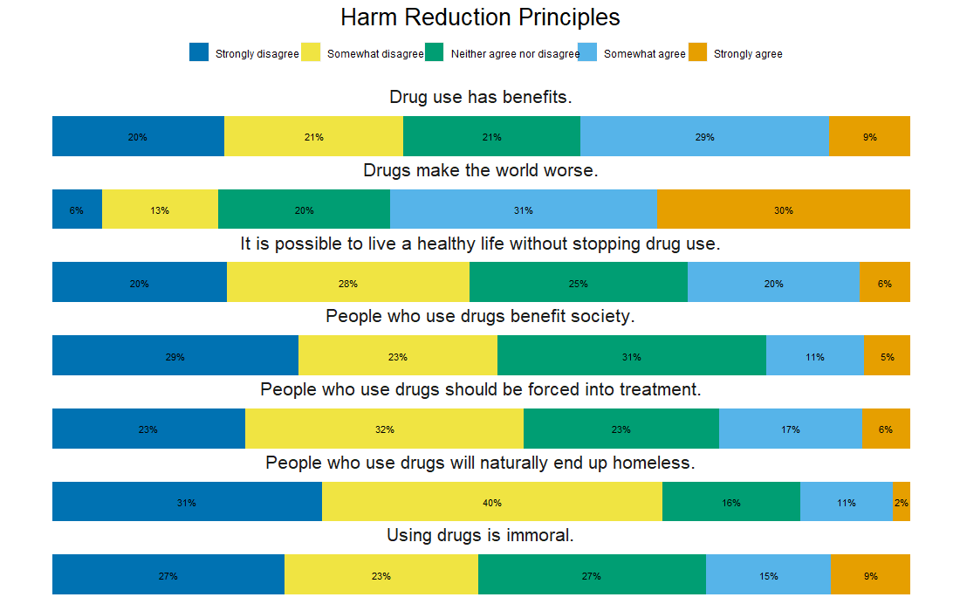

Slide 12
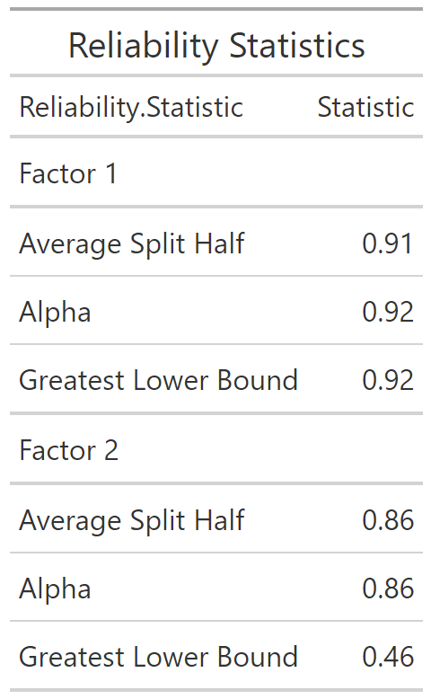
Psychometric Statistics
r = -0.07 [-0.16, 0.03]
Strategies
Mean = 3.5
SD = 0.9
Principles
Mean = 2.7
SD = 0.4
OSF.IO/EJCYT

Slide 13
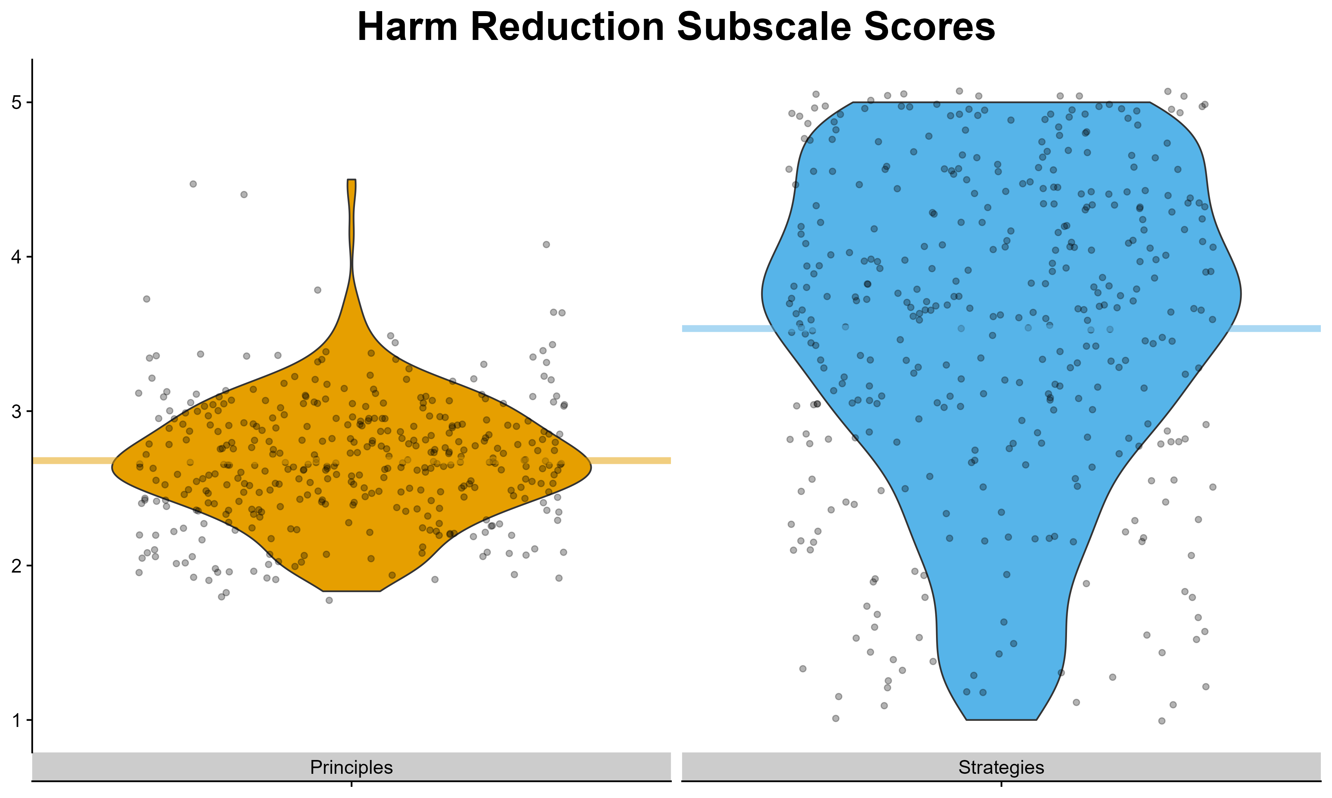
OSF.IO/EJCYT

Slide 14
Next Steps
Validity & Reliability Evidence
Relationships with stigma, closeness with people who use drugs, experience with substance use diagnoses
Test-retest reliability
Amenability to intervention
Measurement invariance
OSF.IO/EJCYT

Slide 15
Development of Scales to Measure the Acceptance of Harm Reduction
Budesa, Z., Brown, K., Coffey, B. Ghonasgi, R., Hayes, V., Kondai, R., La Manna, A., Newman, S., Philips, S., Vance, K., Connors, L., Green, L., Lunceford, J., Smith, R., & Winograd, R. P.
OSF.IO/EJCYT

