Slide 1
Development of Scales to Measure the Acceptance of Harm Reduction
Zach Budesa, Sarah Philips, Rithvik Kondai, Jennifer Lunceford, Lauren Green, Liz Connors, Katie Brown, Ryan Smith, Rashmi Ghonsagi, Rachel Winograd

Slide 2
Harm Reduction
Substance Abuse and Mental Health Services Administration
Evicenced-based approach to egaging with people who use drugs
Equipping PWUD with life-saving tools
Incorporates community-driven public health strategies
Harm Reduction Coalition
Practical stratigies & ideas
Reduce negative consequences associated with drug use
Social justice movement

Slide 3
Why Measure Harm Reduction Orientation?

Slide 4
Existing Measures Have Limitations
Single ordinal items (Wild et al., 2021)
Focused on knowledge of harm reduction organizations (Baker et al., 2020)
Single substance focus (Goddard, et al. 2023)
Narrow definition of harm reduction (Bonar & Rosenberg, 2010)
Single population (Sulzer et al., 2021)
Little validity evidence (Hofschulte, 2012)
Survey methods (MacCoun, 2013)
No one uses them!

Slide 5
The Process
Develop Items
Do participants understand items? (3 Rounds)
Refine items
Repeat
Collect data (EFA)
Analyze
Collect more data (CFA & EFA)
Analyze
Collect more data (CFA)
Analyze

Slide 6
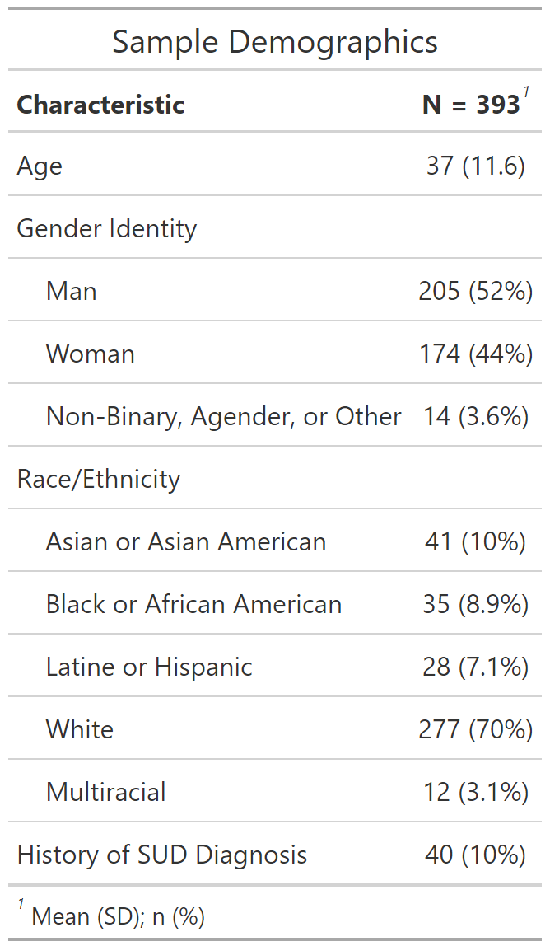
Participants

Slide 7
Closely Related Items
Access to Naloxone
People who use drugs should….
The general public should….
Police officers should….
People who use drugs should have access to…
People who use drugs should have access to safe injection supplies.
People who use drugs should have access to safe inhalation supplies.

Slide 8
Closely Related Items
Medications for Opioid Use Disorder
Medications used to treat addiction are an appropriate treatment option for people who use drugs.
People who use drugs should be able to use medications used to treat addiction for any length of time.
Involvement in Policy and Programs by Recovery Status
People who use drugs should be involved….
People in recovery from drug use should be involved….

Slide 9
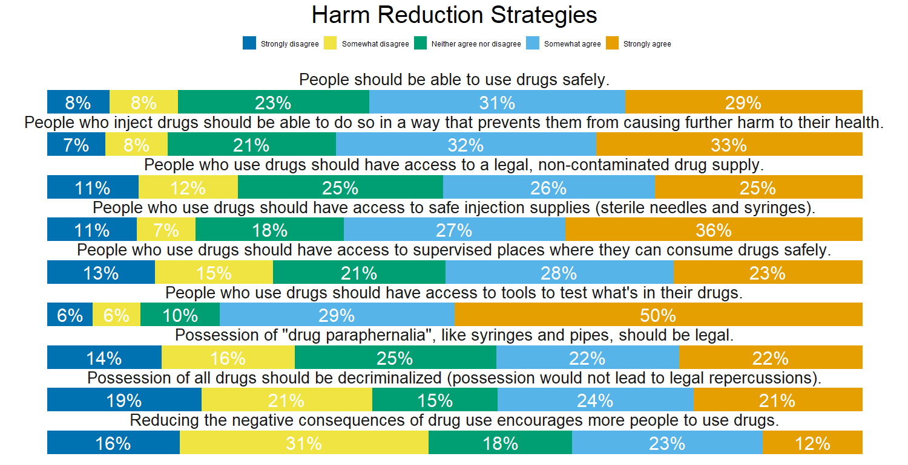
Harm Reduction Strategies

Slide 10
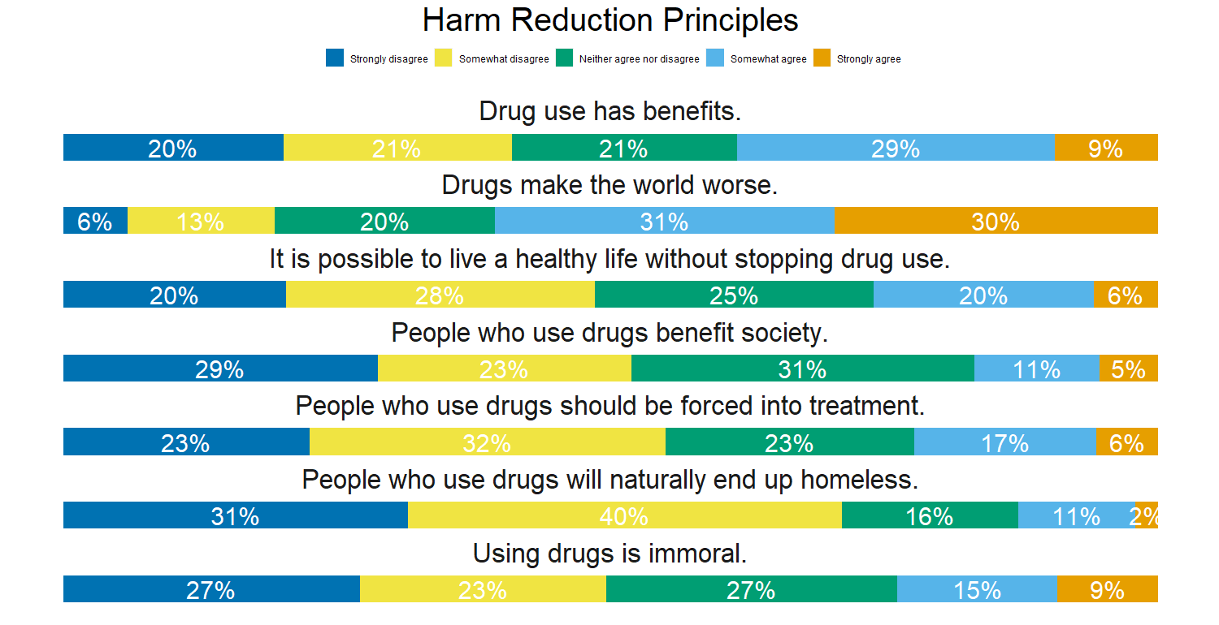
Harm Reduction Principles

Slide 11
Psychometric Info
Reliability Statistics For Both Scales
Reliability.Statistic | Statistic
Strategies
Average Split Half | 0.91
Alpha | 0.92
Greatest Lower Bound | 0.92
Principles
Average Split Half | 0.86
Alpha | 0.86
Greatest Lower Bound | 0.46

Slide 12
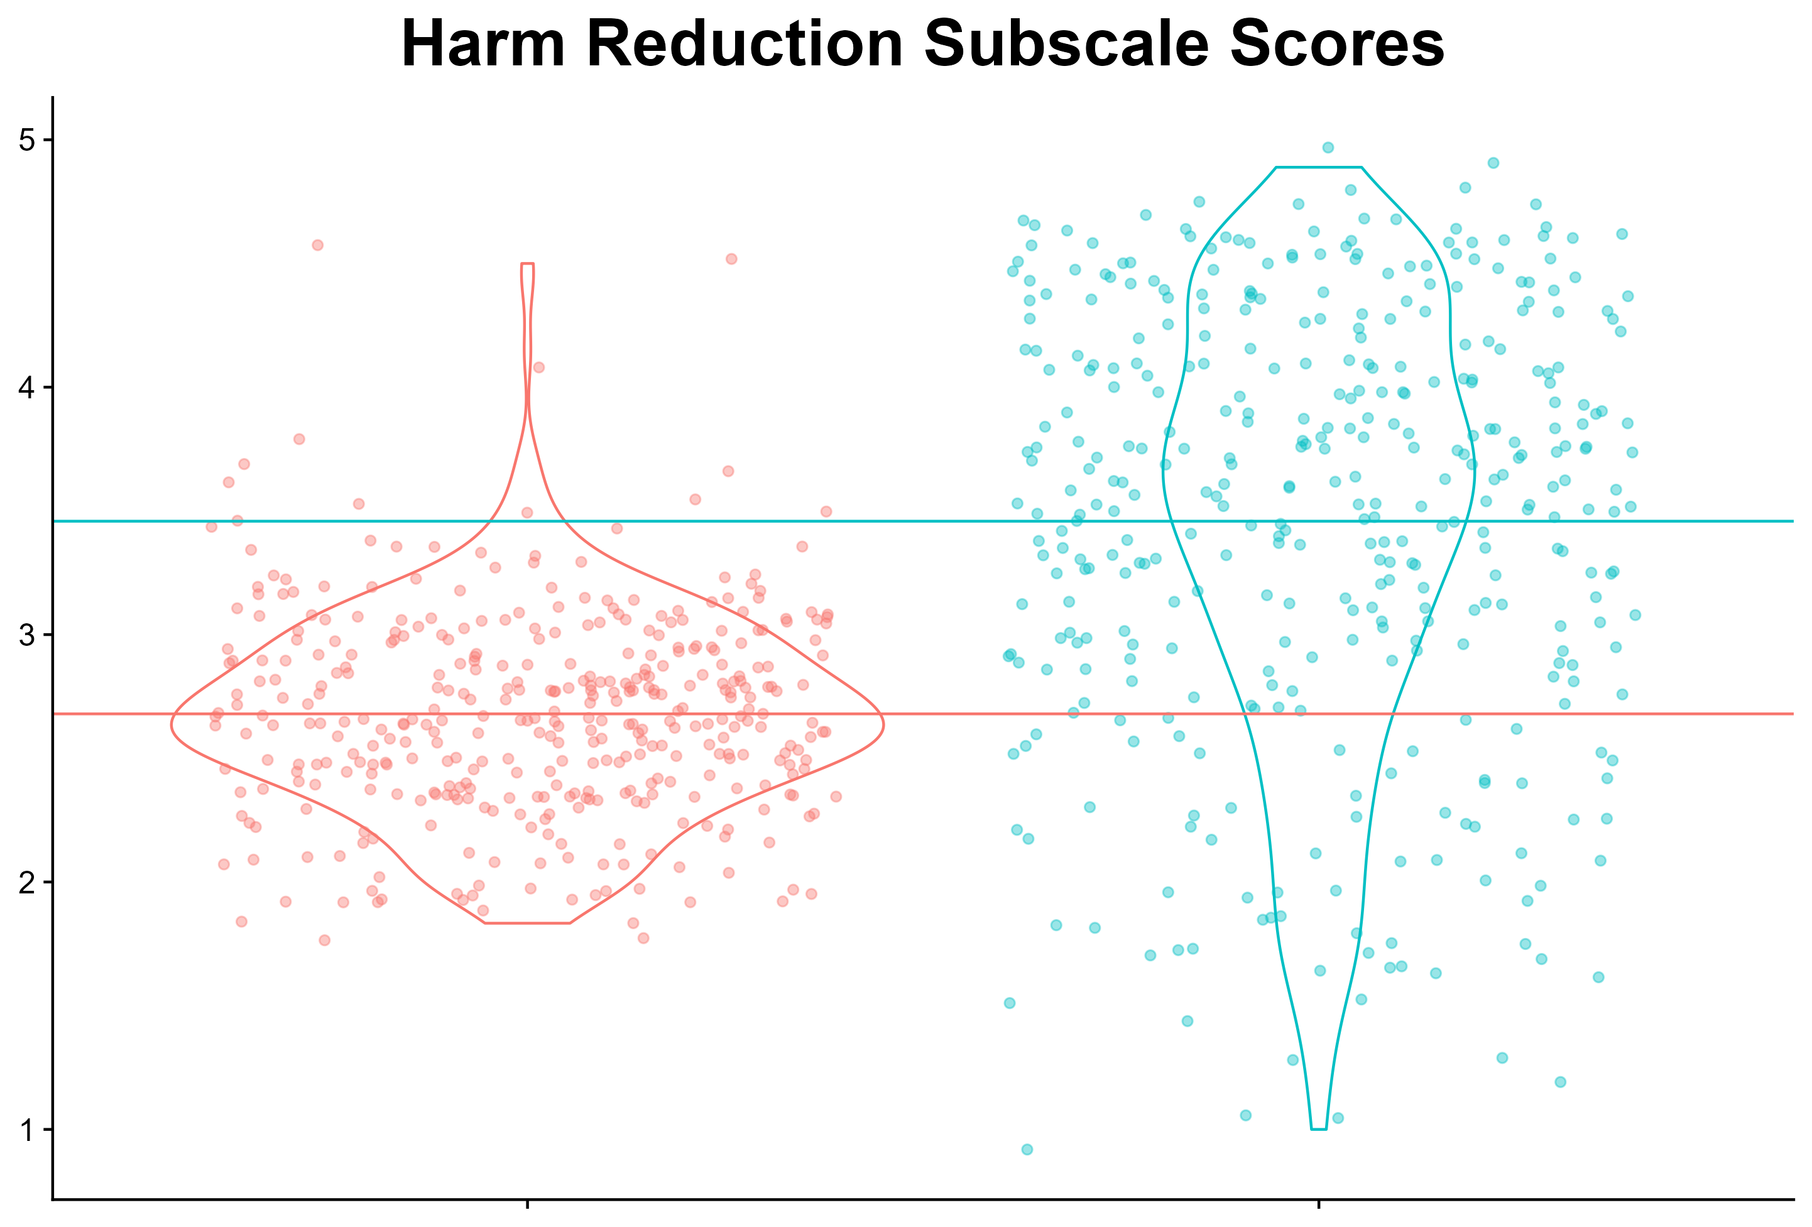
Scale Scores

Slide 13
Next Steps
Validity & Reliability Evidence
Relationships with stigma, closeness with people who use drugs, experience with substance use diagnoses
Test-retest reliability
Amenability to intervention
Measurement invariance

