Slide 1
Big Data Analytics Final Project Spring 2017, Option A Analyzing ACM Citation Network
Zack Burch
zburc3
May 5th, 2017

Slide 2
Overview
1.2 – Building the Citation Network
2.1 – In-Degree Distribution
2.2 – Implementing the Weighted Page Rank Algorithm
Closing Remarks

Slide 3
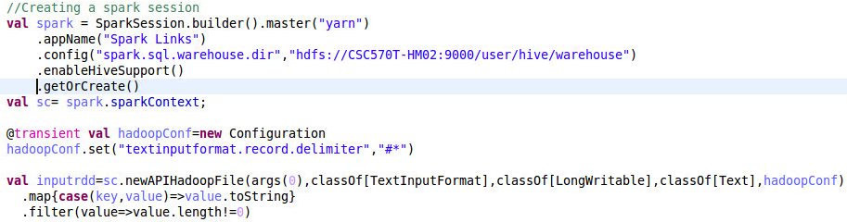
Building the Citation Network
Start with code provided in Project Description to read in file…

Slide 4
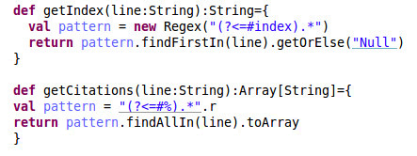
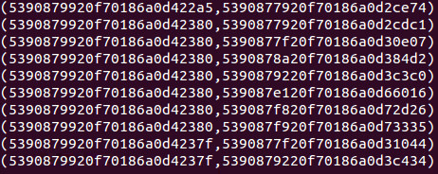

Use Regular Expressions to create the link RDD
Define Regex Functions…
Results…
Use Regex Functions to build Links RDD…
This produces an RDD where the page on the left cites the page on the right. This RDD is then saved to a text file to fulfill the project requirement.

Slide 5
Overview
1.2 – Building the Citation Network
2.1 – In-Degree Distribution
2.2 – Implementing the Weighted Page Rank Algorithm
Closing Remarks

Slide 6


In-Degree Distribution
Read in the text file created in the last section, and pre-process to remove punctuation and split into an RDD…
Results – effectively the same RDD we left off with in the last section…

Slide 7

Creating the graph
Build an Edges RDD of links between two documents.
Implement a Hash code for each Doc Index, as the Graph package cannot handle the alpha characters in the Doc Indices…
Build the graph, retrieve the number of vertices, and define the in-degrees for each vertex…

Slide 8


Producing In-Degree Output
Convert the inDegree RDD to a list of in-degrees and the counts of each one, then divide that by the number of vertices…
Results – Produces all in-degrees in the citation network, along with the probability that a given document has a particular in-degree…

Slide 9
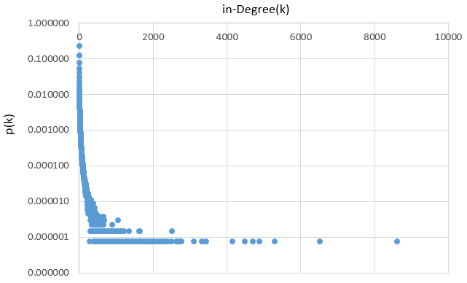
Build chart to view trends
Saving the ‘out’ RDD to a text file, importing it into Excel, and building a logarithmic scale chart produces the following trend…
Results – this chart shows that there is a high likelihood that an arbitrary page has a very few number of citations. The higher the number of citations, the lower the probability.

Slide 10
Overview
1.2 – Building the Citation Network
2.1 – In-Degree Distribution
2.2 – Implementing the Weighted Page Rank Algorithm
Closing Remarks

Slide 11


Implementing the Weighted Page Rank Algorithm
First step – recreate the same links RDD from the 1st objective
Create a second RDD to house titles and indices, for getting a count of pages and for joining titles back into the main RDD at the end. Persist for later usage.
Results…

Slide 12

Define constants for algorithm
D – the constant as defined in the Project Description
N – the number of titles in the dataset
CONSTANT – the simple calculation added to a rank at each iteration

Slide 13
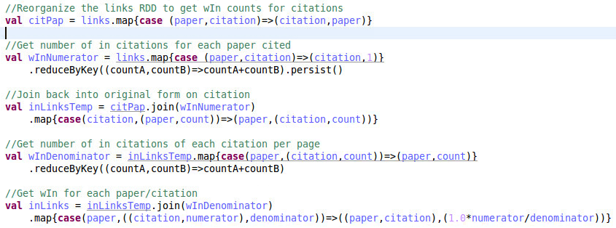

Get the Weighted In-Link Value
Reverse the links RDD then count on the key (citation). This produces the number of in-links for each citation. Join back into include the Paper and sum all counts of citation in-links per Paper. Dividing a citation’s in-links by all of the in-links of all citations for a Paper produces the weighted in-link for a citation.
Code…
Results…

Slide 14
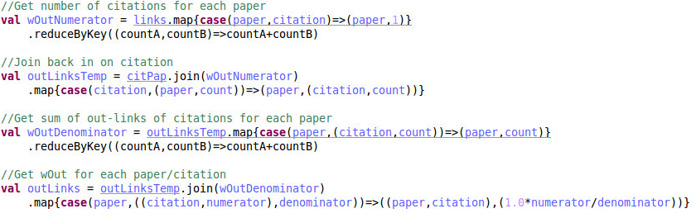
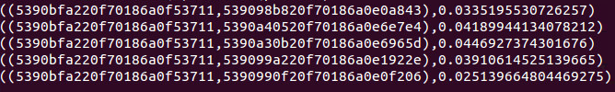
Get the Weighted Out-Link Value
First, sum the number of citations each Paper has. This produces an RDD where every citation has the number of out-links. Join back in on Citation to include the Paper and sum all counts of citation in-links per Paper. Dividing a citation’s out-links by all of the out-links of all citations for a Paper produces the weighted out-link for a citation.
Code…
Results…

Slide 15
Create RDD for iterative algorithm
Now that we have an RDD for in-links and an RDD for out-links, we need to combine the two and provide an initial rank for the algorithm to start with.
Form…

Slide 16
Checkpointing
First, set a directory for checkpointing…
Checkpointing throughout the iterative algorithm will help avoid memory issues due to RDD Lineage tracking
I have chosen to checkpoint every 2nd time through the algorithm (implementation in slides to follow)

Slide 17
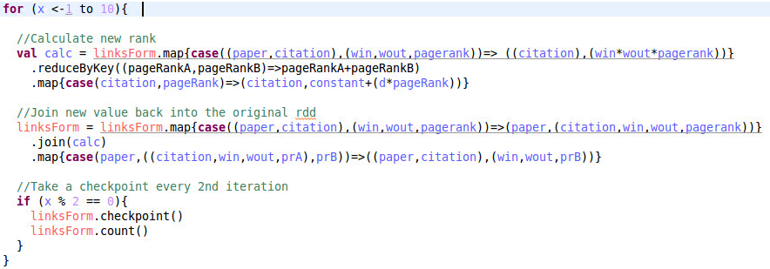
Iterative Algorithm
Code…
Discussion and Results on following slide…

Slide 18
Iterative Algorithm (cont’d)
First define a loop of 10 iterations
For each citation, multiply the weighted in-links, weighted out-links, and pagerank. Sum these all together for each citation, then multiply/add to constants.
Join this new page rank value back into the original data set, and replace the old page rank value with the new one.
Check point every 2nd iteration
Results after 10 iterations…

Slide 19
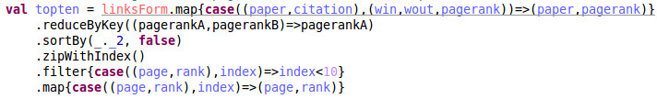

Retrieve the Top 10 Pages
Remove everything from the result RDD from the iterative algorithm except for paper and pagerank. Reduce to one row for each. Then, sort by the page rank descending. Add an index to each rank, and take the top 10 from here.
Results (only 5 taken)…

Slide 20
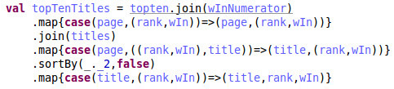
Put in form for output
Join titles and in-links into the dataset, and return the form…
(title, pagerank, in-links)
(Actual Results in next slide)
Save this output to a text file and exit.

Slide 21
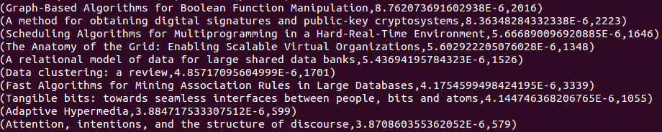
Results
From my program, the top 10 pages the algorithm produced are…

Slide 22
Conclusion
While many papers had far more in-links/citations than those produced in the top 10, those in the top 10 were cited with more impact.
Taking into consideration the weight of each citation allows the ranks to be determined more appropriately, and account for situations where a paper cites many papers, and each citation bears little weight to the Paper citing it as a whole.

