Slide 1
A Study in HCI
James Green

Slide 2
What is HCI?
“HCI (human-computer interaction) is the study of how people interact with computers and to what extent computers are or are not developed for successful interaction with human beings.”
Every day we see the benefits of good HCI, and hopefully don’t see the detriment of bad HCI.
Notes:
Give examples of HCI in action.
Show how good HCI improves the world we live in.
Show how bad HCI can have huge impacts too.

Slide 3
My project within HCI
2 Website
1 App
Use of colour to be explored in the first website
Creation of a website replacement for a small business
Journal Android app to test HCI impacts on touchscreen mobile devices

Slide 4
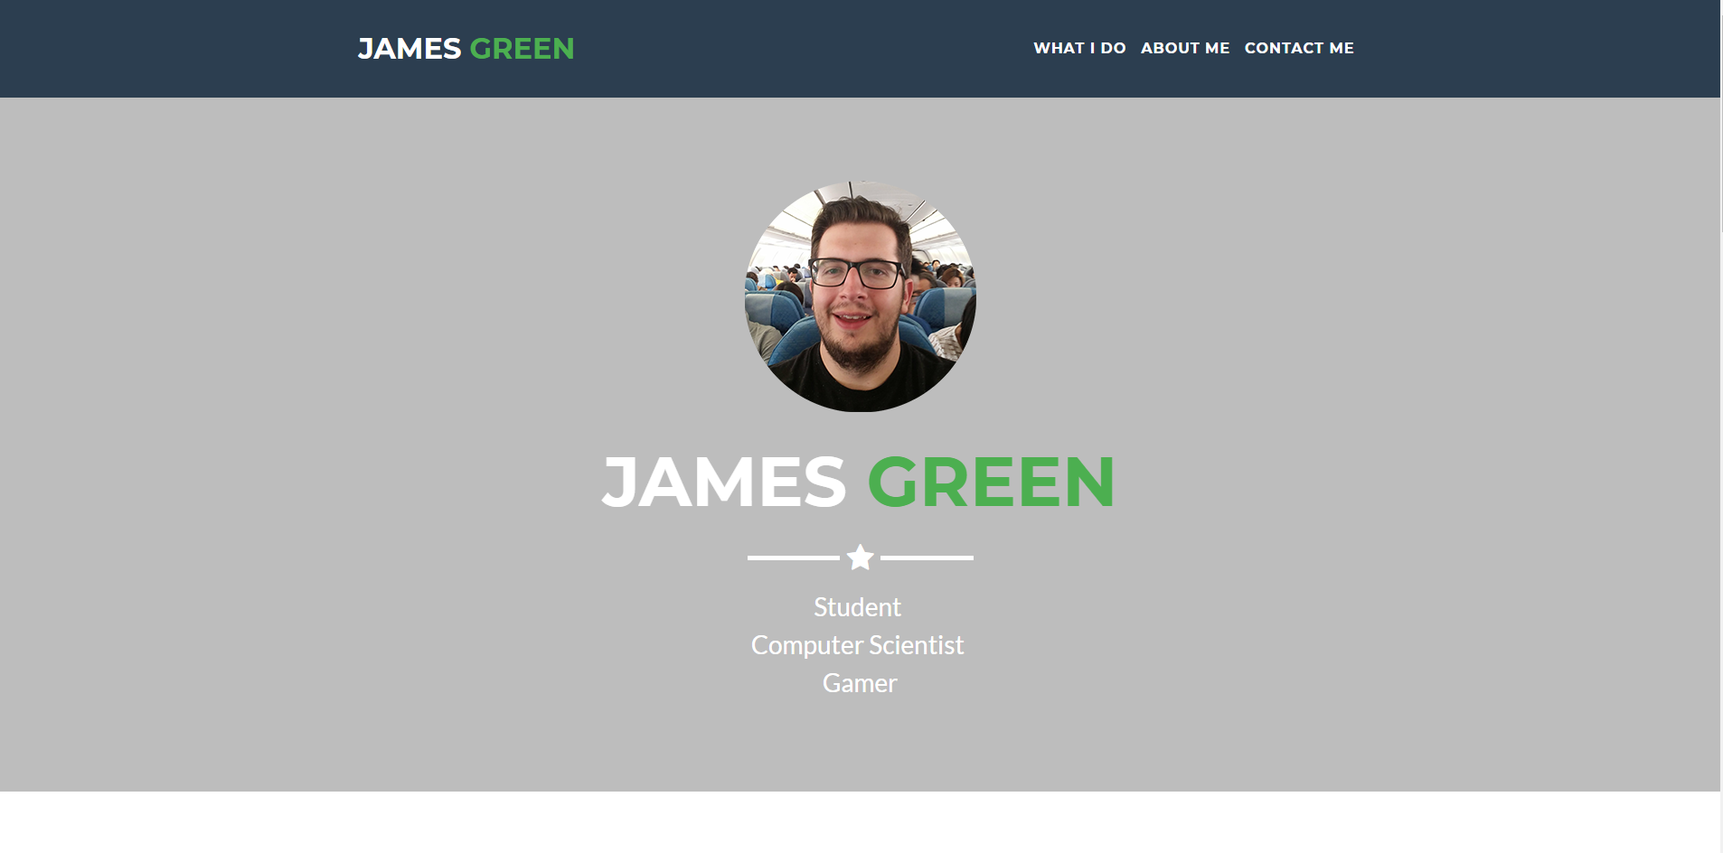
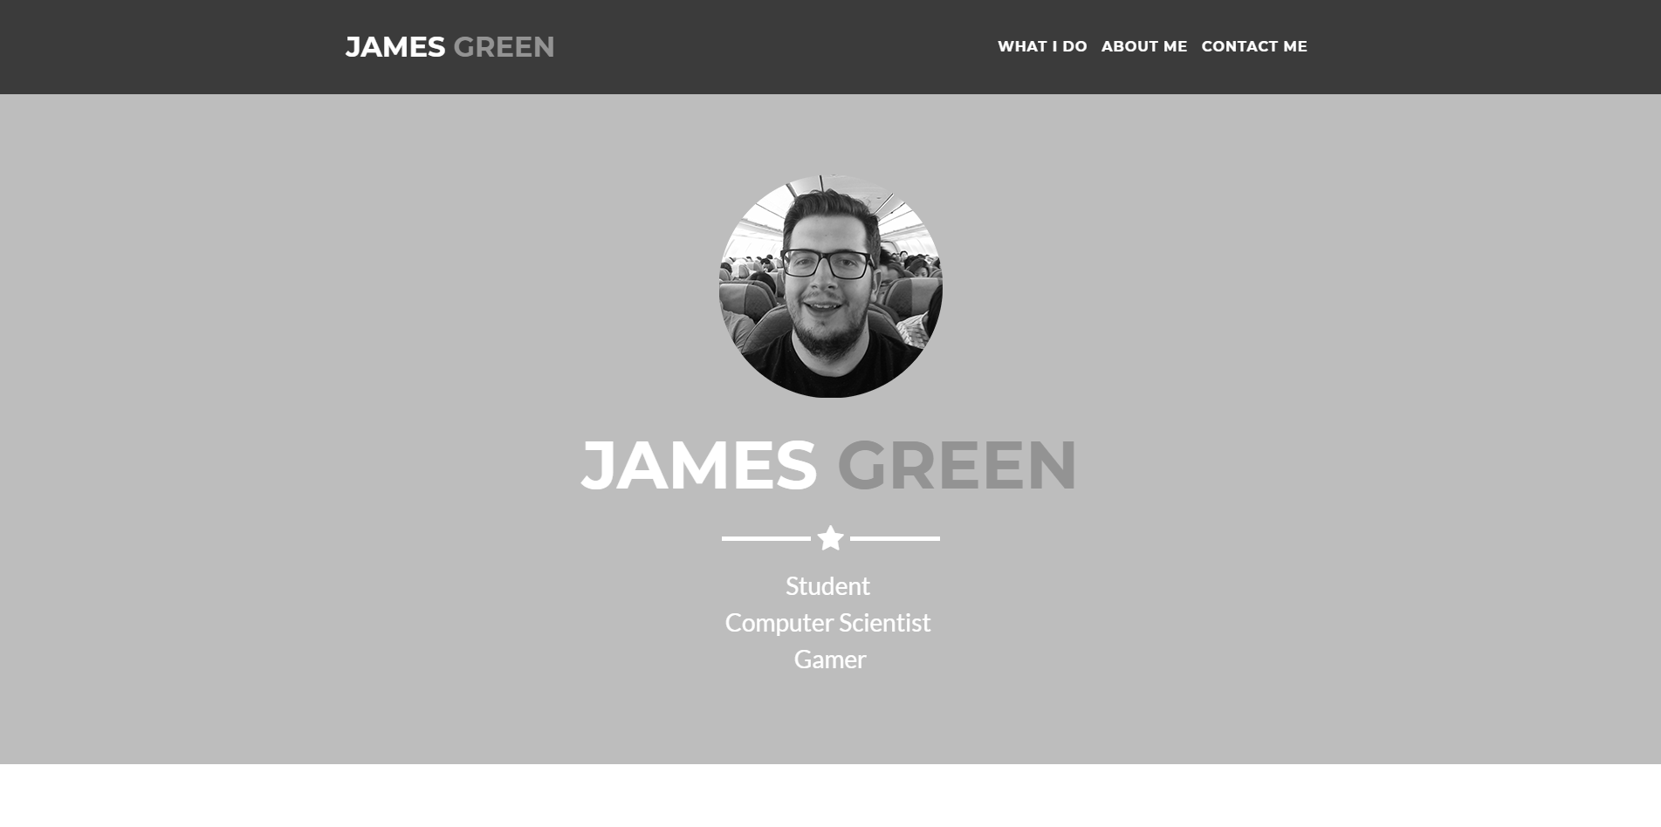
How does colour matter? clarity
chromatic
Greyscale

Slide 5
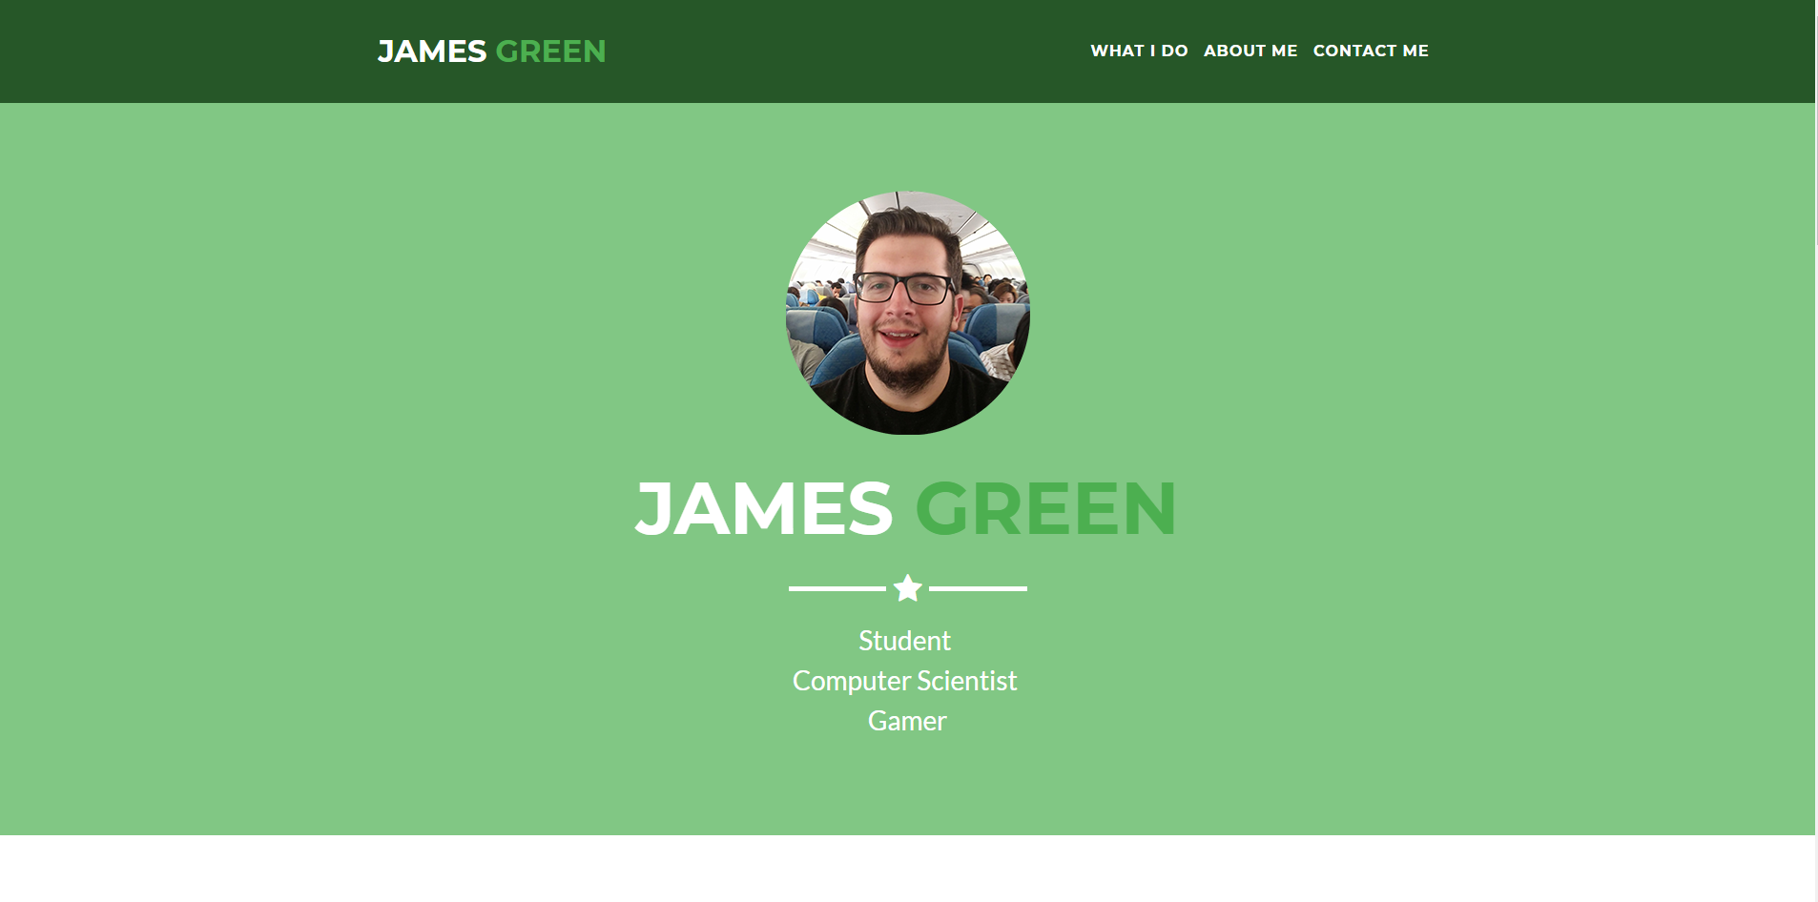
How does colour matter? Meaning/perception
chromatic
Monochromatic

Slide 6
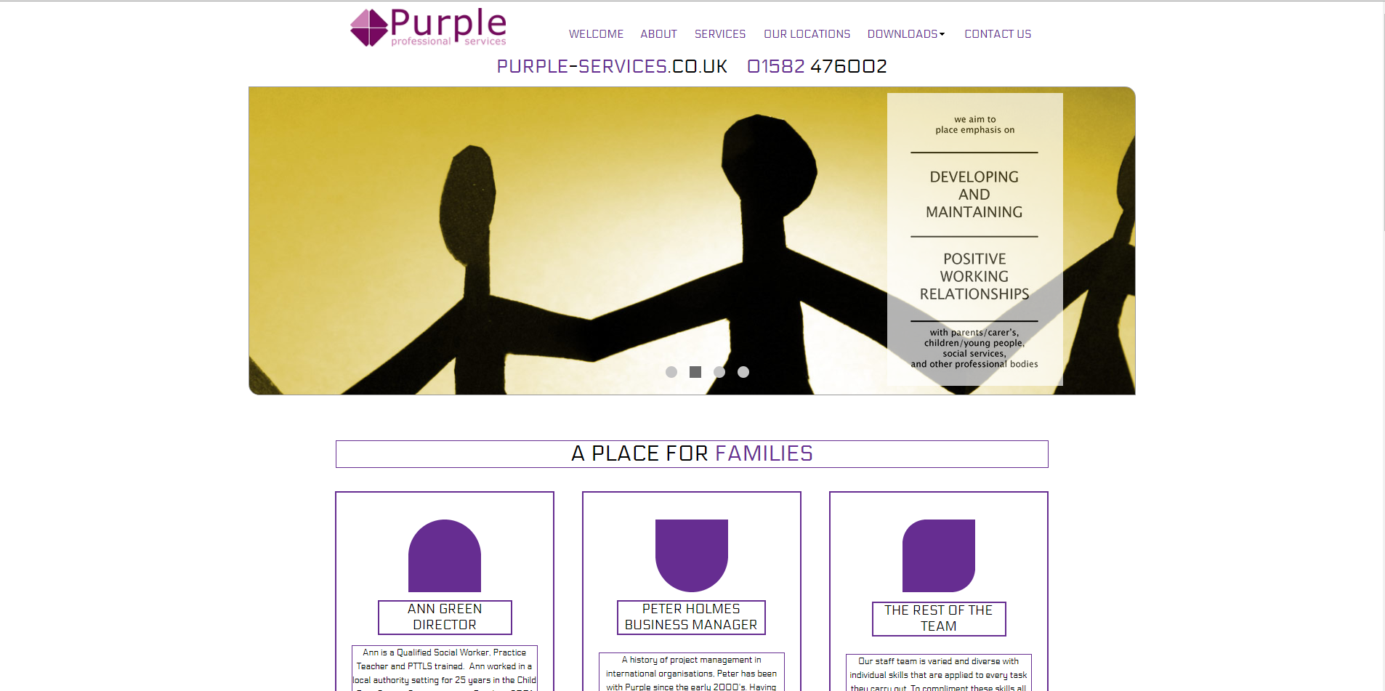
Improving on existing interfaces Recognising the issues
Existing Site
Scrolling interrupted to go to anchor points
Broken links
Poor spacing of elements
Lack of space for information

Slide 7
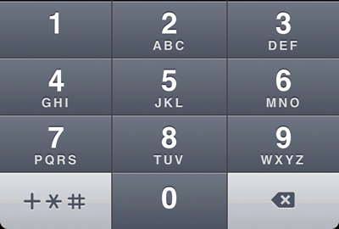
Improving on existing interfaces Resistance to change
What is familiar is “better”
Wanted a new site, that was the same as before?
QWERTY layout is “best”?
Phone keyboard: QWERTY vs Keypad?
Notes:
QWERTY originally created to slow typing on typewriters to avoid jamming, modern keyboards don’t need this, speed up the typing
1-9 mobile typing was faster than qwerty touch input

Slide 8
What next? app
App idea
HCI issues
Simple journal app
Sign in page
Home page
Journal entry page
SIMPLE…
Layout of screens
App icon
Variable screen sizes
Left vs Right hand users
Types of users, professional or recreational

Slide 9
What next? Testing
Hypothesis
Methods
Change we expect to see:
Faster
Better ratings
APM
Null hypothesis:
Lack of change
A/B testing
Quantitative/Qualitative
Significance via p-value
Reject the null?

Slide 10
End Result What I want from the project
Deeper understanding of HCI
Experience for a possible career in HCI
New experience from app development
Meaningful works to add to portfolio

Slide 11
Thank you
Any questions or discussions?

