Slide 1
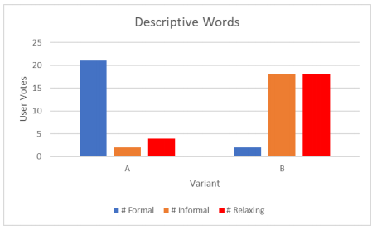
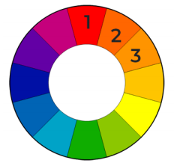
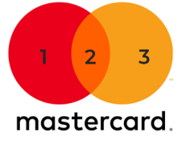
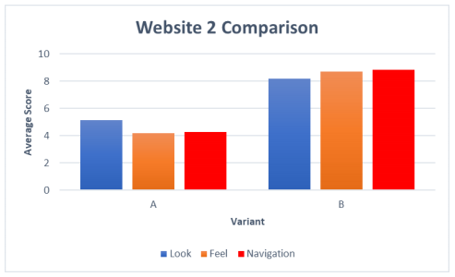
A STUDY IN HCI
James Green
Relevance of HCI
Aims and Objectives
HCI grows with importance as our modern world becomes more entangled with technological advances
Failure of HCI can result in catastrophe if the failure is within a nuclear power plant for example, or mild annoyance if it is your social networking app
The core principles apply to both situations and solving one can assist with the other, this is why I chose HCI
Overall Aim:
To compare various user interfaces and evaluate their design in terms of human usability.
Objectives:
Create and test 2 variants of:
  Small personal website
  Business website for small company to replace previous website
  Journal app
Background Theory
Outcomes
Website 1:
Colour Theory
Nielsen's Heuristics
10 rules for HCI and interaction design in general
Fitts’s Law
Bigger and closer targets are quicker to use
Website 2:
Test Methods
A/B testing
Counter balancing
Google Forms questionnaire
Statistical analysis
Hypothesis testing

