Slide 1
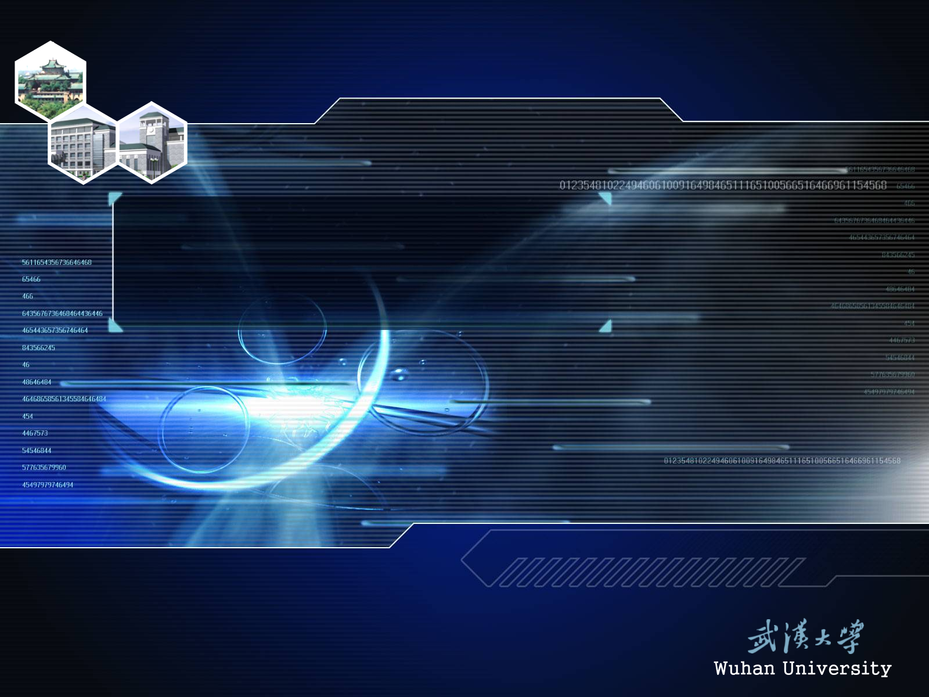
P68. 4; 5.(1, 3, 5, 7, 9)；
P71. 4;
P75. 6; 8. (2), (4), (6)

