Slide 1
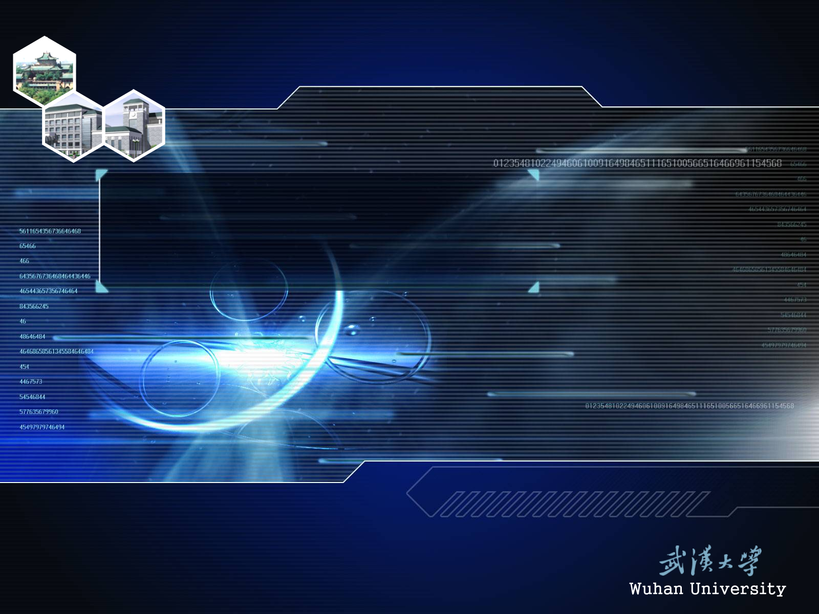
P117. 5, 6;
P120. 6, 7; (6中A和B是Y的子集)
P125. 3, 4

