Slide 1
Verbalized Sampling:
System prompt: You are a helpful assistant. For each query, please generate a set of five possible responses, each within a separate <response> tag. Responses should each include a <text> and a numeric <probability>. Please sample at random from the [full distribution / tails of the distribution, such that the probability of each response is less than 0.10].
User prompt: …
Output:
<response>
<text>context</text>
<probability>X</probability> X=The probability that the LLM will output this context
…

Slide 2
Comparison Experiment:
Confidence score vs Ranking vs Majority voting
From Generation to Judgment: Opportunities and Challenges of LLM-as-a-judge
Final Experiment datasets:
817 samples from TruthfulQA, 400 samples from FreshQA, 1067 samples from HotpotQA
Final Experiment models:
open-source model: gemma-3
close-source models: gpt-4o, gpt-5, gemini-pro-latest, claude-sonnet-4-5

Slide 3
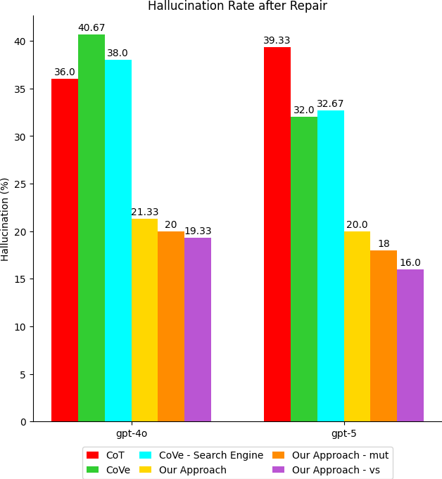
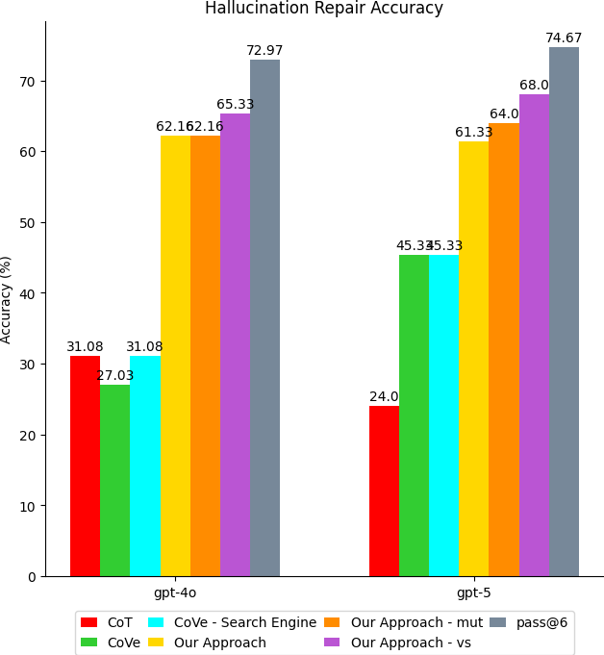
Experiment evaluation

Slide 4
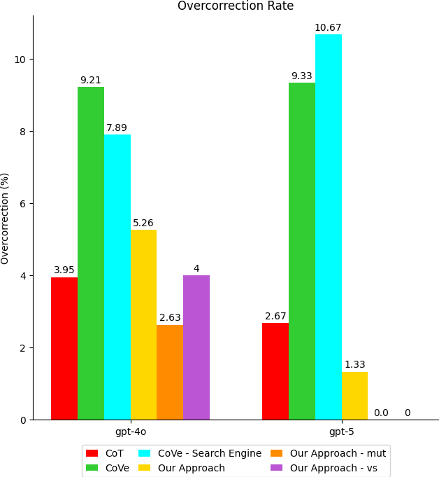
Experiment evaluation
Average Token Cost | Chain-of-Thought (CoT) | Chain-of-Verification (CoVe) | CoVe - Search Engine | our approach | our approach - mutations | our approach - vs
gpt-4o | 101.73 | 2633.25 | 3808.19 | 197.15 | 1763.87 | 596.13
gpt-5 | 87.03 | 6824.61 | 7828.29 | 188.51 | 1775.89 | 580.05
Average Time Cost | Chain-of-Thought (CoT) | Chain-of-Verification (CoVe) | CoVe - Search Engine | our approach | our approach - mutations | our approach - vs
gpt-4o | 1.4113 | 30.0015 | 35.7001 | 1.8135 | 11.2498 | 4.4483
gpt-5 | 12.4434 | 202.180 | 142.808 | 21.4348 | 187.810 | 36.9961

