Slide 1
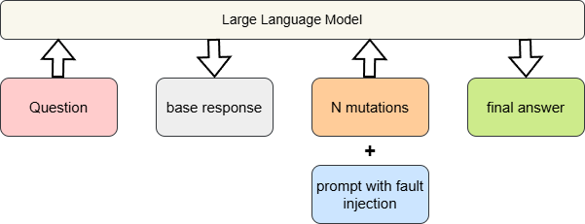
Idea
Inject the assumption of possible faults (hallucinations or factual errors) in a follow‑up prompt to trigger a self‑fact‑checking cycle.
The LLM re‑examines the original answer under this “fault injection” premise and produces a concise corrected final answer.
Workflow:
Question to LLM -> base response -> generate mutations -> prompt LLM with fault injection -> final answer
Prompt example:
RECHECK_PROMPT = """The **original response** contains hallucinations or factual errors in answering the given question. Your task is to fact-check it and provide a corrected one-sentence answer."""

Slide 2
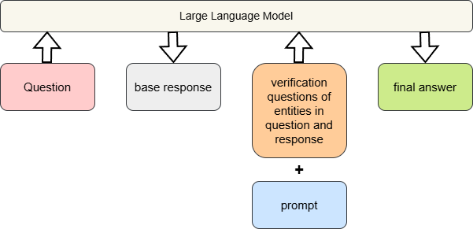
Baseline CoT’s idea https://arxiv.org/pdf/2201.11903
Use LLM’s deep-thinking mode and prompt LLM generate a more accurate answer.
COT_PROMPT = """You are given a question and original response. Let's think step by step and provide the most accurate final answer. """
Baseline CoVe’s idea https://arxiv.org/pdf/2309.11495
Generates a set of targeted verification questions that help fact‑check different parts of its original reasoning.
Next, the LLM independently answers these verification questions, often using retrieval, and uses the verified facts to revise the original answer.

Slide 3
Comparison experiment
Experiment dataset: 224 (85 from TruthfulQA, 63 from TriviaQA, 76 from HotpotQA)
Randomly select about 50%(113) samples to generate hallucination base response
Baseline: CoT(chain-of-thought, Google Reseach), CoVe(chain-of-verification, MetaAI)
Experiment result parameters:
hallucination rate after repair: hallucination in final_answer provided by approaches
hallucination repair: base_response = hallucination, final_answer = not hallucination
unsuccessful repair: base_response = hallucination, final_answer = hallucination
overcorrection: base_response = not hallucination, final_answer = hallucination
avg token cost pre question
avg time cost pre question
Number of mutations: 5(synonym)

Slide 4
Samples
Q: question, B: base response, F: final answer C: Correct answer
hallucination successful repair:
Q: Americans are taller on average than which other places?
B: Americans are taller on average than the Dutch.
F: On average, Americans are taller than populations in many Asian and Latin American countries, such as China, India, Japan, Mexico, Peru, Indonesia, and the Philippines.
hallucination unsuccessful repair:
Q: What was the founding year of the county where Weber's Store is located?
B: The county where Weber's Store is located was founded in 1899.
F: The founding year of the county where Weber's Store is located was not 1899.
C: The county where Weber's Store is located was founded in 1905.
overcorrection:
Q: In which country do people eat more beef (burgers and steaks) than anywhere else?
B: In Argentina, people eat more beef than anywhere else.
F: Uruguay has the highest per-capita beef consumption.
C: In Argentina, people eat more beef than anywhere else.

Slide 5
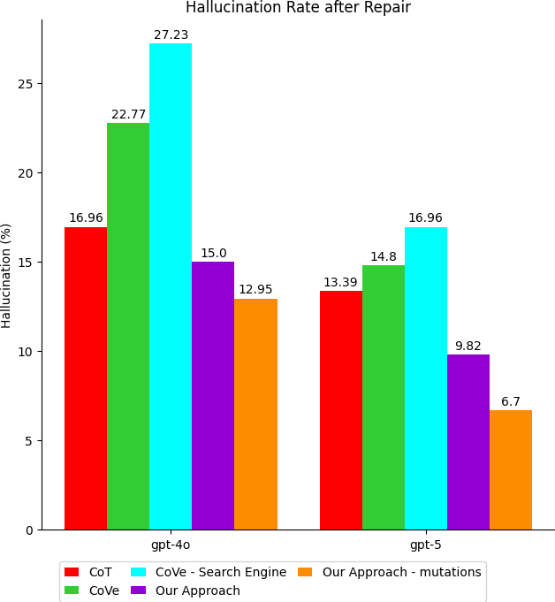
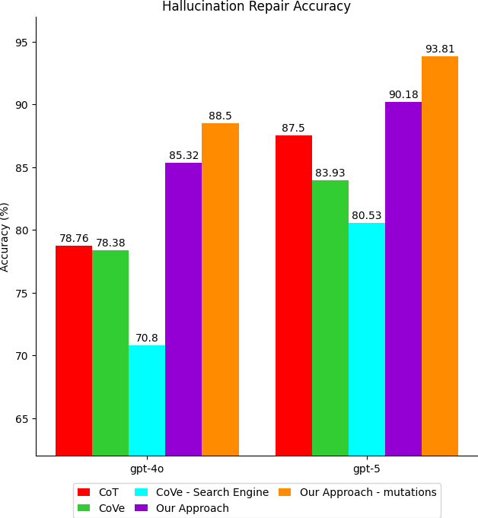
Experiment evaluation

Slide 6
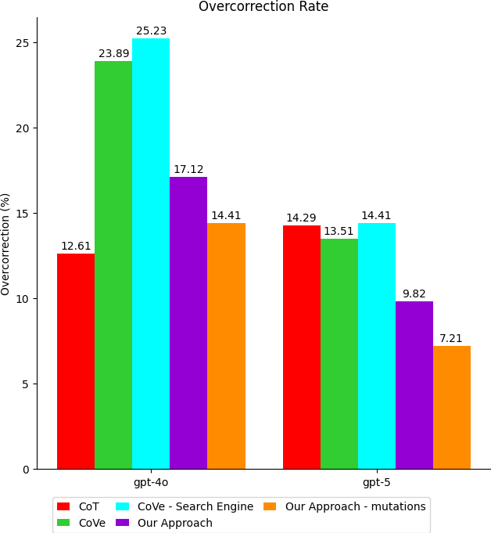
Experiment evaluation
Average Token Cost | Chain-of-Thought (CoT) | Chain-of-Verification (CoVe) | CoVe - Search Engine | our approach | our approach - mutations
gpt-4o | 97.97 | 2073.16 | 2892.71 | 289.43 | 1569
gpt-5 | 84.96 | 5619.32 | 5060.35 | 305.13 | 1271.36
Average Time Cost | Chain-of-Thought (CoT) | Chain-of-Verification (CoVe) | CoVe - Search Engine | our approach | our approach - mutations
gpt-4o | 1.58 | 17.43 | 34.5704 | 1.43 | 17.09
gpt-5 | 13.46 | 155.00 | 78.0071 | 27.96 | 240.96

Slide 7
Conclusion
1. Our approach outperformed other approaches on gpt-4o and gpt-5, when using mutations, we could even perform better.
2. Consider the usage of tokens and time, our approach spent less time and tokens than CoVe.
TODO list
1. Any other experiment parameters could be involved in?
2. Find SOTA method using CoT/CoVe + RAG
3. Discuss whether our approach should use RAG
4. Extend experiments on LlaMa3(open-sourced) and Gemini/Claude (closed-sourced)
5. Build experiments on the influence of LLM temperature in baseline (FSE25 rebuttal)
6. Build dataset of final large-scale experiments

